Slide 2
How Big Should I Be?
Proportional Reasoning
7th, 8th, and 9th Grade Math

Slide 3
Learning Objectives:
Students will be able to:
Solve problems using ratios and proportions.
Apply knowledge of ratio and proportion to solve relationships between similar geometric figures.
Apply a wide variety of problem-solving strategies (identify a pattern, use equivalent representations) to solve problems from within and outside mathematics.
Use various types of logical reasoning in mathematical contexts and real-world situations.

Slide 5
Fortnite Official Cinematic Trailer. (2017). Retrieved from https://www.youtube.com/watch?v=qpKtzf5fXn4
Stop at 1:20
Do the characters look real? Why or why not?
Think about your answer. Then, share with a partner.
Notes:
Link: https://www.youtube.com/watch?v=qpKtzf5fXn4

Slide 7
Toys vs. Us Comparison
Take measurements of your group members and your toy, and record the measurements on your handout.
Develop a plan to determine if your toy is proportional to your group. Then, use your plan and your measurements to compare the toy and your group.
Is your toy proportional to the members of your group? Support your claim with data.

Slide 9
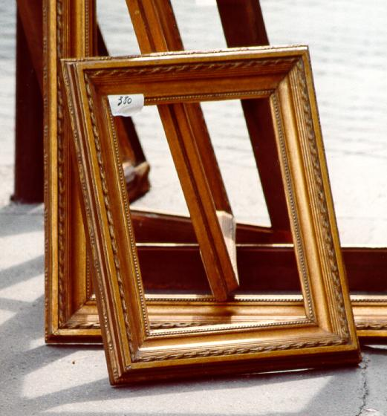
Proportions
You have two proportional picture frames. If the smaller of the two frames is 10 inches wide and 8 inches tall, and the larger is 20 inches wide, how many inches tall is the larger picture frame?
Möller, M. (2004, May 1). Empty wooden picture frames. Retrieved from https://commons.wikimedia.org/wiki/File:Empty_wooden_picture_frames.jpg

Slide 10
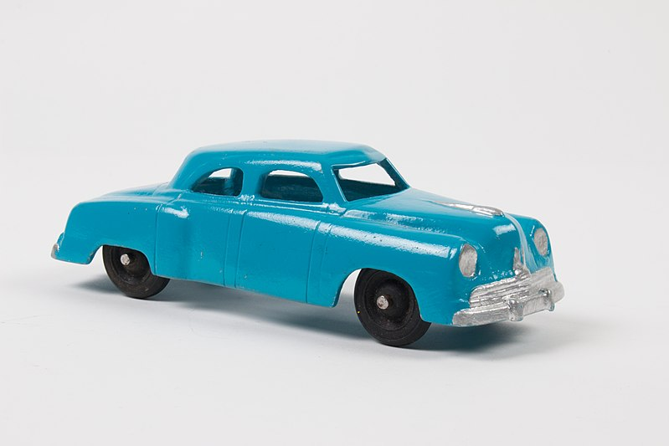
Proportions
You are making a scale model of a blue Studebaker car. The real car is 15 feet long and 9 feet wide. If your scale model were 10 inches long, how wide should it be?
Fun Ho! Toy Company. (2017, November 27). Toy car. Retrieved from https://commons.wikimedia.org/wiki/File:Toy_car_(AM_1996.165.108-1).jpg

Slide 11
Proportions
On grid paper, draw three rectangles:
10 squares by 8 squares
20 squares by 16 squares
20 squares by 18 squares
Which rectangle looks different from the other two?

Slide 12
Setting up Ratios
With an elbow partner, think about how you could set up a comparison of two equal fractions using the rectangle example (10 by 8 and 20 by 16).

Slide 13
Setting up Ratios
With an elbow partner, think about how you could set up a comparison of two equal fractions using the rectangle example (10 by 8 and 20 by 16).

Slide 14
Cross-Multiplication Method
8 × 20 = 160
160 ÷ 10 = 16
x = 16
$$\frac{10}{8}= \frac{20}{x}$$

Slide 15
Dilation Rate Method
× 2
Example 1:
10 × 2 = 20
8 × 2 = 16
x = 16
$$\frac{10}{8}= \frac{20}{x}$$
× 2

Slide 16
Dilation Rate Method
× 0.8
Example 1:
10 × 0.8 = 8
8 × 0.8 = 16
x = 16
$$\frac{10}{20}= \frac{8}{x}$$
× 0.8

Slide 17
Toys vs. Us Comparison
Try using both methods to double-check your math on the Toys vs. Us handout.
Use proportional fractions to compare your toy’s proportions to your group members’ proportions.
Remember the question: Is your toy proportional to the members of your group? Have you changed your mind?

Slide 19
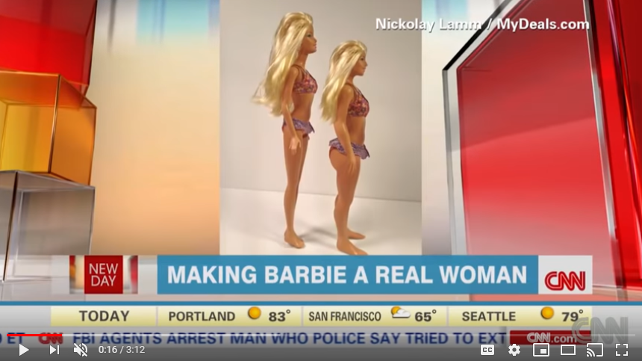
Lamilly – Average is Beautiful. (2014). Retrieved from https://www.youtube.com/watch?v=OfQu8pq0kok#t=58
What are the pros and cons of toy makers and animators using proportions correctly?
What about skewing them on purpose?
Notes:
Link: https://www.youtube.com/watch?v=OfQu8pq0kok#t=58

Slide 20
Your Toy Self
What would a toy modeled after you look like?
Use the height of your group’s toy compared to your height to calculate your toy self’s proportional measurements.
Create a model of the doll using the Model and Report Rubric.

Slide 21
Your Toy Self
Include a written report to answer these questions:
What does it mean for two things to be proportional?
How do you determine whether two things are proportional?
What are three reasons why a toy maker or animator would need to understand the mathematics behind proportions, or understand how to use proportions (or skew them) in their work?

