Slide 2
How Big Should I Be?
Proportional Reasoning

Slide 3
Essential Question
How and why do animators and toy makers use proportions in their craft?

Slide 4
Lesson Objectives
Apply knowledge of ratios and proportions to solve relationships between similar geometric figures.
Apply a wide variety of problem-solving strategies (identify a pattern, use equivalent representation) to solve problems from within and outside of mathematics.
Use various types of logic reasoning in mathematical contexts and real-world situations

Slide 5
Notes:
Illumination. (2024, January 28). Despicable Me 4 | Official trailer [Video]. YouTube. https://www.youtube.com/watch?v=qQlr9-rF32A

Slide 6
Think-Pair-Share
Consider the following questions:
What did you notice about the people in the movie trailer?
Are their features realistic? Why or why not?
Share your thoughts with your partner.
Notes:
K20 Center. (n.d.). Think-Pair-Share. Strategies. https://learn.k20center.ou.edu/strategy/139

Slide 7
Toys vs. Us
Take the measurements listed on your handout of both your toy and your group members. Record the measurements on your handout.
Develop a plan to determine if your toy is proportional to your group members.
Use your plan and your measurements to compare the toy to your group.
Make a claim, backed by evidence, that states whether your toy is proportional to your group members.

Slide 8
Proportions
If a picture is 10 inches wide and 8 inches tall, what would the height of a proportional picture be if the width were increased to 20 inches?
Notes:
Answer: 16 inches

Slide 9
Proportions
A car is 15 feet long and 9 feet wide.
If a scale model of the car had a length of 10 inches, what would the width be?
Notes:
Answer: 6 inches

Slide 10
Proportions
Using grid paper, draw three rectangles with the following dimensions:
10 by 8
20 by 16
20 by 18
Which rectangle looks “different” from the other two?
Notes:
Answer: 20 by 18

Slide 11
Setting Up Ratios
Find an elbow partner.
Choose two of the rectangles from the last slide.
Create a proportion that compares the measurements of the two rectangles using fractions.

Slide 12
Compare Arrangements
Find another pair who compared the same rectangles.
Discuss similarities and differences in your arrangements.
Prepare to share out what you learned from each other.

Slide 13
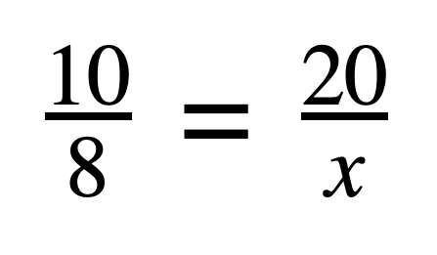
Cross-Multiplication Method
For the first example:
20 × 8 = 160
160 ÷ 10 = 16
x = 16

Slide 14
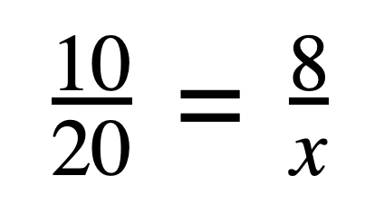
Cross-Multiplication Method
For the second example:
20 × 8 = 160
160 ÷ 10 = 16
x = 16
Is the answer the same?

Slide 15
Dilation Rate Method
× 2
For the first example:
10 × 2 = 20
8 × 2 = 16
x = 16
Is the answer the same?
× 2

Slide 16
Dilation Rate Method
× .8
For the second example:
10 × .8 = 8
20 × .8 = 16
x = 16
Is the answer the same?
× .8

Slide 17
Toys vs. Us Comparison
Double-check your math on the handout.
Write out and check some of your proportional relationships.
For example: toy height vs. member height, toy leg length vs. member leg length.
Change your initial claim as needed.

Slide 18
Your Model Doll
Determine the measurements of a doll version of yourself. Your doll version will have the same height of your group’s toy, but it will be proportional to you.
Complete the table on the second page of the Toys vs. Us handout.
Respond to the prompts on your handout using a full paragraph.

Slide 19
One-Pager
Create a border around your paper that represents a theme or concept from the lesson.
Write the title of the lesson.
Sketch a doll or figure that is proportional to you based on the measurements you calculated in the center of the paper. Your doll should:
Reflect your calculations in the last column of your handout.
Be labeled with your calculated measurements.
Be drawn accurately to the best of your abilities.
Notes:
K20 Center. (n.d.). One-pager. Strategies. https://learn.k20center.ou.edu/strategy/72

Slide 20
One-Pager
At the bottom of your paper, respond to the following prompt in a complete paragraph:
Think about animated movies and video games. What do you think is the purpose of creating characters with accurate and inaccurate proportions?
Notes:
K20 Center. (n.d.). One-pager. Strategies. https://learn.k20center.ou.edu/strategy/72

