Slide 2
Malleable to Marvelous
Stages of Clay

Slide 3
Essential Question
How do the properties of clay in each stage support the techniques used for making clay into a final work of art?

Slide 4
Learning Objectives
Identify the 5 stages of clay and what you can do in each stage
Explore clay working techniques and notable artists and cultures that use them.

Slide 5
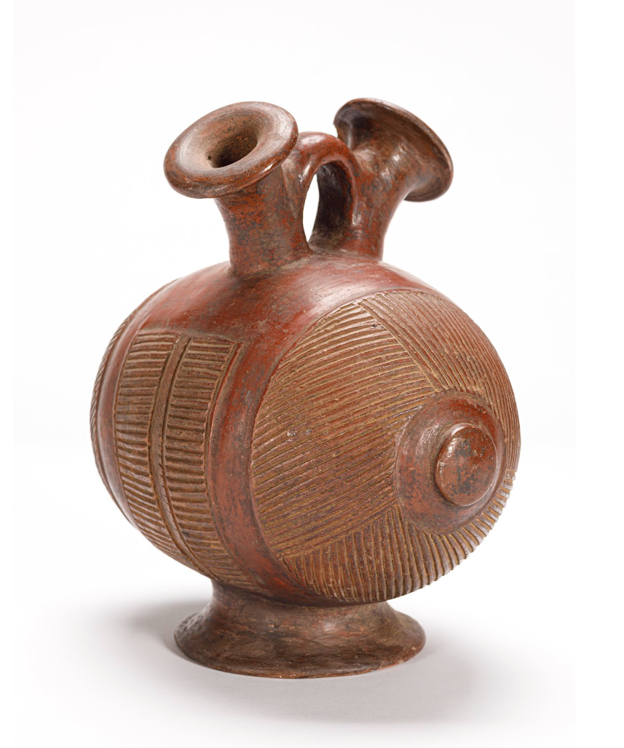
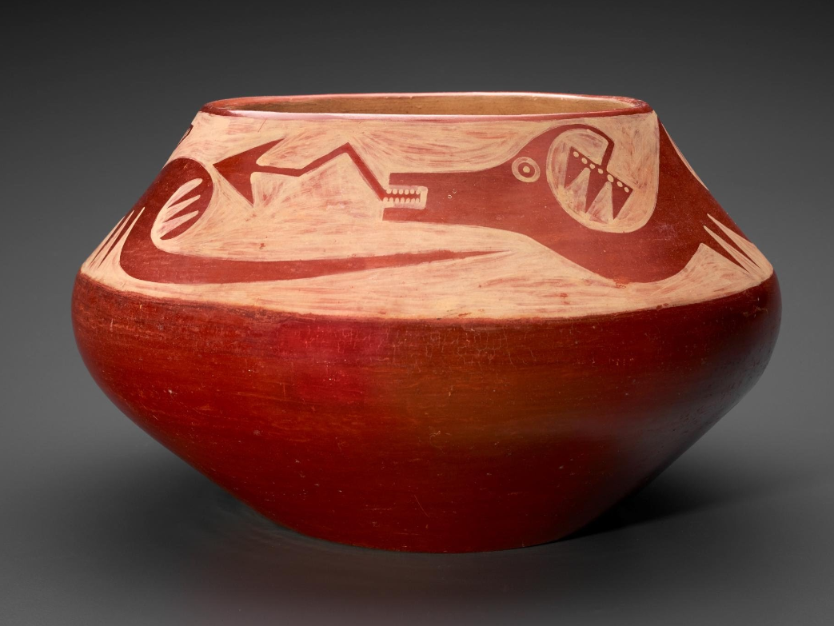
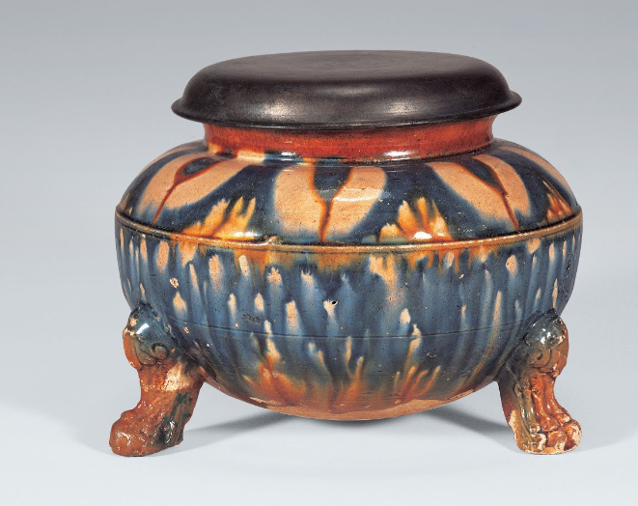
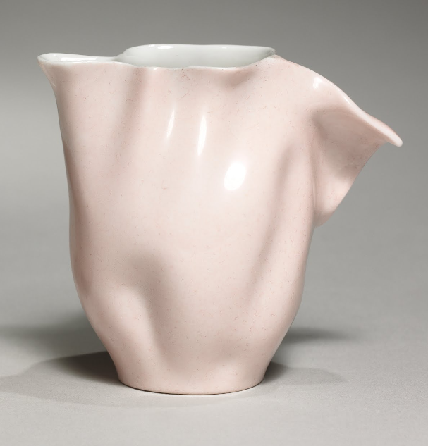
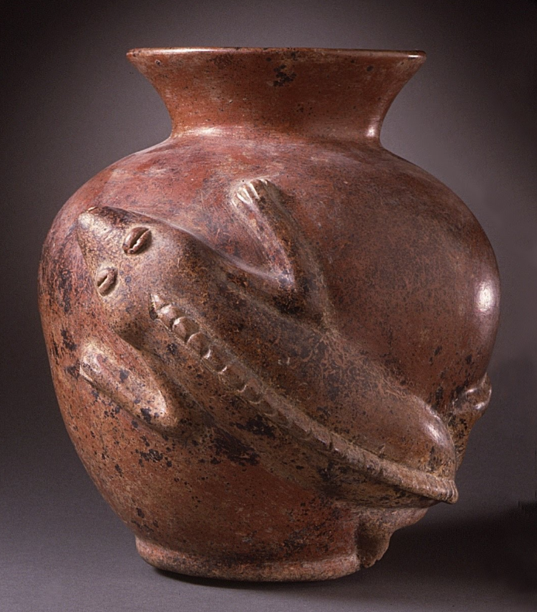
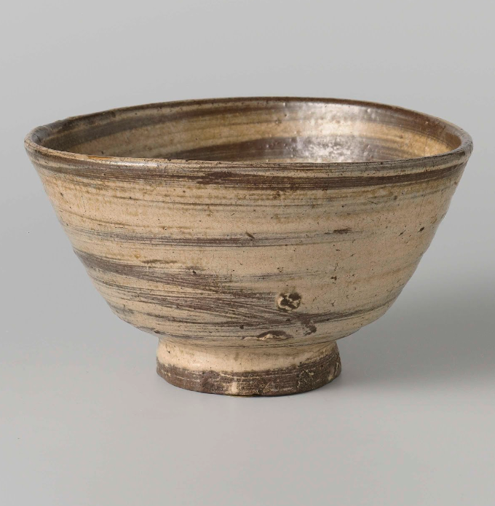
Notes:
top/center, Pueblo 1980s
top/left, Wine container, 1870-1900, Degha People, Africa
bottom/left, Jean Pouyat 1880, France
bottom center, iguana vessel, 200 BC- AD 500, Mexico
top/right Urn, 8th century, Korea
bottom/right, Brown bowl - Japan 1700s

Slide 6
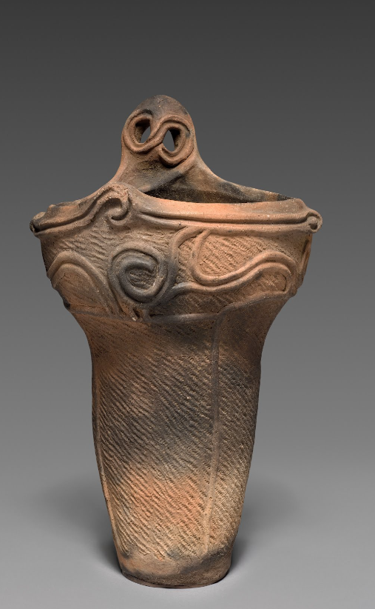
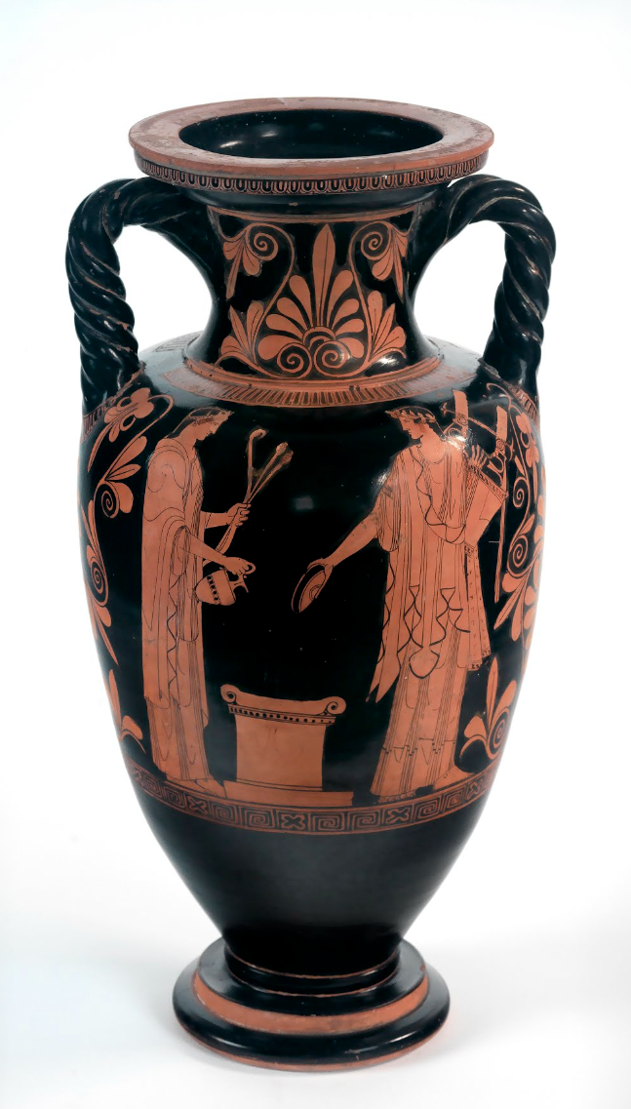
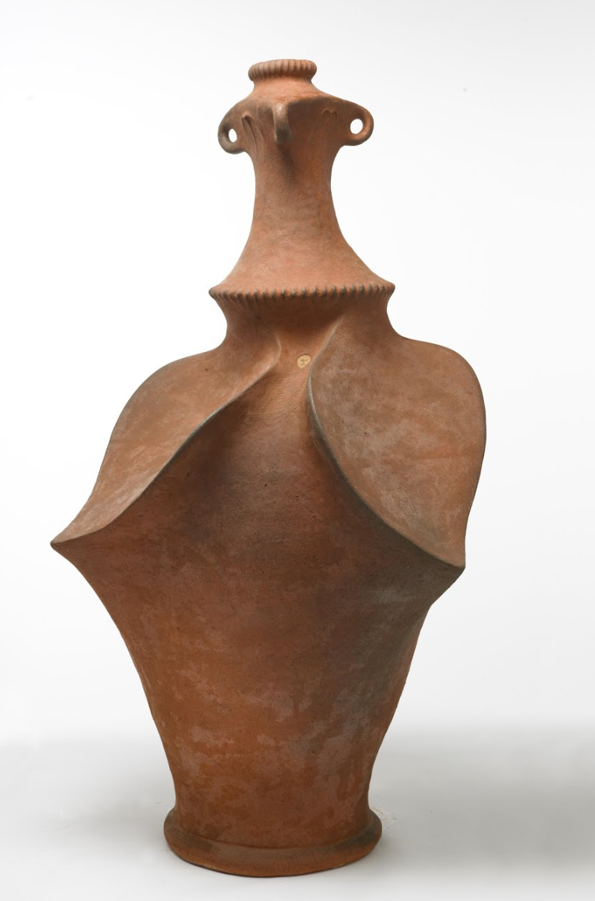
Notes:
center, Greece, 570
Left, 2500 BC, Japan
right, Barry Brickell, 1991, New Zealand
https://artsandculture.google.com/

Slide 7
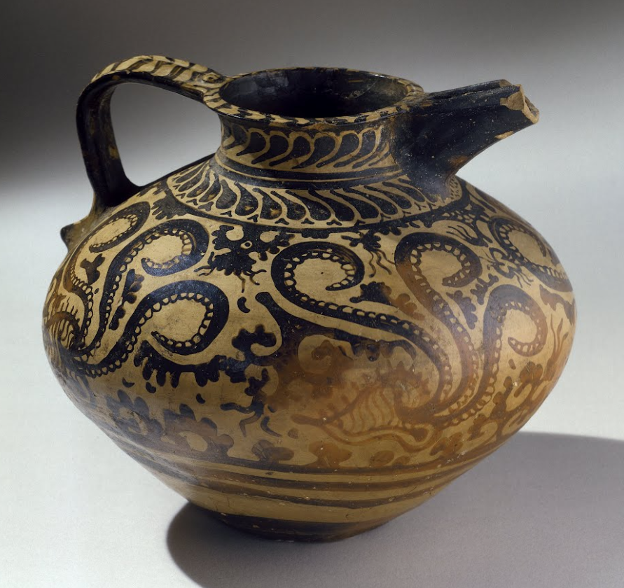
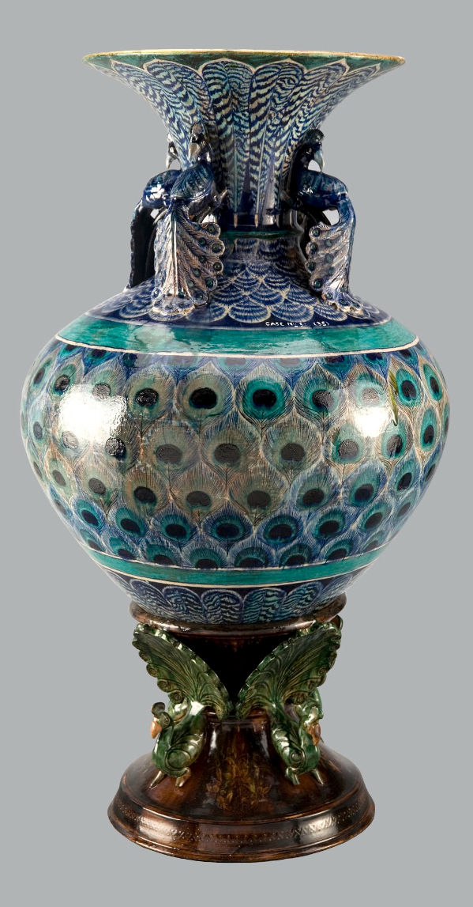
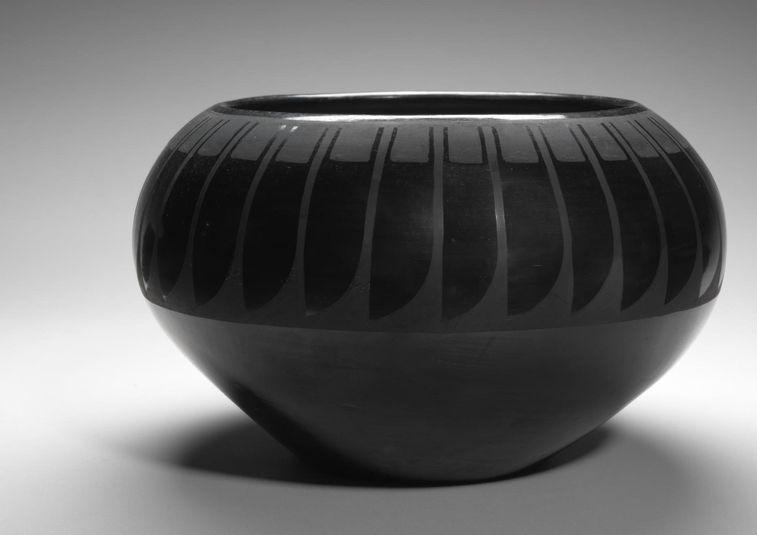
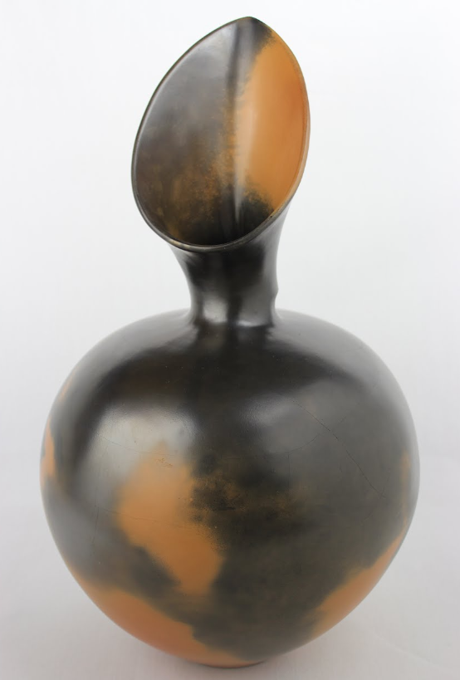
Notes:
right, Bombay School Potter, 1870, India
bottom/center, 1984, Magdalene Odundo, African
bottom/left, Pueblo 1980s
top/center, 1575-1500 BCE, Egypt
top/left, 1127-1279, Song Dynasty, Japan
https://artsandculture.google.com/

Slide 8
How can we identify the stage of clay based on its physical characteristics and behavior?

Slide 9
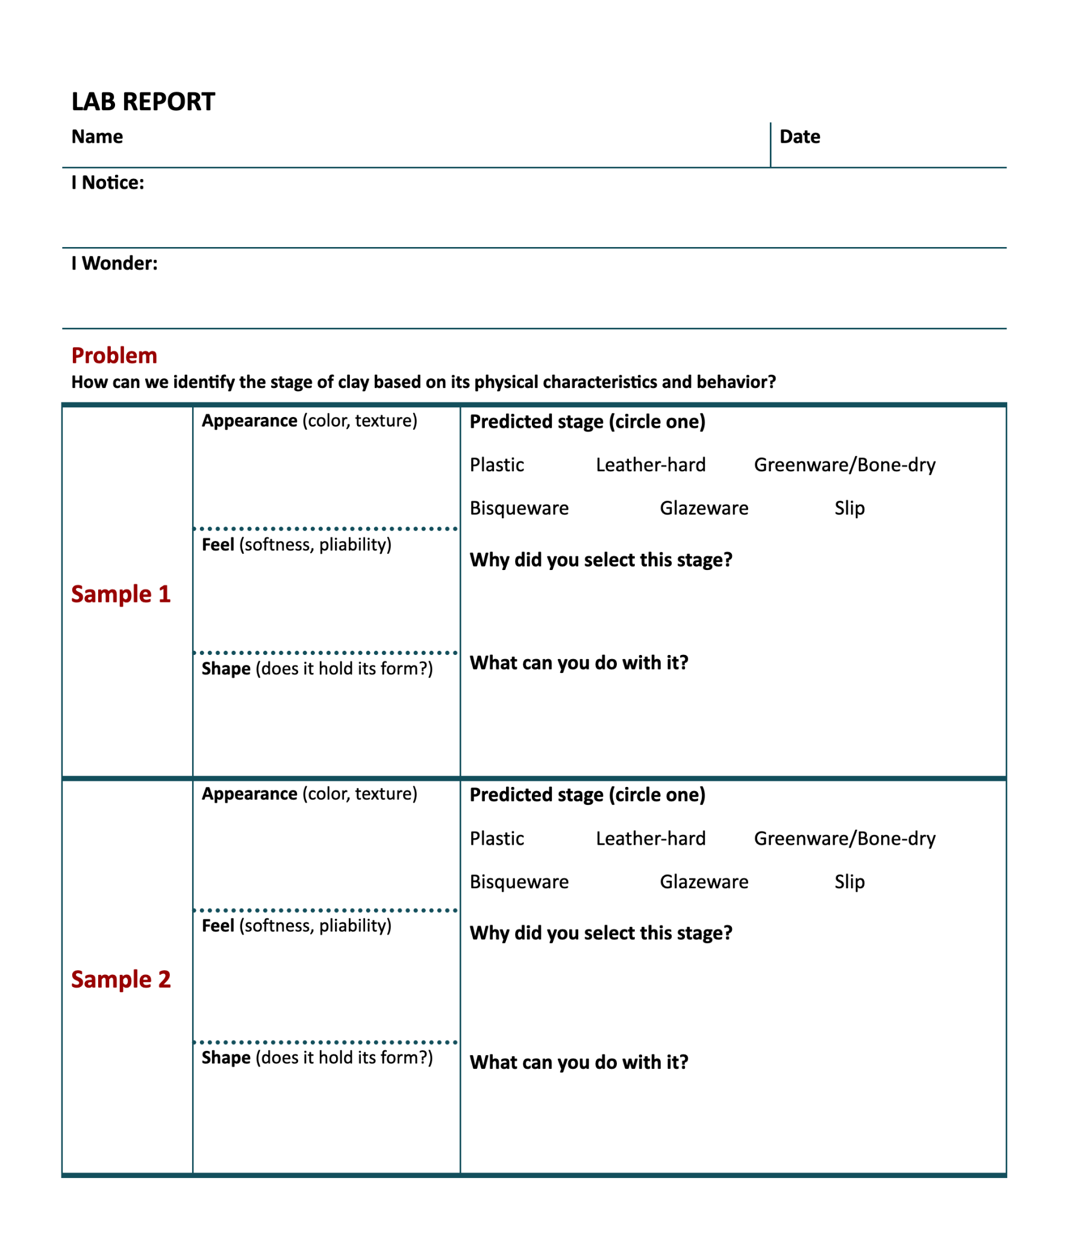
Lab Instructions
Get into your assigned group
Visit and interact with each clay sample
Take notes on your Lab Report handout:
Fill in the appearance, feel, shape, and circle the stage prediction
Answer the questions

Slide 10
Stages Of Clay
Sample ___: Plastic
Sample ___: Leather-hard
Sample ___: Greenware / Bone dry
Sample ___: Bisqueware
Sample ___: Glazeware
Notes:
Reveal the stage each samples students explored in your classroom falls into

Slide 11
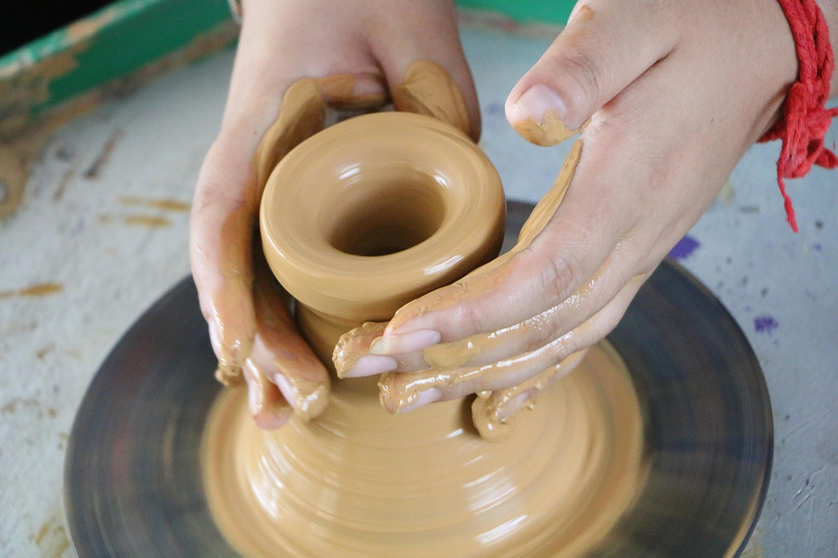
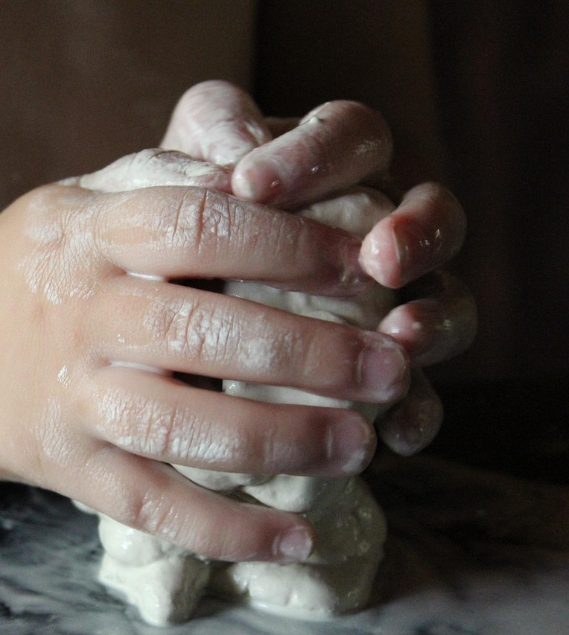
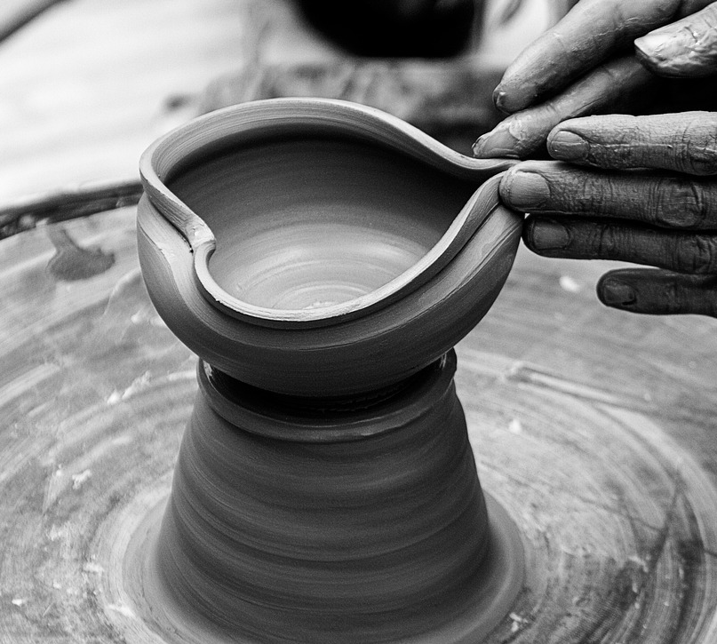
Plastic Clay
Clay is pliable and plastic
Ideal for working with slab, coil, and throwing.
Clay does not need to be reclaimed at this stage.
Notes:
Luzimo. (2017). Clay sculpture, manual make [photo]. https://pixabay.com/photos/clay-sculpture-manual-make-2299844/
Iwana. (2015). Hand, happens, smudge image [photo]. https://pixabay.com/photos/hand-happens-smudge-create-845269/
Stocksnap (2017). Black and while nails, hands image [photo]. https://pixabay.com/photos/black-and-white-nails-hands-clay-2567255/

Slide 12
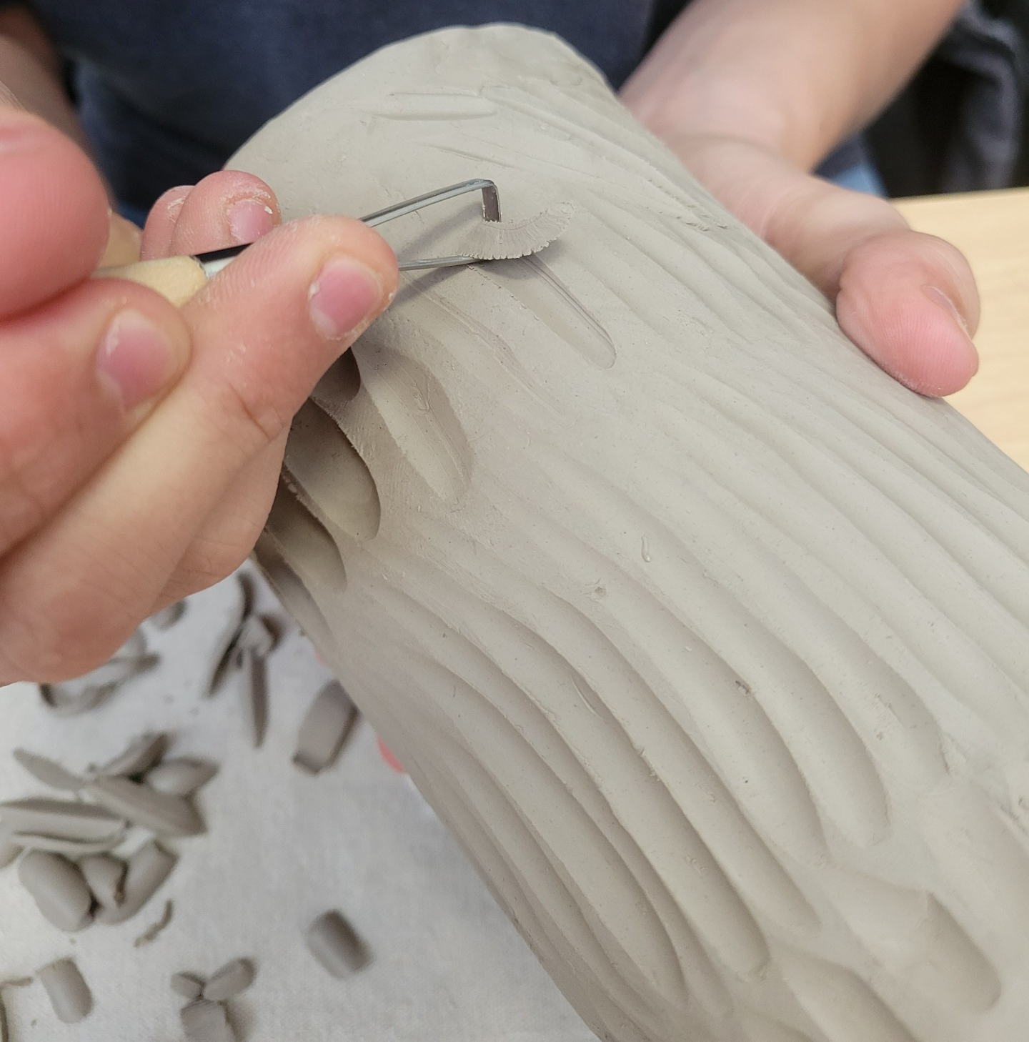
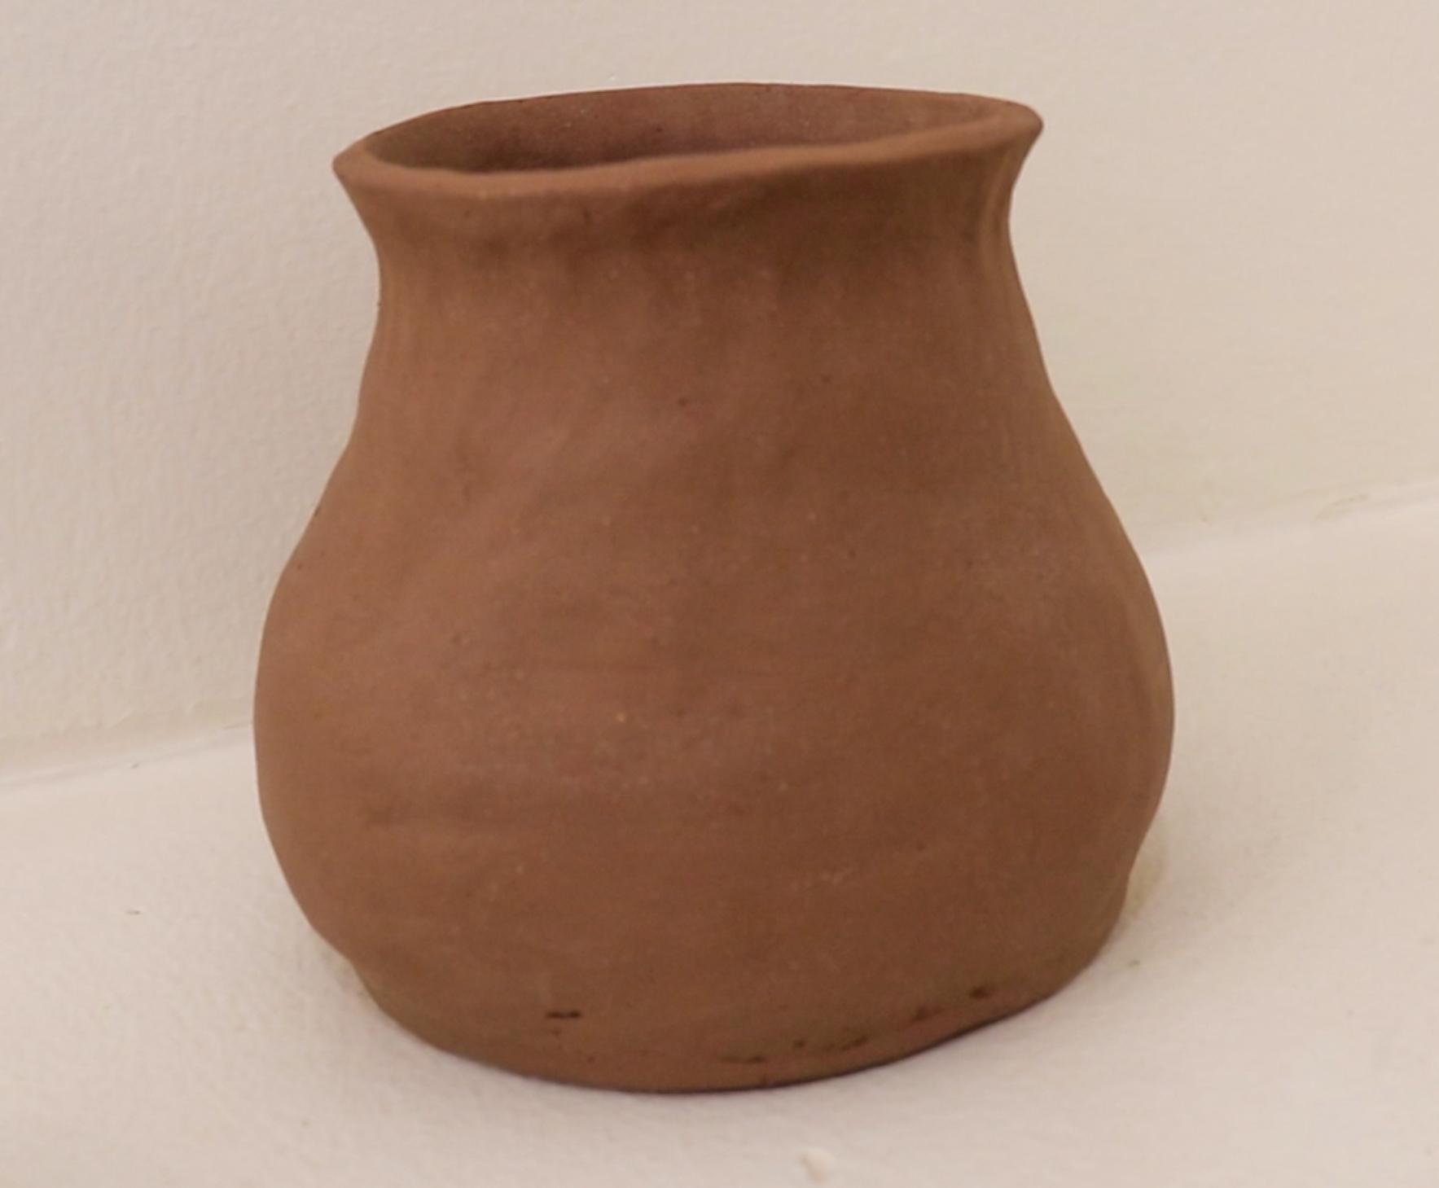
Leather-Hard Clay
Clay is drier and stiffer.
Clay has the consistency of a chocolate bar.
Pots are tooled and decorated at this stage.
Best stage for building with slab and carving designs.
Clay is cool to the touch and darker.
Can be reclaimed at this stage.
Notes:
Eja Collier (2025). [top photo]
Preacher Pottery (2025). [bottom photo]

Slide 13
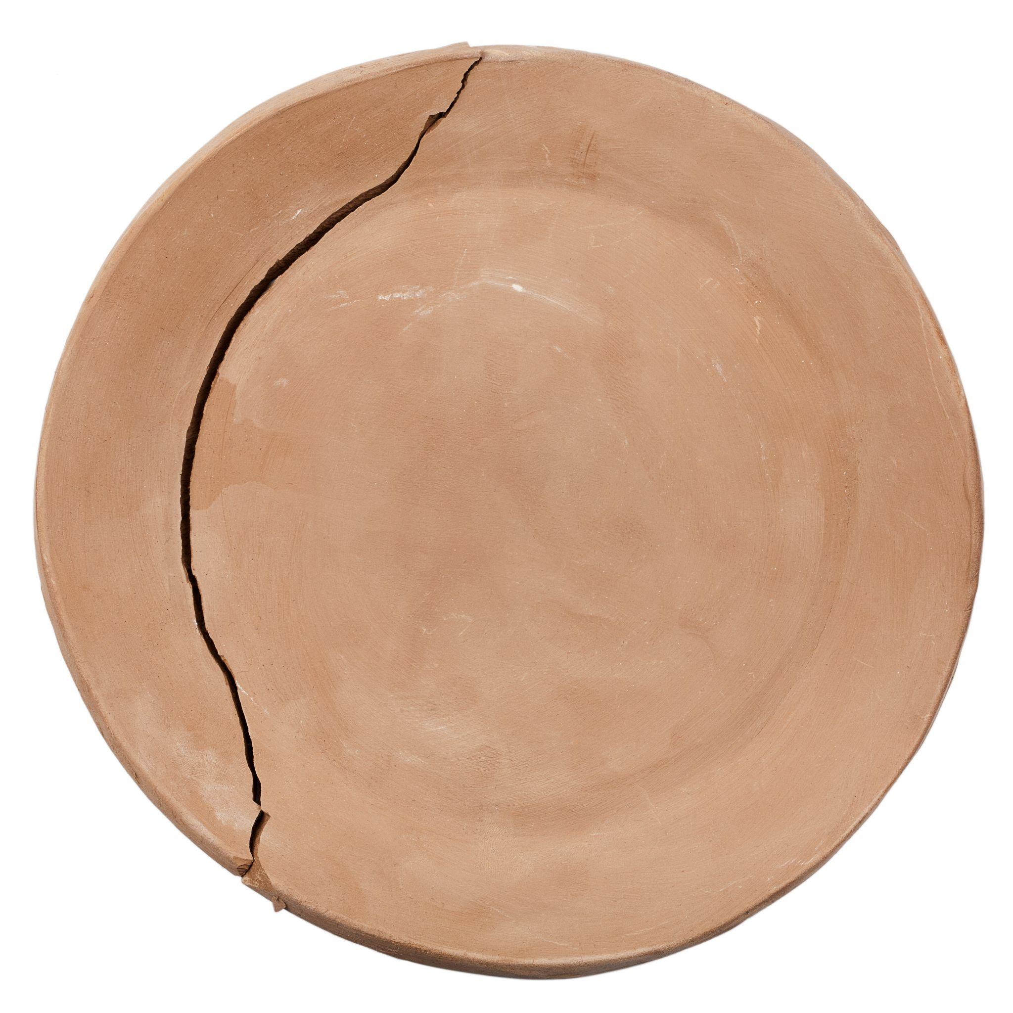
Greenware / Bone Dry Clay
Clay is chalky looking and light gray.
It is VERY FRAGILE at this stage.
Do not try to work with clay at this stage, it is too dry to stick to anything.
Can be sanded
Can be reclaimed
Notes:
Taigi. (2025). Cracked Greenware Plate [photo] / Adobe Stock.
https://rachelimsland.wordpress.com/2017/09/21/bone-dry-clay-repair-9-21-2017/

Slide 14
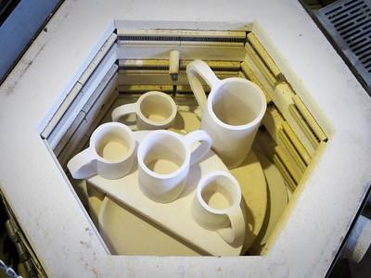
Bisqueware
First firing of piece
After firing piece is white and stronger. Can still be broken if not careful.
Can not be reclaimed!
Notes:
Lynae Zebest (2011). Thing a Day: Kilnload [photo]. https://www.flickr.com/photos/89819035@N00/5555733860/

Slide 15
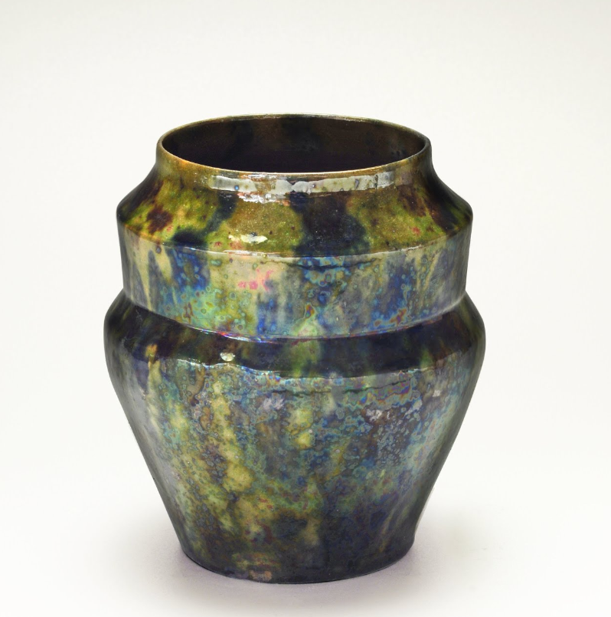
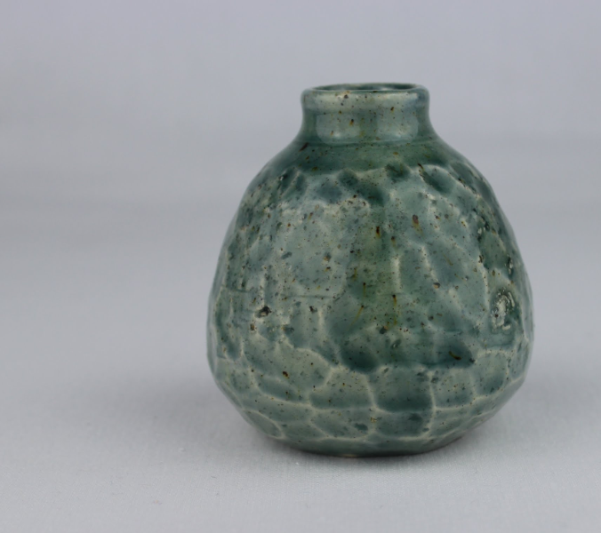
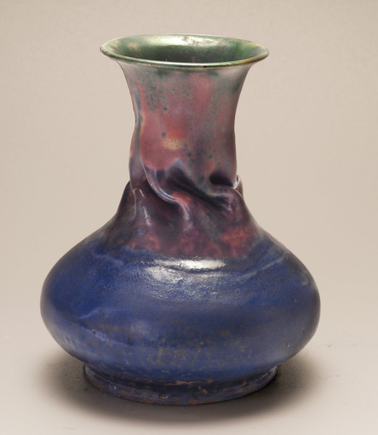
Glazeware
Glaze is applied to surface and piece is fired a second time.
The glaze will melt onto the piece and fuse to the clay.
Can not be reclaimed!
Notes:
top right, green jar, 1955, Barbara Cass, UK
top and bottom right corner, George Ohr, early 1900s. American
https://artsandculture.google.com/

Slide 16
Clay Safety
Little pieces of clay left on the tables break down and turn to dust which can be breathed in.
Often pieces require sanding which immediately turns into dust.
Clay dust is harmful to ingest and/or inhale.
The best way to clean clay dust is with a damp towel.

Slide 17
Stages of Clay Chart
Stage of Clay | What can be done
Draw a T-Chart on your group’s poster
In the Left column list the stages of clay in the order of most pliable to least pliable
In the right column provide examples of what can be done with clay in that stage

Slide 18
K20 ICAP - Malleable to Marvelous with Ashlyn Winters

Slide 19
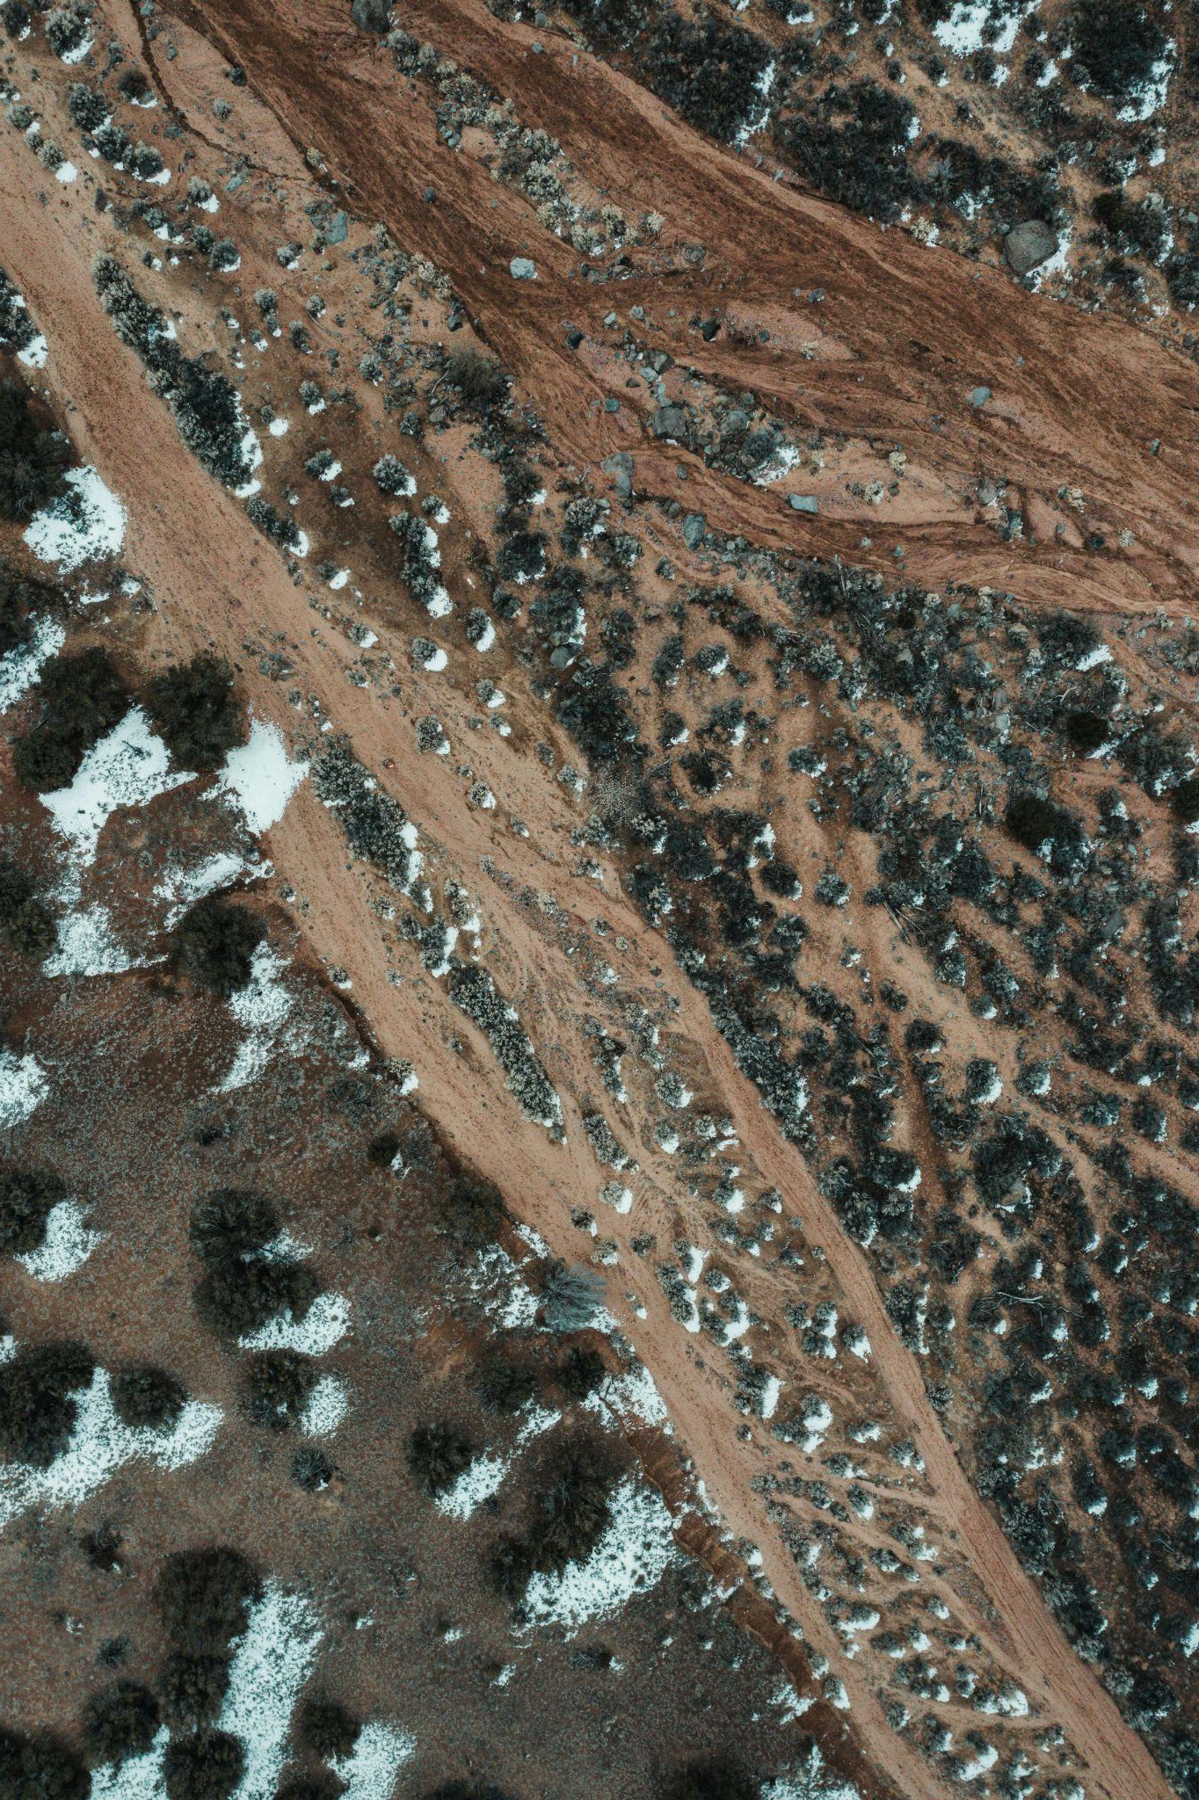
Ceramics
Things made from clay
Clay is created as the result of the decomposition of igneous rock, which makes up the earth's crust.
Everything you do with clay involves the interplay of these three variables.
Moisture, Plasticity, and Heat
Notes:
Alfo Medeiros (2024). Aerial Footage of a Soil with Texture [photo]. https://www.pexels.com/photo/aerial-footage-of-a-soil-with-texture-19786595/

Slide 20
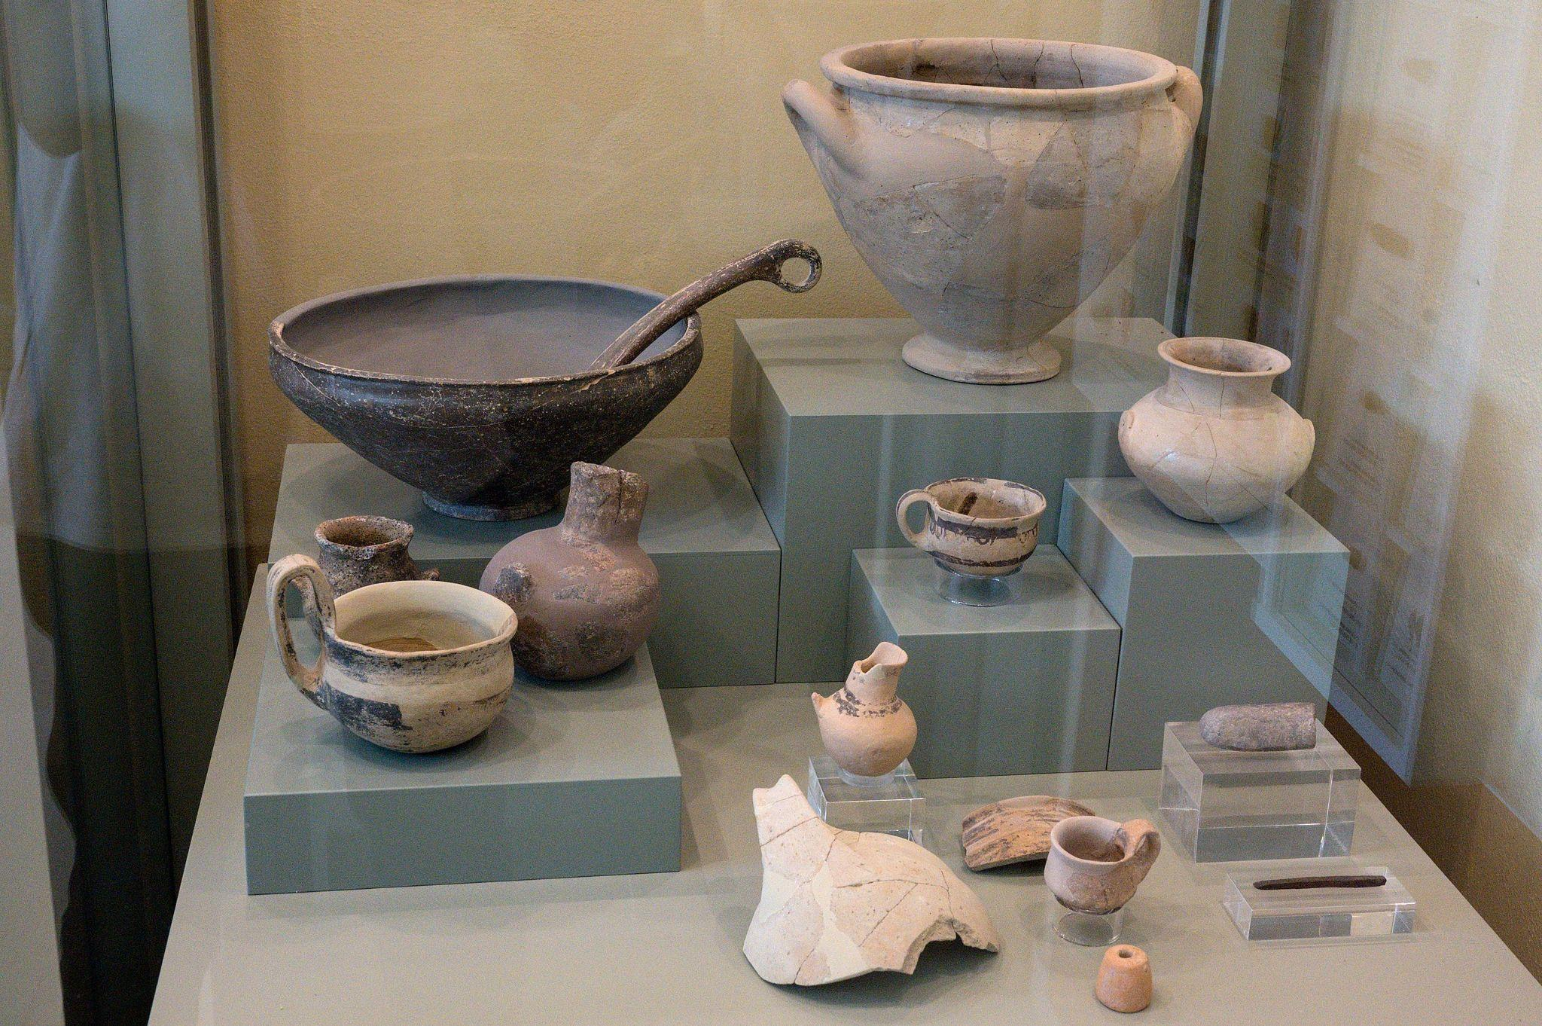
Origins Of Ceramics
Ceramics is one of the oldest art forms, and dates back to when people first learned to control fire.
People probably first began to model clay as a diversion.
Clay became a solution for many practical problems.
Notes:
Zde (2020). Early Helladic II and II pottery from Tsoungiza, Archaeological Museum of Nemea [photo]. https://commons.wikimedia.org/wiki/File:Early_Helladic_pottery_from_Tsoungiza,_AM_of_Nemea,_201892.jpg

Slide 21
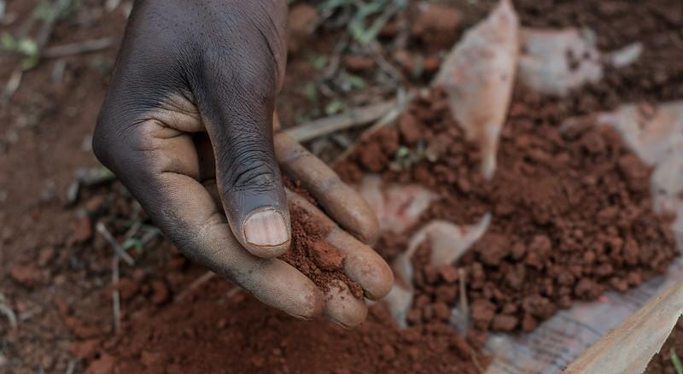
Early Techniques
The clay that we will be using in this studio has been processed and prepared.
Early potters had to dig their raw materials from the ground and prepare it themselves.
Often impurities must be removed from natural clay.
Notes:
©2014CIAT/GeorginaSmith https://www.flickr.com/photos/ciat/15740043356

Slide 22
Working With Clay
Clay properties
Plasticity
Shrinkage
Texture
Moisture
Handling Clay

Slide 23
Plasticity
Plastic. The property of clay that allows it to change shape without tearing or breaking.
There are a few things you can do to keep your clay plastic:
Spray it with water
Store it in a bag with wet paper towels
Mix new plastic clay with the old
Notes:
Monstera Production (2020). Crop faceless woman kneading clay in workshop [photo]. https://www.pexels.com/photo/crop-faceless-woman-kneading-clay-in-workshop-5302891/
Antoni Shkraba (2021). A Person Holding Broken Clay Dough [photo]. https://www.pexels.com/photo/a-person-holding-broken-clay-dough-6694710/

Slide 24
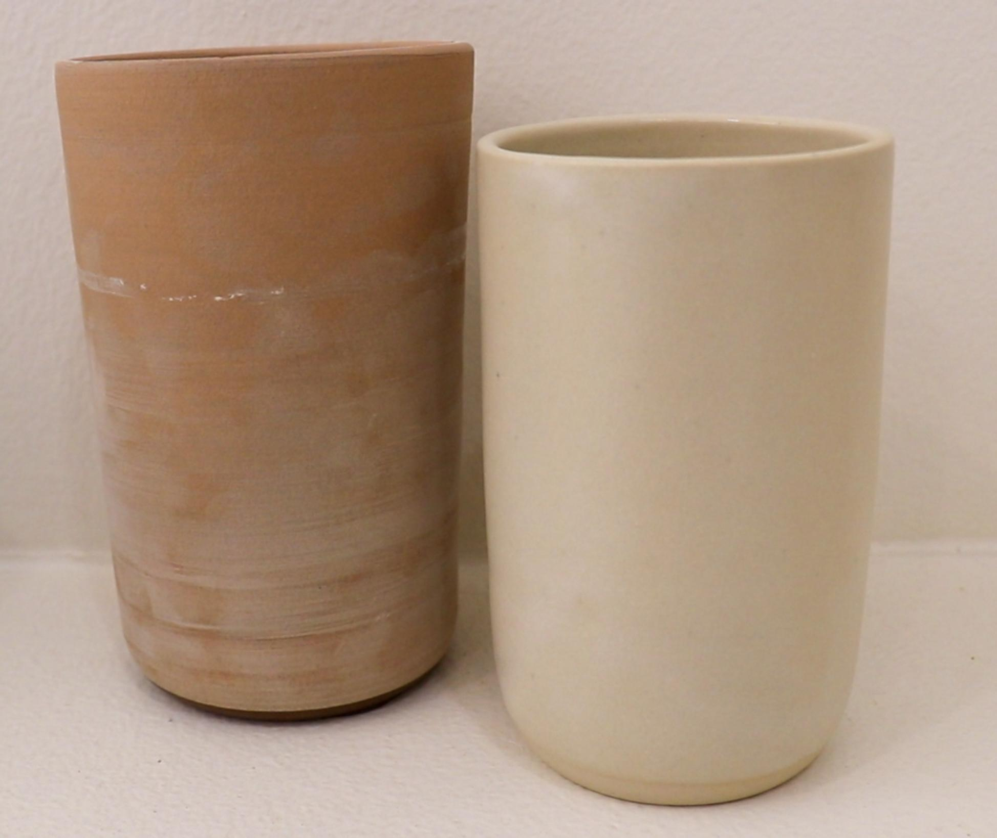
Shrinkage
All clay shrinks a little bit as it dries.
Clay can crack when it shrinks if the walls are uneven, or if it is allowed to dry too fast.
Keeping a bag over your work but not closing it off will allow it to dry out more slowly.
Notes:
Preacher Pottery (2025). [photo]

Slide 25
Texture
The texture of clay can range from coarse to smooth.
Sometime potters add sand or grog to change the texture of the clay.

Slide 26
Moisture
All clay contains water.
You can add water to the clay to make it softer or more plastic. Add too much water and the clay will not be able to hold its shape and become the consistency of putty.
Clay begins to dehydrate when exposed to air.
You will need to put water back into the clay as necessary to keep it from drying out.

Slide 27
Preparing Clay
Before you can make anything with clay, you need to prepare it.
Reclaimed clay often contains harder bits of clay and air pockets. If air is left in the clay it can combust in the kiln.
Clay must be de-aired before it can be used.

Slide 28
Kneading/Wedging Clay
Kneading/wedging is the process used to eliminate air bubbles and create an even consistency in the clay.
Kneading is for smaller amounts of clay, wedging for larger.
Use the wedging table or piece of canvas to absorb extra moisture.
Notes:
Antoni Shkraba (2021). A Person Kneading a Clay Dough [photo]. https://www.pexels.com/photo/a-person-kneading-a-clay-dough-6694683/

Slide 29
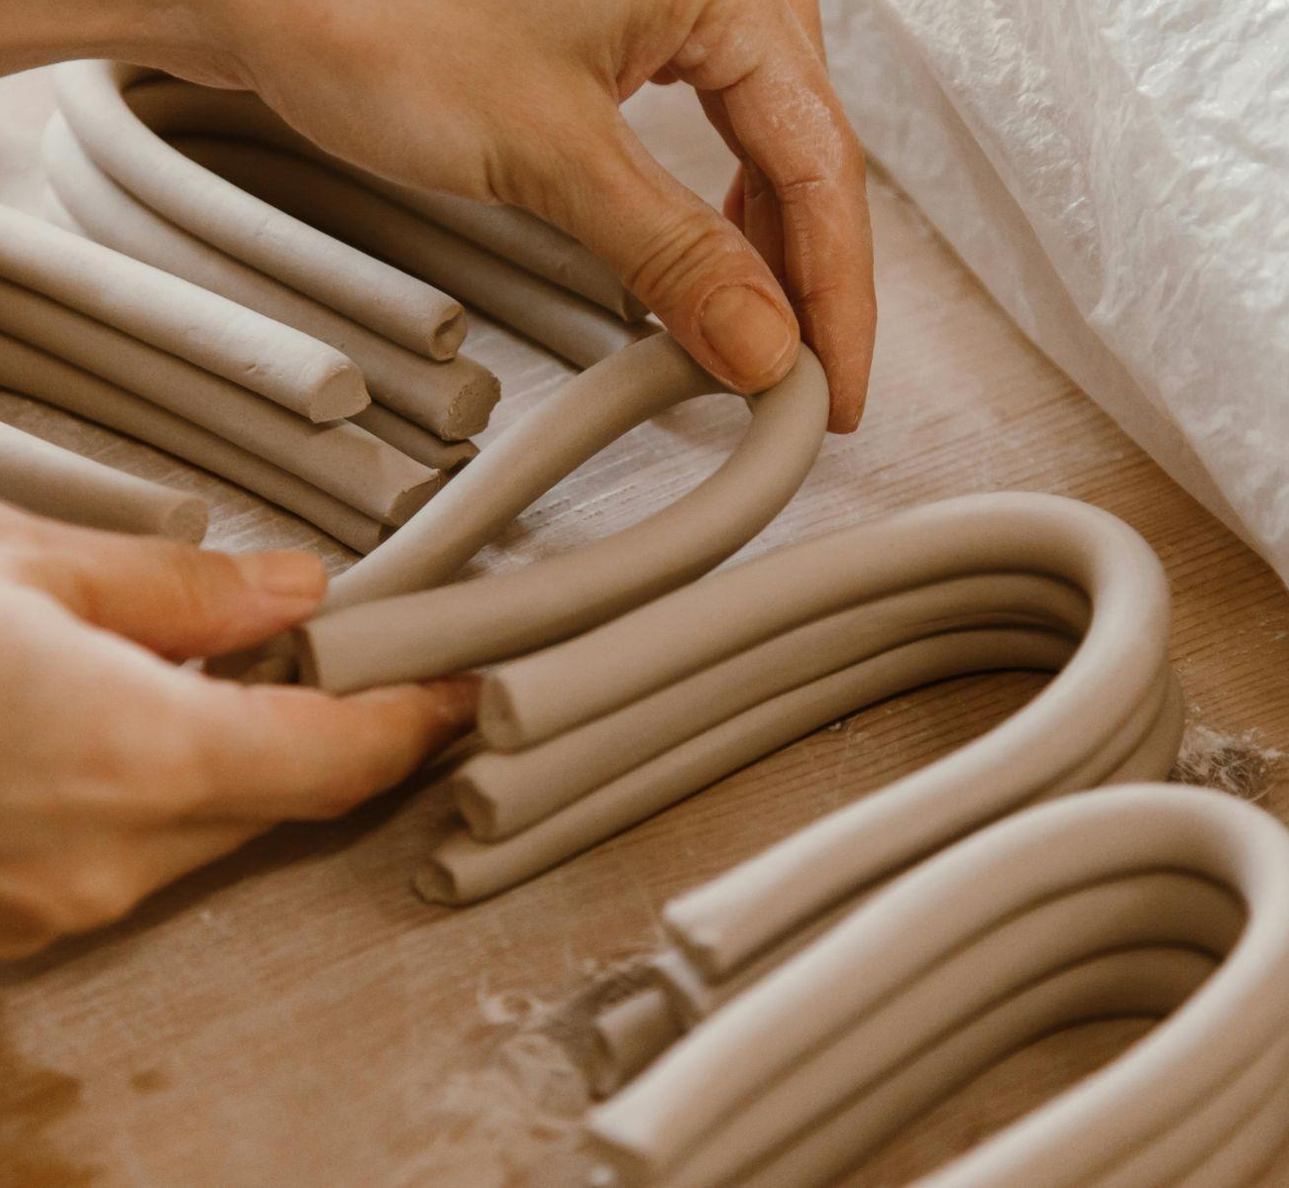
Pinch: Clay squeezed between fingers to form pot
Slab:
Clay rolled flat
Coil: Clay rolled into
snake like pieces
Notes:
Roman Odintsov (2021). A Person Holding Brown U Shaped Clays [photo]. https://www.pexels.com/photo/a-person-holding-brown-u-shaped-clays-8063814/
Mikhail Nilov (2021). A Rolling Pin Beside the Brown Clay [photo].
https://www.pexels.com/photo/a-rolling-pin-beside-the-brown-clay-9304556/
cottonbro studio (2020). Two People Sculpting [photo]. https://www.pexels.com/photo/two-people-sculpting-6694755/

Slide 30
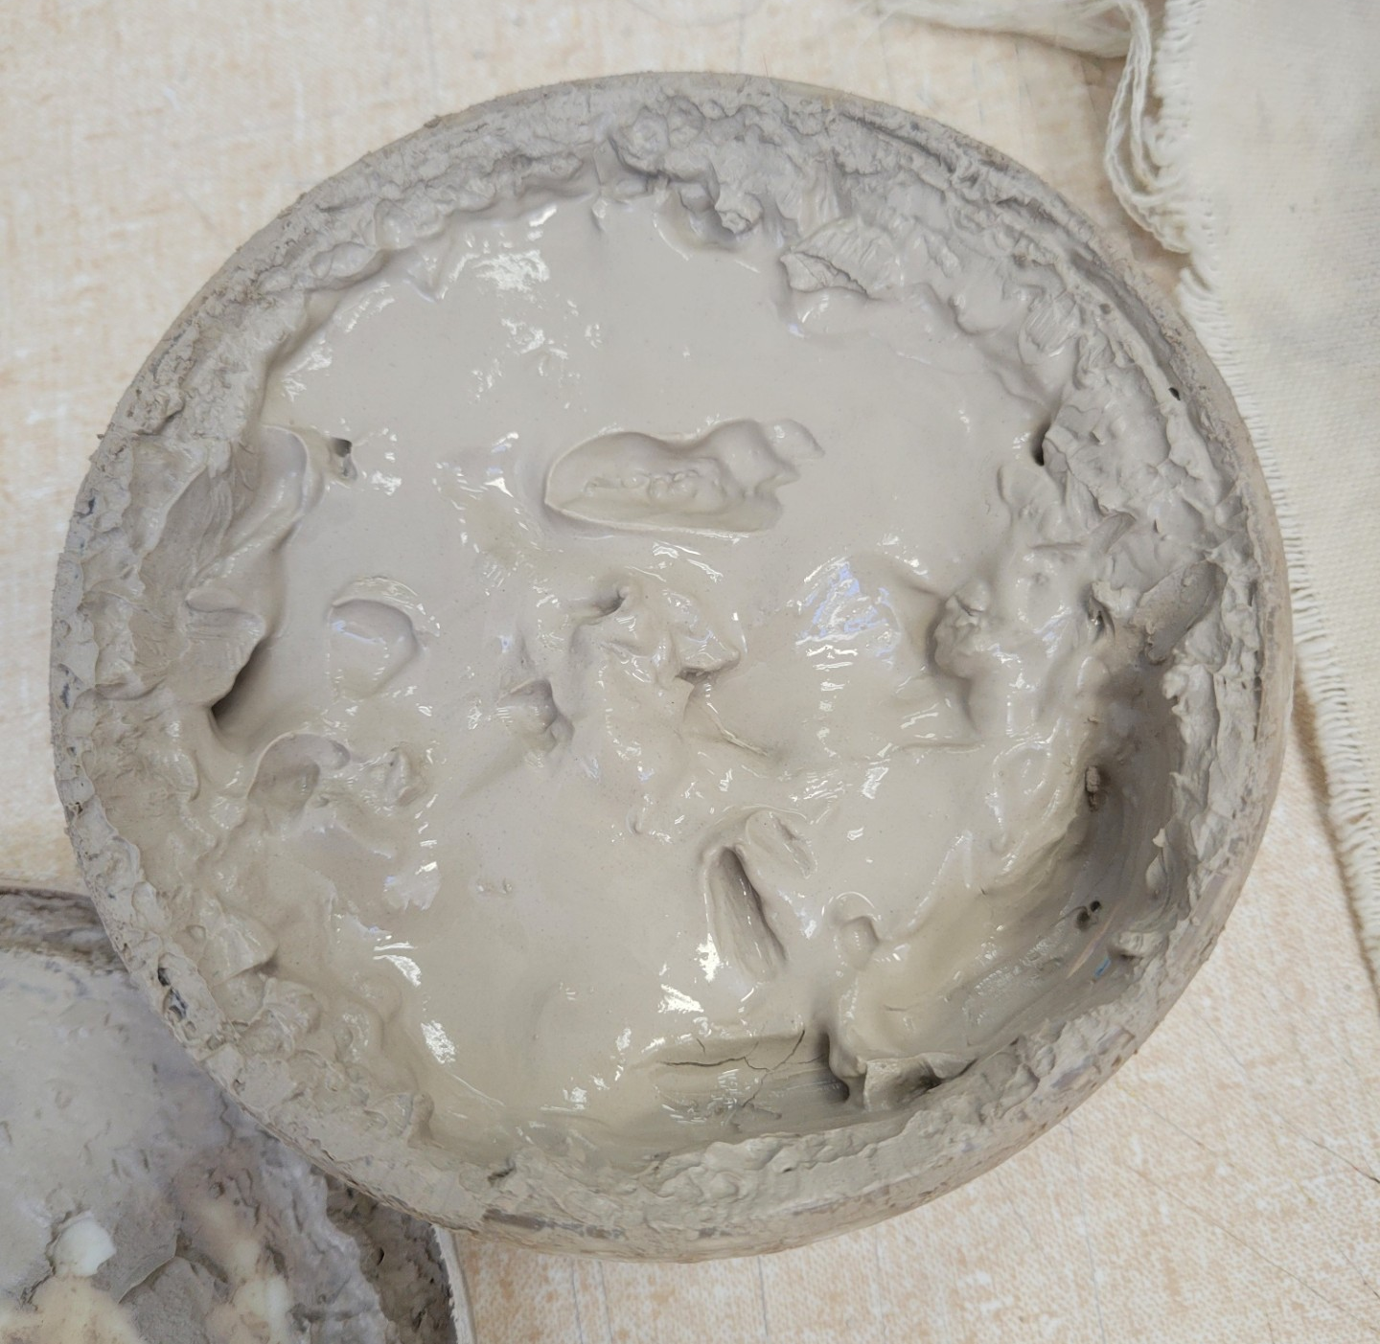
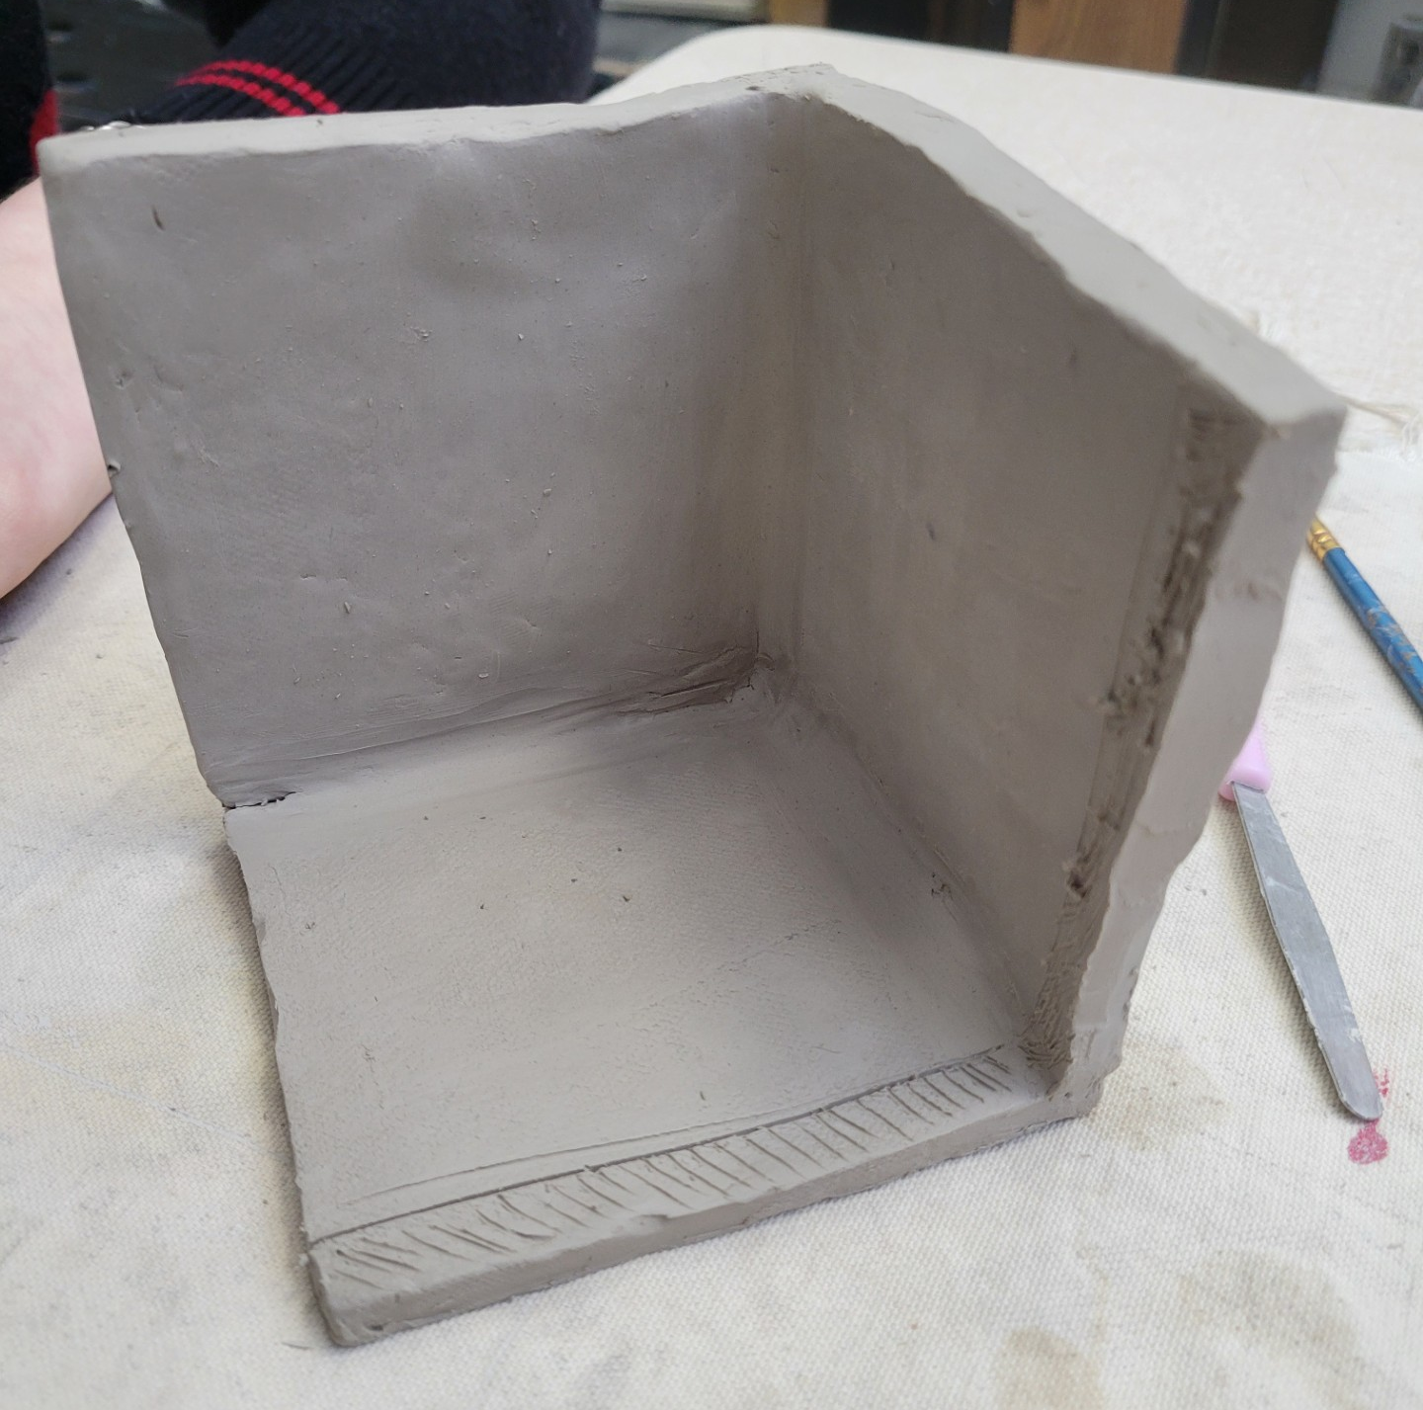
Join Pieces Of Clay
Slip: Liquid clay in the consistency of yogurt.
Score: Roughen up the surface of raw clay.
Slip and Score: The process used to join pieces of clay
Notes:
Eja Collier (2025). [photo]

Slide 31
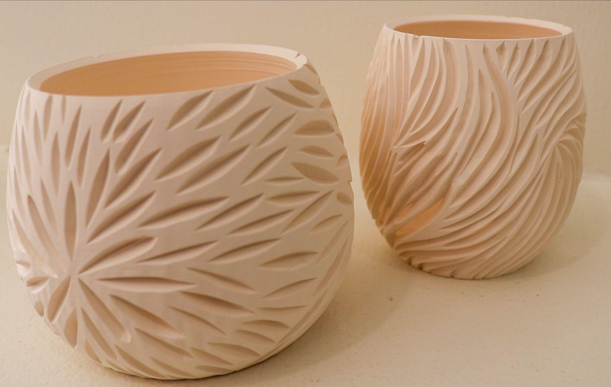
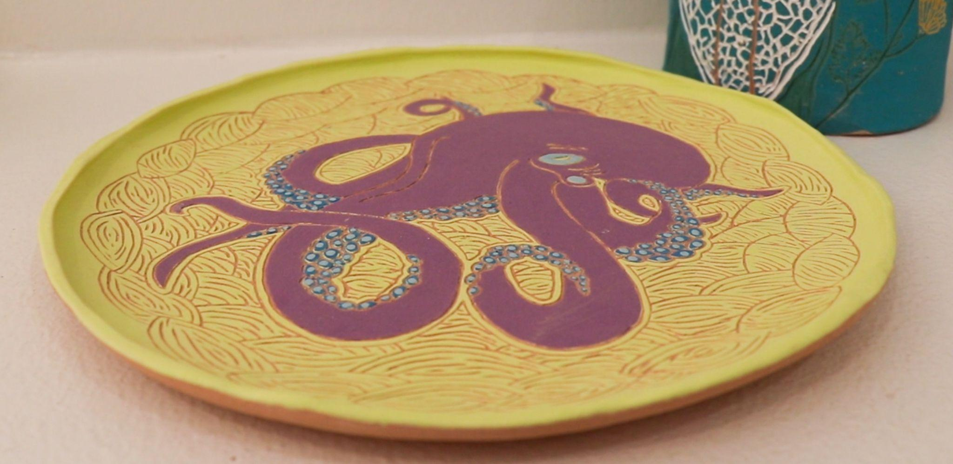
Surface Decoration
Scraiffito: Etch into clay to make a design
Carve: Cut away parts of the clay to reveal a design
Notes:
Preacher Pottery (2025). [photo]

Slide 32
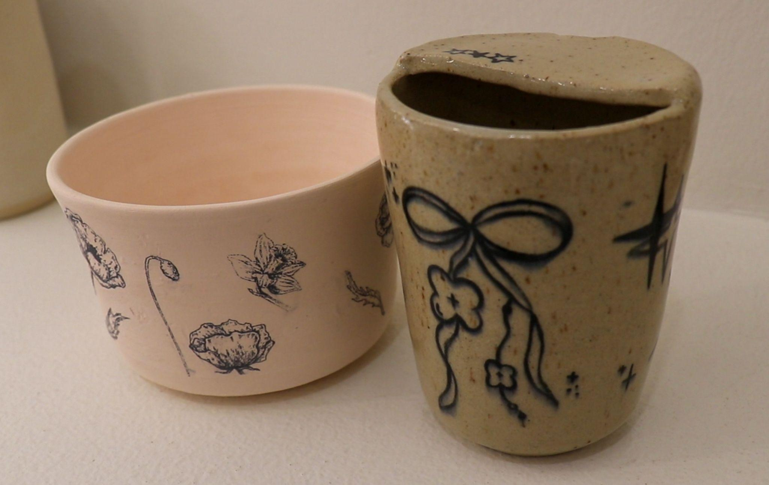
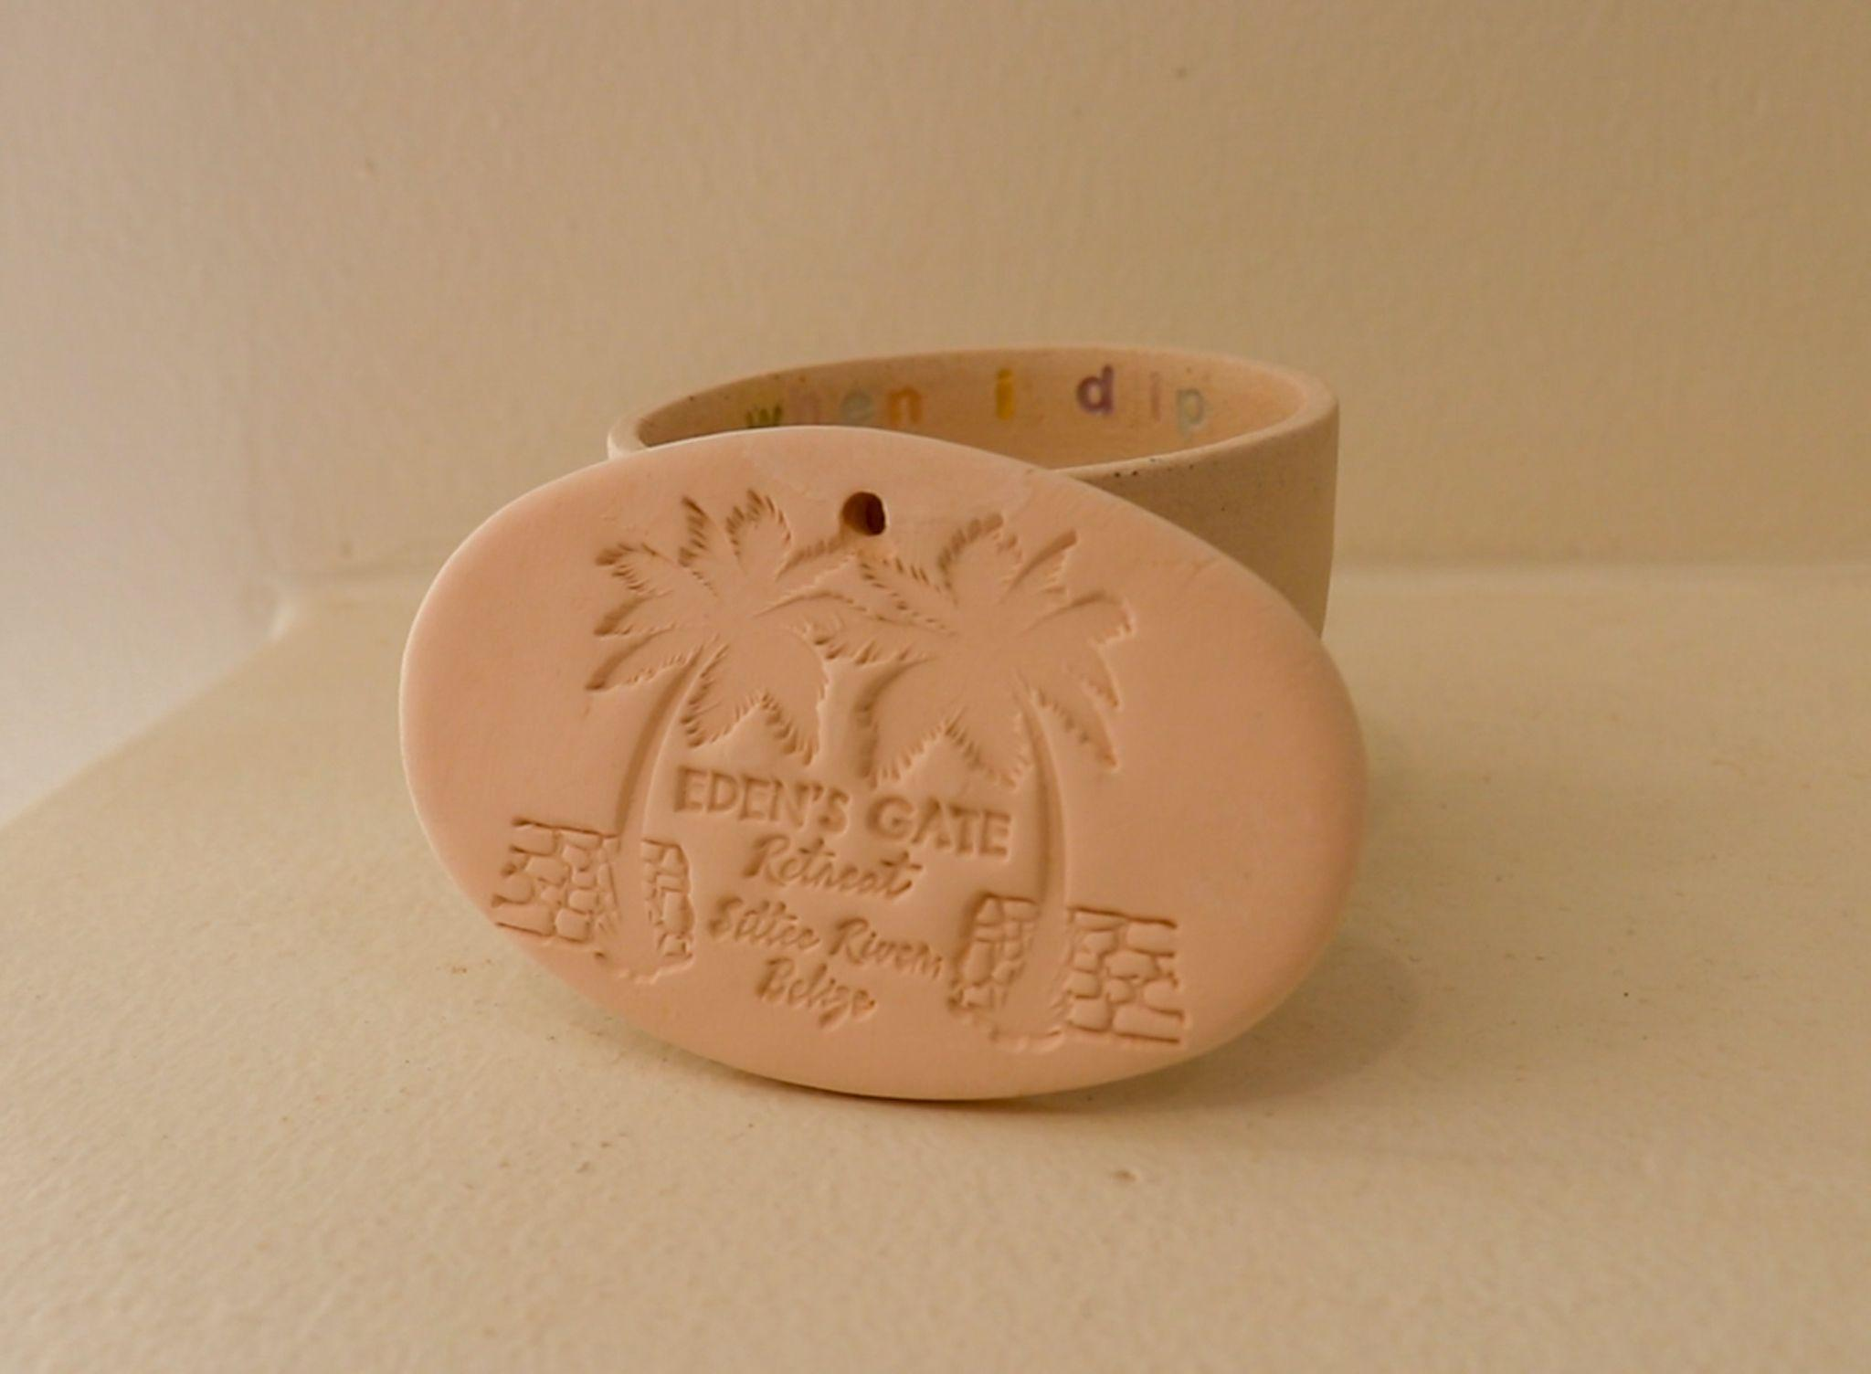
Surface Decoration
Underglaze: A type of matt glaze that can be applied to clay before bisque firing.
Stamping: different textures can be applied to the clay surface like a stamp.
Pieces of clay can be attached by slipping and scoring.
Notes:
Preacher Pottery (2025). [photo]

Slide 33
Research Poster Topics
Techniques
Include on your poster:
Joining Pieces of Clay
Surface Decorations
Hand-building Techniques
Kneading and wedging
Define and describe the clay working technique
Include what tools are needed for the technique
Notable artists, cultures, or historical periods that are known for using this technique

Slide 34
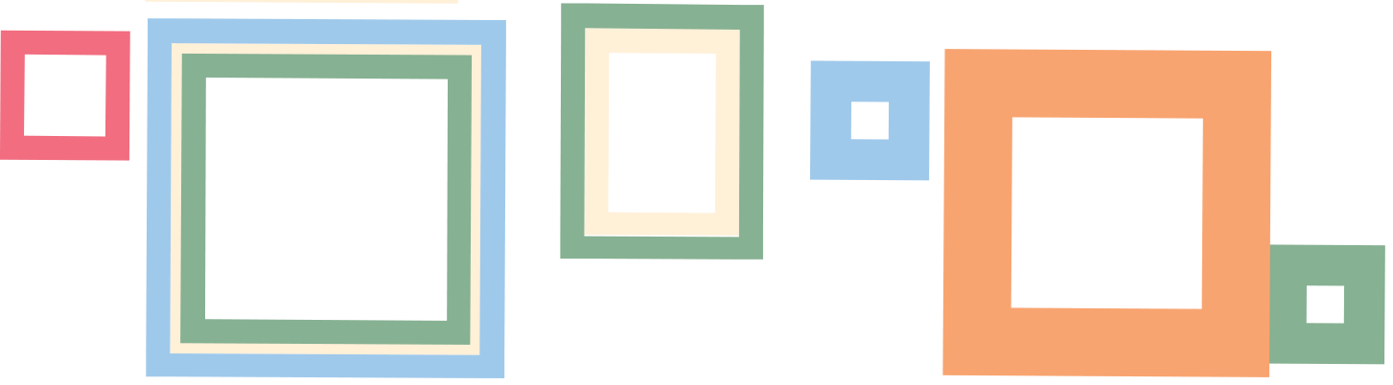
Gallery Walk
Hang posters around the room.
With your groups circulate around the room, stopping at each other group’s poster for about 5 mins
Leave one sticky noting a strength they saw and one noting a question they have about what was presented.

Slide 35
I Used to Think… But Now I Know…
Reflect on you knowledge of ceramics, the stages of clay, and clay working techniques.
Grab two sticky notes.
On one sticky write a statement completing the thought, “I used to think…”
On the other sticky complete the thought, “Now I know…”
Place each sticky note on the corresponding column in the classroom.

