Slide 1
Civil Rights for All – A US History Lesson

Slide 2
Essential Questions:
1.What should be done when something seems unfair?
2. Can a social movement impact our lives? Does it change things?
3. Can we learn lessons from the past to help us with today's social problems?

Slide 3
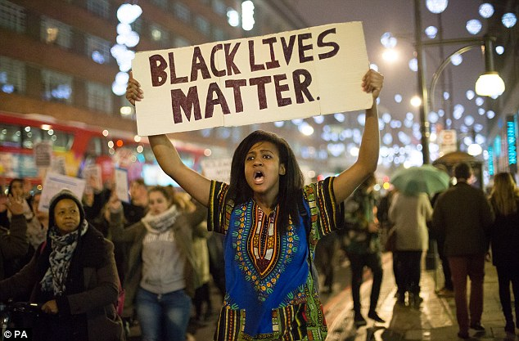
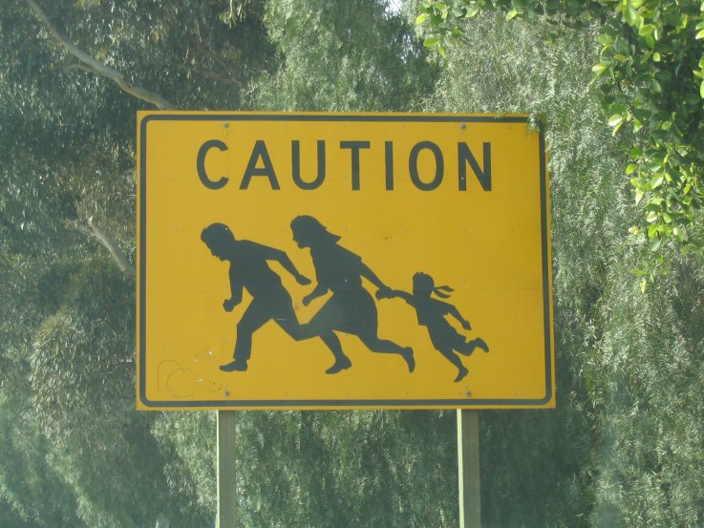
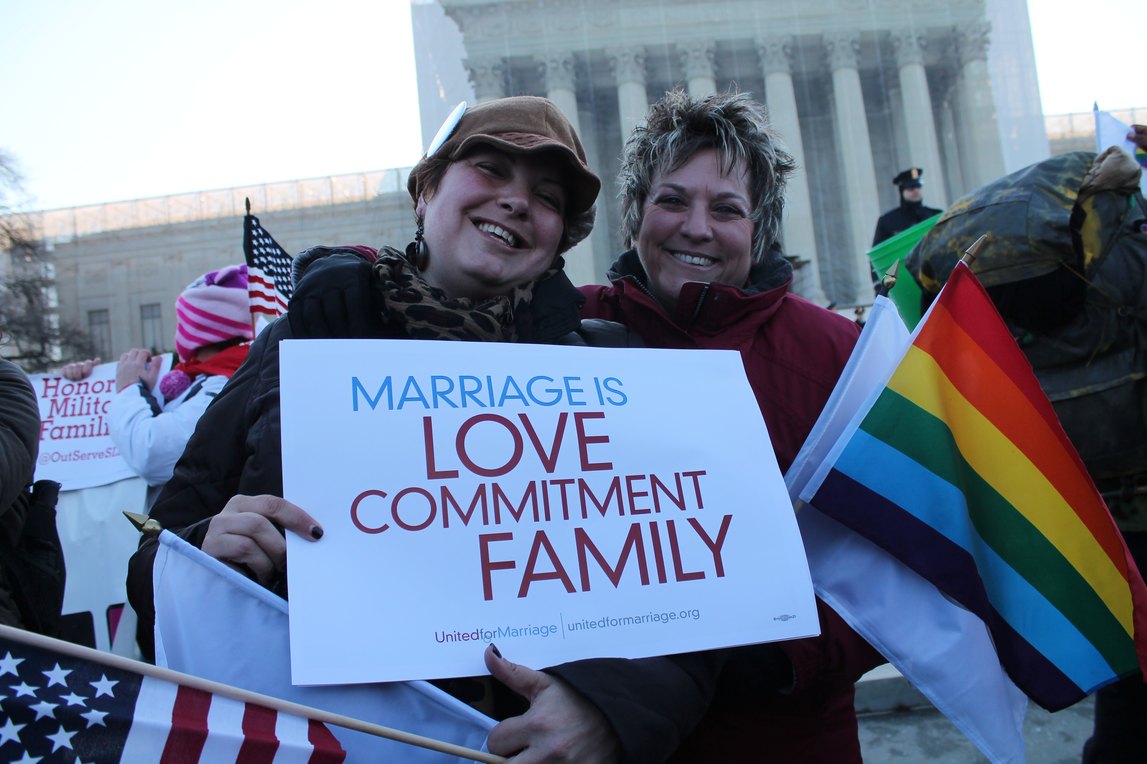
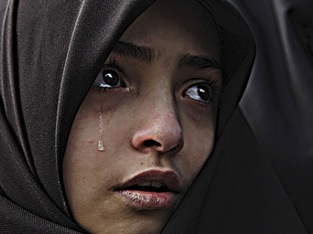
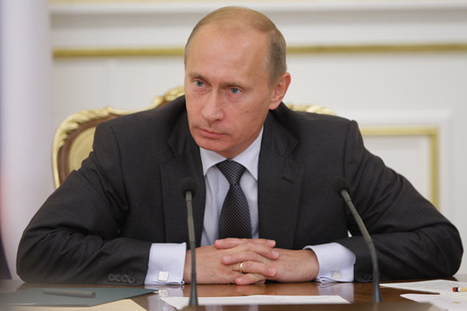
What are some important social issues today?
2
1
3
5
4

Slide 4
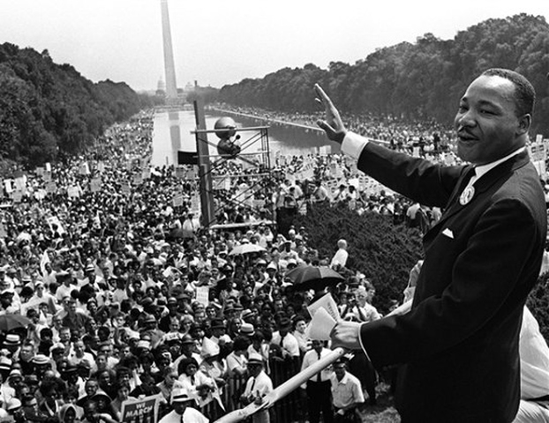
Past social movements have guided others who also felt injustice.
What did the Civil Rights movement teach us about solving social problems?

Slide 5
Video Clips
United Farm Workers:
https://www.youtube.com/watch?v=e7GCCBIgFaQ&index=18&list=PLABF4B6F4347730A0
Cesar Chavez: Embrace the Legacy
History of Cesar Chavez and the organization of The United Farm Workers movement.
https://www.youtube.com/watch?v=qD4u8Zw-gao
Cesar Chavez Day- ABC World News
The struggle of the United Farm Workers.
NOW Movement:
https://www.youtube.com/watch?v=xO304aoUAWE
1950’s Housewife to Women’s Activist: Betty Friedan
AIM Movement:
https://www.youtube.com/watch?v=BlKc19OUR54
The ideas of the American Indian Movement
As you watch the video clips, take notes of what you learn on the video clip chart.

Slide 6
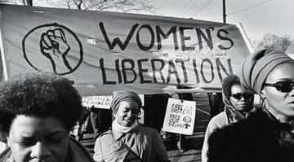
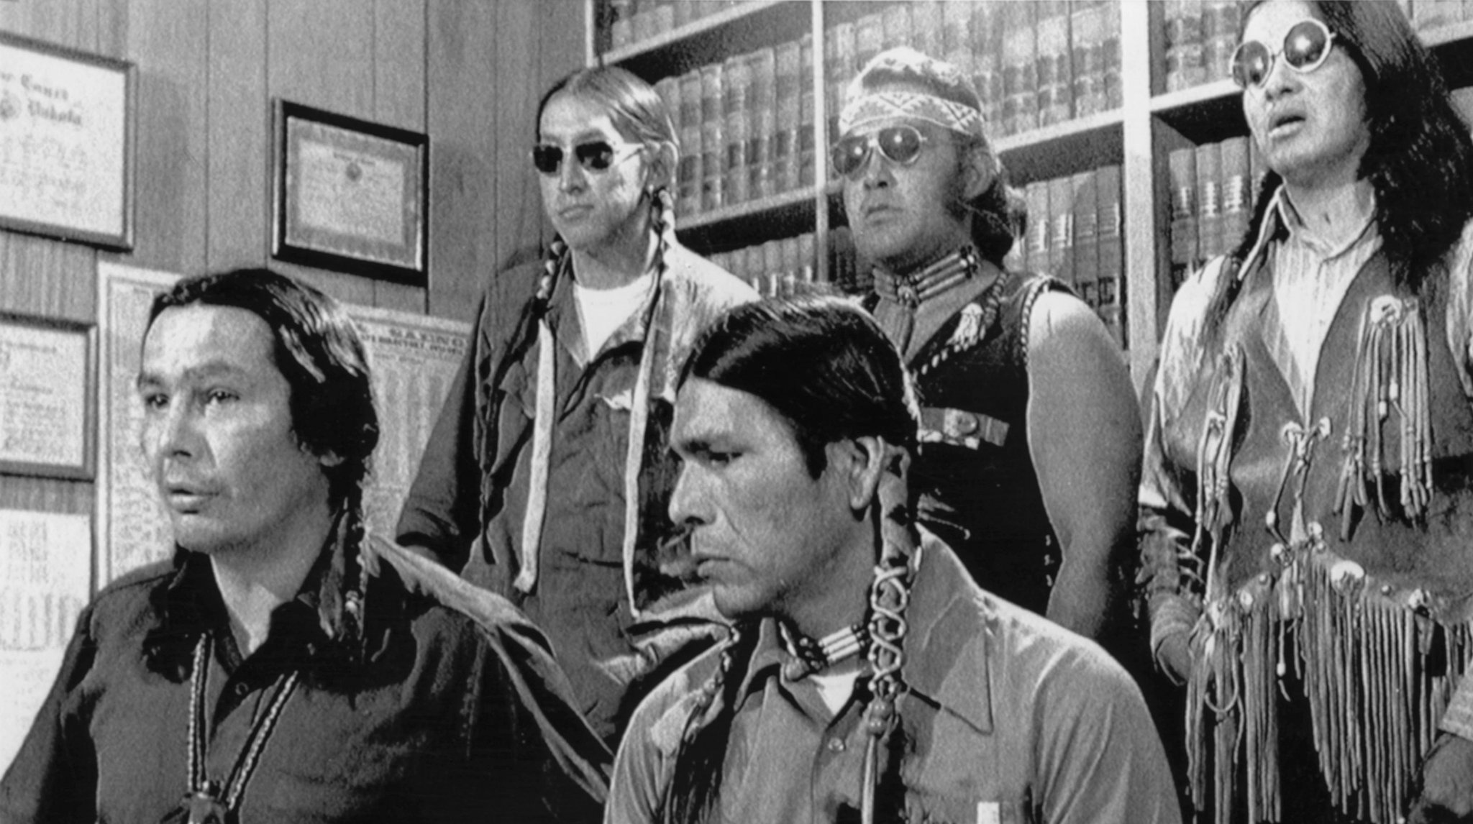
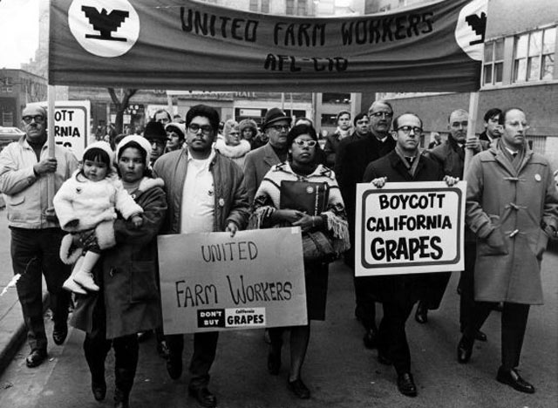
Can we learn lessons from the past to help us with today's social problems?
N.O.W.
Civil Rights
United Farm Workers
A.I.M.

