Slide 2
Show Me the Numbers
Comparing Linear Equations using Income

Slide 3
Essential Question
How do linear equations model the relationship between income and the cost of living, and how can they help us make informed financial decisions?

Slide 4
Lesson Objectives
Apply linear equations to represent and compare hourly wages and living wages in a real-world context.
Analyze the financial implications of earning minimum wage versus a living wage by graphing and interpreting equations.
Evaluate the impact of education, career choices, and benefits on long-term financial stability.

Slide 5
Collective Brain Dump
Write everything you know about
Minimum Wage
Living wage
Income
Notes:
K20 Center. (n.d.). Collective brain dump. Strategies. https://learn.k20center.ou.edu/strategy/111

Slide 6
Collective Brain Dump
Write everything you know about
Minimum Wage
Living wage
Income
Share what you wrote with the class.
Notes:
K20 Center. (n.d.). Collective brain dump. Strategies. https://learn.k20center.ou.edu/strategy/111

Slide 7
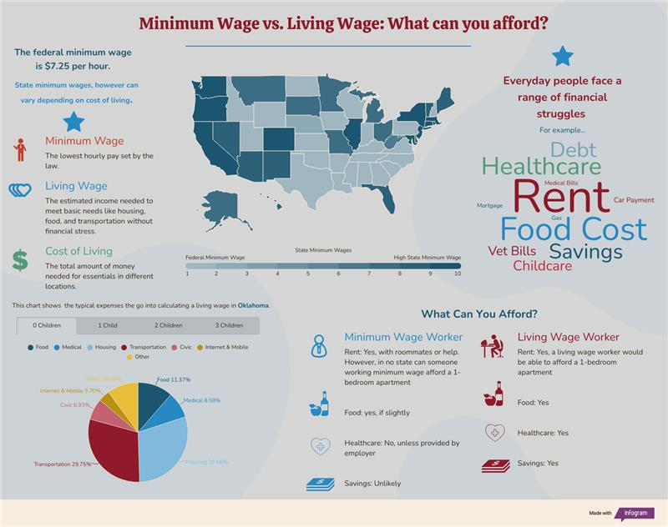
Notes:
https://infogram.com/1pp01eyrpqz6xmurd0qqqd2qq0az97dkvp0?live
Resources
Living wage calculator. Living Wage Calculator - Living Wage Calculation for Oklahoma. (n.d.). https://livingwage.mit.edu/states/40
Minimum wage by state 2025. Data Pandas. (n.d.). https://www.datapandas.org/ranking/minimum-wage-by-state
Open AI. (2025). ChatGPT (Mar 6 version). [Large language model]. ChatGPT. https://chat.openai.com/chat

Slide 8
Preflections
What type of jobs might you find in your local community?
What do you expect to learn about the cost of living in your community?
What relationship exists between hourly pay and living wage?
Notes:
K20 Center. (n.d.). Preflections. Strategies. https://learn.k20center.ou.edu/strategy/191

Slide 9
Living Wage Calculator
Navigate to: https://livingwage.mit.edu/states/40/locations
Look up your county.
Write the Minimum Wage and Living Wage of your county on your handout.
Example | Minimum Wage | Living Wage
Cleveland Country (1 Adult, 0 Children) | $7.25 | $21.30

Slide 10
Minimum Wage vs. Living Wage
Write a linear equation to represent each wage for a 40-hour work week.
Graph both wages based on a 40-hour work week on the graph provided.
Revisit your Preflection responses:
Underline things that you learned.
Add anything new you learned.

Slide 11
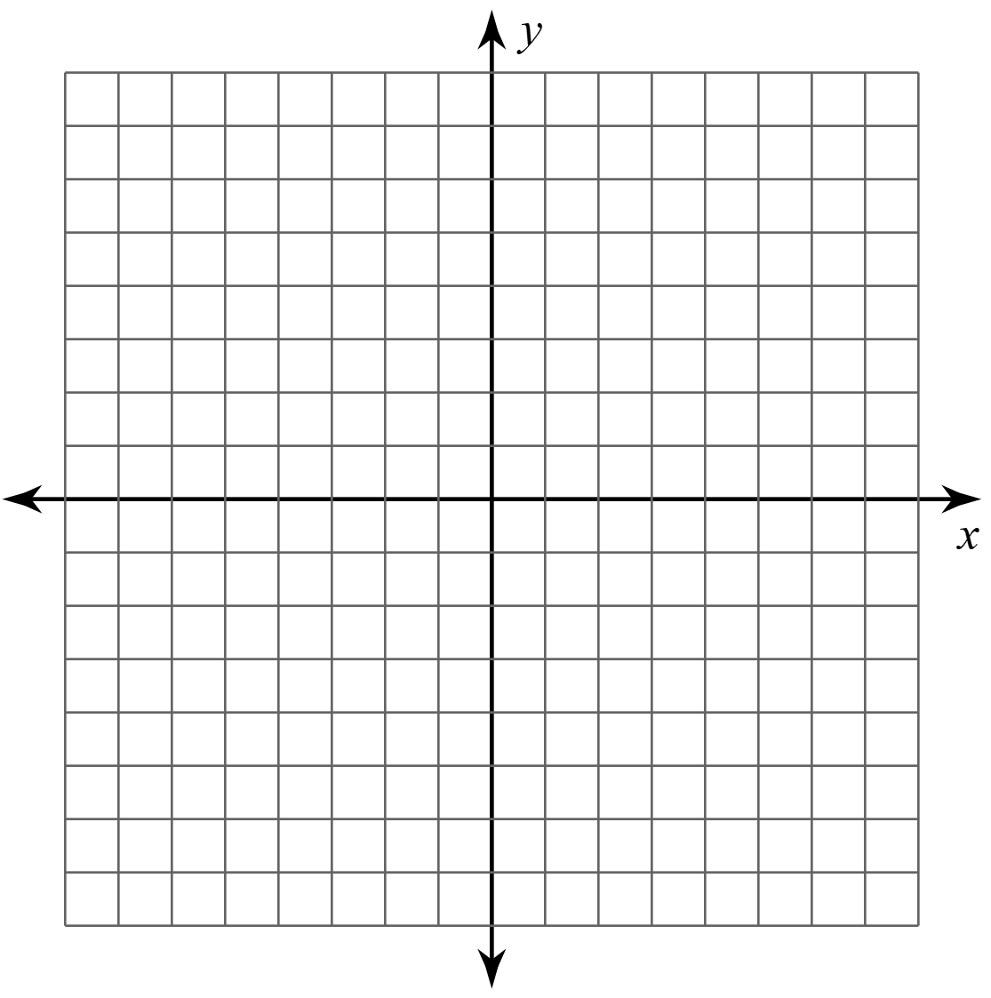
What did you Find?
County | # of Adults / # of Children | Linear Equation
Minimum Wage
Living Wage
What is the purpose of the slope?
What is the purpose of the y-intercept?

Slide 12
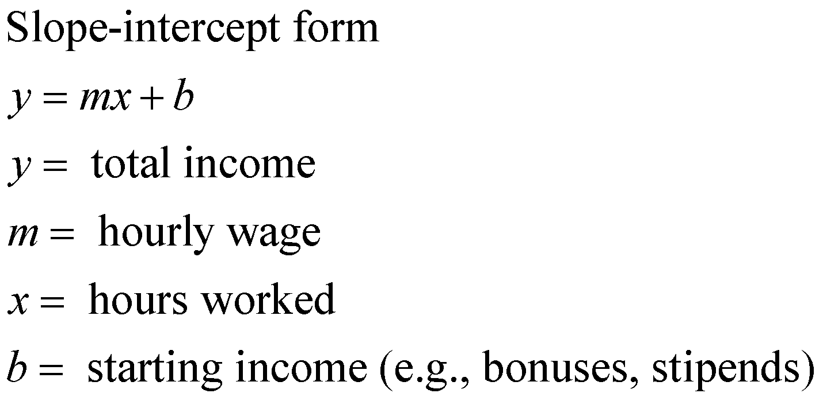
Linear Equations and Income

Slide 13
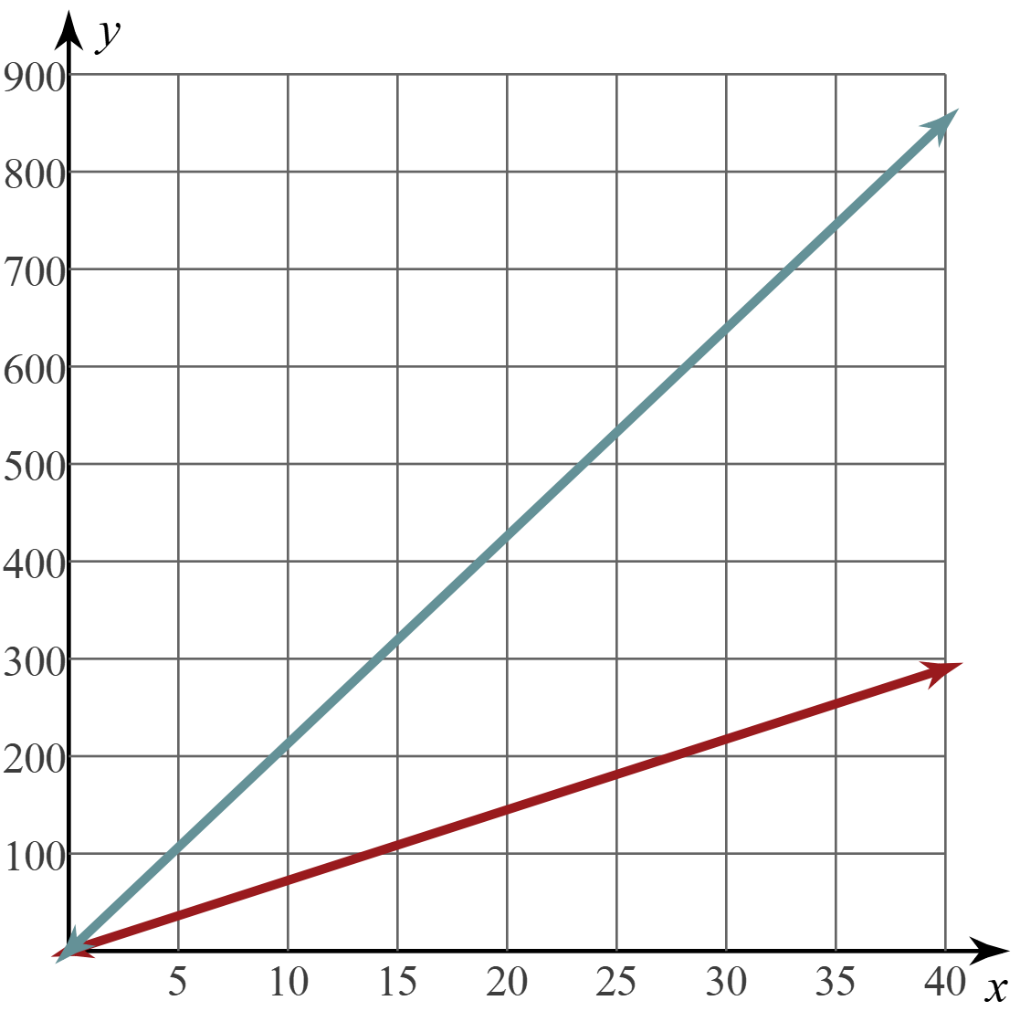
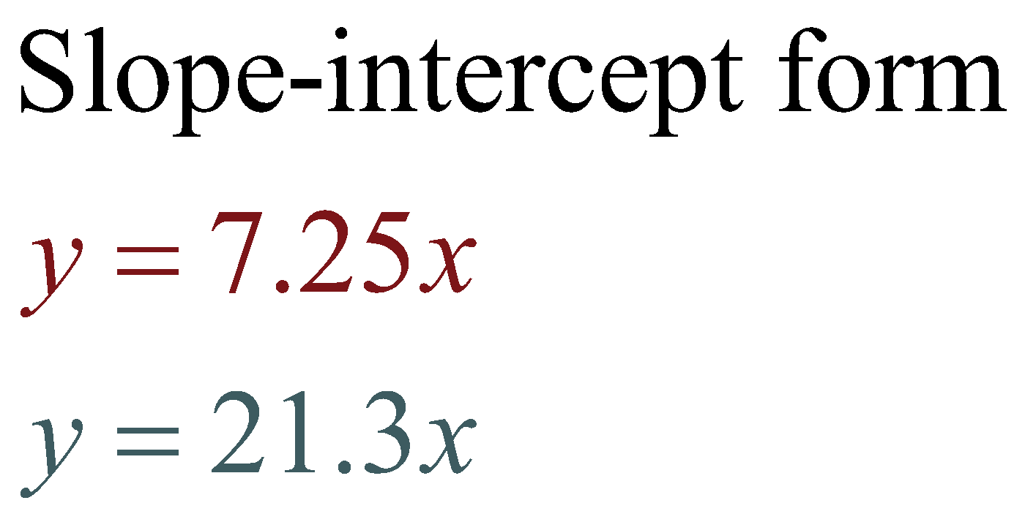
Algebraic vs. Graphical representation
Notes:
Example based on Cleveland Country. 1 adult, 0 Children

Slide 14
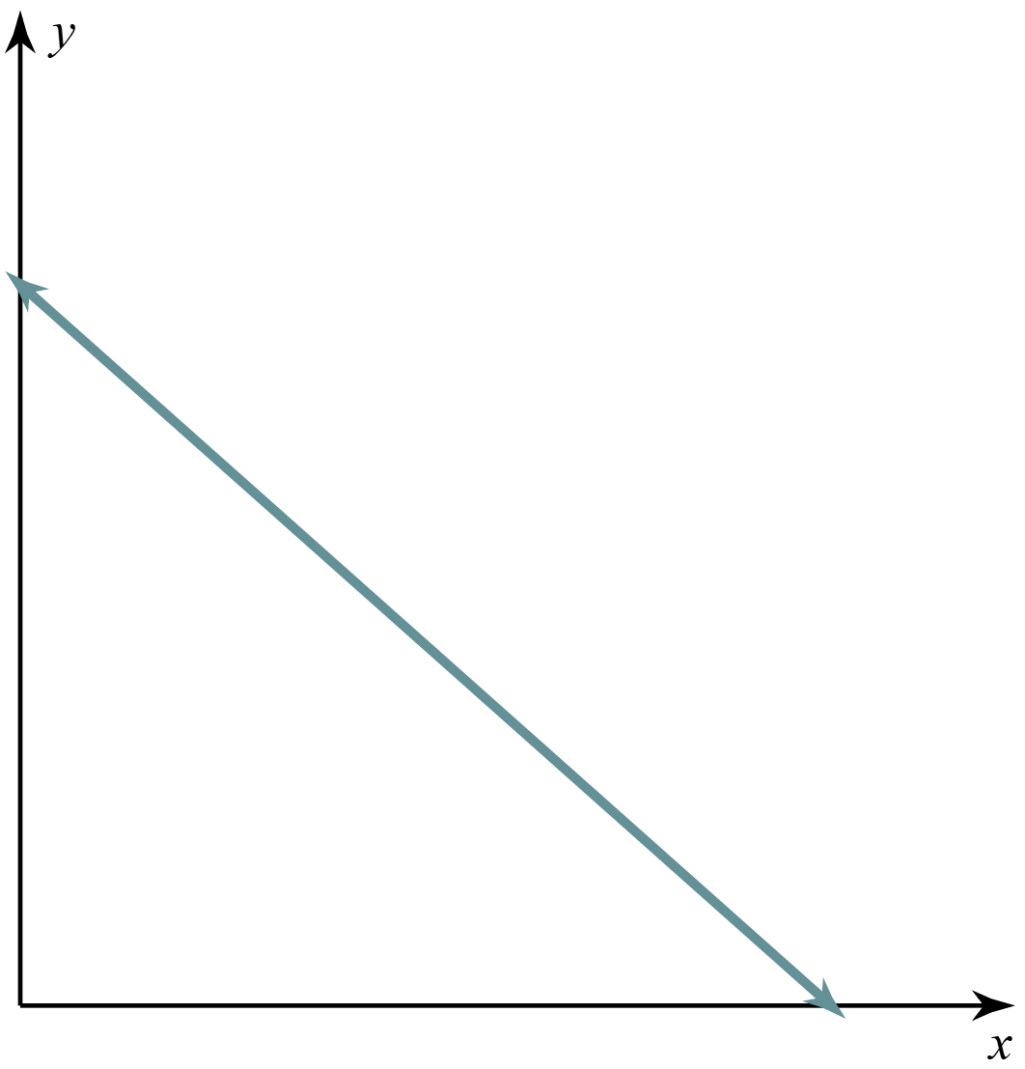
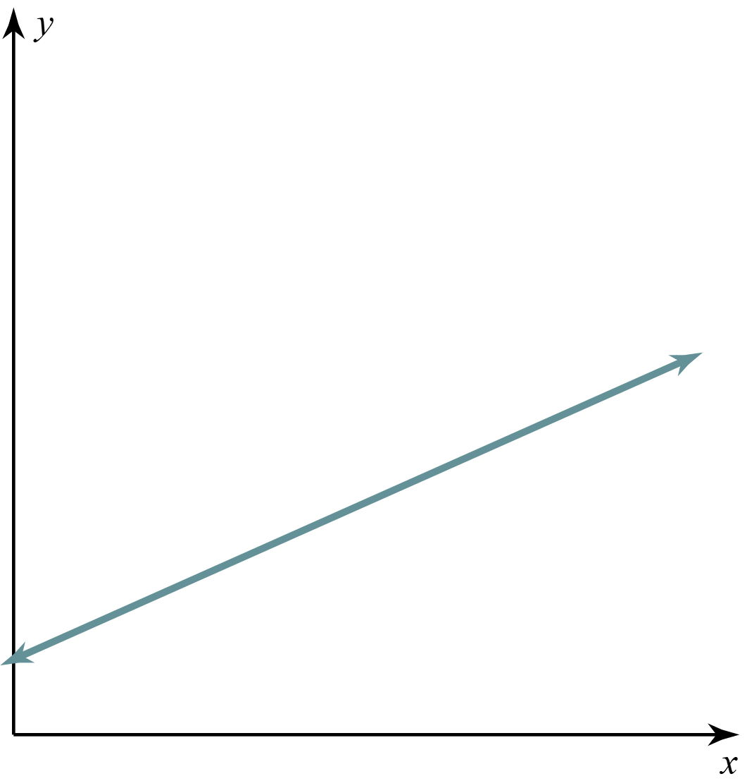
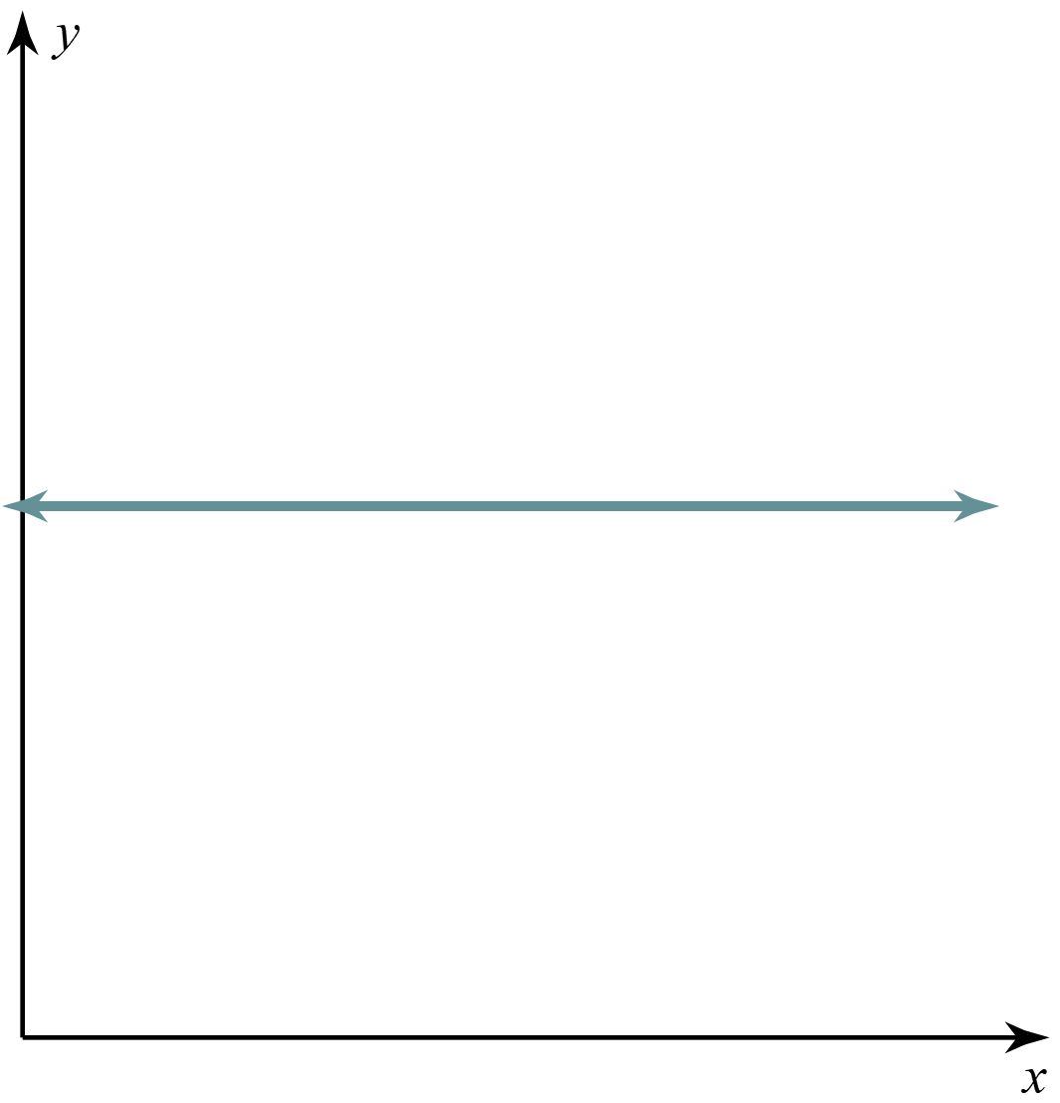
Interpreting graphs: Trend
Downwards value decreases over time/use | Upwards value increases over time/use | Remains the same value does not change over time/use

Slide 15
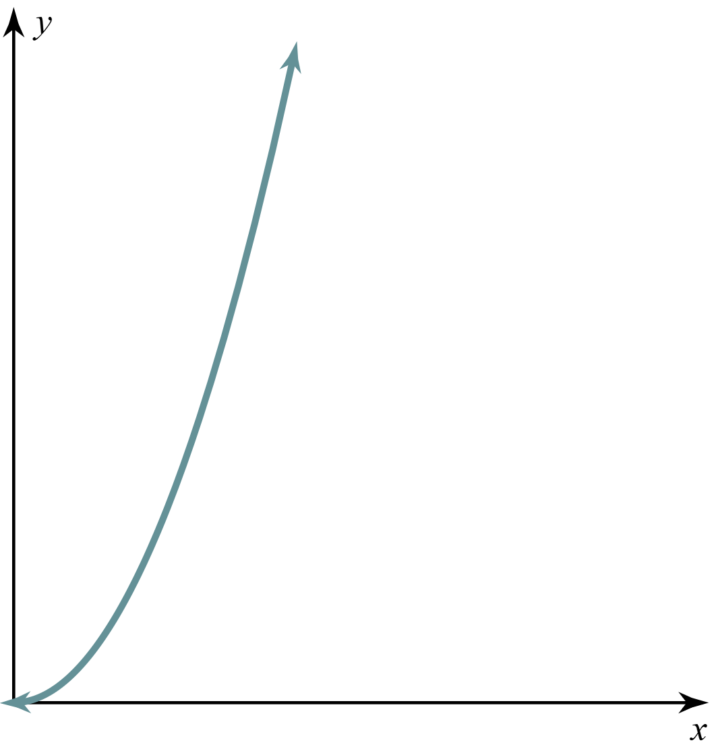
Interpreting graphs: Shape
Straight line Increasing: Simple interest Decreasing: Depreciation | Curved line Increasing: Compound interest Decreasing: Reducing loan balance | Flat line A bond or other savings with no fixed maturity date

Slide 16
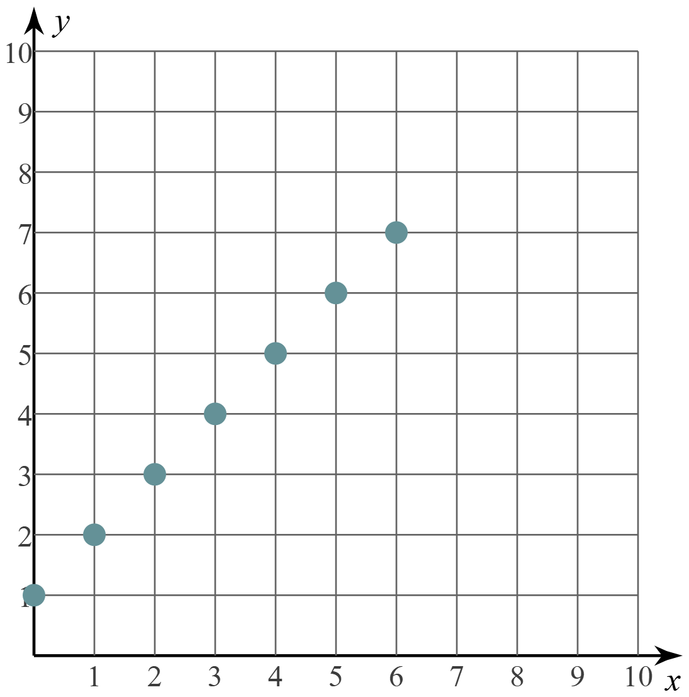
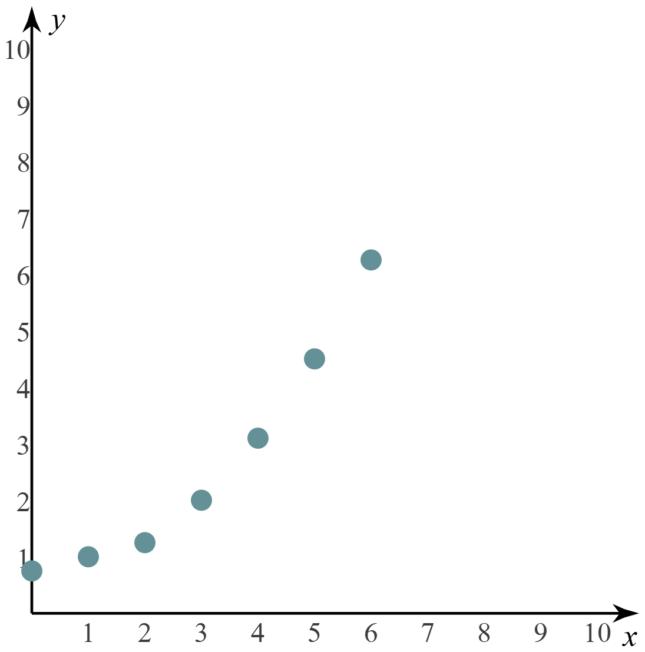
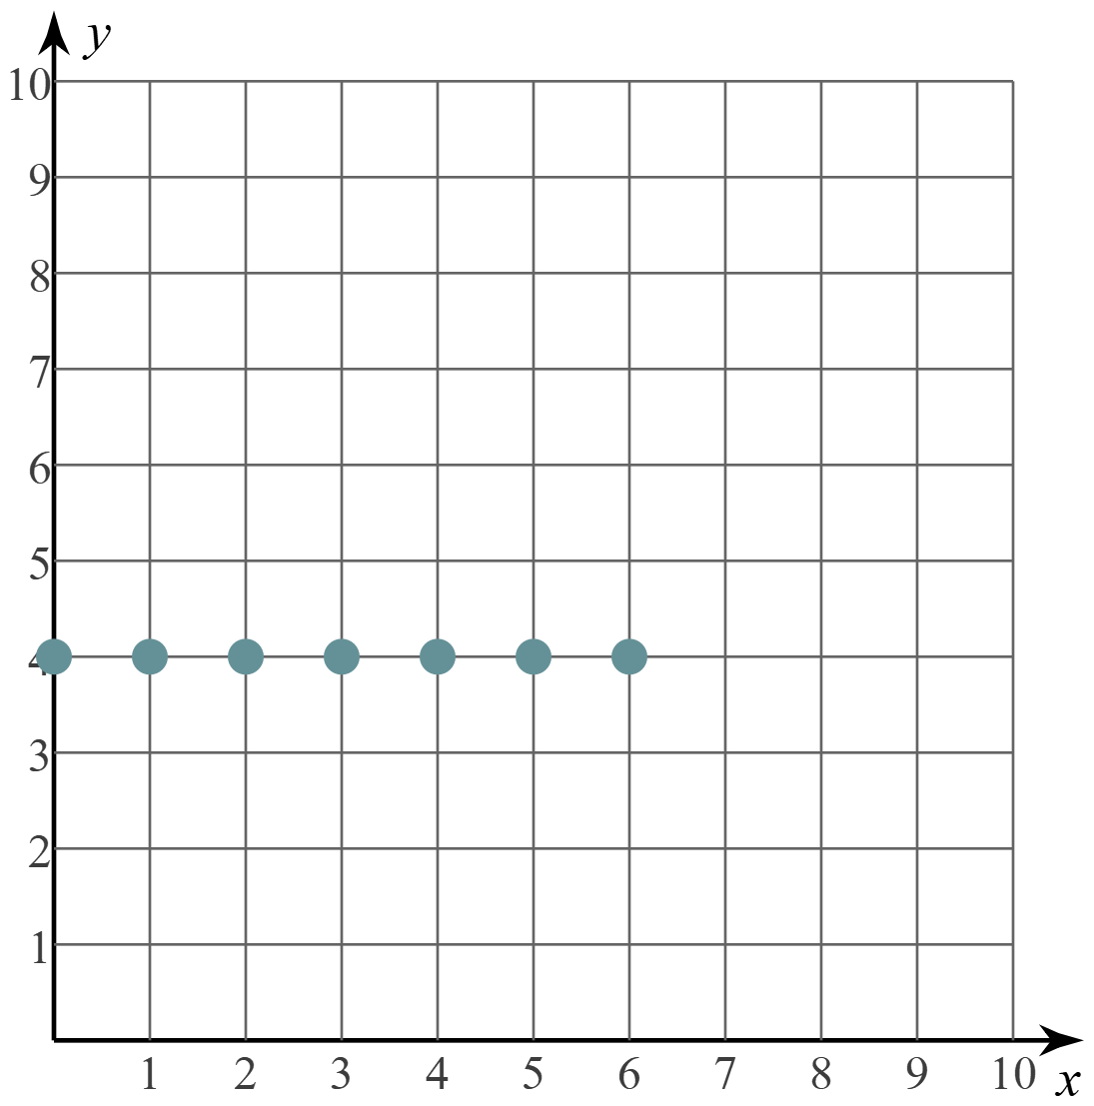
Interpreting graphs: Difference Between Terms
Common Difference The difference between the value of each successive term is the same | Common Ratio The multiplication ratio between the value of each successive term is the same | No Difference Each successive term is the same

Slide 17
Wants vs. Needs
Needs are essential expenses required for survival and basic well-being, while wants are non-essential expenses that improve quality of life.
Distinguishing between these is important for budgeting, prioritizing spending, and planning for future goals.
Wants | Needs
Rent/Mortgage
Utilities
Dining at restaurants
Transportation
Groceries
Media/Streaming
Designer Clothing
Vacation/Travel
Notes:
K20 Center. (n.d.). Card Sort. Strategies. https://learn.k20center.ou.edu/strategy/147

Slide 18
Gross vs. Net Income
What is Gross Income?
What is Net Income?
Total earning before any deductions.
Includes wages, bonuses, and overtime pay.
Example:
If you earn $12/hour and work 40 hours/week, your gross income is…
$12 x 40 = $480/week
Take-home pay after deductions
Taxes, Social Security, Health Insurance, Retirement, etc.
Typically, 15% or more of your paycheck goes to deductions.
Example:
$480/week x .85 = $408/week

Slide 19
Wakelet Jigsaw
Create a group of 3-4.
Each of you choose 1 column to become an “expert” on.
Summarize three sources from your column on the You Had me at Reflections handout.
After learning about your chosen topic, you will “teach” your group members about it.
Add notes to each column and summarize the Wakelet as a group.
Notes:
K20 Center. (n.d.). Jigsaw. Strategies. https://learn.k20center.ou.edu/strategy/179

Slide 20
Wakelet GramIt
Navigate to https://k20.ou.edu/mathurpath or scan the QR code.
Each group member choose 1 column to focus on.
Read/watch 2-3 texts.
Create a #hashtag for each source that summarizes it.
Notes:
K20 Center. (n.d.). GramIt. Strategies. https://learn.k20center.ou.edu/strategy/2554

Slide 21
Wakelet Jigsaw
Use your #hashtag_summaries to help you “teach” your group members about your column.
Take notes in your table based on what group members share.
As a group, summarize the wakelet on your reflection handout.
Notes:
K20 Center. (n.d.). Jigsaw. Strategies. https://learn.k20center.ou.edu/strategy/179

Slide 22
One-Pager
Complete the back of your You Had Me At Reflection handout.
Reflect on what you have learned so far.
Notes:
K20 Center. (n.d.). One-pager. Strategies. https://learn.k20center.ou.edu/strategy/72

Slide 23
What does it take to live comfortably in our community?

