Slide 2
Round and Round We Go
Relationship Between the Unit Circle and the Sine Curve

Slide 3
Essential Question
What can trigonometric functions tell us about real-world situations?

Slide 4
Lesson Objective
Explore the rotations of a Ferris wheel and make conjectures about the function represented by the motion.

Slide 5
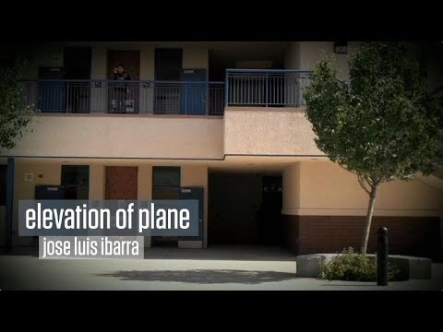
What Will the Graph Look Like?
Graph the elevation of the paper airplane.
Why do you feel your graph is correct? Use appropriate mathematical language.
Notes:
Buzzmath. “Graphing Stories - Elevation of Plane by Jose Luis Ibarra.” (2018, February 23). YouTube. https://www.youtube.com/watch?v=OXZAeXgq4t8

Slide 6
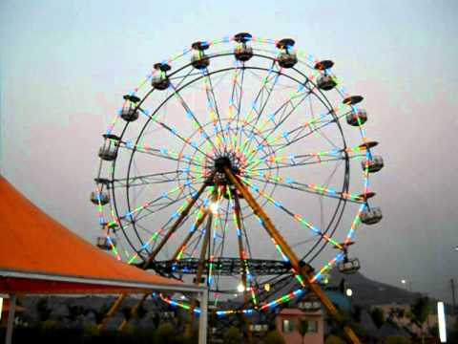
What Will the Graph Look Like?
What do you think this graph would like?
Share your answer with a partner.
As a pair, share your answer with the class.
Notes:
Mumbai. (2011, November 15). Ferris Wheel - The Giant Wheel Ride At Yazoo Park Virar. https://www.youtube.com/watch?v=plKIn1Qg3Mk

Slide 7
How Is Your Ferris Wheel Rotating?
Record the height of the rider at least three times per rotations for at least five rotations.
You should have 15 total data points.
Before collecting data, figure out a plan for how you will collect your data.
Once you have collected all your measurements, create a graph of your findings.

Slide 8
Gallery Walk
Place your graph on the wall.
Rotate clockwise to each graph.
With the sticky note, answer the following prompt:
What is one thing your graphs have in common?
What is one thing you have a question about?

Slide 9
Ferris Wheel Mathematics and Desmos
Go to the link: http://tinyurl.com/myferriswheel
Complete the steps on the Ferris Wheel Desmos Handout and answer the questions at the end.

Slide 10
Exit Ticket
Draw a picture that depicts how you are feeling about the material covered in class.
Write down one question or concern you have about moving forward.

