Slide 2
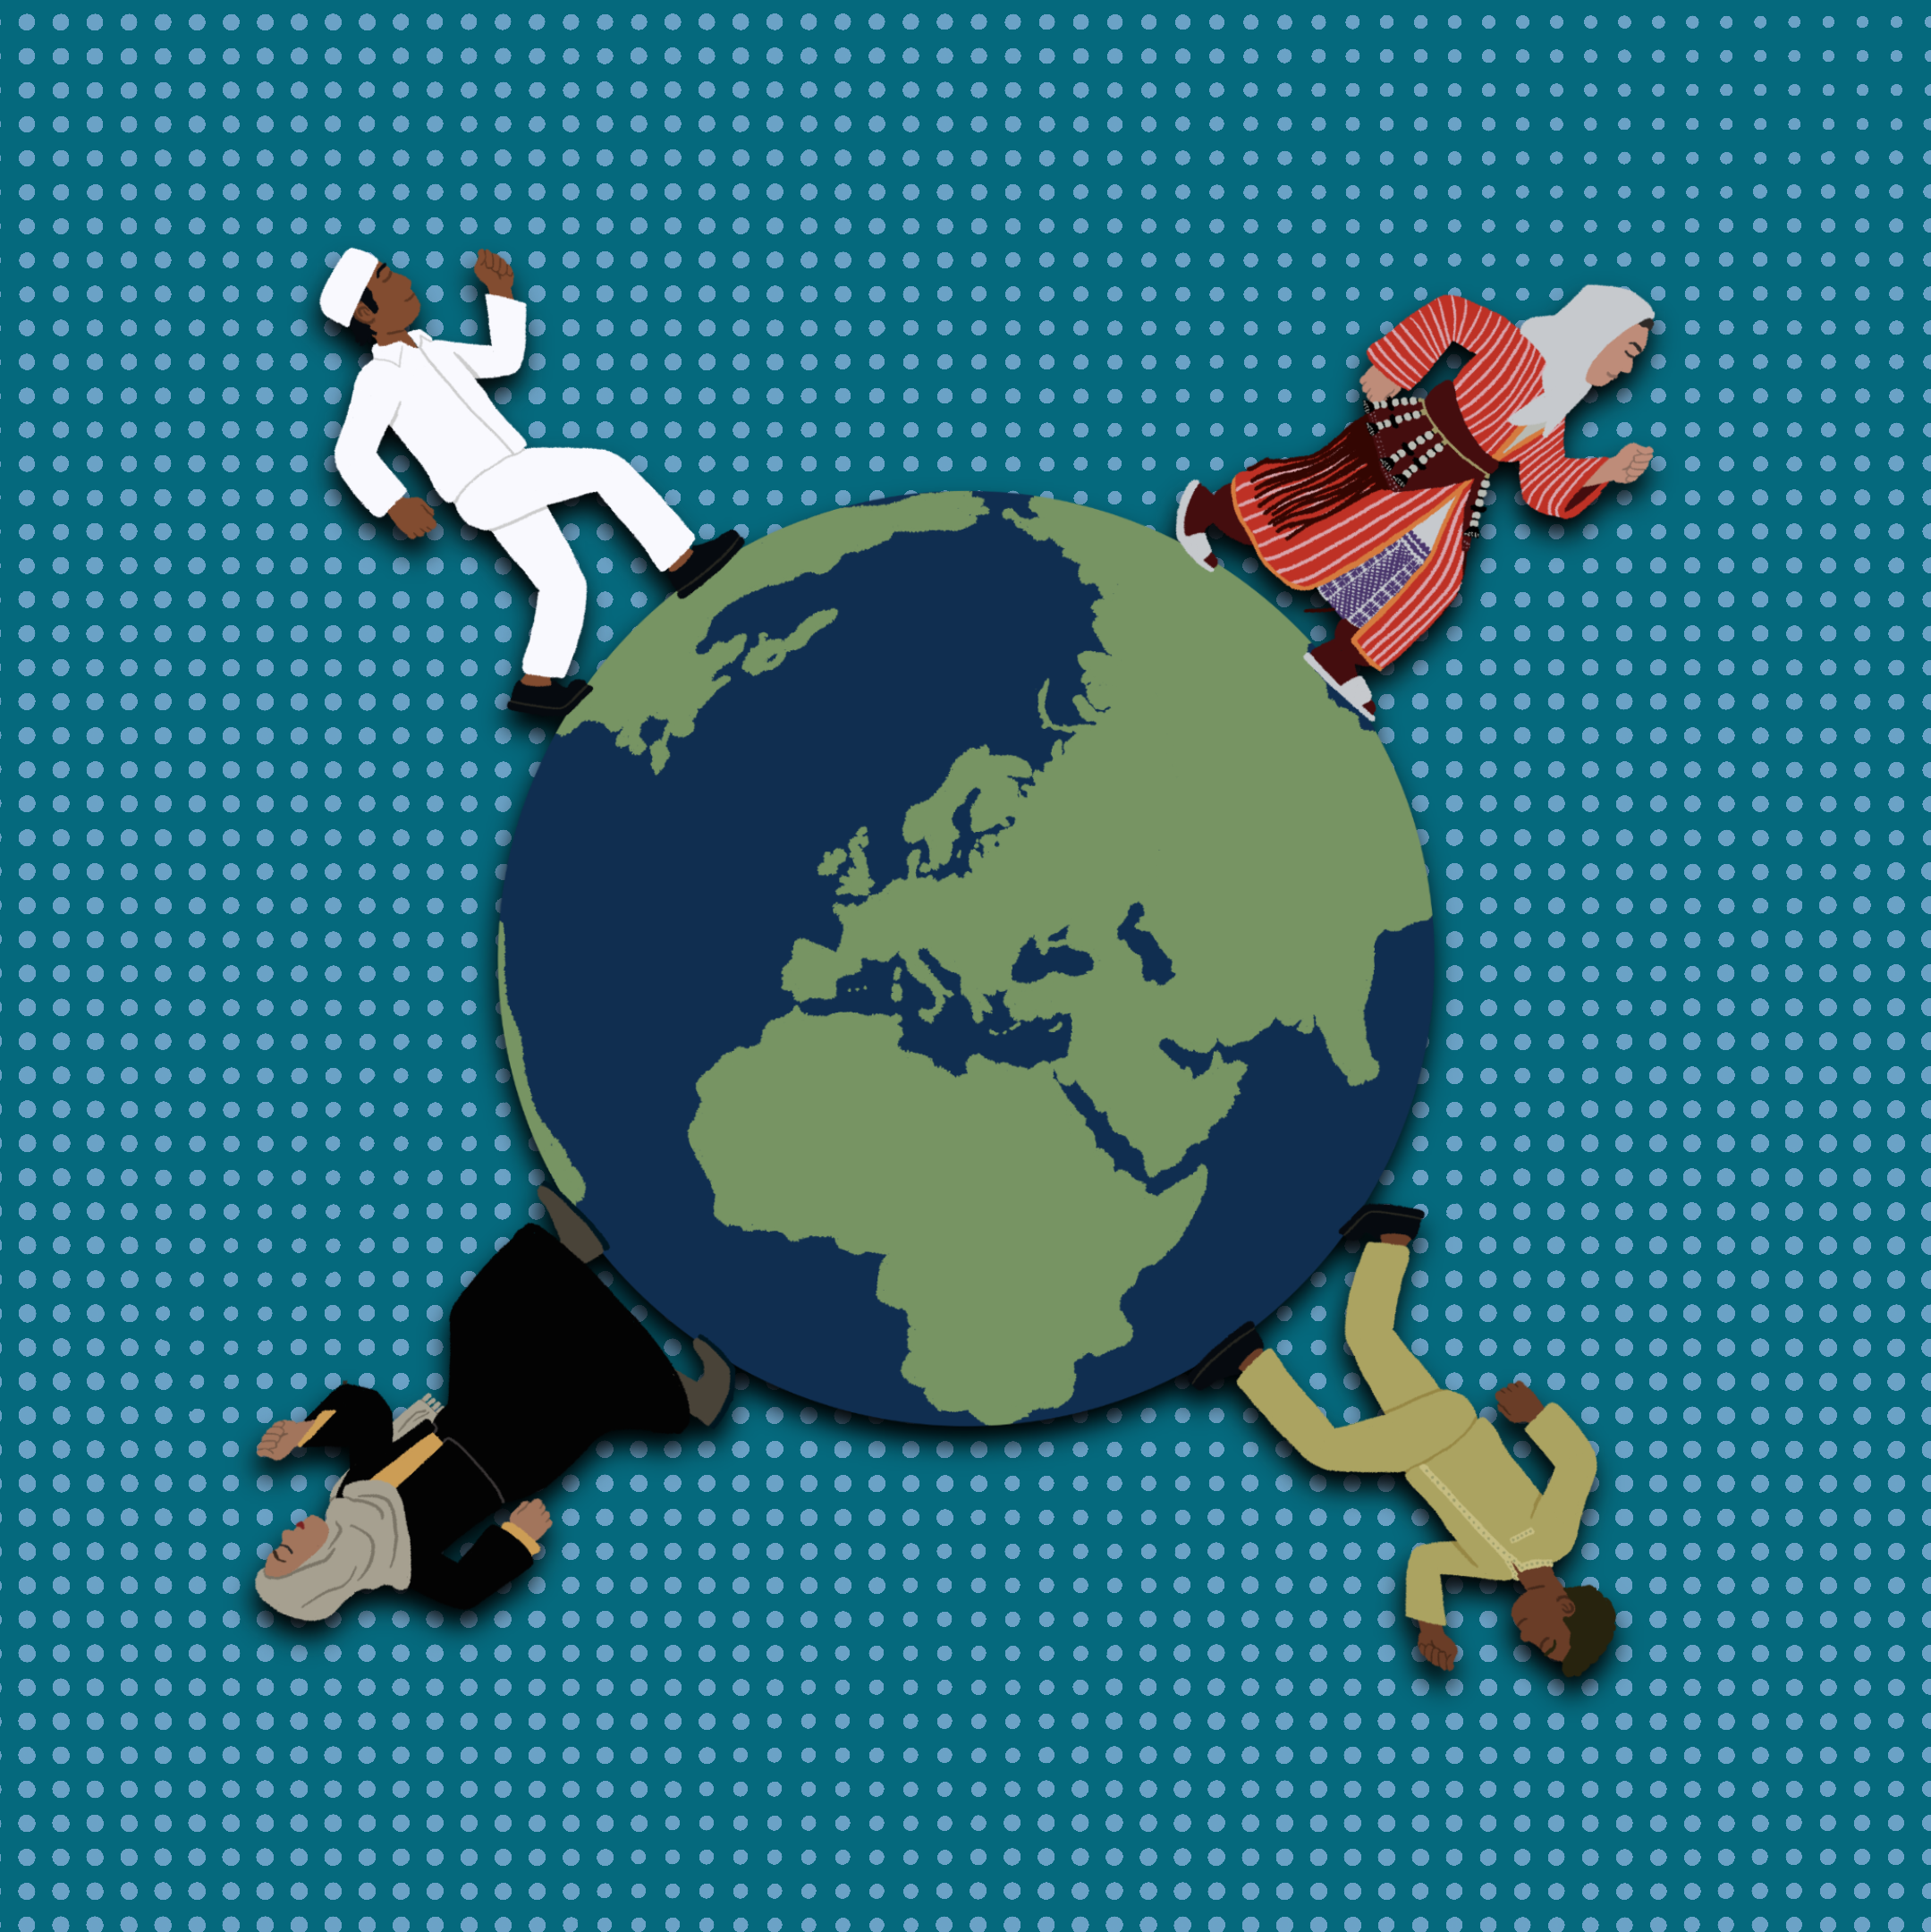
The Spread of Islam: A Four-Way Comparison
Major Religions

Slide 3

Fiction in the Facts
Islam is the fastest growing religion of the three major Abrahamic faiths.
Most Muslims live in Europe.
More than 1 billion people practice Islam worldwide.
Notes:
K20 Center. (n.d.). Fiction in the facts. Strategies. https://learn.k20center.ou.edu/strategy/60

Slide 4
Fiction in the Facts
Islam is the fastest growing religion of the three major Abrahamic faiths.
Most Muslims live in Europe.
More than 1 billion people practice Islam worldwide.
Notes:
K20 Center. (n.d.). Fiction in the facts. Strategies. https://learn.k20center.ou.edu/strategy/60

Slide 5
Essential Question
How did the spread of Islam influence cultural development?

Slide 6
Learning Objective
Analyze the influence of Islam on the cultural development in various parts of the world.

Slide 7
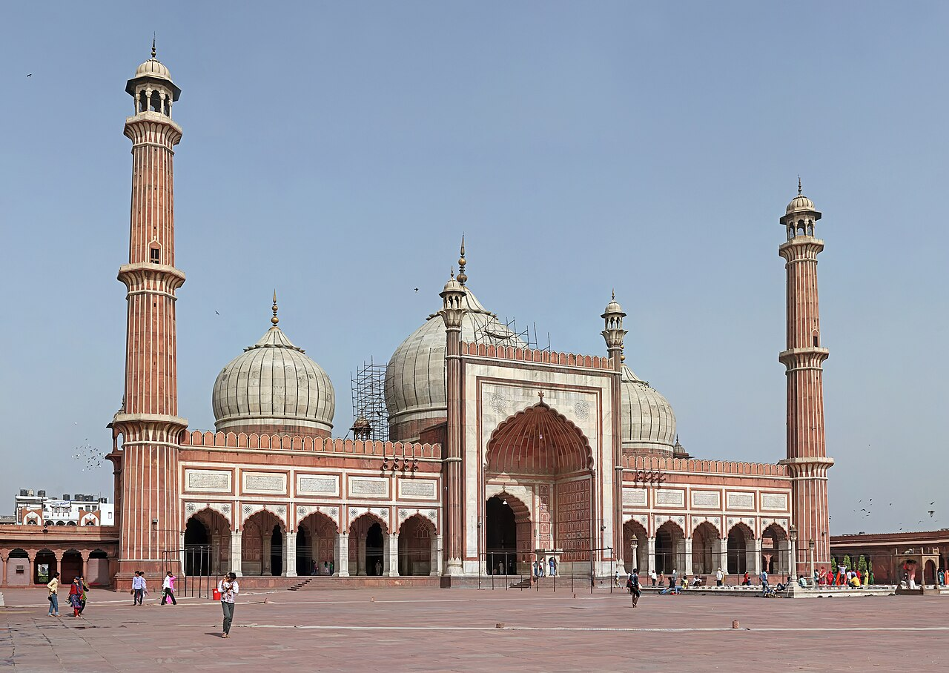
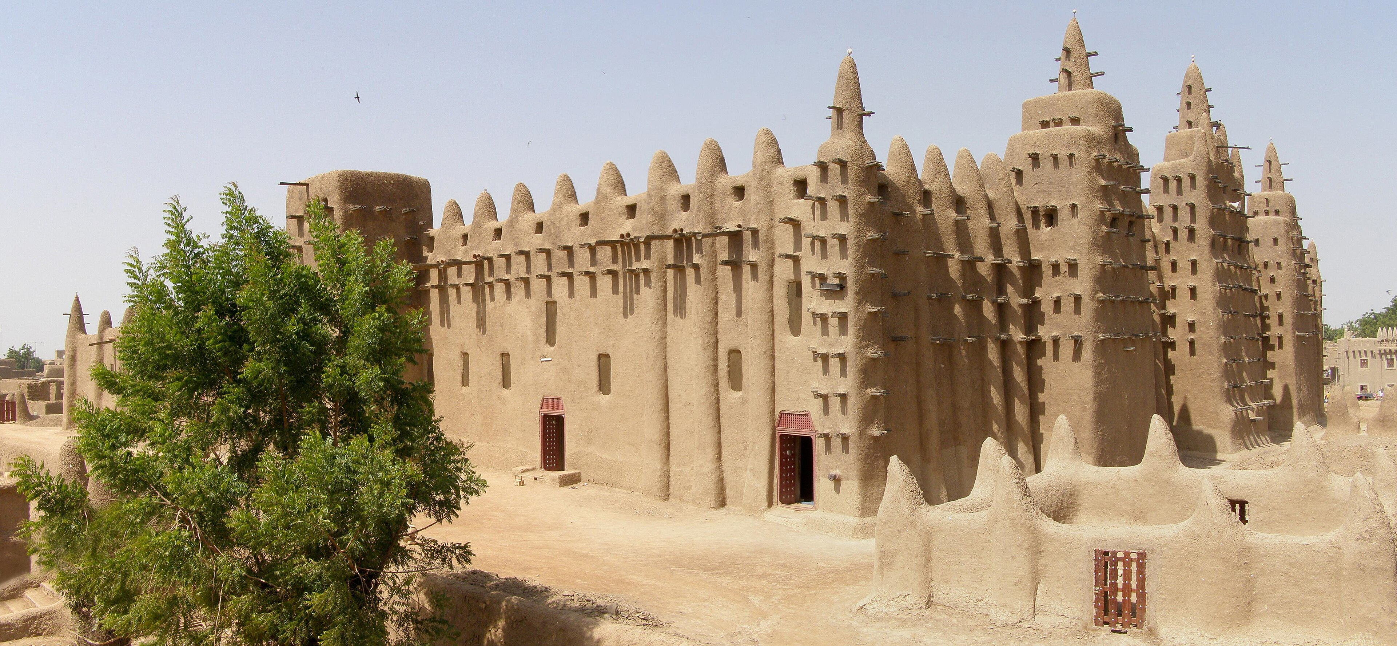
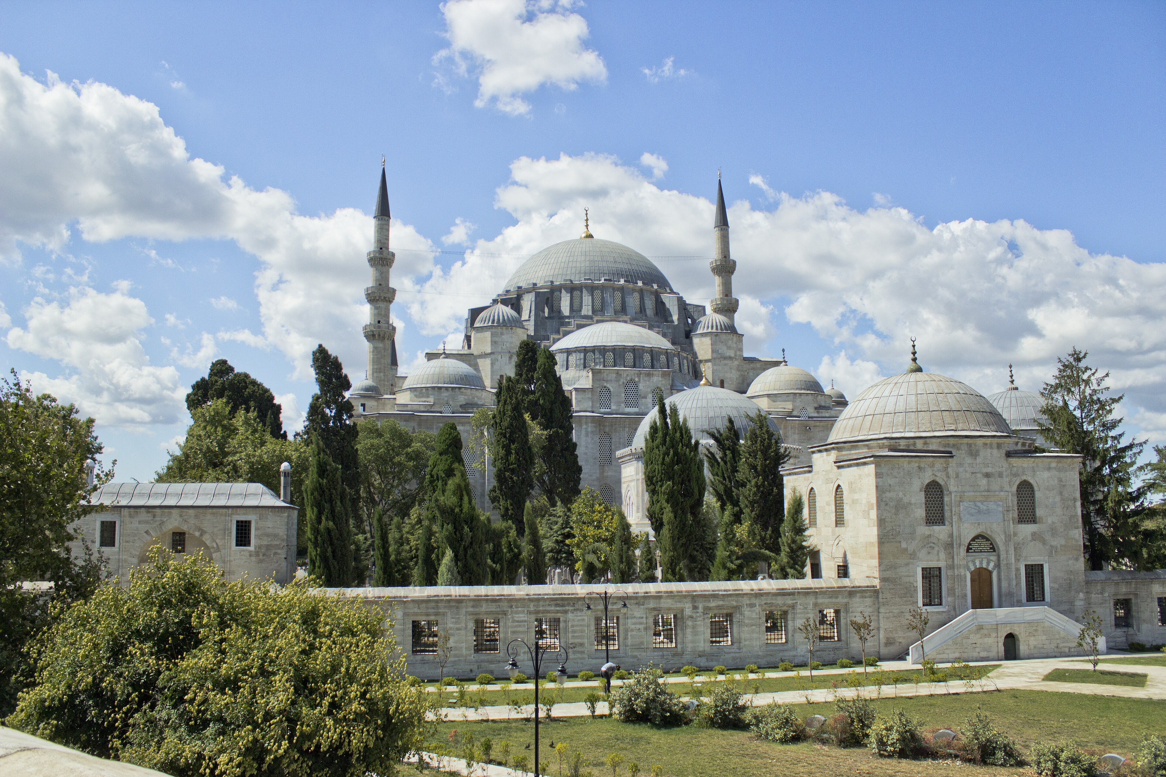
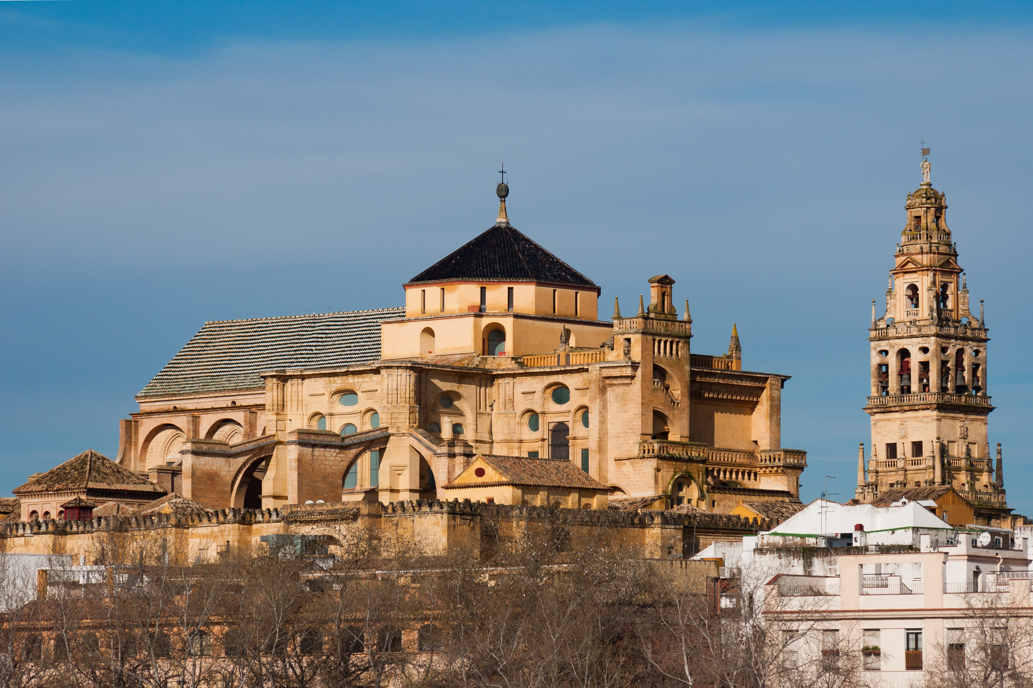
Notes:
Karim, M. M. (2012). Jama Masjid, Delhi [Photograph]. Wikimedia Commons. https://commons.wikimedia.org/wiki/File:Jama_Masjid,_Delhi.jpg
BluesyPete. (2007, November 26). Great Mosque of Djenné, Mali [Photograph]. Wikimedia Commons.https://commons.wikimedia.org/wiki/File:MaliDjenn%C3%A9Mosqu%C3%A9e.JPG
Kılıçoğlu, İ. D. (2013, July 22). Süleymaniye Mosque exterior view [Photograph]. Wikimedia Commons. https://commons.wikimedia.org/wiki/File:S%C3%BCleymaniye_Mosque_exterior_view.JPG
Aranas, U. (2010, February 19). Córdoba, Spain: View of the Mosque of Cordoba (La Mezquita-Catedral de Córdoba) [Photograph]. Wikimedia Commons. https://commons.wikimedia.org/wiki/File:C%C3%B3rdoba_Spain_View-of-the-Mosque-of-Cordoba-01.jpg

Slide 8
The Spread of Islam
How did Islam spread to this region?
What factors influenced these people to convert to Islam?
Before Islam, what was the predominant religion? After Islam, what was dominant?
To what extent do we see any blending/syncretism of Islam with existing beliefs?
What impact does this religion have in this region today?
Notes:
K20 Center. (n.d.). Jigsaw. Strategies. https://learn.k20center.ou.edu/strategy/179

Slide 9

The Spread of Islam
Share your notes with the members of your group.
Notes:
K20 Center. (n.d.). Jigsaw. Strategies. https://learn.k20center.ou.edu/strategy/179

Slide 10

The Spread of Islam Connections
Examine each hexagon.
Connect the hexagons so that related terms are touching one another.
Notes:
K20 Center. (n.d.). Honeycomb harvest. Strategies. https://learn.k20center.ou.edu/strategy/61

Slide 11
The Spread of Islam
How did the spread of Islam influence cultural development?

