Slide 2
Trading Rights and Sovereignty
The Commerce Clause and U.S. Tribal Relations

Slide 3
Essential Question
How did the Commerce Clause impact the relationship between the U.S. government and Tribal Nations?

Slide 4
Lesson Objectives
Identify and describe the effects of the Commerce Clause.
Explain the changes tribal nations endured as a result of the Commerce Clause.
Consider how the relationship between tribal governments and the U.S. government has evolved over time.

Slide 5

T.A.C.O.S.
Use the T.A.C.O.S. strategy to analyze the political cartoon.
Identify the following:
  T: Time and place
  A: Action
  C: Caption
  O: Objects
  S: Summary
Notes:
K20 Center. (n.d.). T.A.C.O.S. Strategies. https://learn.k20center.ou.edu/strategy/1196

Slide 6
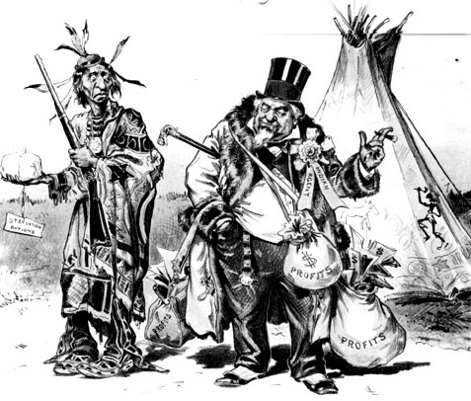
Notes:
The reason of the Indian outbreak [Image]. (1890). Library of Congress Prints and Photographs Division. https://digital.newberry.org/scalar/indians-midwest/media/political-cartoon-1890

Slide 7

KWHL Chart
Find a partner.
Consider your knowledge of the U.S. Constitution and Tribal Nations.
  Complete the “K” section with what you know about the topic.
  Complete the “W” section with what you want to know about the topic.
  Complete the “H” section with how you plan to find the information to answer your questions from the “W” section.
Notes:
K20 Center. (n.d.). KWHL graphic organizer. Strategies. https://learn.k20center.ou.edu/strategy/127

Slide 8
KWHL Chart
Open each of the following Wakelets:
  k20.ou.edu/2v
  k20.ou.edu/2u
Explore the resources in each Wakelet.
Record what you learn about the history of the relationship between the U.S. government and Tribal Nations in the “L” section of your handout.
Notes:
K20 Center. (n.d.). KWHL graphic organizer. Strategies. https://learn.k20center.ou.edu/strategy/127
K20 Center. (n.d.). Wakelet. Tech Tools. https://learn.k20center.ou.edu/tech-tool/2180

Slide 9
KWHL: Learned
Notes:
K20 Center. (n.d.). KWHL graphic organizer. Strategies. https://learn.k20center.ou.edu/strategy/127
K20 Center. (n.d.). Wakelet. Tech Tools. https://learn.k20center.ou.edu/tech-tool/2180

Slide 10

Why-Lighting
As you read, highlight information that will help you answer the questions on the next slide.
Next to each piece of information you highlight, add a note about why you chose to highlight it.
Notes:
K20 Center. (n.d.). Why-Lighting. Strategies. https://learn.k20center.ou.edu/strategy/128

Slide 11
Why-Lighting
Questions:
How was the Commerce Clause used to expand the powers of the federal government?
What was the impact of the Commerce Clause on Native American tribes?
Why do you think the United States continued to use the Commerce Clause to expand federal power and impact Native American tribes?
Notes:
K20 Center. (n.d.). Why-Lighting. Strategies. https://learn.k20center.ou.edu/strategy/128

Slide 12
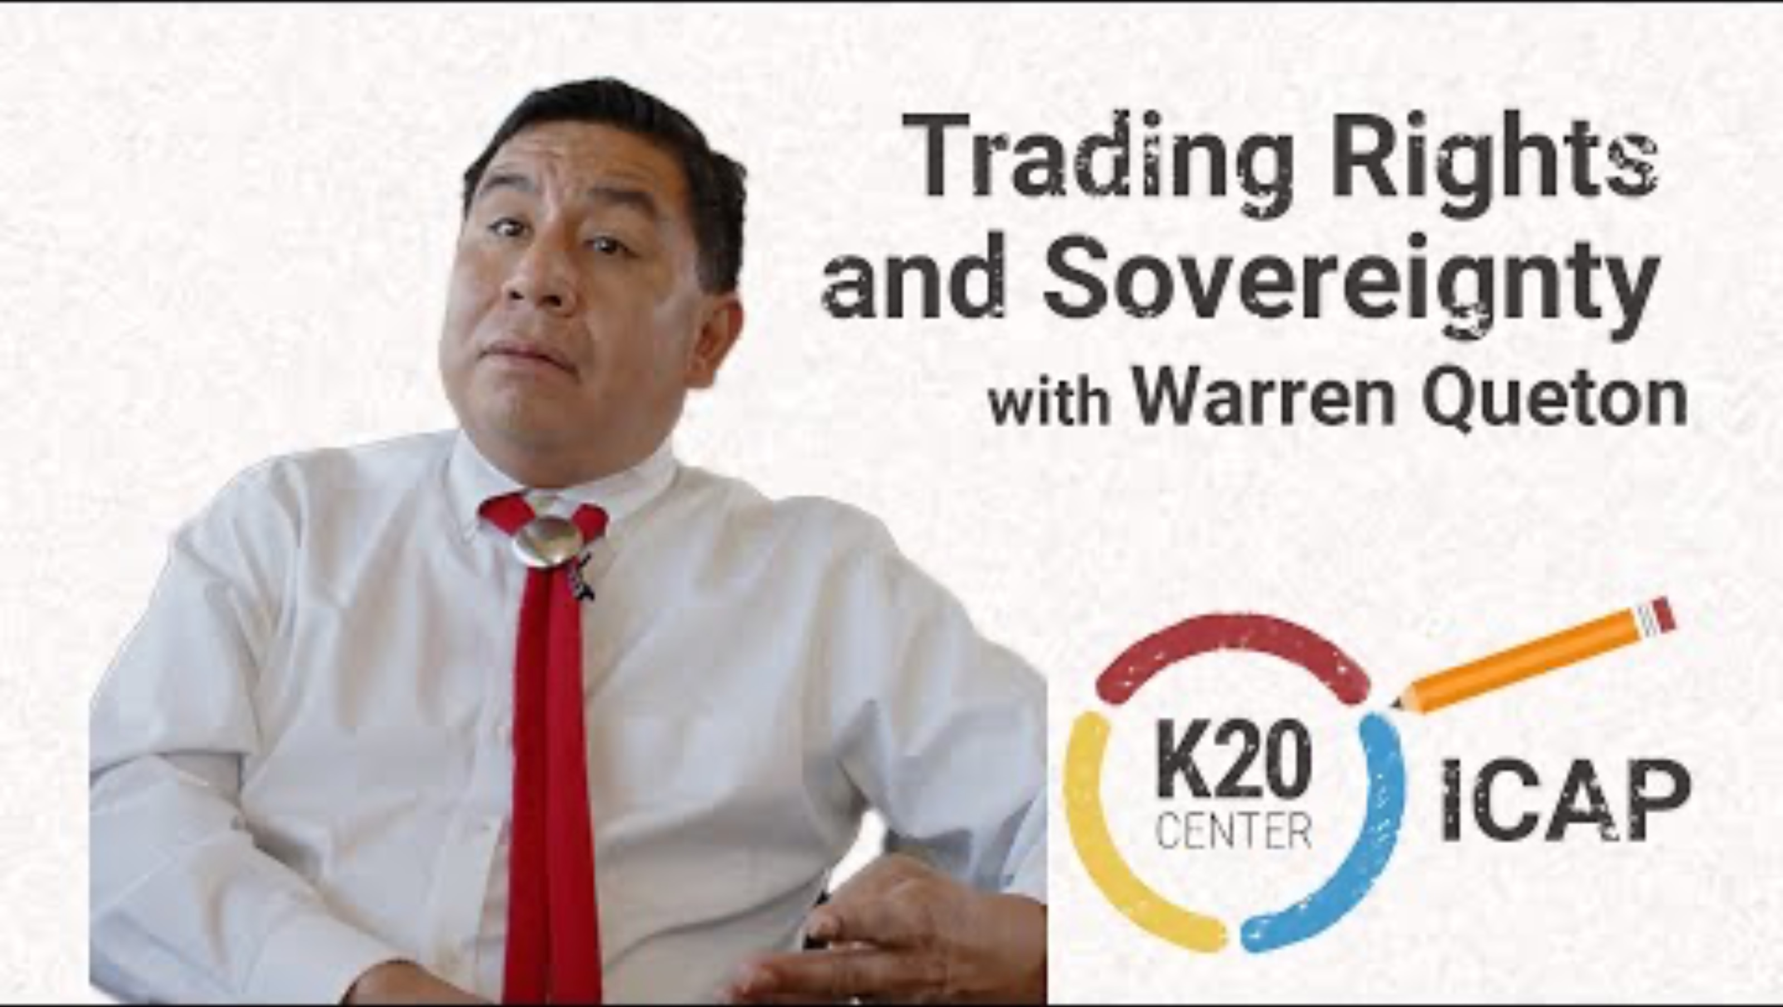
ICAP Video
Notes:
K20 Center. (2025, April 21). Trading rights and sovereignty [Video]. YouTube. https://www.youtube.com/watch?v=FTIJ2SinkYE

Slide 13
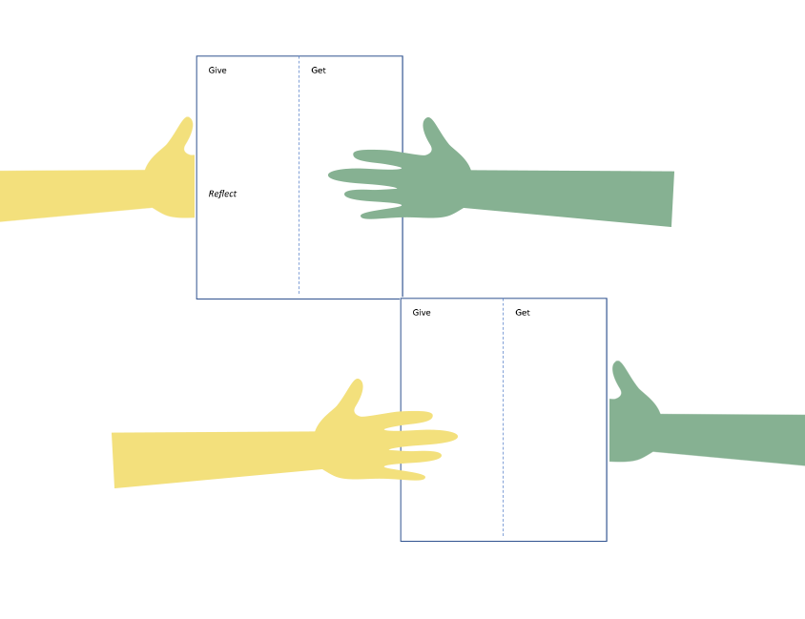
Give, Get, Reflect
Respond to the question below in the Give section:
  What did you learn about public service careers after watching the interview?
Notes:
K20 Center. (n.d.). Give, get, reflect. Strategies. https://learn.k20center.ou.edu/strategy/2184

Slide 14
Give, Get, Reflect
Share your “Give” with a partner.
Record any information you learn from your partner in the Get section.
Find another partner and repeat the process.
After you share with three partners, Reflect on what you learned.
Notes:
K20 Center. (n.d.). Give, get, reflect. Strategies. https://learn.k20center.ou.edu/strategy/2184

Slide 15
Give, Get, Reflect
Would you be interested in a public service career?
What kinds of skills or experience do you need to work in public service?
Why are public service jobs important?
Notes:
K20 Center. (n.d.). Give, get, reflect. Strategies. https://learn.k20center.ou.edu/strategy/2184

Slide 16

Friends Without Pens
Discuss the questions below without writing anything.
  Why is the Commerce Clause such an important part of the U.S. Constitution?
  How did the Commerce Clause impact the relationship between the U.S. government and Tribal Nations?
  In what ways did enforcing the Commerce Clause ultimately affect both the United States and Tribal Nations?
Notes:
K20 Center. (n.d.). Friends without pens. Strategies. https://learn.k20center.ou.edu/strategy/4438

Slide 17
Pens Without Friends
Write a response to the questions below without talking to anyone.
  Why is the Commerce Clause such an important part of the U.S. Constitution?
  How did the Commerce Clause impact the relationship between the U.S. government and Tribal Nations.
  In what ways did enforcing the Commerce Clause ultimately affect both the United States and Tribal Nations?
Notes:
K20 Center. (n.d.). Friends without pens. Strategies. https://learn.k20center.ou.edu/strategy/4438

