Slide 2
The Poetry Playlist
Analyzing Lyrics Like Literature

Slide 3
Essential Question
In what ways do song lyrics exhibit poetic qualities, and can they be considered a form of poetry?

Slide 4
Lesson Objectives
Identify and analyze poetic elements in song lyrics, including imagery, figurative language, structure, and sound devices.
Compare and contrast the literary qualities of poetry and song lyrics across different genres.
Construct and defend an argument on whether a selected song should be considered poetry.

Slide 5
Walking Vote
Do not go gentle into that good night, rage, rage against the dying of the light
Poem
Song
Poem
Notes:
Poem: “Do not go gentle into that good night” by Thomas Dylan (1952)
Thomas, D. (1952). Do not go gentle into that good night. In D. Thomas, In country sleep, and other poems. New Directions.

Slide 6
Walking Vote
And the sun poured in like butterscotch and stuck to all my senses
Song
Poem
Song
Notes:
Song: “Chelsea Morning” by Joni Mitchell (1969)
Mitchell, J. (1969). Chelsea morning [Song]. On Clouds [Album]. Reprise Records.

Slide 7
Walking Vote
I seen a rainbow yesterday, but too many storms have come and gone
Song
Poem
Song
Notes:
Song: “Waterfalls” by TLC (1994)
Mitchell, J. (1969). Chelsea morning [Song]. On Clouds [Album]. Reprise Records.

Slide 8
Walking Vote
I have measured out my life with coffee spoons
Poem
Song
Poem
Notes:
Poem: “The Love Song of J. Alfred Prufrock” by T.S. Eliot (1915)
Eliot, T. S. (1915). The love song of J. Alfred Prufrock. Poetry, 6(3), 130–135.

Slide 9
Walking Vote
And when we meet, which I’m sure we will, all that was there will be there still
Song
Poem
Song
Notes:
Song: “Long & Lost” by Florence + The Machine (2015)
Florence + The Machine. (2015). Long & lost [Song]. On How big, how blue, how beautiful [Album]. Republic Records.

Slide 10
Walking Vote
There’s a bluebird in my heart that wants to get out, but I’m too tough for him
Poem
Song
Poem
Notes:
Poem: “Bluebird” by Charles Bukowski (1992)
Bukowski, C. (1992). Bluebird. In C. Bukowski, The last night of the earth poems. Black Sparrow Press.

Slide 11
Card Sort
Sort the cards into two groups
Poetic
Not Poetic
As you sort, discuss these questions with your group:
What qualities make lyrics feel more like poetry?
Are there specific elements—imagery, metaphor, rhythm, structure—that distinguish poetic lyrics?
Were there any lyrics that were difficult to categorize? Why?

Slide 12
Categorical Highlighting
Group 1: Imagery and Symbols – Highlight words or phrases that create vivid pictures or represent deeper meanings.
Group 2: Figurative Language – Highlight metaphors, similes, personification, etc.
Group 3: Sound Devices – Highlight examples of rhyme, repetition, alliteration, or rhythm.
Group 4: Structure and Line Breaks – Highlight areas where the song’s formatting (i.e., line breaks, stanza structure, or pauses) affects meaning.
Group 5: Tone and Mood – Highlight words that establish the song’s emotional effect or overall attitude.
Group 6: Theme and Message – Highlight key lines that suggest the song’s deeper meaning, lesson, or central idea.

Slide 13
Jigsaw
Share with your new group some of the lines you highlighted that were excellent examples of your assigned poetic element.
Discuss the following questions:
How do poetic elements interact in the song?
Which poetic elements make the lyrics feel poetic versus not-so-poetic?
Notes:
To control the pace of the conversations, use the K20 Timers playlist and decide how much time each student and group will have to discuss.

Slide 14
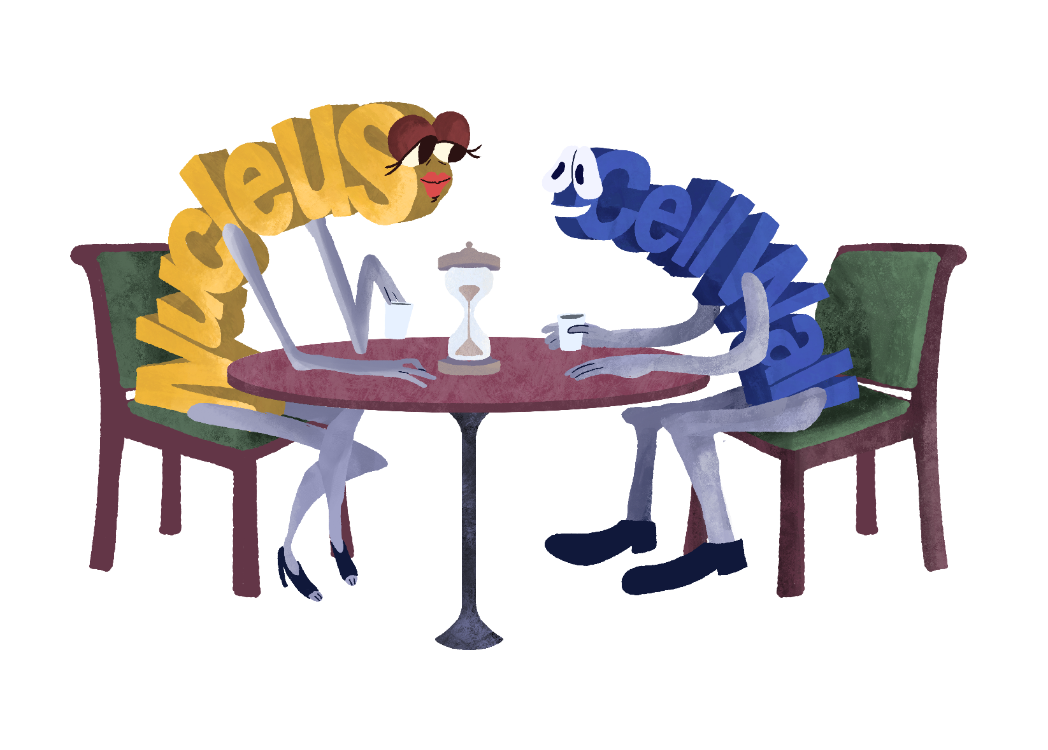
Concept Speed Dating
Read your song excerpt and complete your “Dating Profile.”
While dating other genres, discuss the poetic elements you identified on your profile and complete the Note Catcher to determine compatibility between genres.
Notes:
K20 Center. (2021, September 21). K20 Center 30 second timer. [Video]. YouTube. https://www.youtube.com/watch?v=o9ViOMe_Wnk&list=PL-aUhEQeaZXLMF3fItNDxiuSkEr0pq0c2&index=1

Slide 15
Concept Speed Dating
Which genres were the most compatible?
Which two genres felt the most poetic?
Did one genre rely more on storytelling versus poetic elements?
How did musical style influence whether the lyrics felt poetic?

Slide 16
30 Second (3-Minute) Spotlight
Your 3-minute presentation should include:
Why you chose your specific song
At least three poetic elements you identified in the lyrics
A justification of whether this song should be considered poetry
Notes:
K20 Center. (2021, September 21). K20 Center 3 minute timer. [Video]. YouTube. https://www.youtube.com/watch?v=iISP02KPau0&list=PL-aUhEQeaZXLMF3fItNDxiuSkEr0pq0c2&index=5

