Slide 2
ABC Graffiti
As a group, write a word or phrase for every letter on the poster.
When the timer goes off, rotate to the next poster.
Take your marker with you as you move.
Notes:
K20 Center. (n.d.). ABC graffiti. Strategies. https://learn.k20center.ou.edu/strategy/96

Slide 3
ABC Graffiti | Round 1
Write a word or phrase for every letter answering the prompt below:
What can we learn from bugs?
K20 3 Minute Timer
Notes:
K20 Center. (n.d.). ABC graffiti. Strategies. https://learn.k20center.ou.edu/strategy/96
K20 Center. (2021, Sept. 21). 3 Minute Timer. YouTube [video]. https://youtu.be/iISP02KPau0?feature=shared

Slide 4
ABC Graffiti | Round 2
Write a word or phrase for every letter answering the prompt below:
What can we learn from bugs?
K20 3 Minute Timer
Notes:
K20 Center. (n.d.). ABC graffiti. Strategies. https://learn.k20center.ou.edu/strategy/96
K20 Center. (2021, Sept. 21). 3 Minute Timer. YouTube [video]. https://youtu.be/iISP02KPau0?feature=shared

Slide 5
ABC Graffiti | Round 3
Write a word or phrase for every letter answering the prompt below:
How can bugs help solve crimes?
K20 3 Minute Timer
Notes:
K20 Center. (n.d.). ABC graffiti. Strategies. https://learn.k20center.ou.edu/strategy/96
K20 Center. (2021, Sept. 21). 3 Minute Timer. YouTube [video]. https://youtu.be/iISP02KPau0?feature=shared

Slide 6
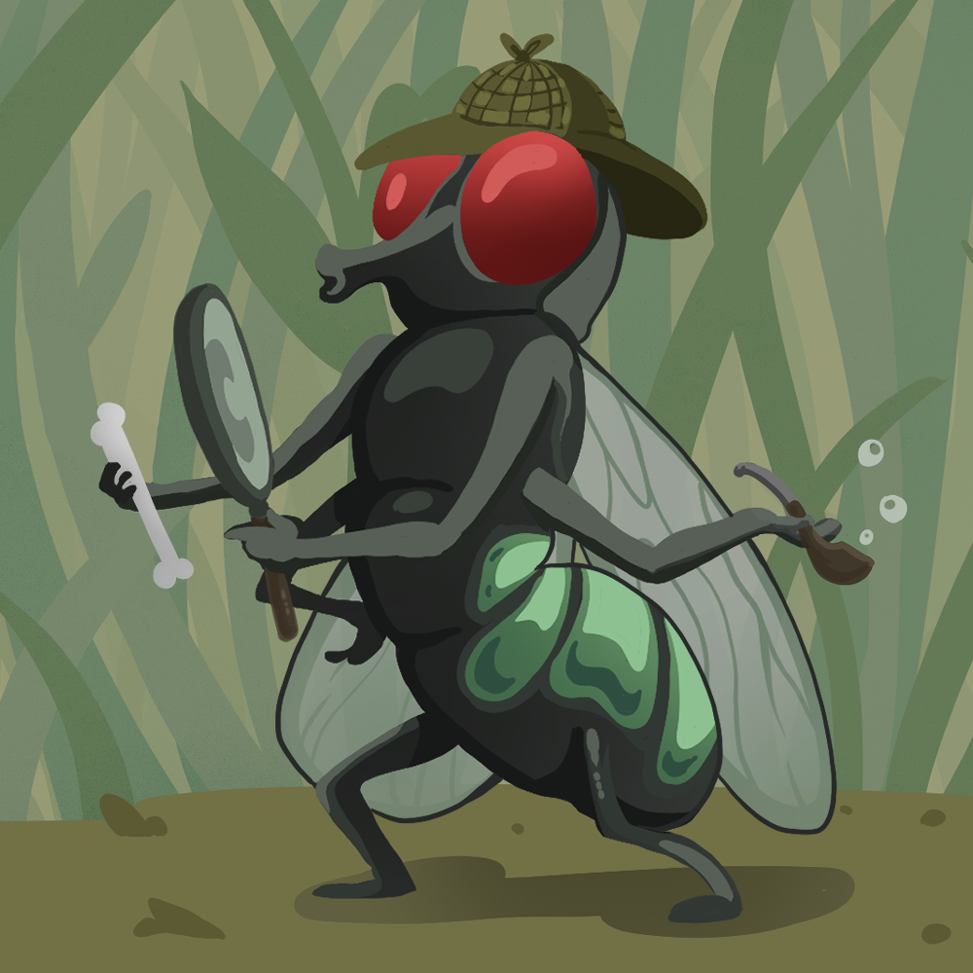
Crime Solving Insects
Forensic Entomology

Slide 7
Essential Question
How do insects aid in forensic investigations?

Slide 8
Lesson Objectives
Identify Forensics Entomology vocabulary.
Understand how environmental conditions affect insect activity and biodiversity.
Determine post-mortem interval (PMI) by analyzing insect activity in realistic forensic entomology case studies.

Slide 9
Blow Fly Metamorphosis | Card Sort
Round 1
With your partner, use the Round 1 cards and the Map to depict the life cycle stage of the Blow Fly.
K20 2 Minute Timer
Notes:
K20 Center. (n.d.). Card sort. Strategies. https://learn.k20center.ou.edu/strategy/147
K20 Center. (2021, Sept. 21). 2 minute timer. YouTube [video]. https://www.youtube.com/watch?v=HcEEAnwOt2c

Slide 10
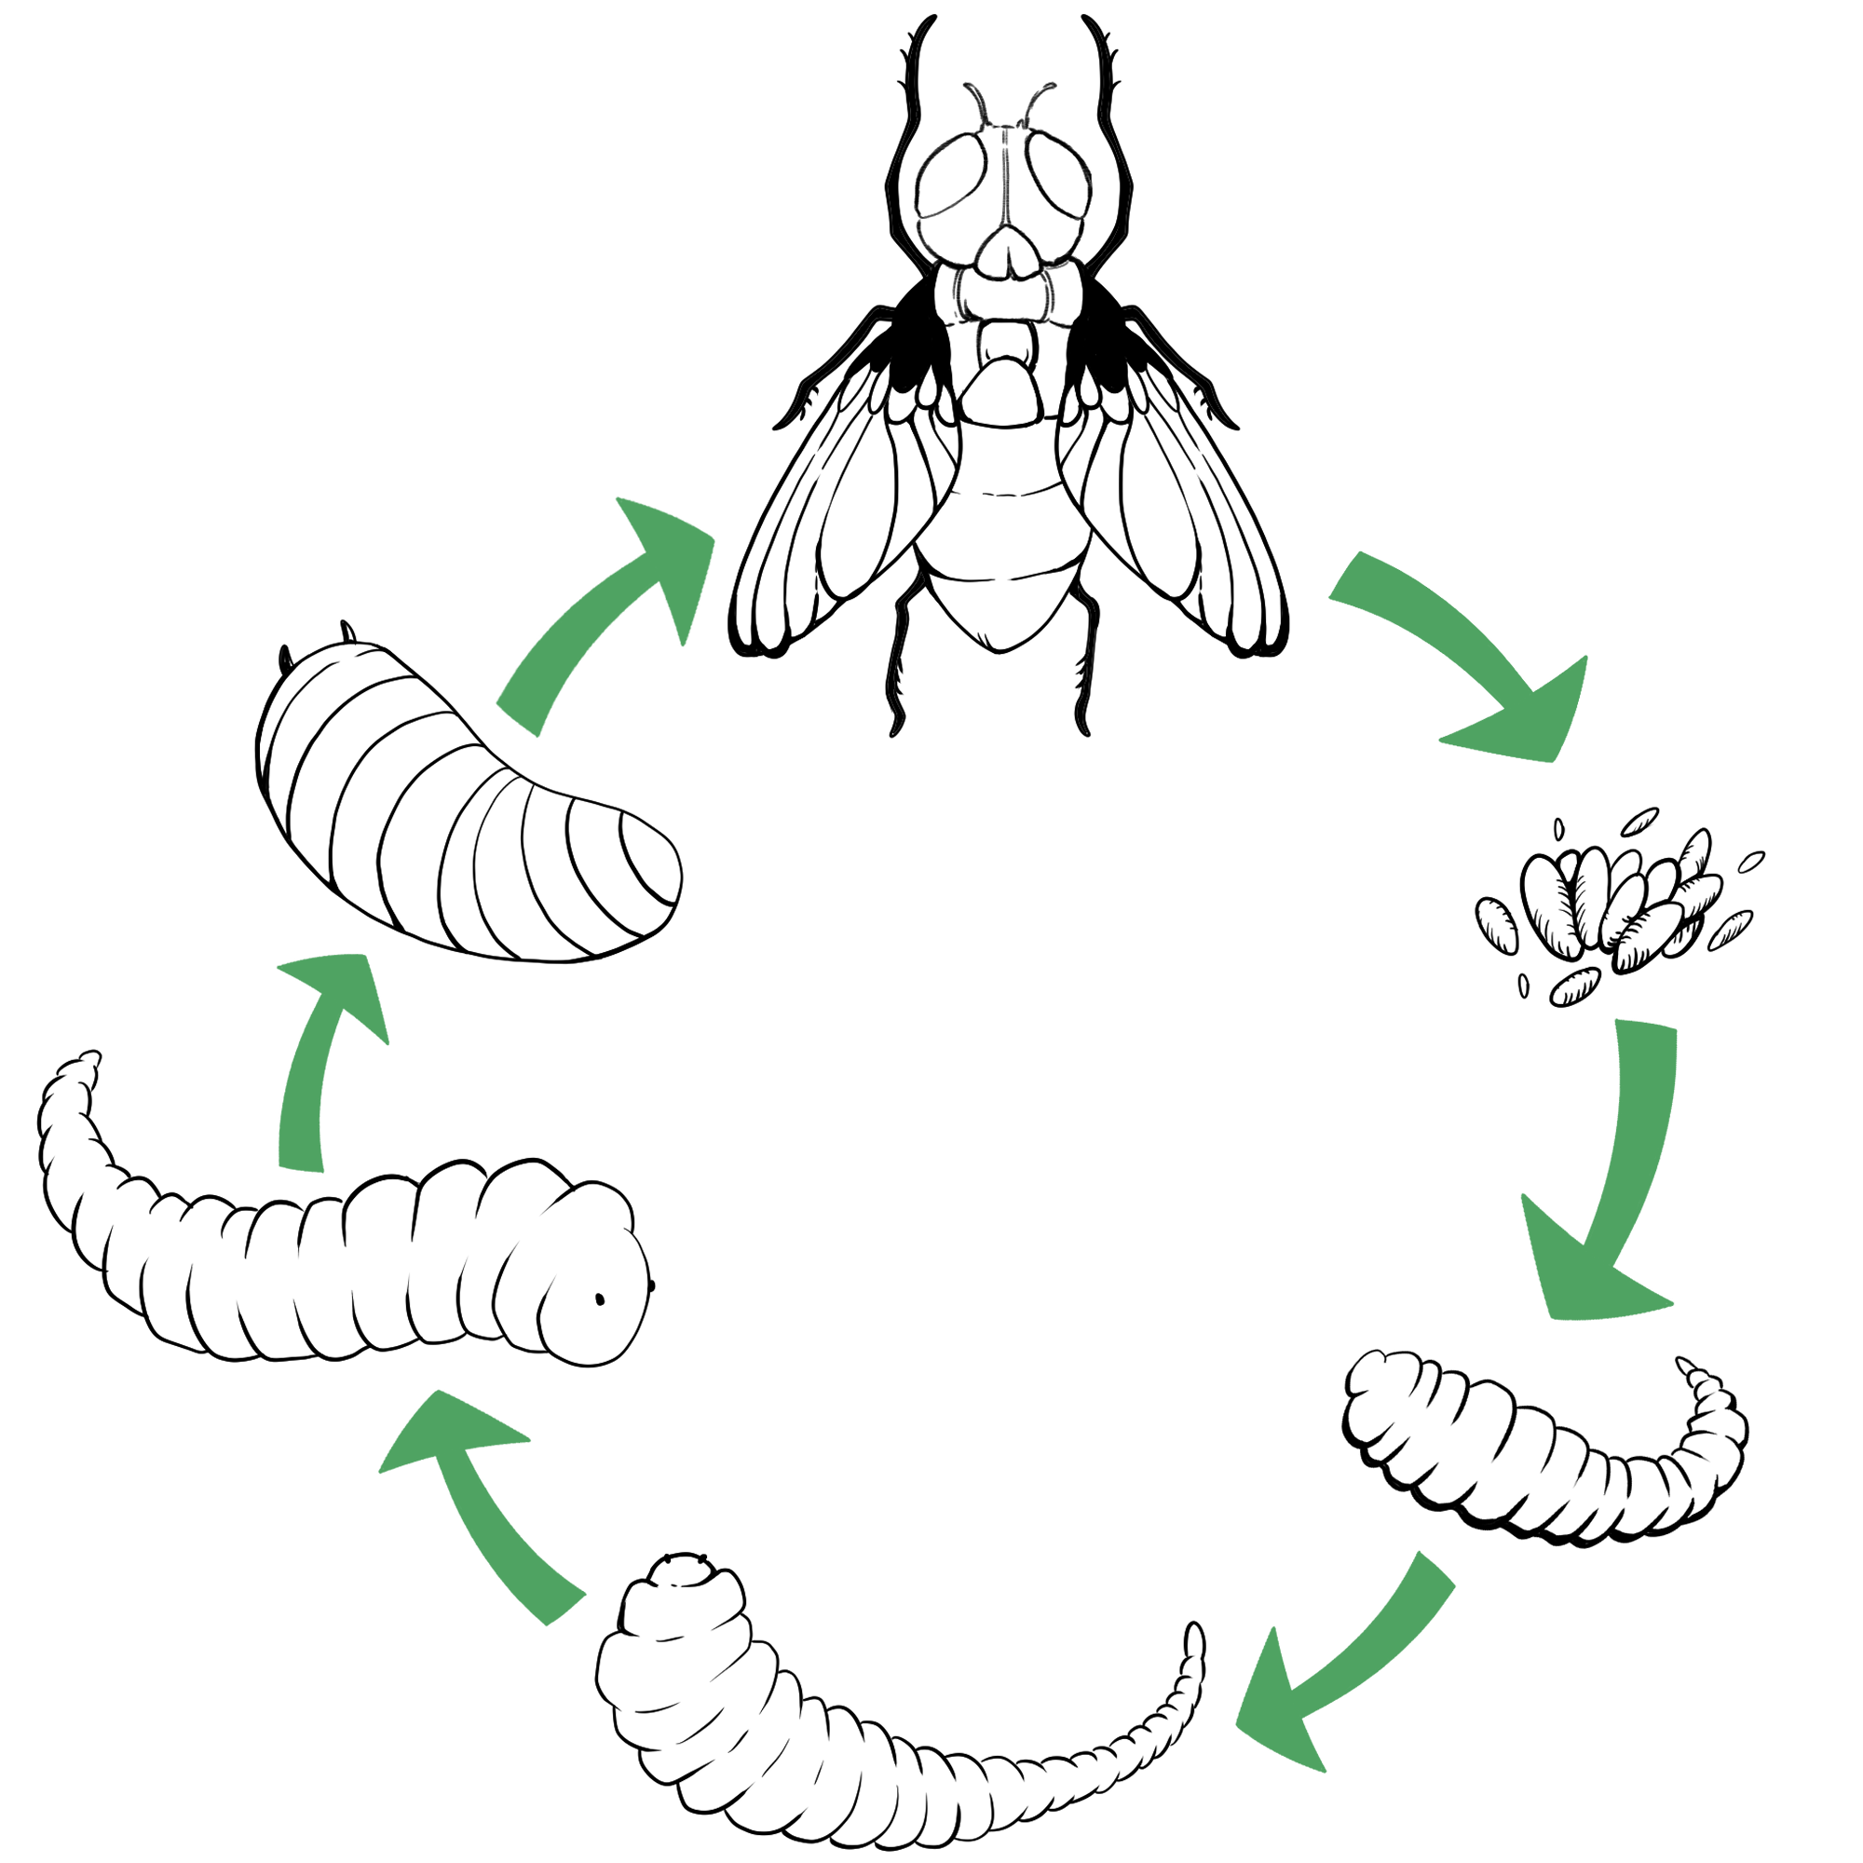
Blow Fly Metamorphosis | Round 1 Answer
Attracted to dead bodies and arrive within minutes of death>
Complete life cycle that consists of egg, larva, pupa, and adult stages.
Life cycle is 14-16 days, depending on the temperatures and humidity levels at the location of the body.
Adult
Pupa
Eggs
3rd Instar Larva
1st Instar Larva
2nd Instar Larva
Notes:
Image: http://www.umext.maine.edu/images/FlyLife.jpg
Information: http://www.kathyreichs.com/entomology.htm and http://www.forensicentomologist.org/

Slide 11
Blow Fly Metamorphosis | Card Sort
Round 2
Use Round 2 “bugs” and the Map to determine the size of the blow fly at each life cycle stage.
Use the ruler to measure each pipe cleaner.
Place each pipe cleaner where you think it goes.
K20 3 Minute Timer
Note: Not all stages will have a pipe cleaner.
Notes:
K20 Center. (n.d.). Card sort. Strategies. https://learn.k20center.ou.edu/strategy/147
K20 Center. (2021, Sept. 21). 3 minute timer. YouTube [video]. https://youtu.be/iISP02KPau0?feature=shared

Slide 12
Blow Fly Metamorphosis | Card Sort
Round 3
Use Round 3 cards and the Map to determine the number of hours/days a blow fly is at each life cycle stage.
K20 2 Minute Timer
Notes:
K20 Center. (n.d.). Card sort. Strategies. https://learn.k20center.ou.edu/strategy/147
K20 Center. (2021, Sept. 21). 2 minute timer. YouTube [video]. https://www.youtube.com/watch?v=HcEEAnwOt2c

Slide 13
Blow Fly Metamorphosis | Rounds 2 & 3 Answers
1st – Adult flies lay eggs on the carcass especially at wound areas or around the openings in the body, such as the nose, eyes, ears, anus, etc.
2nd – Eggs hatch into larva (maggots) in 12-24 hours.
Adult
Pupa
Eggs
3rd Instar Larva
1st Instar Larva
2nd Instar Larva
Notes:
Image: http://www.umext.maine.edu/images/FlyLife.jpg
Information: http://www.kathyreichs.com/entomology.htm and http://www.forensicentomologist.org/

Slide 14
Blow Fly Metamorphosis | Rounds 2 & 3 Answers
3rd– Larvae continue to grow and molt (shed their exoskeletons) as they pass through the various instar stages.
1st Instar - 9-16 mm long up to 5 days
2nd Instar - 17-25 mm long up to 9 days
3rd Instar – 26-35 mm long after 10-13 days
Adult
Pupa
Eggs
3rd Instar Larva
1st Instar Larva
2nd Instar Larva
Notes:
Image: http://www.umext.maine.edu/images/FlyLife.jpg
Information: http://www.kathyreichs.com/entomology.htm and http://www.forensicentomologist.org/

Slide 15
Blow Fly Metamorphosis | Rounds 2 & 3 Answers
4th – Larvae develop into pupa after 14 days by burrowing in surrounding soil.
5th – Adult flies emerge from pupa cases after 21 days.
Adult
Pupa
Eggs
3rd Instar Larva
1st Instar Larva
2nd Instar Larva
Notes:
Image: http://www.umext.maine.edu/images/FlyLife.jpg
Information: http://www.kathyreichs.com/entomology.htm and http://www.forensicentomologist.org/

Slide 16
What do they do?
Forensic entomologists apply their knowledge of entomology to provide information for criminal investigations.
A forensic entomologist’s job may include:
Identification of insects at various stages of their life cycle.
Collection and preservation of insects as evidence.

Slide 17
What do they do?
A forensic entomologist’s job may include:
Determining an estimate for the postmortem interval or PMI (the time between death and the discovery of the body) using factors such as insect evidence, weather conditions, location and condition of the body, etc.
Testifying in court to explain insect-related evidence found at a crime scene.

Slide 18
I Notice, I Wonder
Use your Forensic Entomology Guided Notes handout.
As you watch the video, reflect on what you’re seeing and what you still have questions about.
Write these reflections under their respective column.
Notes:
K20 Center. (n.d.). I notice, I wonder. Strategies. https://learn.k20center.ou.edu/strategy/180

Slide 19
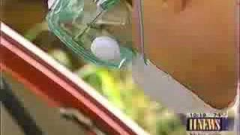
Maggots & Murder
Forensic Entomology
Notes:
fearlessaggie. (2008, September 26). Forensic entomology. YouTube. https://www.youtube.com/watch?v=dntO3YANo18

Slide 20
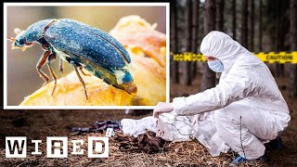
What do they do?
Did you know?
Maggots can be used to test a corpse for the presence of poisons or drugs. Some drugs can speed up or slow down the insect’s development.
How Entomologists Use Insects to Solve Crimes
Notes:
Wired. (2022, Oct. 21). How entomologists use insects to solve crimes. YouTube [video]. https://youtu.be/j8PoWlQkduA?feature=shared

Slide 21
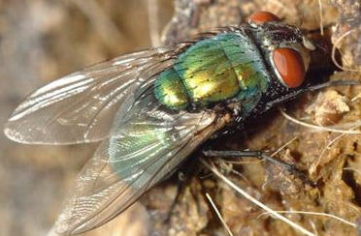
Insects as Evidence
Forensic entomologists use their knowledge of insects and their life cycles and behaviors to give them clues about a crime.
Most insects used in investigations are in two major orders:
Flies (Diptera) and
Beetles (Coleoptera)
Blow Fly
Carrion Beetle
Notes:
Anderson, M., & Kaufman, P. (n.d.). Common green bottle fly - lucilia sericata (meigen). Featured Creatures. https://entnemdept.ufl.edu/creatures/livestock/flies/lucilia_sericata.htm
Encyclopædia Britannica, inc. (n.d.). Carrion beetle. Encyclopædia Britannica. https://www.britannica.com/animal/carrion-beetle

Slide 22
Sketching Decomposition
In the space provided, visually depict the different stages of decomposition reviewed in the following slides.
Sketch an image that comes to mind when you think about forensic science or body decomposition.
Fill in the image to help you remember each stage.
Write a description of what’s happening in each box.
Notes:
K20 Center. (n.d.). Cognitive comics. Strategies. https://learn.k20center.ou.edu/strategy/198

Slide 23
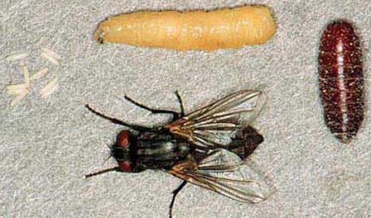
Stages of Decomposition
1 - Fresh Stage
Begins at the moment of death and ends when the body becomes bloated.
Blow flies and flesh flies are among the first to find the body.
Predatory wasps and beetles may arrive later to eat fly maggots only.
Life Cycle of a Fly
Notes:
Sanchez-Arroyo, H., & Capinera, J. (2017, April). House fly - musca domestica linnaeus. Featured Creatures. https://entnemdept.ufl.edu/creatures/urban/flies/house_fly.htm

Slide 24
Stages of Decomposition
2 - Bloated Stage
Begins as gasses produced by bacteria inflate the body, triggering putrefaction and decomposition.
House fly maggots join other flies, forming feeding masses that liquefy tissues.
Life Cycle of a Fly
Notes:
Sanchez-Arroyo, H., & Capinera, J. (2017, April). House fly - musca domestica linnaeus. Featured Creatures. https://entnemdept.ufl.edu/creatures/urban/flies/house_fly.htm

Slide 25
Stages of Decomposition
3 - Decay Stage
Begins when the skin breaks and the gases escape.
Maggot masses are large and very active as they grow older and larger.
This stage is noticeable because of bad smells emitted.
Maggots exit to pupate in the soil.
Life Cycle of a Fly
Notes:
Sanchez-Arroyo, H., & Capinera, J. (2017, April). House fly - musca domestica linnaeus. Featured Creatures. https://entnemdept.ufl.edu/creatures/urban/flies/house_fly.htm

Slide 26
Stages of Decomposition
4 – Post-Decay Stage
Most of the flesh is gone from the corpse with only cartilage, bone, and skin remaining.
This stage is devoid of flies. Some beetles continue to feed on the highly desiccated or dried remains.
Life Cycle of a Fly
Notes:
Sanchez-Arroyo, H., & Capinera, J. (2017, April). House fly - musca domestica linnaeus. Featured Creatures. https://entnemdept.ufl.edu/creatures/urban/flies/house_fly.htm

Slide 27
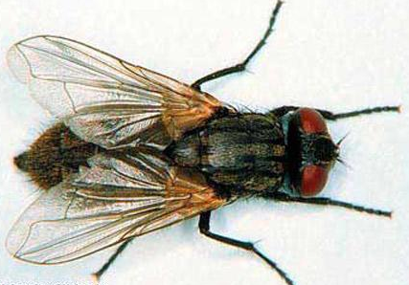
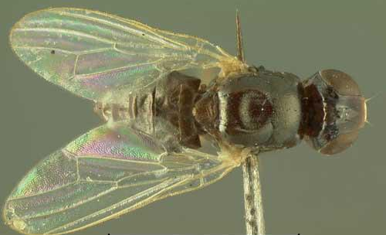
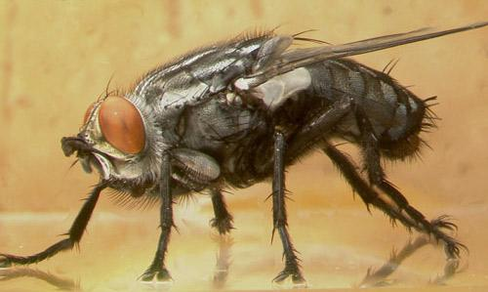
Examples of Diptera (Flies)
Early Stage Decomposition
Late Stage Decomposition
Blow & Greenbottle
Metallic thorax and abdomen
Flesh Fly
Striped thorax
House Fly
Cheese Skipper
Notes:
Anderson, M., & Kaufman, P. (n.d.). Common green bottle fly - lucilia sericata (meigen). Featured Creatures. https://entnemdept.ufl.edu/creatures/livestock/flies/lucilia_sericata.htm
Diaz , L., & Kaufman, P. (2013, January). Sarcophaga crassipalpis Macquart - a flesh fly. Featured Creatures. https://entnemdept.ufl.edu/creatures/misc/flies/sarcophaga_crassipalpis.htm
Lewis , C., Kaufman, P. E., & Entomology and Nematology Department. (2010, January). Cheese skipper - piophila casei (linnaeus). Featured Creatures. https://entnemdept.ufl.edu/creatures/urban/flies/cheese_skipper.htm
Sanchez-Arroyo, H., & Capinera, J. (2017, April). House fly - musca domestica linnaeus. Featured Creatures. https://entnemdept.ufl.edu/creatures/urban/flies/house_fly.htm

Slide 28
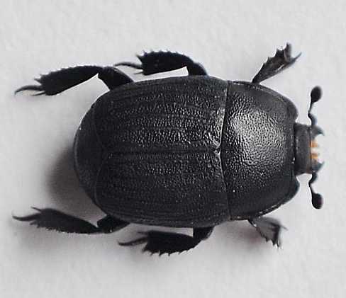
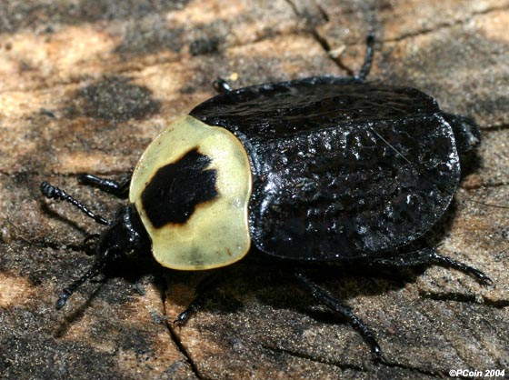
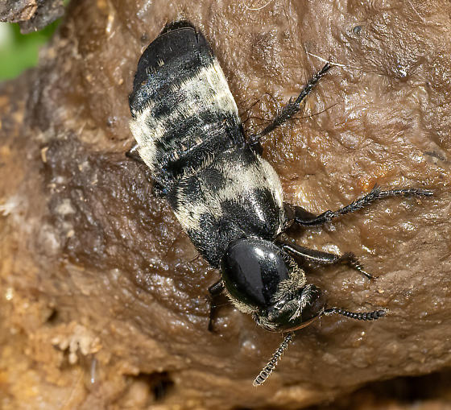
Examples of Coleoptera (Beetles)
Early Stage Decomposition
Early to Late Stage Decomposition
Carrion Beetles Adults & larvae feed on fly larvae
Rove Beetles
Predator of fly eggs
Clown Beetles
Predator of fly eggs
Notes:
Encyclopædia Britannica, inc. (n.d.). Carrion beetle. Encyclopædia Britannica. https://www.britannica.com/animal/carrion-beetle
Cotinis. (2004, September 8). American carrion Beetle - Necrophila americana. Welcome to BugGuide.Net! - BugGuide.Net. https://bugguide.net/node/view/6885
Jim Moore1. (2024, March 13). Hairy Rove Beetle (Creophilus maxillosus) - Creophilus maxillosus. Welcome to BugGuide.Net! - BugGuide.Net. https://bugguide.net/node/view/2338506
Andrew McKorney. (2014, April 14). Clown beetle2 - Psiloscelis. Welcome to BugGuide.Net! - BugGuide.Net. https://bugguide.net/node/view/909022

Slide 29
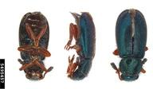
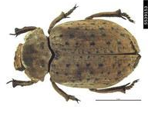
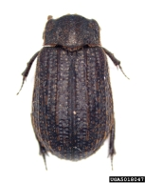
Examples of Coleoptera (Beetles)
Late Stage Decomposition
Ham & Checkered Beetles Predator of flies & beetles;
also feed on dead tissue
Hide Beetles Usually the last to arrive
Skin Beetles Feed on dried skin & tissues
Notes:
Bess, E. (n.d.). Red-legged ham beetle [Photograph]. USDA APHIS PPQ, Bugwood.org. https://www.invasive.org/browse/detail.cfm?imgnum=5495457
Emmy, E. (n.d.). Hawaiian scarab ID, [Photograph]. USDA APHIS PPQ, Bugwood.org. https://www.invasive.org/browse/detail.cfm?imgnum=5539153
Pennsylvania Department of Conservation and Natural Resources - Forestry (n.d.). Skin beetle [Photograph]. Bugwood.org. https://www.invasive.org/browse/detail.cfm?imgnum=5018047

Slide 30
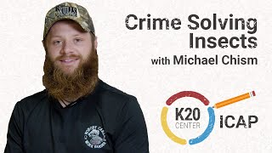
ICAP
K20 ICAP - Crime Solving Insects with Michael Chism
Notes:
K20 Center. (2025, February 19). K20 ICAP - Crime Solving Insects with Michael Chism [Video]. YouTube. https://www.youtube.com/watch?v=ieiBSQyKEoo

Slide 31
Educational Pathways
Zoology 4-year Degree
Meat Processing Associate Degree or Certificate
Tissue Removal Techniques
Knife and Tool Proficiency
Sanitation and Safety
Understanding of Animal Anatomy
Chemical Processing and Preservation
Regulatory Compliance
Business and Customer Service Skills
Anatomical Knowledge
Biological and Chemical Processes
Taxonomy and Classification
Ethical and Legal Considerations
Industry Applications
Check out the programs at
University of Oklahoma & Oklahoma State University!
Check out the program at
Eastern Oklahoma State!
Notes:
College of Arts and Sciences. (n.d.). Requirements for the bachelor of science in zoology. Norman; University of Oklahoma. https://checksheets.ou.edu/07checksheets/zoo-biomed-2007.pdf
Eastern Oklahoma State College (n.d.)Division of Agriculture | Eastern Oklahoma State College. https://www.eosc.edu/academics/explore-programs-majors/agriculture
Zoology. Oklahoma State University. (2018, November 20). https://go.okstate.edu/undergraduate-academics/majors/zoology.html

Slide 32
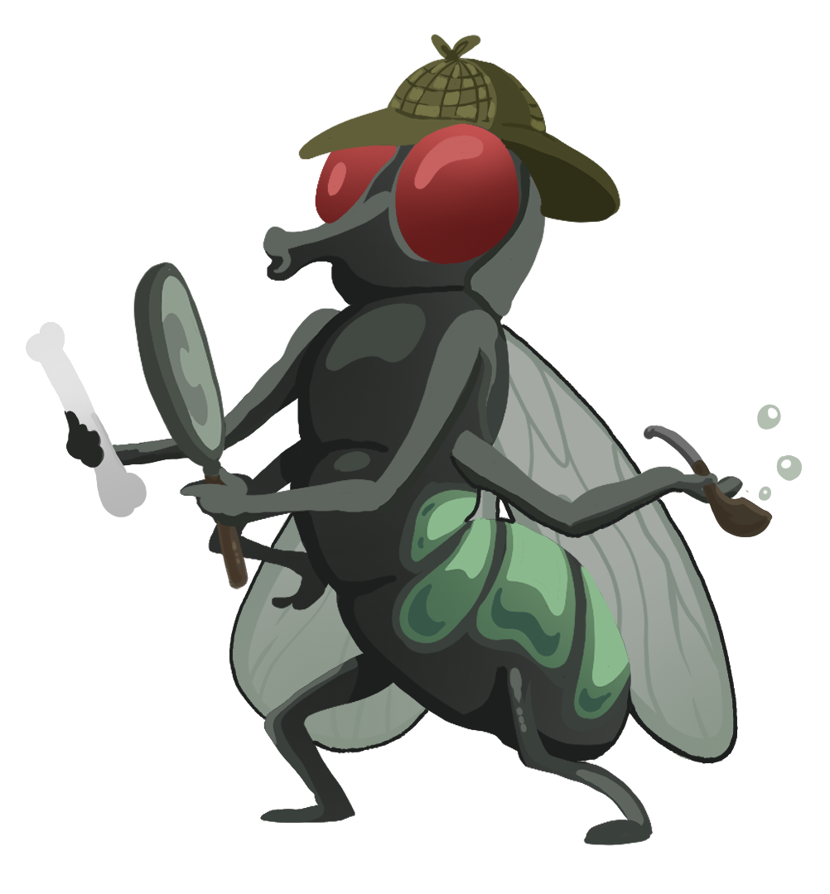
Model Case Study | “Canine Caper”
You are now a Forensic Entomologist!
Open your case file.
What do we know?
What can we infer about the case so far?
What is the first step we need to take?

Slide 33
Insects as Evidence
Species succession may also provide clues for investigators.
Some species may feed on a fresh corpse, while another species may prefer to feed on one that has been dead for two weeks.
Investigators will also find other insect species that prey on the insects feeding on the corpse.
Notes:
Adapted from A Manual of Forensic Entomology (p. 16), by K. G. V. Smith, 1986, Trustees of the British Museum/Cornell University Press.

Slide 34
Insects as Evidence
Notes:
Adapted from A Manual of Forensic Entomology (p. 16), by K. G. V. Smith, 1986, Trustees of the British Museum/Cornell University Press.

Slide 35
Model Case Study | “Canine Caper”
Find your table and data.
Using what we know, what can we learn from the table?
How does this help us solve the case?

Slide 36
Other Factors
Weather data is also an important tool in analyzing insect evidence from a corpse. Investigators will…
Take note of the temperature – of the air, ground surface; – between the interface area of the body and the ground; – soil under the body; – temperature inside any maggot masses.
Collect weather data (daily temperatures and precipitation) for a period of time before the body was discovered up to the time the insect evidence was collected.

Slide 37
Other Factors
Other factors that might affect their PMI (postmortem interval) estimates:
Was the body enclosed in an area or wrapped in a material that would have prevented flies from finding the corpse and laying eggs?
Were other insect species present that may have affected the development of the collected species?
Were there drugs or other poisons in or on the body that might have affected the larvae’s development?

Slide 38
Model Case Study | “Canine Caper”
Approximately how long has this animal been dead?
What effect, if any, does the outside temperature have on your estimation of time of death in this case?
How does the fact that the windows were closed relate to the populations of flies you observed in and around the corpse?
Do you suspect foul play? Explain.
Species & Stage | Size (mm) | Age (days)

Slide 39
Model Case Study | You’ve Solved it!
5 days
None. The windows were closed. The inside temperature was 72 degrees.
Since the windows were closed, the only flies that could have laid eggs on the body were those that were already inside at the time of death.
Yes. The maggots behind the shoulder indicate an opening was present like a stab wound or bullet hole.
Species & Stage | Size (mm) | Age (days)
House fly | 6 | 4-5
Flesh fly | 15 | 2

Slide 40
Let’s Crack the Case!
Station Rotations
With your group, go to your first assigned station and solve that case.
When the timer goes off, move to the next available station.
Solve all the cases!

Slide 41
Things to Remember
Insect life cycles follow a pattern and are predictable.
Life cycles are influenced by temperature. Being ectothermic, insects rely on external warmth to activate, eat, and grow.
Not all fly species are found everywhere. This can provide important information also.
For example, skipper flies are found only in urban settings.
House flies, blow flies, and flesh flies live in both urban and rural settings.

Slide 42
Let’s Crack the Case!
Use the information from the reports and your examination to answer the questions.
Measure the length of the maggots & pupae.
Record your data in the chart.
Consult the Key and the tables to determine the various fly species and their ages.
K20 10 Minute Timer
Notes:
K20 Center. (2021, Sept. 21). 10 minute timer. YouTube [video]. https://www.youtube.com/watch?v=9gy-1Z2Sa-c

Slide 43
Case #2: Oh, Deer
Approximately how long has this animal been dead?
Why are maggots of different ages found in the body?
Other than temperature, what abiotic (external to the corpse) conditions would you obtain from the weather station to help you be more confident of your time of death estimation?
Species & Stage | Size (mm) | Age (days)

Slide 44
Case #2: Oh, Deer
11 days
Adult flies of the same species may arrive at different times and different species arrive at different stages of decomposition.
Humidity, rain, wind, and cloud cover.
Species & Stage | Size (mm) | Age (days)
House fly (1) | 29 | 10
House fly (2) | 20 | 8
Blow fly (1) | 25 | 8-9
Blow fly (2) | 29 | 10-11
Flesh fly | 29 | 5
Skipper | 9 | 10
Pupae | 39 | 11

Slide 45
Case #3: Dandy’s Death
Approximately how long has this animal been dead?
What effect, if any, does Oleandrin have on your estimation of time of death?
What effect, if any, does temperature have on your estimation of time of death in this case?
Do you suspect foul play? Explain.
Species & Stage | Size (mm) | Age (days)

Slide 46
Case #3: Dandy’s Death | Answers
7 days
Oleandrin speeds up development of the blow fly by 2 to 3 days.
High temperatures speed up larvae development, so you subtract from the number of days because they develop faster.
Not exactly. While the insects present were consistent with the location, the presence of Oleandrin raised suspicions. More investigation is needed.
Species & Stage | Size (mm) | Age (days)
House fly | 28 | 7
Blow fly | 35 | 6
Flesh fly | 45 | 7
Pupae | 33 | 7

Slide 47
Case #4: Porky’s Peril
Approximately how long has this animal been dead?
What effect, if any, does temperature have on your estimation of time of death in this case?
Do you suspect foul play? Explain.
Species & Stage | Size (mm) | Age (days)

Slide 48
Case #4: Porky’s Peril | Answers
12 days
Since it is cooler in the forest, maggot development is slower. You have to add to the number of days because it appears the maggots have been developing because it takes longer.
Yes. The skipper fly only lives in urban habitats. Its presence indicates the pig died in an urban habitat and was later moved to the woods after death. The missing hair on the pig’s neck suggests a collar.
Species & Stage | Size (mm) | Age (days)
House fly (1) | 6 | 8-9
House fly (2) | 19 | 12
Flesh fly (1) | 9 | 3
Flesh fly (2) | 15 | 4
Blow fly | 18 | 10
Skipper | 5 | 10

Slide 49
ICAP
K20 ICAP - Crime Solving Insects with Ashley Meerschaert
Notes:
K20 Center. (2025, February 19). K20 ICAP - Crime Solving Insects with Ashley Meerschaert [Video]. YouTube. https://www.youtube.com/watch?v=MyJAvzPElW4

Slide 50
Reflect & Discuss
Complete your “Reflect & Discuss” handout reflecting on what you have learned about Forensic Entomology.
Turn to your Elbow Partner and write their responses to the same questions in the space provided.
Add if your thoughts have changed.
Notes:
K20 Center. (n.d.). Elbow partners. Strategies. https://learn.k20center.ou.edu/strategy/116

