Slide 2
Zombie Takeover
Logistic Functions

Slide 3
Essential Question
How can logistic functions model real world phenomena?

Slide 4
Lesson Objectives
Graph a logistic growth function.
Interpret key characteristics of a function.

Slide 5
What Do You Think This Video Represents?
You are about to watch a silent video.
Pay close attention to what is going on and be ready to explain what you think this video is illustrating.
Notes:
Vallinder, M. (2010, April 23). Simulation of a Zombie Outbreak! [Video]. YouTube. https://youtu.be/t_AlsNx5UhA

Slide 6
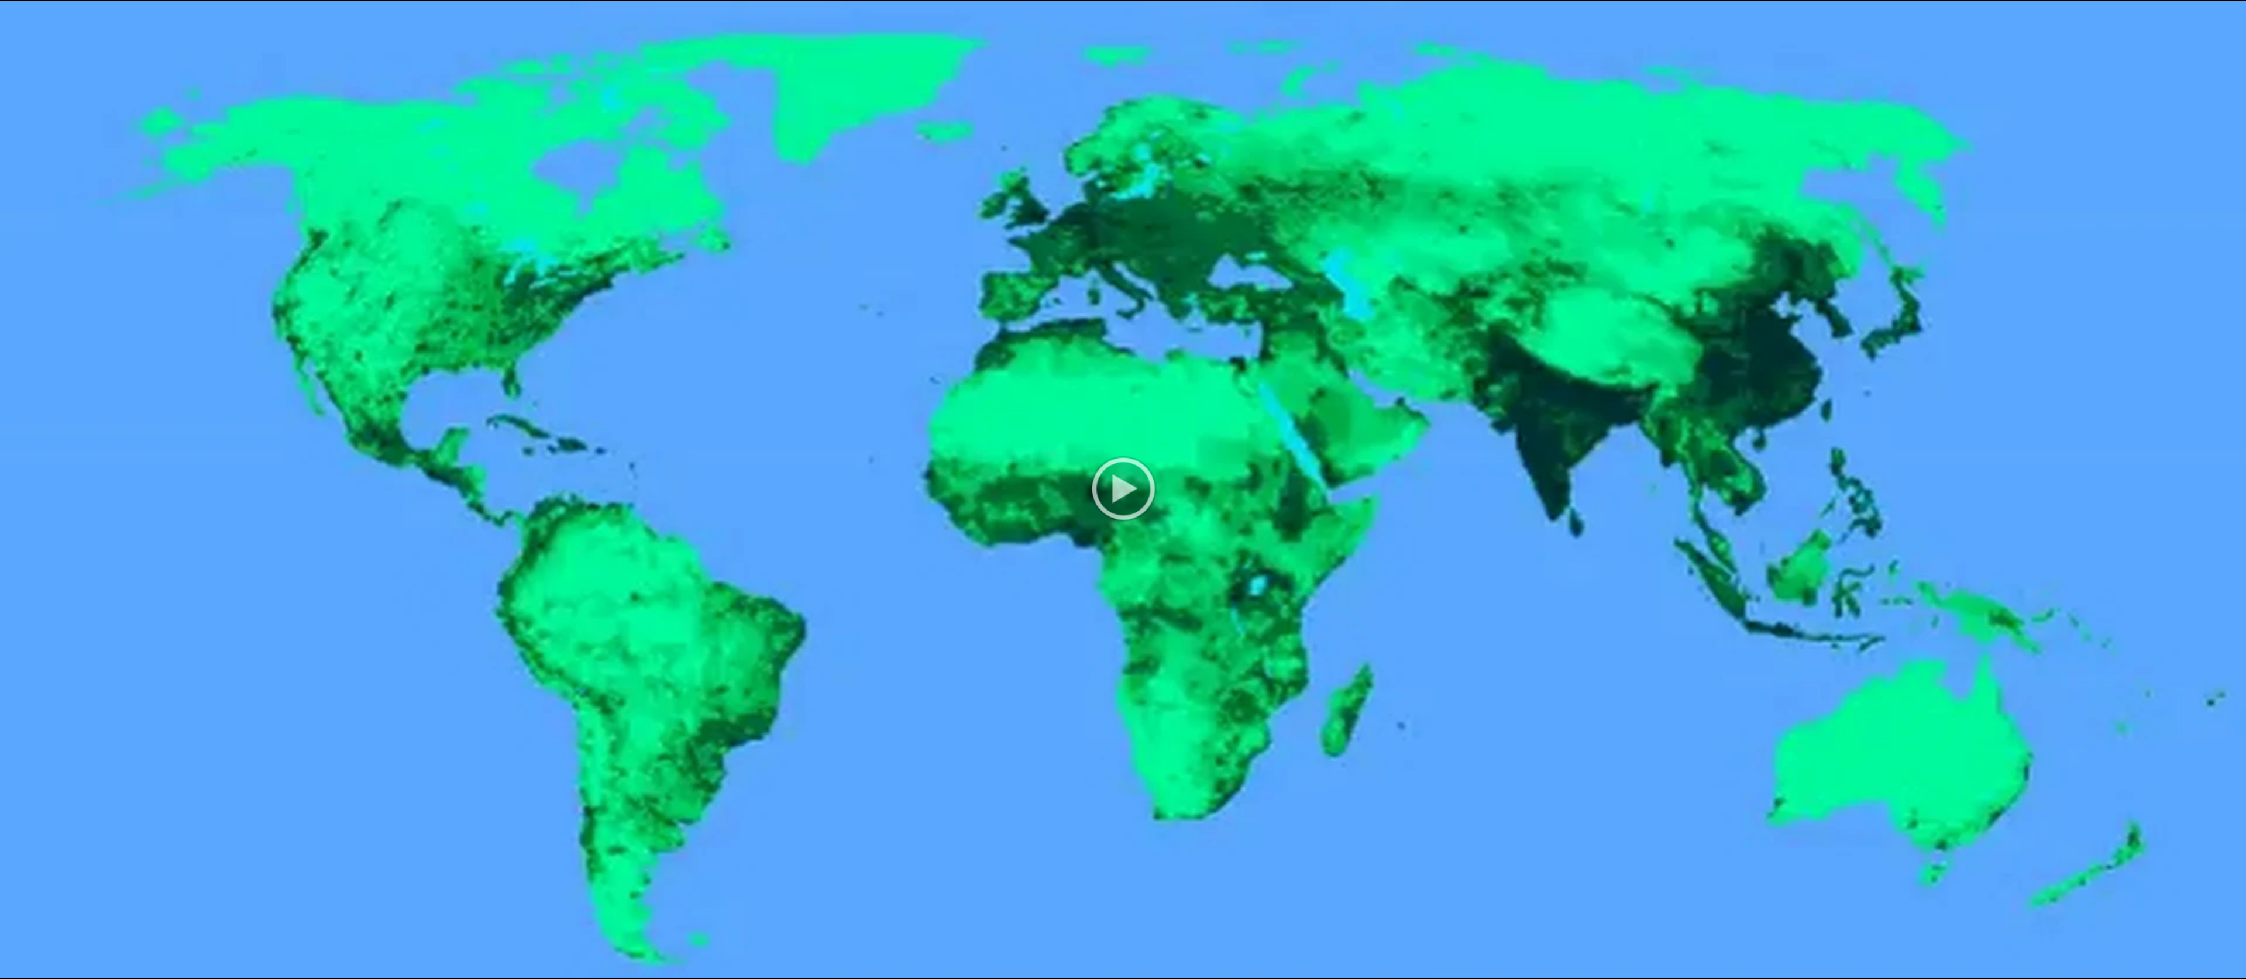
What Do You Think This Video Represents?
Notes:
Vallinder, M. (2010, April 23). Simulation of a Zombie Outbreak! [Video]. YouTube. https://youtu.be/t_AlsNx5UhA

Slide 7
Zombie Outbreak (Part 1)
When the first human on Earth got infected, no one believed it. We all thought zombies could never be real. As time went by, it was obvious that we had underestimated the swiftness with which human populations could decrease. Our town was one of the last to get hit, but it was brutal. By the time the first infection came, so many residents had left or died of starvation that only 2,000 of us remained to see it.
If there is one zombie among us, how long will it take for all of us to become infected?

Slide 8
Zombie Outbreak (Part 2)
Our town quickly turned from a safe hiding space into the worst place to try to survive. With zombie populations increasing and resources depleting, several of us decided to run. We spent days hiding out in empty grocery stores and vacated homes to plan our escape, and we were able to make it out of town to a remote cabin that a family had abandoned. By the time our plan was executed, there were only 20 of us left.

Slide 9
Zombie Outbreak (Part 2)
We’ve been safe here for a while. I’m a little worried about Joe, though—he’s been extremely tired ever since we arrived. He said he wasn’t feeling well. What if he has the zombie infection and doesn’t know it yet?
If there is one zombie among us, how long will it take for all of us to become infected?

Slide 10
Exploring a Zombie Outbreak
Work with your partner to simulate the zombie outbreak.
Red Tiles: Zombies
Blue Tiles: Humans
Drawing 2 Tiles: A Random Interaction Between 2 Community Members

Slide 11
Exploring a Zombie Outbreak
Draw 2 tiles and record your results.
If 2 humans (2 blue tiles) interact or 2 zombies (2 red tiles) interact, record and repeat.
If 1 human (blue tile) and 1 zombie (red tile) interact, record your result, then remove the human (blue tile) from the community (bag) and replace them with a zombie (red tile) and repeat.

Slide 12
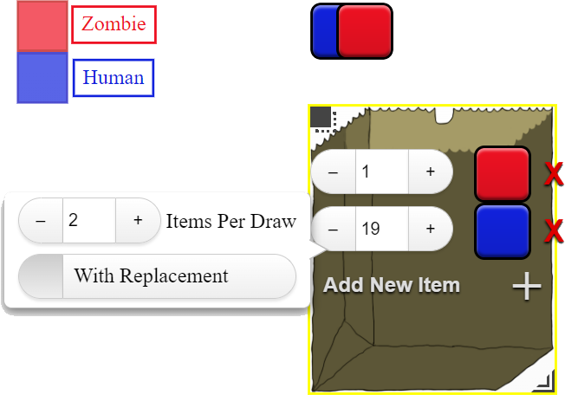
Exploring a Zombie Outbreak
Go to https://bit.ly/3LEgtbh.
Locate the directions on the left.
Right-click on the bag to adjust the number of zombies (red tiles) and humans (blue tiles) in the community (bag).

Slide 13
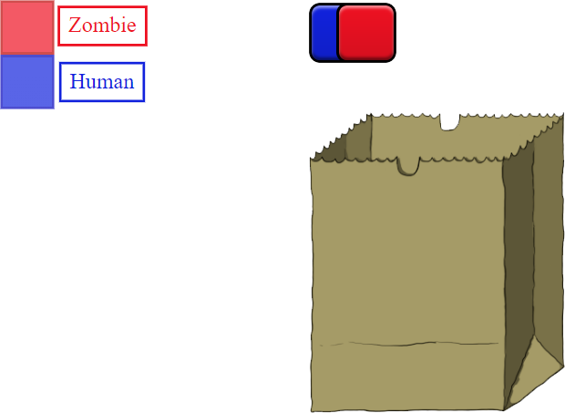
Exploring a Zombie Outbreak
Click on the bag to draw to tiles (simulating an interaction).
Record your results on your handout and repeat.

Slide 14
Exploring a Zombie Outbreak
Go to desmos.com.
Click “Graphing Calculator.”
Press the plus sign in the top-left corner and add a table.
Enter your data from your handout into the table.

Slide 15
Exploring a Zombie Outbreak: Results
Create a curve in Desmos that models your data:
In the 2nd input row, type: y1~L/1+Ae^–kx1 The result should look like:
Desmos will also display the values for A, L, and k that are specific to the curve generated to fit your data.

Slide 16
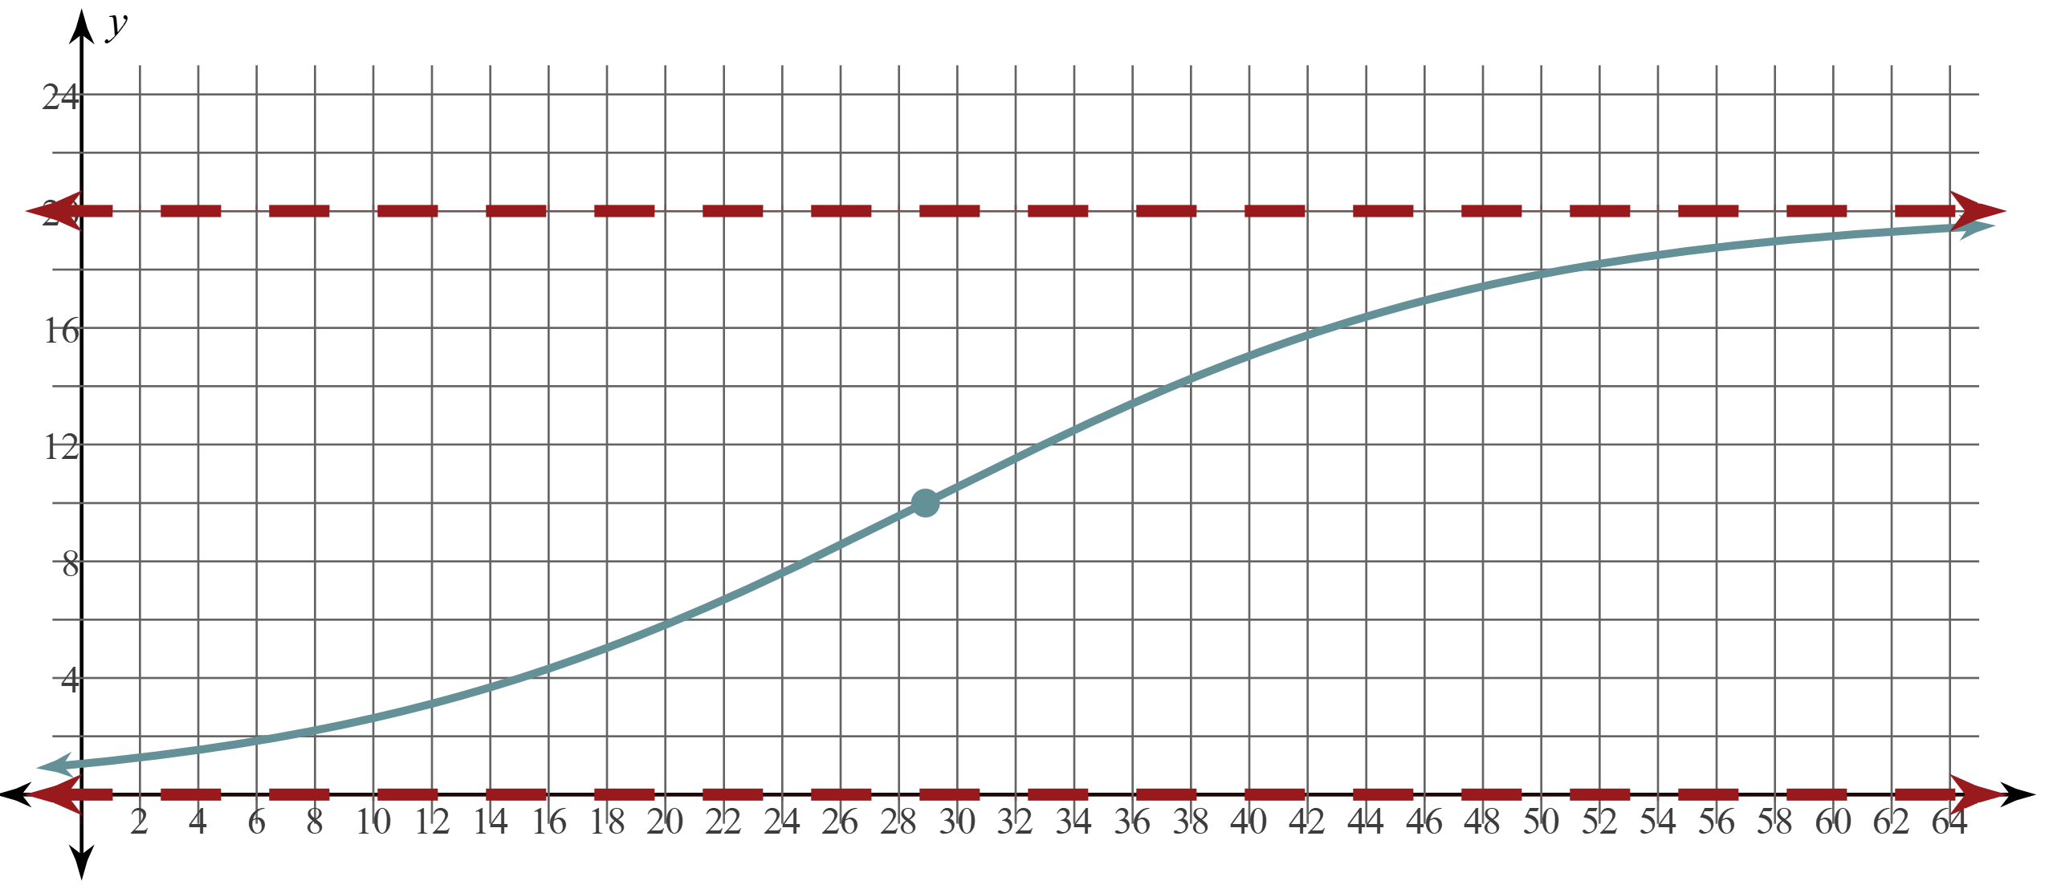
Logistic Functions
The graph on your screen is known as a logistic curve.
Notice that it has two horizontal asymptotes.
Notice the maximum growth point, where the graph changes from an increasing rate of change to a decreasing rate of change.

Slide 17
Logistic Functions
Graph the asymptotes.
Plot the y-intercept.
Plot the maximum growth point.
Gently sketch an S-shaped curve.

Slide 18
Using Key Characteristics
Work with a partner to graph the given functions and label the key characteristics.
Use those characteristics to make inferences.
Use academic language and the new vocabulary you have just learned.

Slide 19
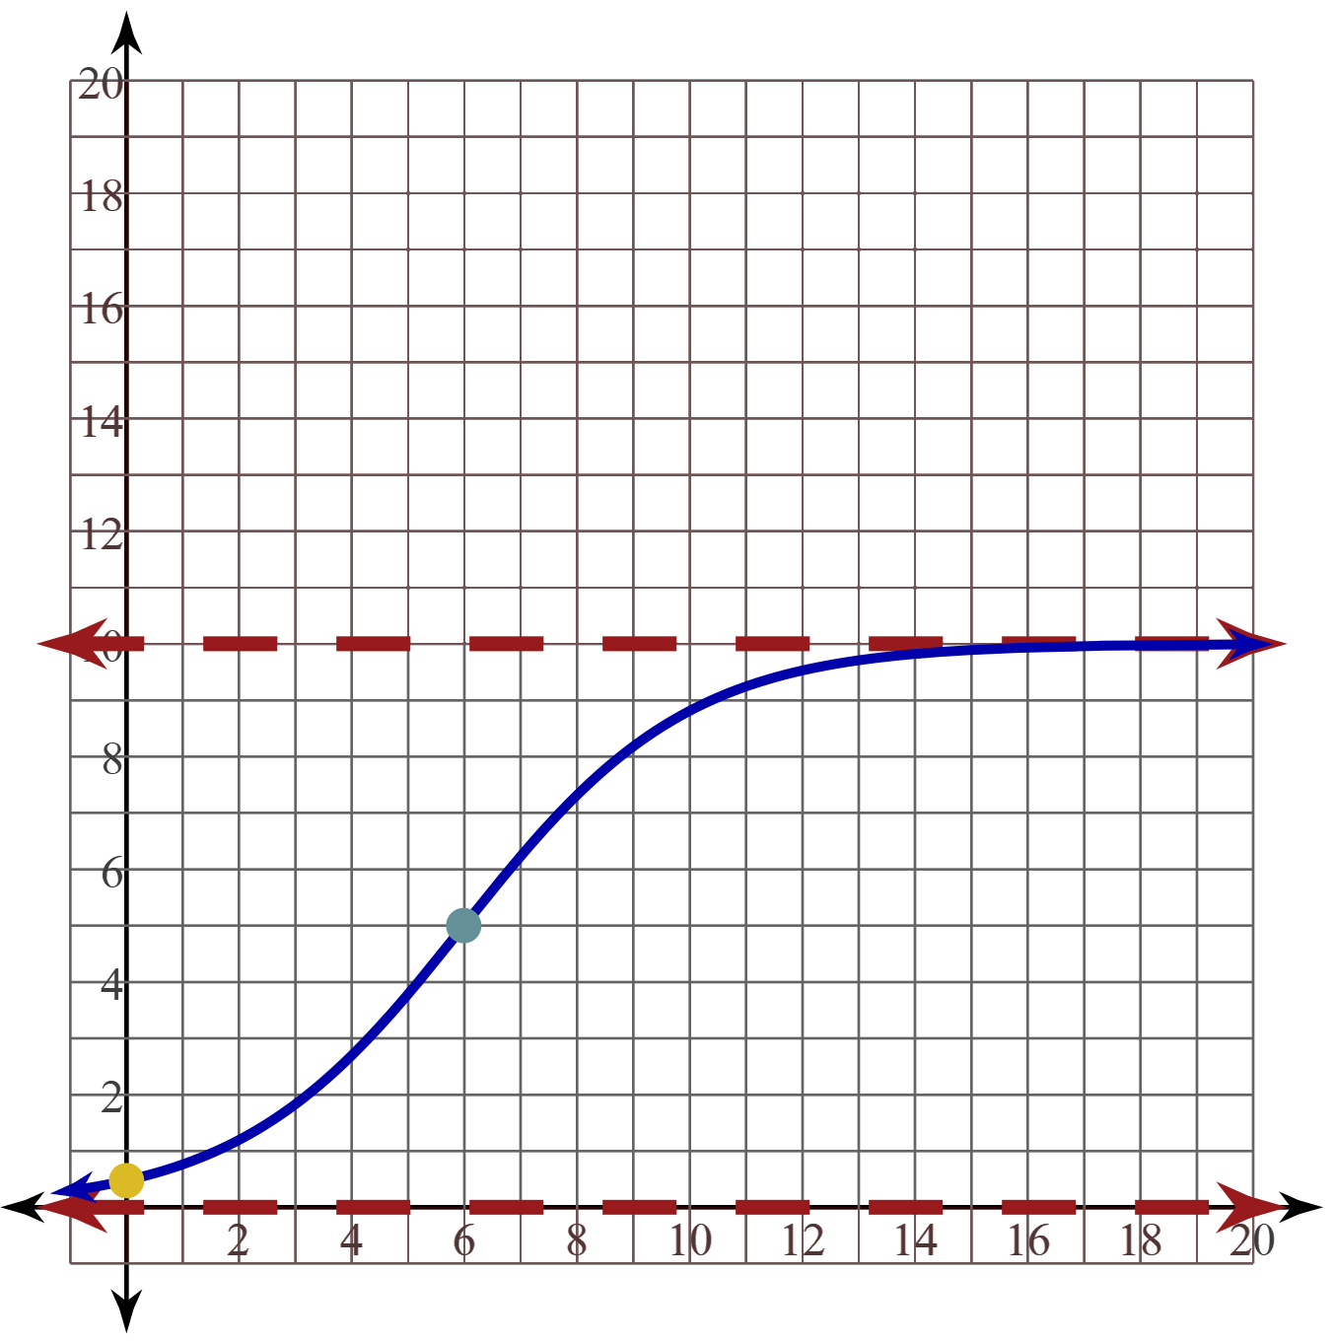
Using Key Characteristics (Solution 1)

Slide 20
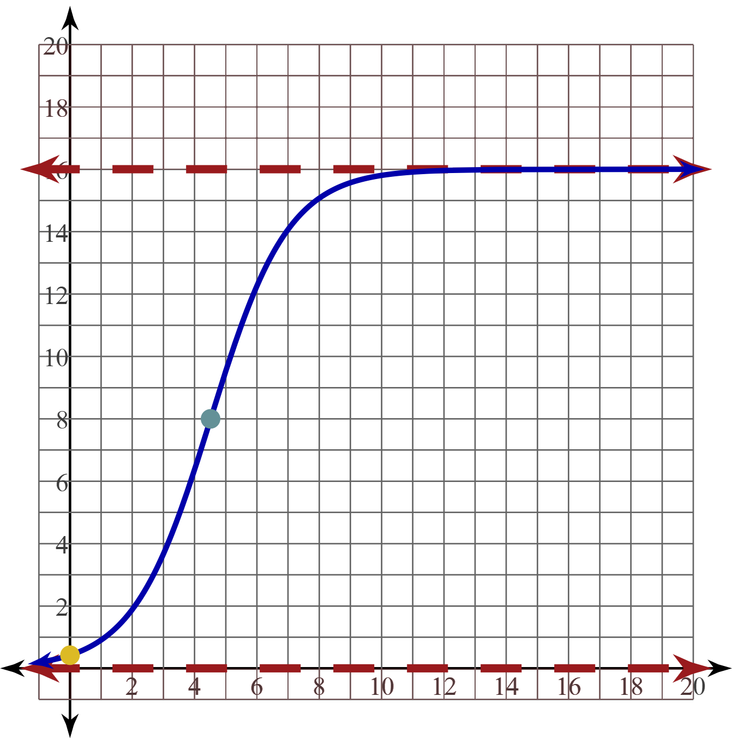
Using Key Characteristics (Solution 2)

Slide 21
Using Key Characteristics (Solution 3)
The maximum population of a nearby town is 12,000 people because that is where the curve is approaching (asymptote) as time goes on. The maximum growth point seems to be at t = 460, since that is where the population is 6,000 (half of the maximum).

Slide 22
Using Key Characteristics (Solution 4)
The maximum population of the community is 500 people because that is where the curve is approaching (asymptote) as the number of days increase. The maximum growth point seems to be at t = 62, since that is when half of the community (250) have heard the rumor.

Slide 23
Exit Ticket
Read each scenario and decide which function, exponential or logistic, would best model the growth described in the scenario.
Write your reasoning in the Explain column.
Notes:
K20 Center. (n.d.). Bell Ringers and Exit Tickets. Strategies. https://learn.k20center.ou.edu/strategy/125

Slide 24
Exit Ticket (Solution 1)
The spread of the word truthiness:
This would be best modeled by logistic growth because the rate that the word would spread would be high in the beginning but decrease over time.
Notes:
K20 Center. (n.d.). Bell Ringers and Exit Tickets. Strategies. https://learn.k20center.ou.edu/strategy/125

Slide 25
Exit Ticket (Solution 2)
The population of the toads:
This could be modeled by either function:
One could argue that since the toads in the zoo have ideal conditions, then nothing would be prohibiting their reproduction, so the exponential growth model would be best. If space is a concern, then those toads could be released into the wild.
One could argue that even with ideal conditions, the population could not infinitely grow, so the logistic growth model is more appropriate.
Notes:
K20 Center. (n.d.). Bell Ringers and Exit Tickets. Strategies. https://learn.k20center.ou.edu/strategy/125

Slide 26
Exit Ticket (Solution 3)
The phone sending text messages:
This would be best modeled by exponential growth because the first day your phone sent 1 text message to a random phone number, then the following day it sent 3, then 9, then 27, and so on. Because it has even used the same phone number twice, there is no limit to the number of messages being sent.
Notes:
K20 Center. (n.d.). Bell Ringers and Exit Tickets. Strategies. https://learn.k20center.ou.edu/strategy/125

Slide 27
Exit Ticket (Solution 4)
The Channel catfish population:
This would be best modeled by logistic growth because fish in a lake are often competing for the same resources to survive (to be able to reproduce), and there is a finite amount of space in a lake for fish to live.
Notes:
K20 Center. (n.d.). Bell Ringers and Exit Tickets. Strategies. https://learn.k20center.ou.edu/strategy/125

