Slide 2
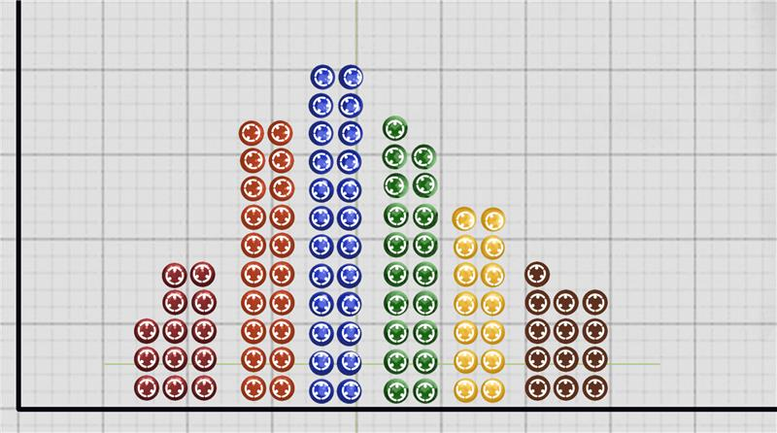
Math, Models, and M&Ms
Hypothesis Testing for Proportions

Slide 3
Essential Question
How can we use the sample proportions of M&M colors in a bag to test the manufacturer’s claim?

Slide 4
Learning Objectives
Test distribution of M&Ms by creating confidence intervals, testing hypotheses, and calculating p-values from binomial and normal distributions.
Observe the cumulative relative frequency of the sample proportion to determine if we believe it is converging on the claimed proportion and at what point if any did our sample proportion cross the threshold of significance.

Slide 5
Sort your M&Ms by color.
Record your sample in the frequency table.
Were half your M&MS the same color?
Were you missing any colors?

Slide 6
What are the chances of that happening?
What sample proportion seemed most unusual to you?

Slide 7
M&Ms 2008 Color Distribution
0.13 0.24 0.16 0.14 0.20 0.13
We will investigate if a random sample of M&Ms is still 20% orange.

Slide 8
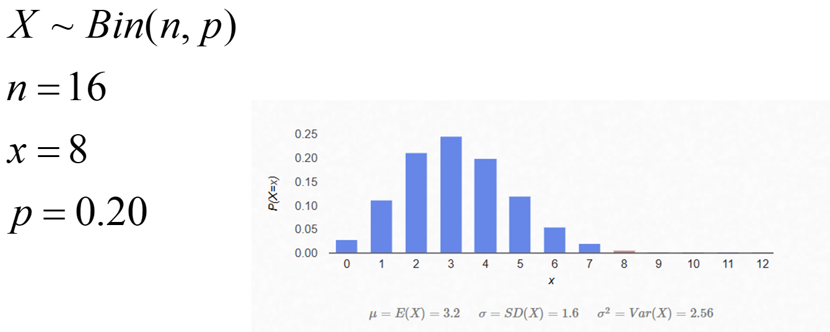
Binomial Distribution

Slide 9
Mars, Inc., removed the distribution from their website.
Let’s test the claim for the proportion of orange M&Ms.
Work with a partner to write your hypothesis.
What alpha level should we use?
Notes:
K20 Center. (n.d.). Elbow partners. Strategies. https://learn.k20center.ou.edu/strategy/116

Slide 10
Check our assumptions and conditions.
Success/Failure Condition, what is the minimum sample size that would allow us to proceed with a 1-proportion z-test?
Notes:
K20 Center. (n.d.). Elbow partners. Strategies. https://learn.k20center.ou.edu/strategy/116

Slide 11
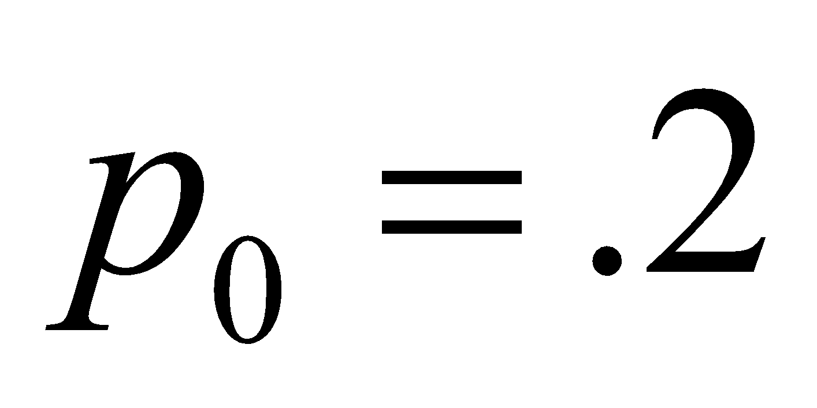
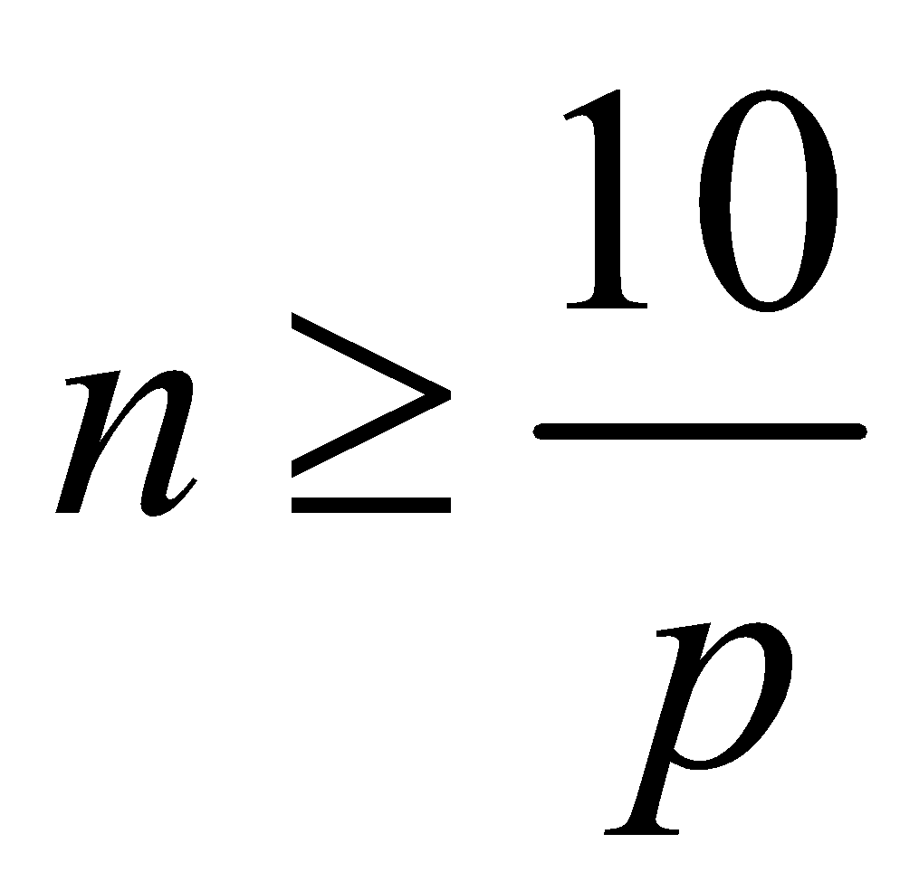
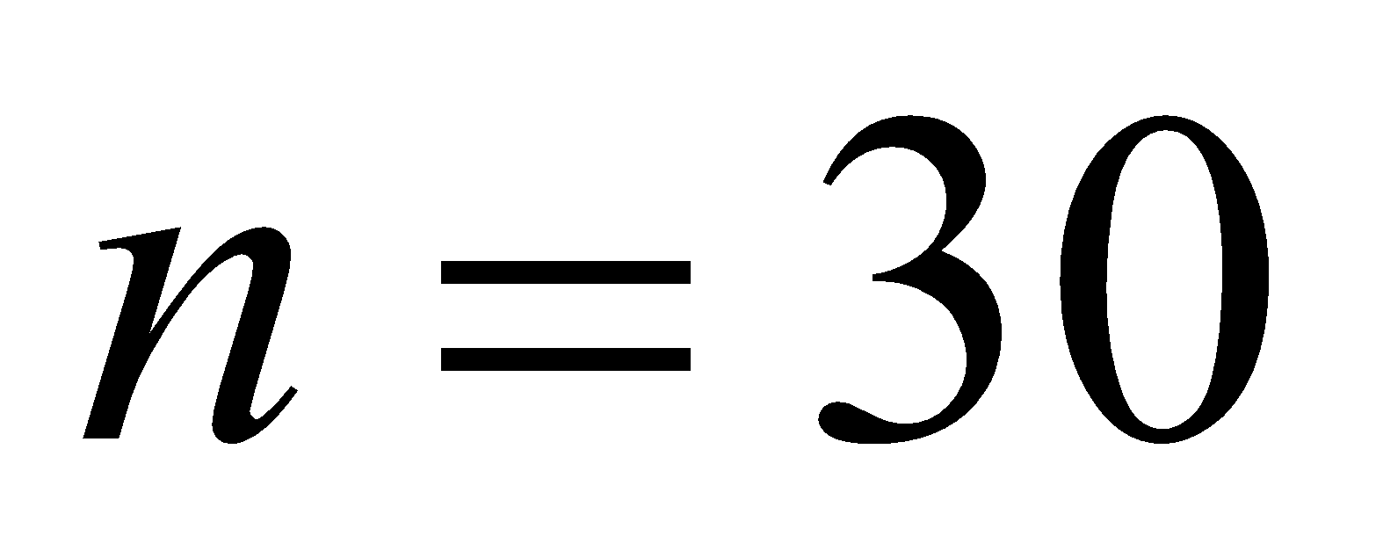
Success/Failure Condition
Is our sample large enough to test the company's claim that ?
What sample size would allow us to use the normal model without being cut off for at least three standard deviations?
, so when I divide both sides by I get
Our minimum sample size to be able to use the 1-proportion Z-test would be .

Slide 12
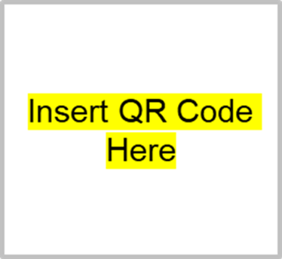
Let’s pool our data!
Access the class “Testing M&Ms Claim” spreadsheet by typing in URL or scanning the QR code:
Record the number of orange M&Ms and the total sample size on the sheet.

Slide 13
Color by Number
With your elbow partner, analyze the data collected by answering all of question 3 on your handout.

Slide 14
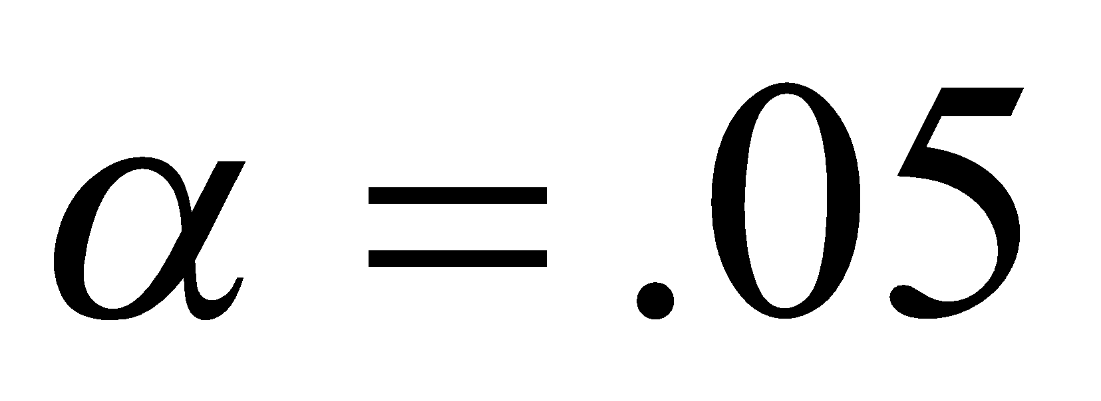
What statistical method was used?
Null Hypothesis:
Alternative Hypothesis:
Alpha Level:

Slide 15
Assumptions for Normality
Check if we can use a normal model:
Random: were the bags chosen randomly?

Slide 16
Assumptions for Normality
Check if we can use a normal model:
Random: were the bags chosen randomly?
10%: Sample size < 10% of population?

Slide 17
Assumptions for Normality
Check if we can use a normal model:
Random: were the bags chosen randomly?
10%: Sample size < 10% of population?
S/F:

Slide 18
Assumptions for Normality
Check if we can use a normal model:
Random: were the bags chosen randomly?
10%: Sample size < 10% of population?
S/F:

Slide 19
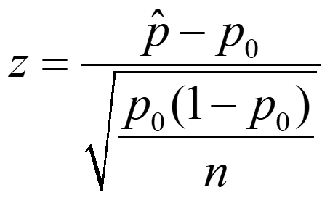
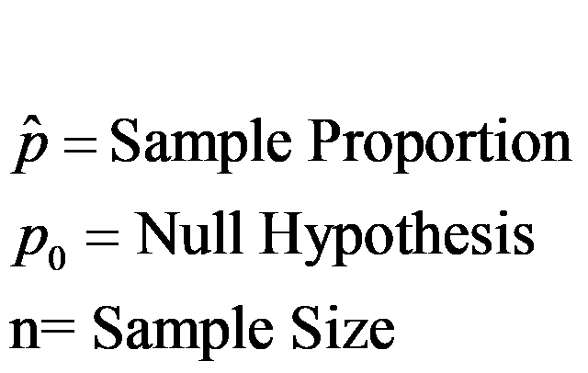
Because assumptions are met, we can use a 1-proportion z-test!

Slide 20
Interpreting the P-Value
The p-value tells us the probability of getting results this extreme or more, assuming the null hypothesis is true.

Slide 21
Let’s gather more data!
Independently count and input the frequency of orange M&Ms from your additional bags on the spreadsheet for Trial 2.
With your elbow partner, analyze the data collected by answering all of question 4 on your handout.

Slide 22
Confidence Intervals
Use if we want to estimate the true proportion:

Slide 23
Color by Number
The Law of Large Numbers suggests that the cumulative relative frequency for a random phenomenon will approach the empirical probability as the sample size approaches infinity.
In other words, the margin of error of a sampling distribution model decreases as our sample increases.
We can model this with ± Z*√((p×q)/n).

Slide 24
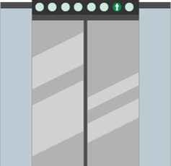
Elevator Speech
Create a summary of the data collected on the Color by Number handout.
Cut out any unnecessary details and flesh out remaining ideas.
Connect your thoughts with transition words. Try for 5–7 sentences or 30 seconds.
Practice your speech!
Notes:
K20 Center. (n.d.). Elevator speech. Strategies. https://learn.k20center.ou.edu/strategy/57

Slide 25
Summarize your findings:
State your conclusion regarding the population proportion of orange M&Ms from the 2008 distribution.
Does our sample proportion appear to be converging on .2 as we opened more bags of candy?
Notes:
K20 Center. (n.d.). Elevator speech. Strategies. https://learn.k20center.ou.edu/strategy/57

