Slide 2
Truth Detective
Creating Research Questions

Slide 3
Essential Question
How do you ask questions to get the best possible answers?

Slide 4
Learning Objective
Understand how to create a high-quality research question.

Slide 5
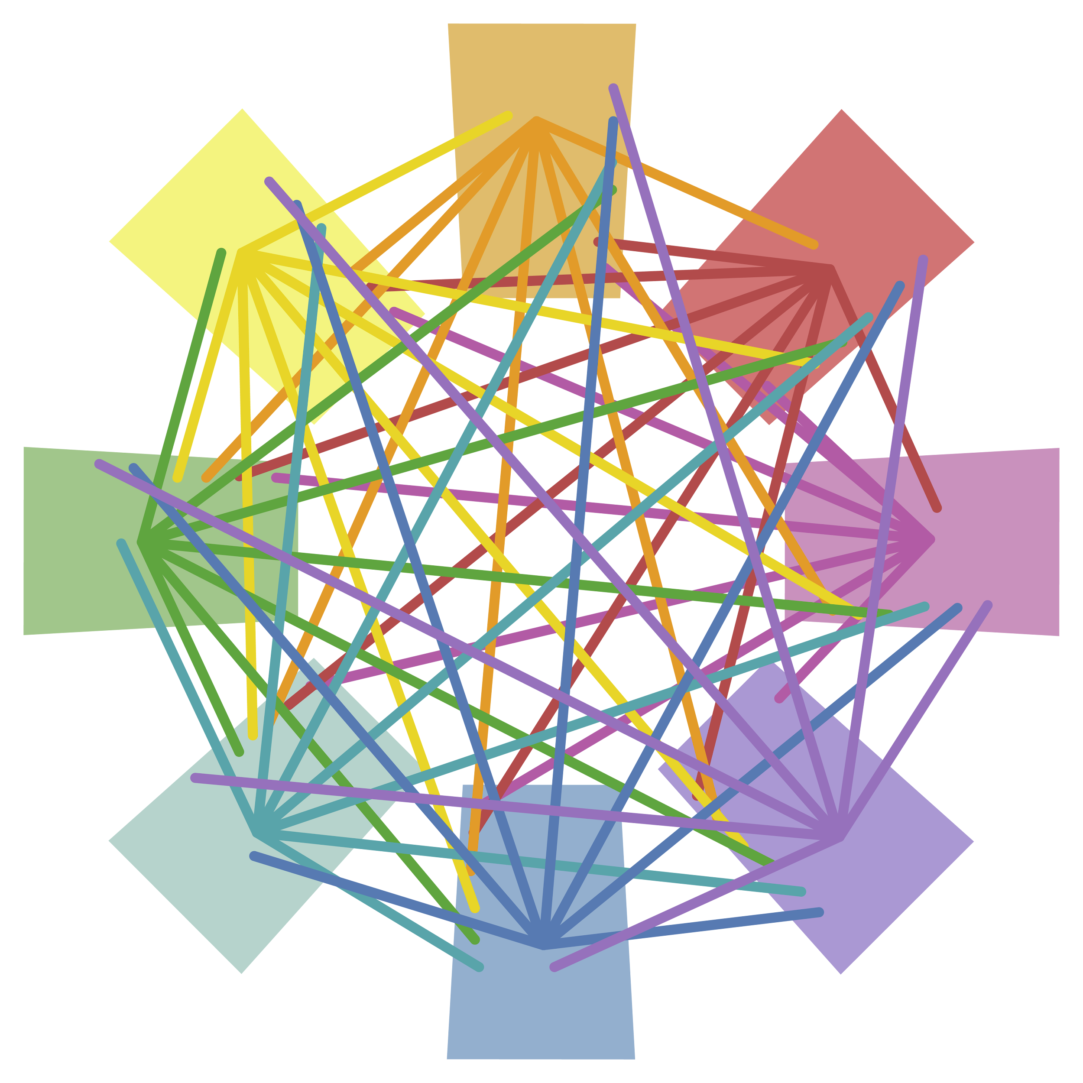
Detective Board
You and your group are detectives on a case.
Sort through all of the evidence to determine what is useful and what isn’t.
Some pieces of evidence will connect and some won’t.

Slide 6
Detective Board
Take the case out of your dossier.
Tape it to the middle of your paper.
Read the case and name it at the top of your paper.
    “The Case of the ____________”
Brainstorm three questions you need to ask to solve the case.

Slide 7
Detective Board
Take out the evidence.
Sort the pieces of evidence that go together.
Tape down the pieces and draw lines to show how things connect to the case.
Group evidence that doesn’t connect to anything else in the corner. Circle this.

Slide 8
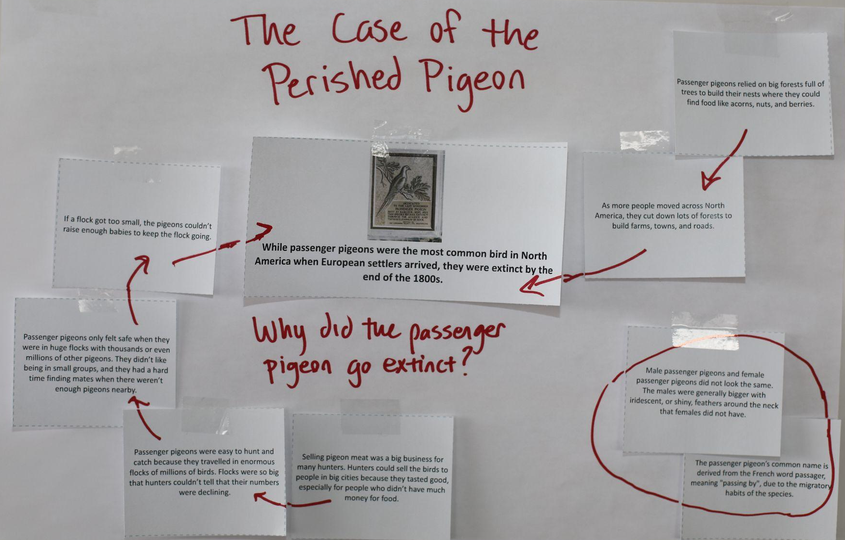

Slide 9
Detective Board
Review all of your evidence and connections.
Determine the cause of the problem.
To solve the case, write one sentence to explain the cause of the problem.

Slide 10
Share Your Case
On your Case Tracker, fill out the information for your case at the top.
Share the information of your case with the class. As the other groups are sharing, fill out one of the lower columns with notes regarding their case.

Slide 11
Did We Just Research?
Problem
Questions
Gather evidence
Analyze what will help
Conclusion

Slide 12
Did We Just Research?
Problem
Questions
Gather evidence
Analyze what will help
Conclusion

Slide 13
Levels of Questioning
Level 1
  Purpose: Gather and recall factual information.
  1–2 words
  Examples:
    Who wrote Romeo and Juliet?
    How many oceans are there?

Slide 14
Levels of Questioning
Level 2
  Purpose: Make connections within a text; analyze concepts more deeply.
  A couple of sentences
  Examples:
    How does the feud between Romeo’s family and Juliet's family affect their relationship?
    Why are there so many different species in the ocean compared to land?

Slide 15
Levels of Questioning
Level 3
  Purpose: Connect information from multiple sources; apply learning to new situations.
  A paragraph
  Examples:
    How would changing to a modern setting affect the relationship between Romeo and Juliet?
    How can fish in the Pacific Ocean best be protected from pollution?

Slide 16
Levels of Questioning
Look back at your questions on the Case Tracker.
Which level is each of your questions? Put a 1, 2, or 3 next to each one.
Level 1 | Level 2 | Level 3
Gathering and recalling simple factual information | Making connections, analyzing concepts | Connect info from multiple sources, apply to new situations
How many oceans are there? | Why are there so many different species in the ocean compared to land? | How can fish in the Pacific Ocean best be protected from pollution?

Slide 17
What is a Research Question?
Level 3 questions require synthesis, which is the bringing together of ideas from different sources to create something new or create better understanding of a topic.
It helps you focus your research.
Usually, it takes multiple drafts to get it right.
Similar to your case, to find the right answers you have to ask the right questions.

Slide 18
Research Questions need to be:
Interesting to you.
  Pick something you want to learn more about.
Clear and focused.
  It should be easy for another person to understand.
  It should stick to one main topic.
Not too broad or too narrow.
  “Space” is way too broad, but “How many grains of dust are in Saturn’s rings?” is way too narrow.
Researchable
  You need to be confident that you can actually find some answers.
Complex and arguable.
  It can’t be answered with a simple yes or no.
  It likely needs multiple sources.
  It leads to an answer that you can support with facts; people may have different opinions.

Slide 19
Creating a Research Question:
Step 1: Choose a topic.
Step 2: Think about what you want to investigate about that topic.
Step 3: Start with a level 1 or 2 question about your topic, then try to turn it into a level 3 question.

Slide 20
Research Question Example:
I need to pick a topic related to “Space.”
I’m curious about asteroids, so I ask, “What are asteroids made of?”
  Although this is a Level 1 question, it helps me understand the topic better.
Notes:
K20 Center. (n.d.). Mingle. Strategies. https://learn.k20center.ou.edu/strategy/53

Slide 21
Research Question Example:
Now that I know more, I’m ready for my Level 3 Research Question:
  “What are the potential benefits and challenges of mining asteroids for resources?”
This gives me a great place to start, but I might revise it after I get feedback.

Slide 22
Draft Your Research Question
Look at the questions you made about each case.
Select one question to turn into a research question.

Slide 23

Peer Review
With your partner exchange your research questions.
Review your partner’s question and complete the checklist about the research question criteria.
Notes:
K20 Center. (n.d.). Mingle. Strategies. https://learn.k20center.ou.edu/strategy/53

Slide 24
Trying Out Research Questions
Type your research question exactly as you have written it into search engine.
Look through three different result options and briefly read the answers.

Slide 25

Surprising, Interesting, Troubling
S – What surprised you in your search?
I – What was something that interested you in exploring more?
T – What was an issue you had with your search?
Notes:
K20 Center. (n.d.). S-I-T (Surprising, interesting, troubling). Strategies. https://learn.k20center.ou.edu/strategy/926

