Slide 1
Unfaithful
Exploring the Balancing Act of Adaptation Using Pride and Prejudice

Slide 2
Essential Questions
Why do we adapt established texts and media?
What makes an adaptation good?
What do we gain and lose when a text is adapted?
How do we stay true to an original text while adapting it to new scenarios?

Slide 3
Objectives
Students will be able to
Analyze an original text and assess characters’ motivations.
Use those motivations to believably apply new scenarios/time periods to said characters.
Adapt a chapter of a novel.

Slide 4
What is an adaptation?

Slide 5
What makes a good adaptation?
What things need to be considered when adapting a text to a different medium?
Write down your ideas
Notes:
Have students think of adaptations they have seen or know about and what they liked/disliked about them

Slide 6
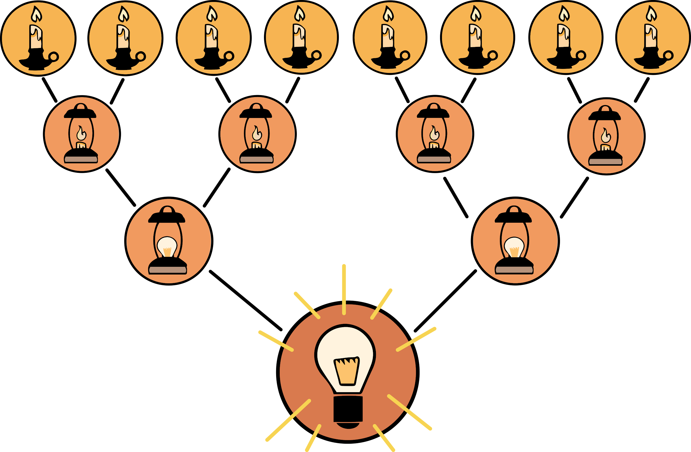
8-Up Strategy
In your group, agree on the three most important considerations for making a good adaptation.

Slide 7
8-Up Strategy
Pair with another group.
Each group share your three responses.
Together, whittle your six combined responses into the two most important considerations.

Slide 8
8-Up Strategy
5. Each group, share your 2 considerations with the whole class.
6. As a class, agree on the single most important consideration for a good adaptation.

Slide 9
Hand Flex
Notes:
Pride and Prejudice Hand Flex Scene. (n.d.) [Video]. YouTube. https://www.youtube.com/watch?v=b2Z_LEa5TsE

Slide 10
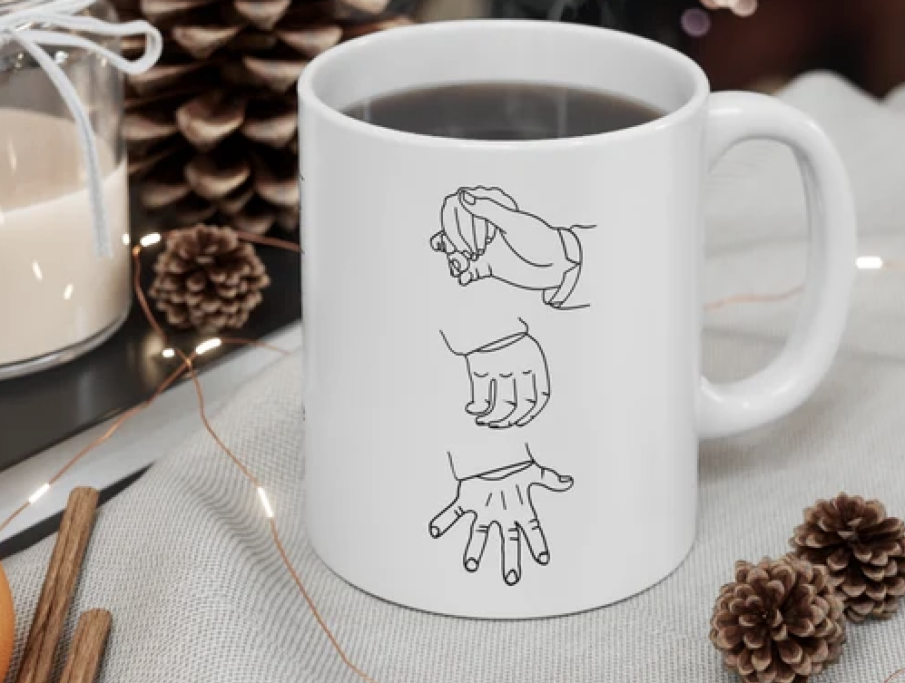
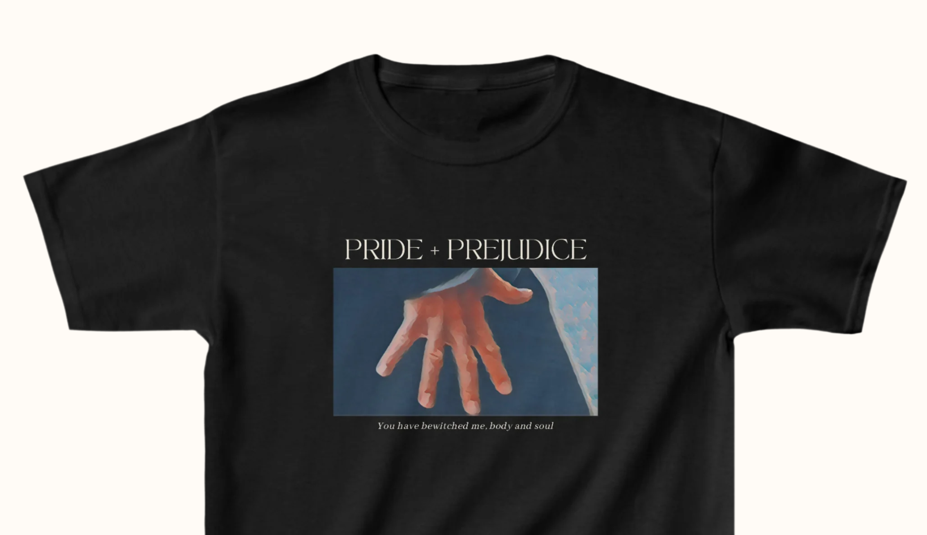
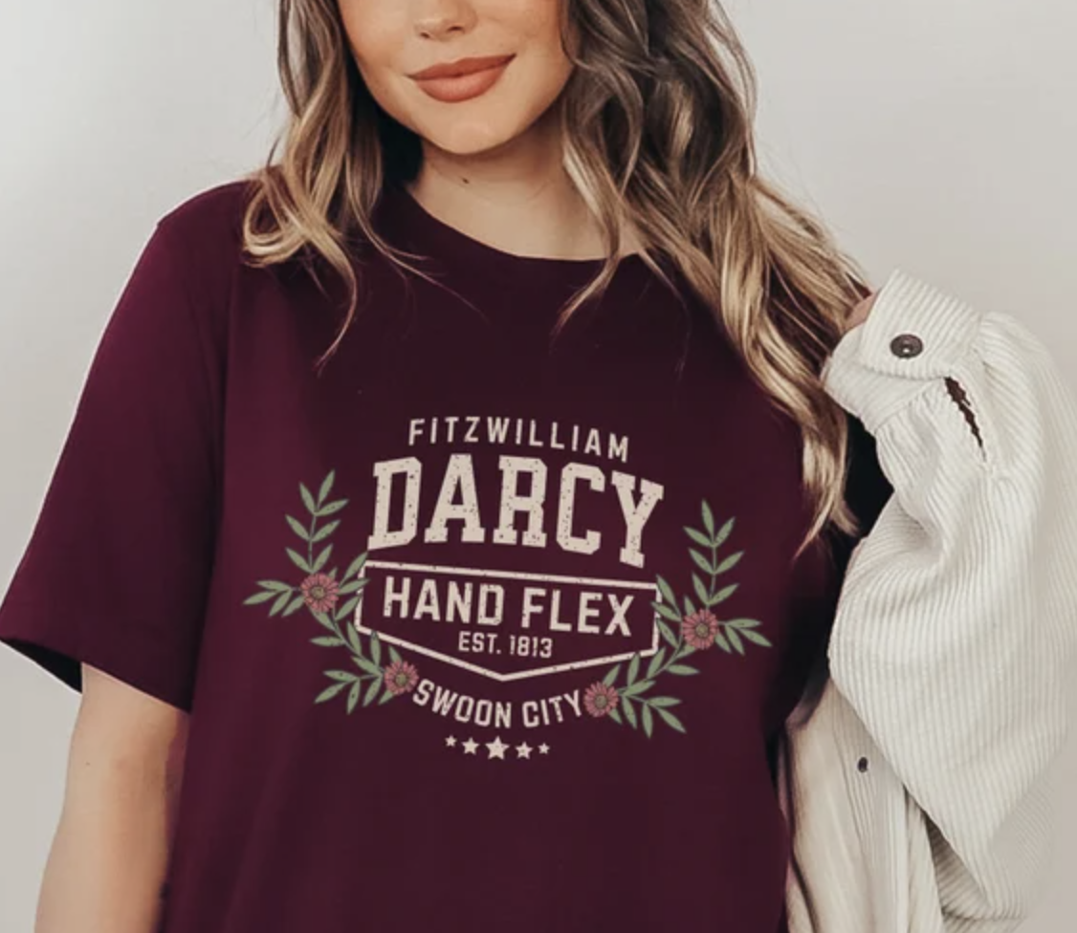
memes

Slide 11
Pride & Prejudice Plot
Basically, it’s the story of how Elizabeth Bennet and Mr. Darcy go from absolutely loathing each other to realizing they're soulmates—mostly because Darcy stops being an arrogant snob, and Elizabeth stops assuming he's the worst. Along the way, Elizabeth’s mom nearly dies of excitement trying to marry off her daughters, her dad hides in his study to avoid the chaos, and her younger sister runs off with a scoundrel. In the end, love conquers pride, prejudice, and awkward ballroom encounters.
Notes:
Video Summaries:
https://www.britannica.com/biography/Jane-Austen
https://www.english-heritage.org.uk/learn/story-of-england/georgians/

Slide 12
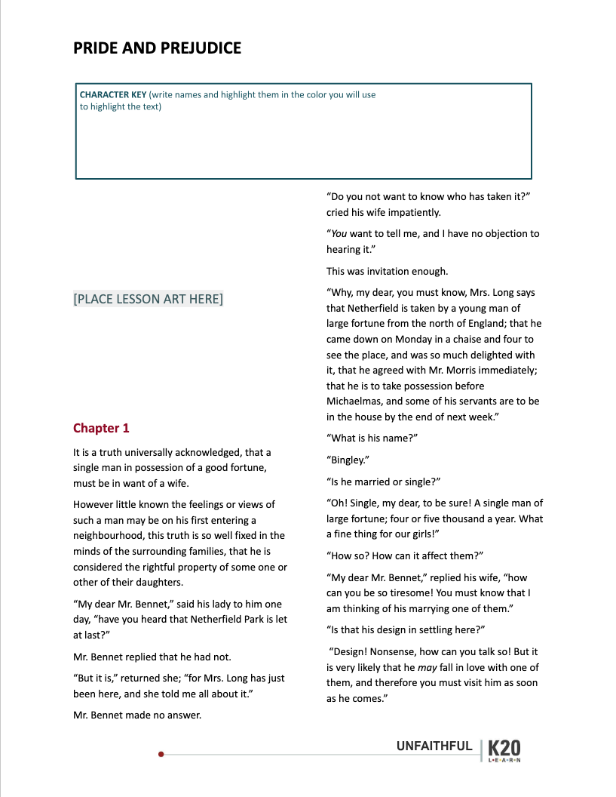
Categorical Highlighting
Write the name of each character in your chapter in the “key” box at the top of the chapter.
Highlight each name a different color.
Use these colors to highlight the chapter text showing what each character is saying and doing.

Slide 13
Notes:
Screen Bites. (n.d.). Elizabeth Rejects Mr. Darcy [Video]. YouTube. https://www.youtube.com/watch?v=WeCBoYbixEk&t=52s

Slide 14
Notes:
Pride and Prejudice – Mr Darcy Proposes (n.d.) [Video]. https://www.youtube.com/watch?v=9K_9vpUnxh0

Slide 15
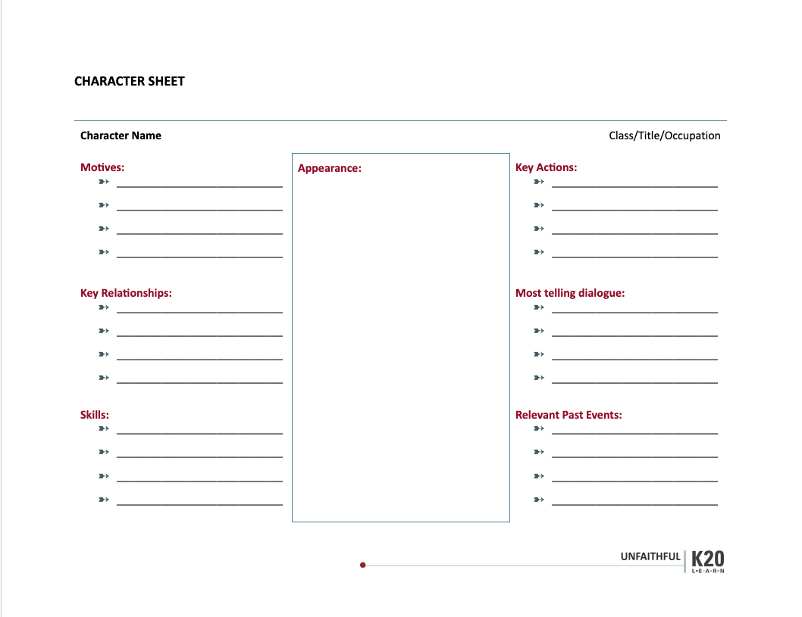
Character Sheet
After reading and highlighting the chapter, discuss with your group and complete the character sheets together.

Slide 16
Answer these questions for the Video Adaptation you watched with your group.
Do the characters stay true to the original enough that it is believable they are based on the original characters?
Do the characters act in ways the original character would if they lived in the world that the adaptation establishes?
Explain how so and how not.
Notes:
Have groups share their conclusions and reasoning with the whole class.

Slide 17
Categorical Highlighting
& Character Sheets
This time work with your group on your assigned chapter.

Slide 18
Adaptation Planning
KEEP: What elements of your chapter will be kept intact so your adaptation still feels like Pride and Prejudice?
CHANGE: How will you deviate from the original? (place, time, perspective, genre, etc.)
RATIONALE: Explain why you took this approach to adapting the chapter. What theme or message is emphasized by your changes?
Notes:
Use the planning handout and respond to the questions as you develop the concept for your adaptation.

Slide 19
Adaptation Presentations

Slide 20
Reflection
Mirror: How has this lesson changed or expanded your thinking about adaptations?
Microscope: What part of the activity was difficult or unexpected? Were you able to be true to the source material and the world of the adaptation?
Binoculars: How do you think modern adaptations of Pride and Prejudice are impacted by what is going on in the world?

