Slide 2
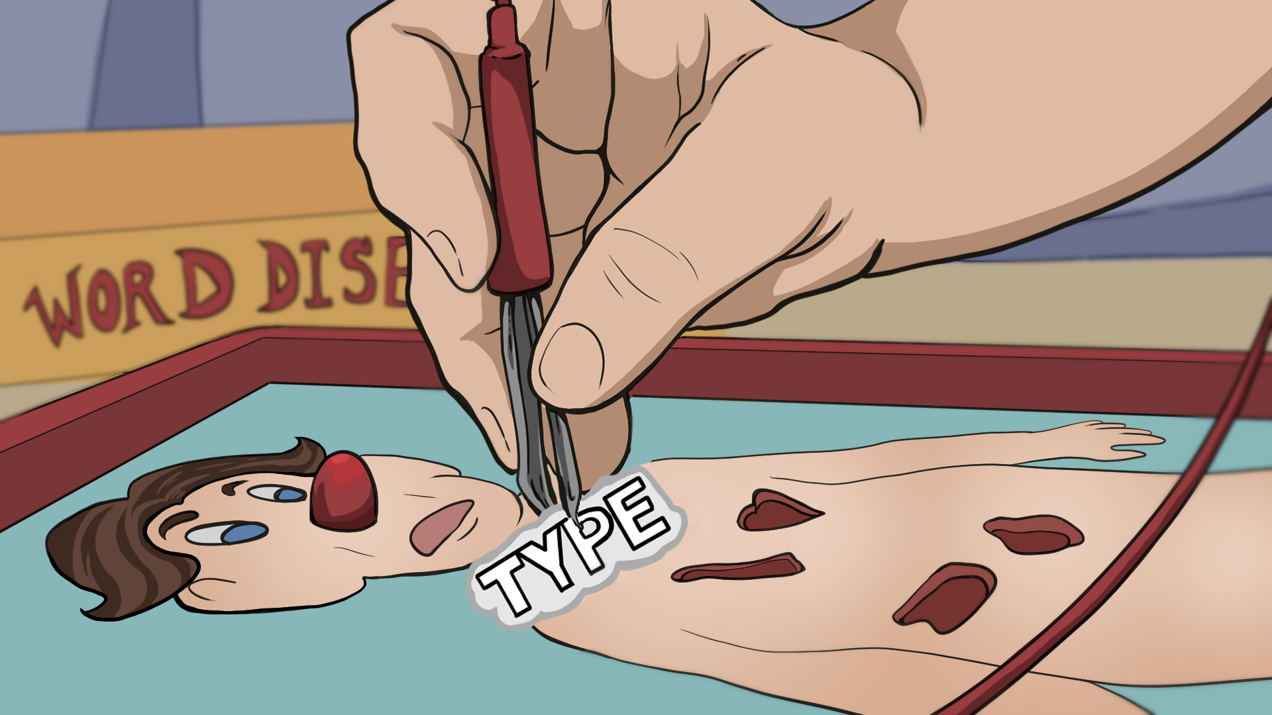
Operation Word Dissection
Analyzing Writing Prompts

Slide 3
Essential Question
How does breaking down a prompt help you to answer it effectively?

Slide 4
Lesson Objectives
Analyze and write ACT style writing prompts.

Slide 5

Puzzling Parts
With your group try to complete the puzzle without any directions.
K20 5 Minute Timer
Notes:
K20 Center. (2021, September 21). 5 Minute Timer. YouTube. https://www.youtube.com/watch?v=EVS_yYQoLJg

Slide 6

Puzzling Parts
With your group try to complete the puzzle.
TIP - [add a brief description of the puzzle you gave students]
K20 3 Minute Timer
Notes:
K20 Center. (2021, September 21). 3 Minute Timer. YouTube. https://www.youtube.com/watch?v=iISP02KPau0

Slide 7

Puzzling Parts
With your group try to complete the puzzle.
[insert an image of the final product of the puzzle]
K20 1 Minute Timer
Notes:
K20 Center. (2021, September 21). 1 Minute Timer. YouTube. https://www.youtube.com/watch?v=6ilD555O_RE

Slide 8
Puzzling Parts | Discussion
At what point in the process did your group feel comfortable with the task?
Did some groups figure out the puzzle quicker than other groups?
For the groups that progressed the furthest, what strategies did you use to figure out the puzzle?

Slide 9

Prompt Card Sort
Rearrange the sections so that they create a prompt.
Use the Prompt Map as a guide.
Notes:
K20 Center. (n.d.). Card Sort. Strategies. https://learn.k20center.ou.edu/strategy/147

Slide 10
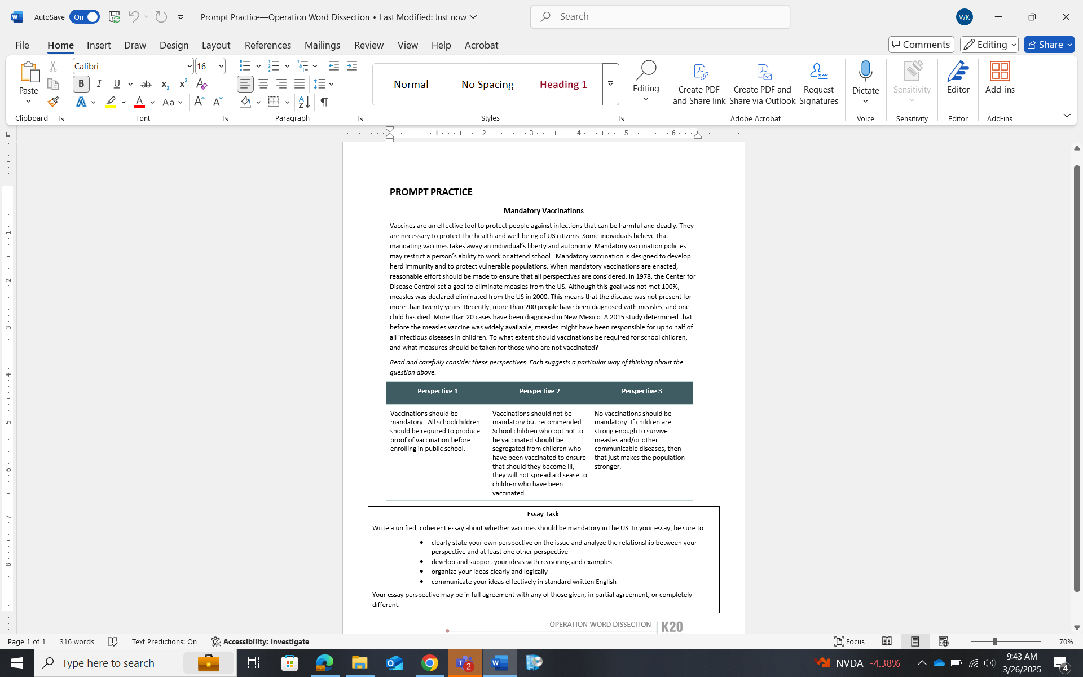
Answer
What is the prompt saying?
How did you break up the prompt?
Who is your audience? How do you know this?

Slide 11
How would you answer the prompt?
Write out the steps you would take to answer the prompt.

Slide 12

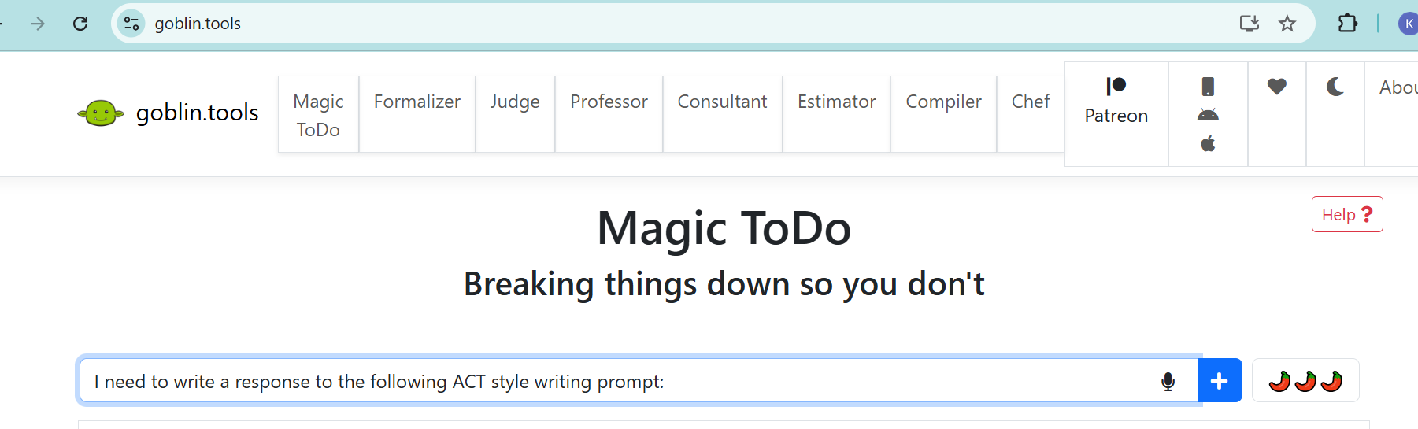
Compare your steps to the Goblin’s
Navigate to https://goblin.tools/
On the “Magic To Do” tab, write in the “Add new item” bar something like the following:
I need to write a response to the following ACT style writing prompt: [insert prompt]
Notes:
K20 Center. (n.d.). Goblin tools. Tech Tools. https://learn.k20center.ou.edu/tech-tool/3864

Slide 13
Reflection
How did you come up with your list of steps?
How did your list compare to the Goblin’s?
What else did you notice about the Goblin’s response?
Would you change anything about your original list? Explain.

Slide 14
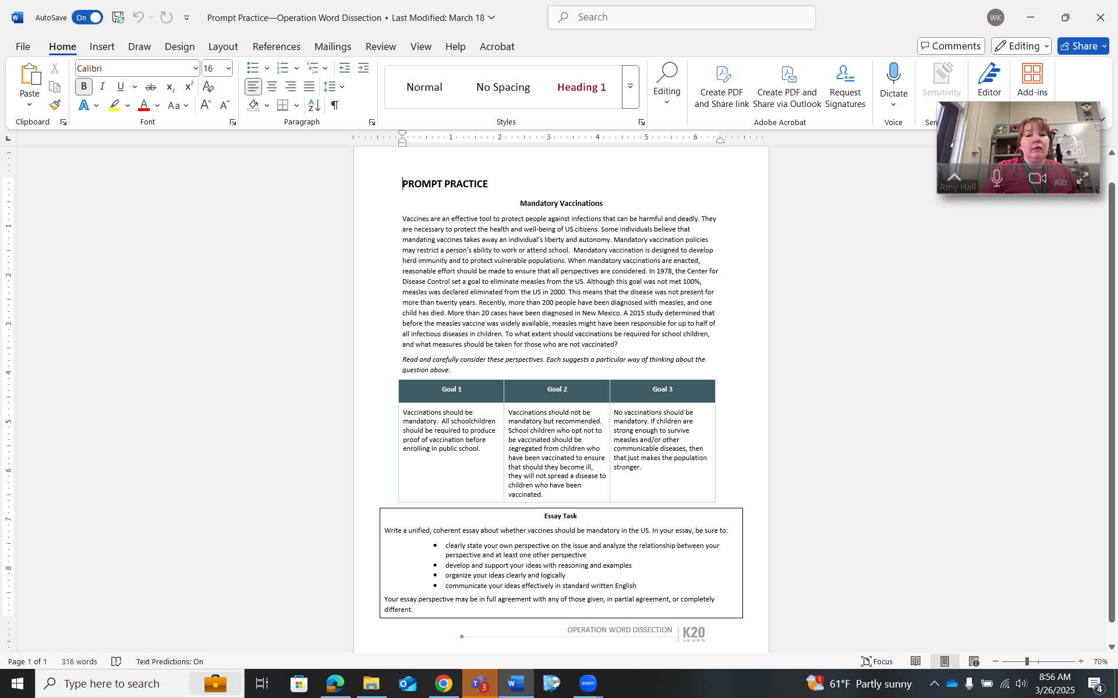
Parts of a Prompt | Introduction
Usually begins the prompt.
Includes background information that students won’t write about, but helps students understand the purpose of the prompt more clearly.
Background information can include: a story, a quote, a current event situation.

Slide 15
Parts of a Prompt | Audience
The audience is whoever is reading the essay.
Sometimes the audience is explicitly stated, but for the ACT, that is not always the case
If the audience is not stated, assume the audience is business/professional. This will keep your writing more formal and free from slang.

Slide 16
Parts of a Prompt | Type
Descriptive: Uses multiple sensory details to describe something.
Expository: Explains a topic clearly with supporting details.
Narrative: Tells a story.
Persuasive: Takes a stance on a topic and provides evidence to support that stance.

Slide 17
Parts of a Prompt | Goal/Perspective
States the outcome of the essay.
Need to accomplish the goal in order to create an effective essay.
Targets the implied or stated audience.

Slide 18

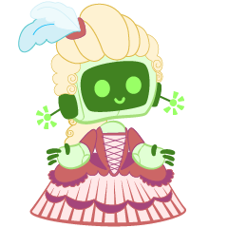
A.I. or Human?
As you read and analyze both of the responses, highlight the following elements:
Introduction
Audience
Type
Goal/Perspective
Notes:
K20 Center. (n.d.). Categorical highlighting. Strategies. https://learn.k20center.ou.edu/strategy/192

Slide 19

A.I. or Human?
Did each sample essay accurately respond to the writing prompt? Explain.
Which essay was written by A.I. and which was written by a human?

Slide 20
A.I. or Human?
Response #1 was written by an A.I. chatbot.
Response #2 was written by a human.
What gave A.I. away? What did you notice?

Slide 21
Sentence Stems | Introduction + Audience
Introduction
Audience

Slide 22
Sentence Stems | Type + Goal/Perspective
Type
Goal/Perspective

Slide 23
Prompt Surgery
Use the spaces provided to create you own ACT style writing prompt.
Your prompt should have:
  Introduction
  Audience
  Type
  Goal/Perspective
Remember to consider what 3 different goals your prompt could have.

Slide 24
Possible Ideas
Should school attendance be mandatory?
Should cell phones be banned in the classroom?
Should Tik Tok and social media be banned for teens?
Is Beowulf a hero?
Who is the true villain from Shakespeare’s play MacBeth?
Do school dress codes work?
Should homework be abolished?
Is there a diet (Mediterranean, vegan, vegetarian, etc.) that works best?
Should students be allowed to retake tests if they fail them?

Slide 25
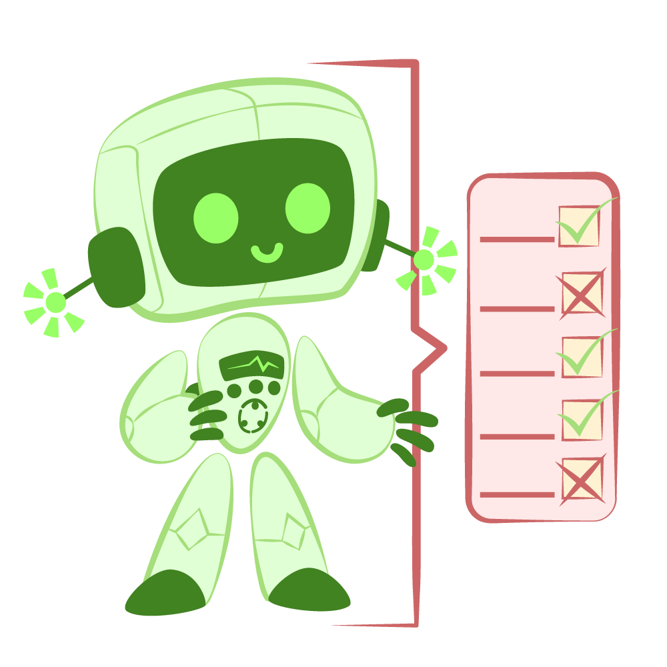
Critique the Bot
Navigate to your preferred chatbot.
  Ex: https://chatgpt.com/
Type in something like the following:
Write a response to the ACT style prompt [insert prompt] from this perspective [insert perspective 1].
Repeat for remaining “Perspectives.”
Read through the bot’s response and “grade” them using your handout as a rubric.
How did the bot measure up?
Notes:
K20 Center. (n.d.). Critique the Bot. Strategies. https://learn.k20center.ou.edu/strategy/3491

