Slide 2
What Do You Have in Common with Your Dog?
Mammalian Characteristics and Adaptations for Survival

Slide 3
Essential Question
How do mammalian body systems coordinate to maintain homeostasis and ensure survival in various environments?
In what ways have evolutionary adaptations facilitated the ability of mammals to thrive in diverse ecosystems?

Slide 4
Lesson Objectives
Explain how mammalian body systems interact to maintain homeostasis.
Investigate how mammals have adapted to their environments through natural selection.
Create models and collaborate to explain mammalian traits and their evolutionary significance.

Slide 5
Card Sort 1: Physical and Behavioral Adaptations
Physical Adaptations | Behavioral Adaptations

Slide 6
Card Sort 2: Behavioral Adaptations
Use your animal cards as column headers and complete a second card sort for each animal.

Slide 7
Homeostasis: Review
Homeostasis
Notes:
Unhide this slide for a video reintroduction to homeostasis. MITK12Videos. (2012, October 23). Homeostasis [Video]. YouTube. https://www.youtube.com/watch?v=rSBbnHLR_cg&t=187s

Slide 8
Characteristics of Mammals
Characteristics of Mammals
Notes:
Watch video from the beginning until 07:20.
Miacademy Learning Channel. (2023, March 1). Mammals - Biology for Teens! [Video]. YouTube. https://www.youtube.com/watch?v=n9ud5ZPu2Po

Slide 9
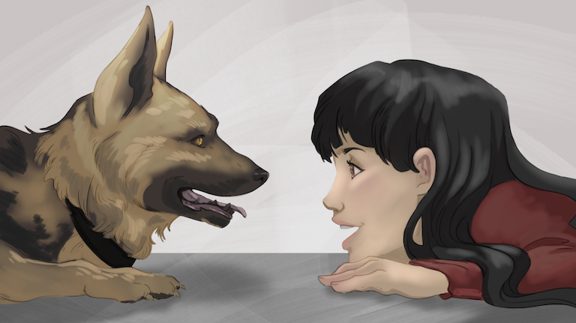
Mammals Poster Project
Research one of three different mammals.
Create a group poster that compares their adaptations.
Include labeled diagrams of key adaptations.

Slide 10
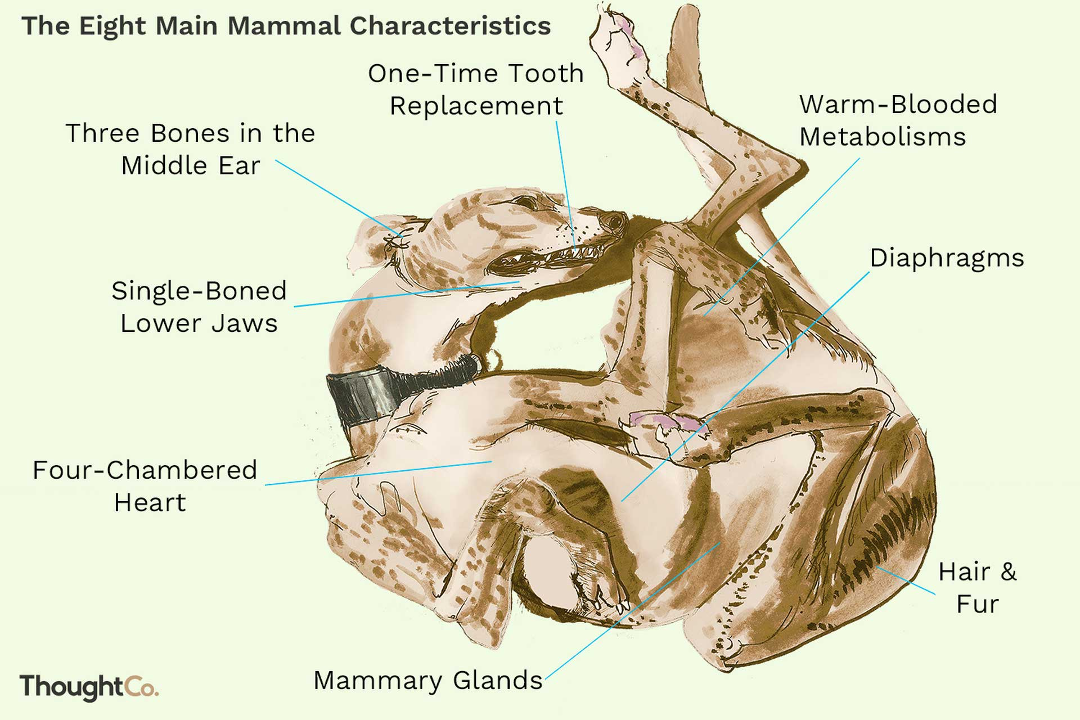
I Notice, I Wonder
Notes:
Write 2 or 3 observations that you Notice (including key details, main ideas, and themes; use the picture for inspiration). How do those adaptations make a mammal a “best fit” for its environment? Have you ever wondered about how these adaptation help a mammal maintain homeostasis?

Slide 11
Categorical Highlighting
In your reading, use two different marker colors to highlight the following two topics:
What do mammals have in common?
What are specific examples of mammalian adaptations?
Notes:
Use handout “Mammalian Characteristics and Adaptations” for this activity.

Slide 12
Exit Ticket
Choose one of the following questions and write a brief paragraph (three sentence minimum!).
How do mammal body systems interact to maintain homeostasis?
Describe one adaptation of a mammal and how it helps with survival and reproduction.

Slide 13
It’s Always Bunny Rush Hour on This Island
Bunny Rush Hour
Notes:
Science Channel. (2015, May 9). It's always bunny rush hour on this Japanese island [Video]. YouTube. https://www.youtube.com/watch?v=6nBs_yRqg4w&t=111s

Slide 14
PhET Simulation
To access the Natural Selection simulation, type in the URL or scan the QR code.
k20.ou.edu/bunnies
Notes:
https://phet.colorado.edu/en/simulations/natural-selection
University of Colorado, Boulder. (n.d.). Natural selection [Interactive simulation]. PhET Interactive Simulations. https://phet.colorado.edu/en/simulations/natural-selection
https://k20.ou.edu/bunnies

Slide 15
Three Stray, One Stays
A core representative stays to describe the group’s poster while the others move on to discover new perspectives and report back.

Slide 16
Exit Ticket
Think about an animal you examined on your recent Gallery Walk.
Compare it to the mammal you researched.
Describe how the adaptations of these mammals contribute to their survival in unique environments.

