Slide 2
Mastering Manual Mode
Part One: Camera Operations

Slide 3
Essential Question
How does a videographer use the camera settings to control the image they want to capture?

Slide 4
Learning Objectives
Master the concept of ISO, shutter speed, aperture, and their relationships to light, brightness, and noise.
Analyze and apply ISO settings in diverse scenarios using virtual and physical tools.
Relate exposure adjustments to real-world applications in photography and broadcast production.
Collaborate and reflect on creative and technical decisions.

Slide 5
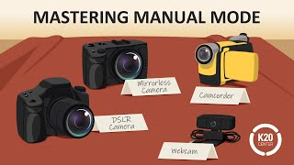
I Notice, I Wonder
Notes:
K20 Center. (2025, March 14). Mastering manual mode: Camera operations demystified [Video]. YouTube. https://www.youtube.com/watch?v=ZNwGyE8FZVk

Slide 6
Gallery Walk
Review the posters stationed around the room. Using your notecatcher, continue to build on your I Notice, I Wonder from earlier.
Notes:
K20 Center. (n.d.). Gallery walk / carousel. Strategies. https://learn.k20center.ou.edu/strategy/118

Slide 7
Card Sort
With a partner, match the camera element with the vocabulary definition.
Notes:
K20 Center. (n.d.). Card sort. Strategies. https://learn.k20center.ou.edu/strategy/147

Slide 8
Scavenger Hunt Notes
Look for camera functions on the different camera body types.
ISO, shutter, aperture
WB (white balance)
Delete
Media/playback
Q.Menu (Quick Menu)
FUNC (Function)
REC (Record)
Identify any icons used to represent those functions.
Notes:
K20 Center. (n.d.). Scavenger hunt notes. https://learn.k20center.ou.edu/strategy/3113

Slide 9
3-2-1
What 3 things have you learned today?
What are 2 questions you still have?
What is 1 thing you found interesting?
Notes:
K20 Center. (n.d.). 3-2-1. Strategies. https://learn.k20center.ou.edu/strategy/117

