Slide 2
Rules of the Mogwai
6th–12th Grade Science

Slide 3
Essential Question
How do scientists determine the safest way to handle lab chemicals and materials, and how do they communicate this?

Slide 4
The Rules of the Mogwai
Warner Bros. Entertainment. (2012, April 27). Gremlins | Rules | Warner Bros. Entertainment. YouTube. https://youtu.be/OrHdo-v9mRA
Notes:
Warner Bros. Entertainment. (2012, April 27). Gremlins | Rules | Warner Bros. Entertainment. YouTube. https://youtu.be/OrHdo-v9mRA

Slide 5
Safety: It’s Not Just for Gremlins!
List some rules you have heard growing up that are meant to help keep you safe.
Share out with the class.
List some safety rules you have heard in the science lab.
Share out with the class.

Slide 6
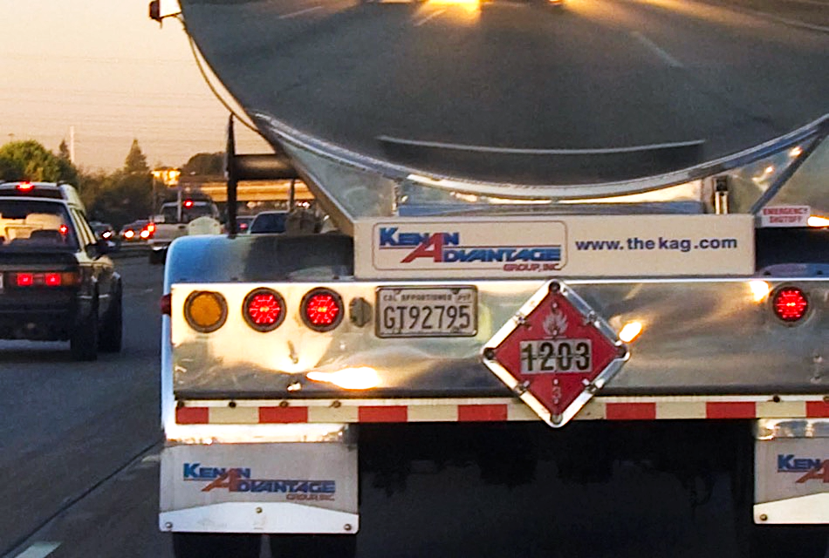
Name That Item
Source: Couse-Baker, R. (2008, October 14). DOT 1203 - Flammable Liquid Gasoline. Flickr. Retrieved from https://www.flickr.com/photos/29233640@N07/2943670660/
Notes:
Answer: Gas tanker. Source: Couse-Baker, R. (2008, October 14). DOT 1203 - Flammable Liquid Gasoline. Flickr. Retrieved from https://www.flickr.com/photos/29233640@N07/2943670660/

Slide 7
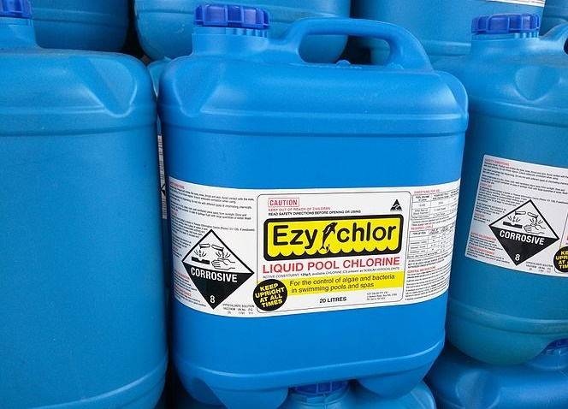
Name That Item
Source: Kozlenko, M. (2015, November 14). Liquid pool chlorine. Wikimedia Commons. Retrieved from https://commons.wikimedia.org/wiki/File:Liquid_Pool_Chlorine.jpg
Notes:
Answer: Pool cleaner/chlorine. Source: Kozlenko, M. (2015, November 14). Liquid pool chlorine. Wikimedia Commons. Retrieved from https://commons.wikimedia.org/wiki/File:Liquid_Pool_Chlorine.jpg

Slide 8
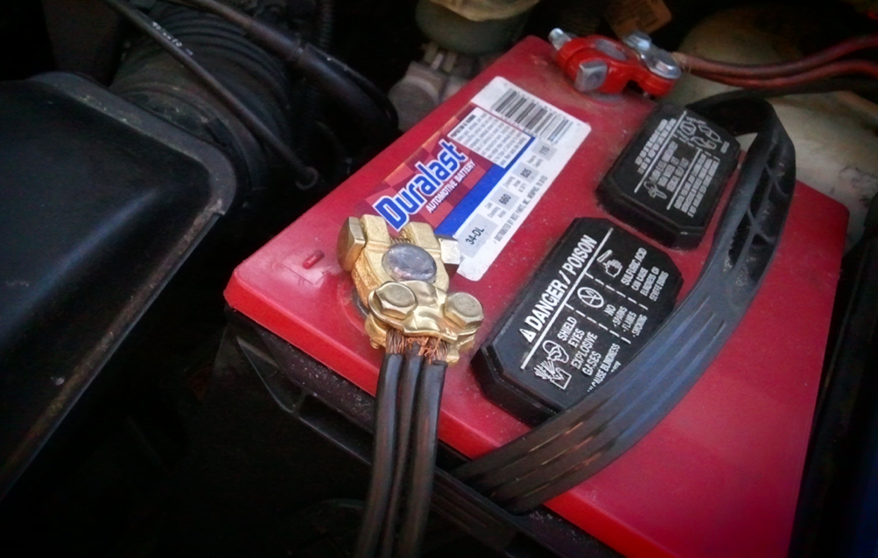
Name That Item
Source: EvelynGiggles. (2011, April 4). Battery terminal. Flickr. Retrieved from https://www.flickr.com/photos/29233640@N07/2943670660/
Notes:
Answer: Car battery. Source: EvelynGiggles. (2011, April 4). Battery terminal. Flickr. Retrieved from https://www.flickr.com/photos/29233640@N07/2943670660/

Slide 9
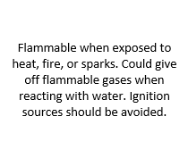
Card Sort
Match the safety symbols cards to the category of the hazard and the description of the hazard. For example:

Slide 10
Safety Data Sheets (SDS)
Every chemical has an SDS. These are used by scientists to communicate important information to others (scientists and non-scientists).
In groups, let’s look at the SDS for materials you might have used: rubbing alcohol, vinegar, ibuprofen, Pam® cooking spray, WD-40 ®, bleach, Comet ®, Windex ®, Pledge ®, gasoline, acetone, hydrogen peroxide, and lithium-ion batteries.
While reading, follow the Stop and Jot strategy using the questions on your handout.
When instructed, switch your SDS with another group’s.

Slide 11
Safety Data Sheets (SDS)
16 categories of information given
The main categories are:
properties of the chemical
hazards to human health and the environment
protective measures (gloves, masks, etc.)
safety precautions for handling, storing, and transporting the chemical

Slide 12
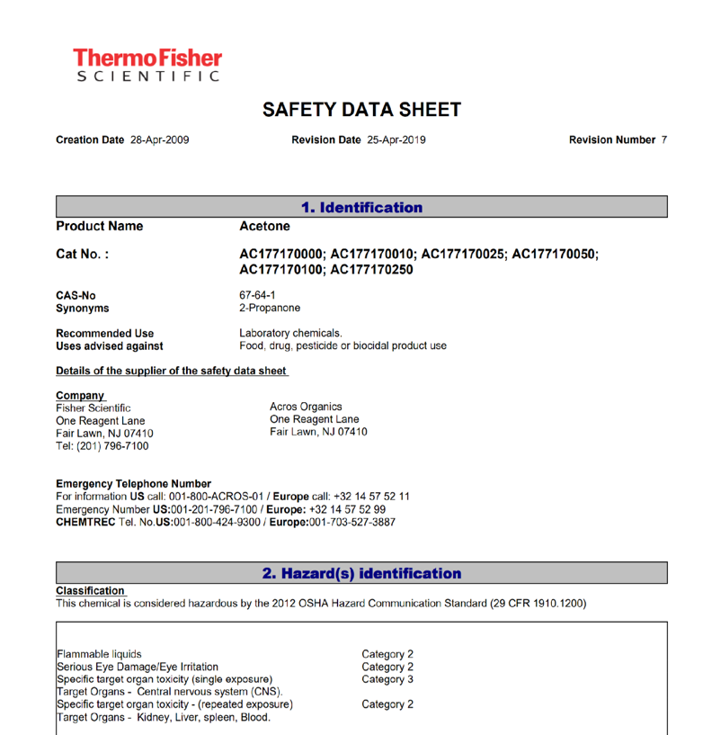
Notes:
Accessed online at https://www.fishersci.com/shop/msdsproxy?productName=AC177170010&productDescription=ACETONE

Slide 13
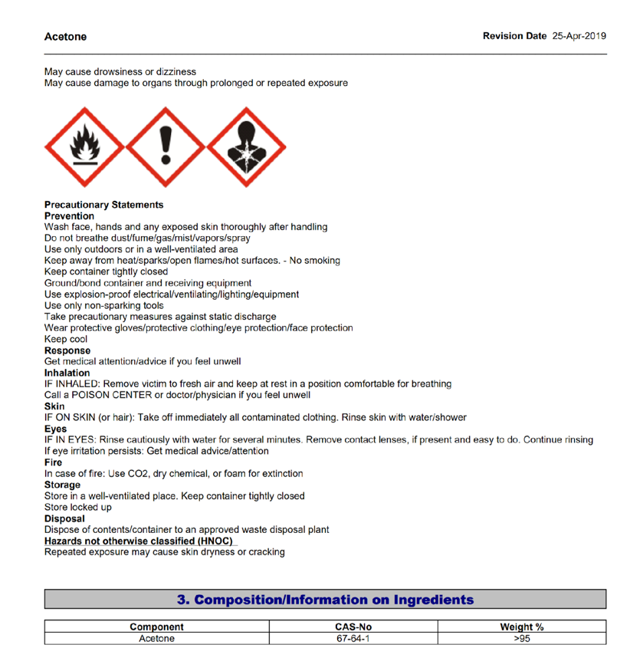

Slide 14
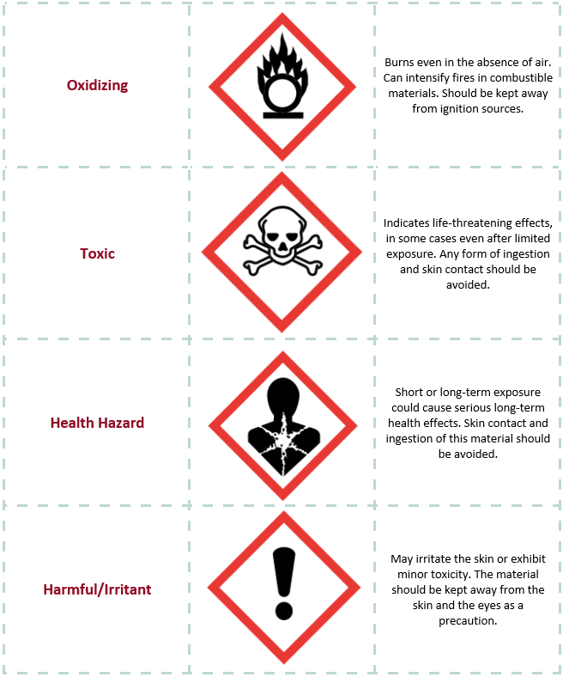
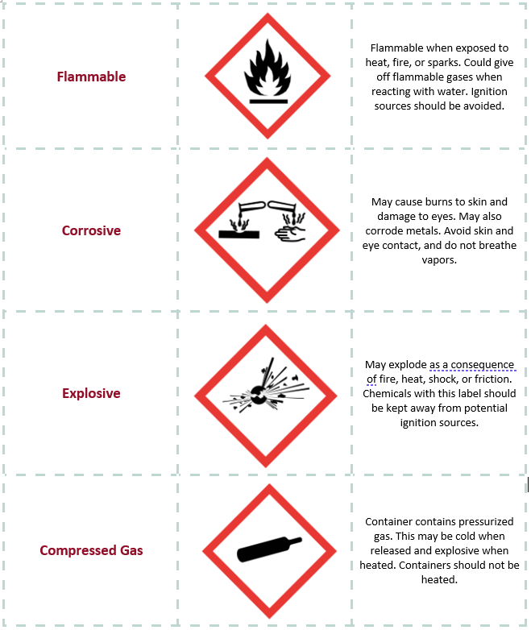
Card Sort Answers

Slide 15
Safety Posters
If we were to make safety posters for chemicals we commonly use, what information would we include?

Slide 16
Safety Posters
In groups, create a poster using the last SDS you had when doing the Card Sort.
Include the characteristics we’ve discussed that are important for sharing safety information.
Posters will be displayed around the room, and your peers will give you feedback.

Slide 17
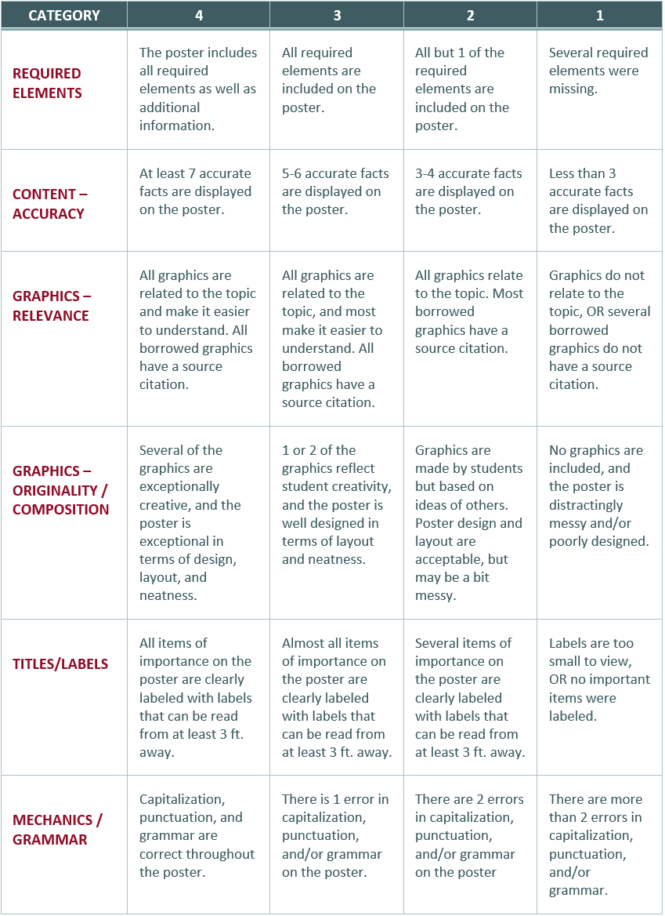
Poster Rubric
6 categories
Scoring
4 = excellent
1 = needs improvement
Be creative! Make your posters creative, colorful, and informative. Add color, 3D elements, etc.

Slide 18
Gallery Walk
Using the rubric provided, tell your classmate(s) what they did well and what they could improve. It’s your chance to learn from each other.
You’ll have 3 minutes at each poster before receiving the signal to move to the next one.

