Slide 2
The Cost of Being Seen
The Cost of Marketing and Sales

Slide 3
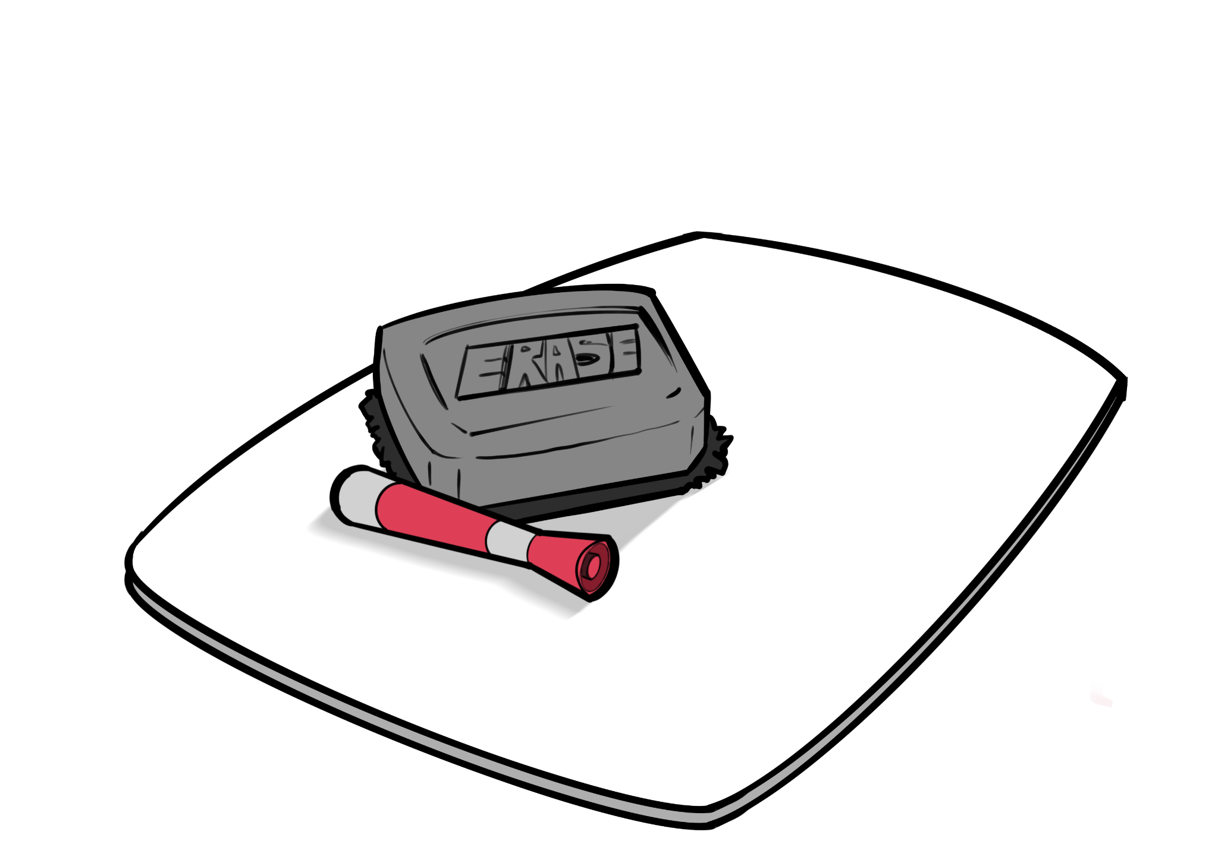
Wipeout
What do you think of when you hear the word “marketing?”

Slide 4
Essential Question
How do we determine the costs of marketing and selling a particular product?

Slide 5
Lesson Objectives
Evaluate costs of marketing and selling a particular product.
Analyze and justify data of marketing expenses to infer impacts of different marketing strategies.

Slide 6
Chat Stations
You and your group will go to each station to discuss and answer the questions using the data from the table or graph.
Record your answers on the provided handout.
Include data from the graph or table to support your answer.

Slide 7
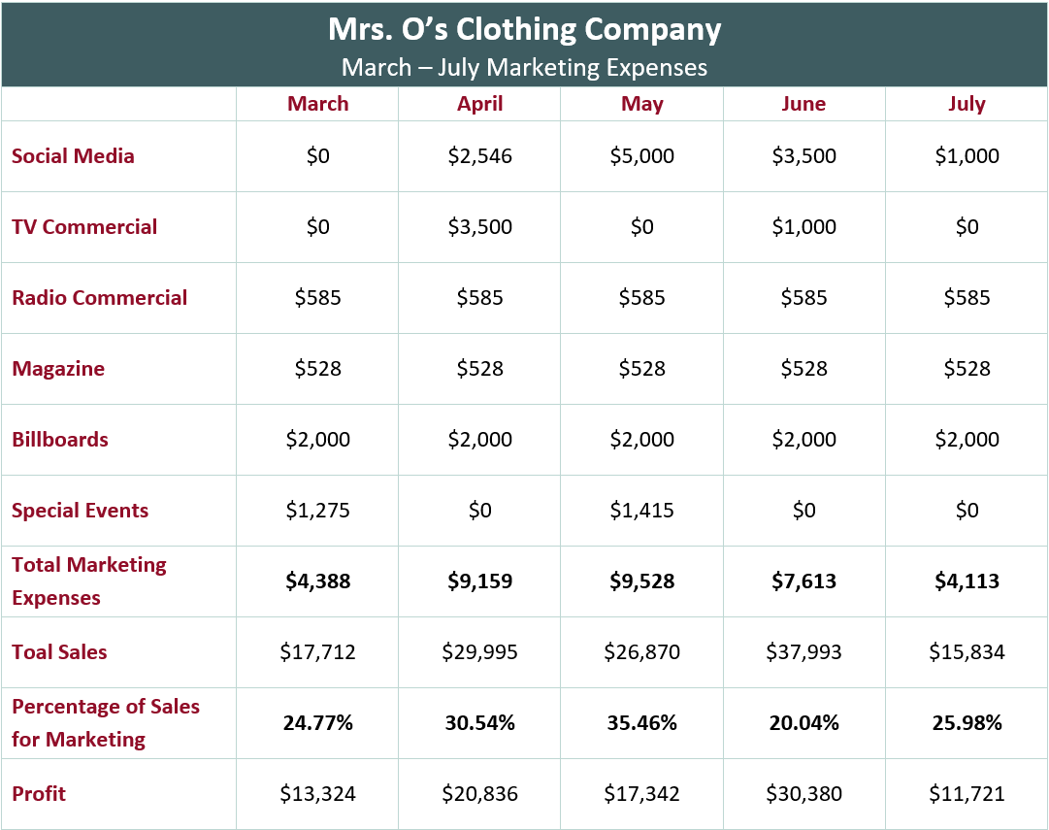
Chat Stations —Station 1
In which month did Mrs. O’s company spend the greatest percentage of sales for marketing? Least? What do you have to consider to calculate the percentage of sales for marketing?
What was the greatest marketing expense for the entire quarter? Least?
What was the average monthly marketing expense?
Notes:
Greatest: May; Least: June; Consider: the total marketing expenses out of total sales
Greatest: Social Media; Least: Magazine
$6,960.20, add up the total marketing expenses and divide by the number of months

Slide 8
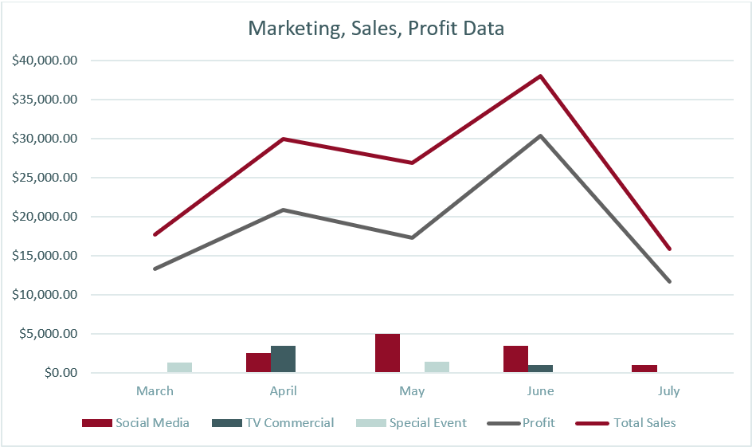
Chat Stations—Station 2
What impact do you think social media has on the marketing strategy? Justify your answer with data from the graph.
Notes:
Social media helped the sales of the product, It was better when paired with TV commercial

Slide 9
Chat Stations—Station 3
If you are a marketing director in this company and the CEO tells you to cut down on the marketing expenses, which two marketing strategies should you keep? Justify your answer with data from the graph.
Notes:
Social media and TV commercial, the sales and profit were higher during those months of April and June where both were present

Slide 10
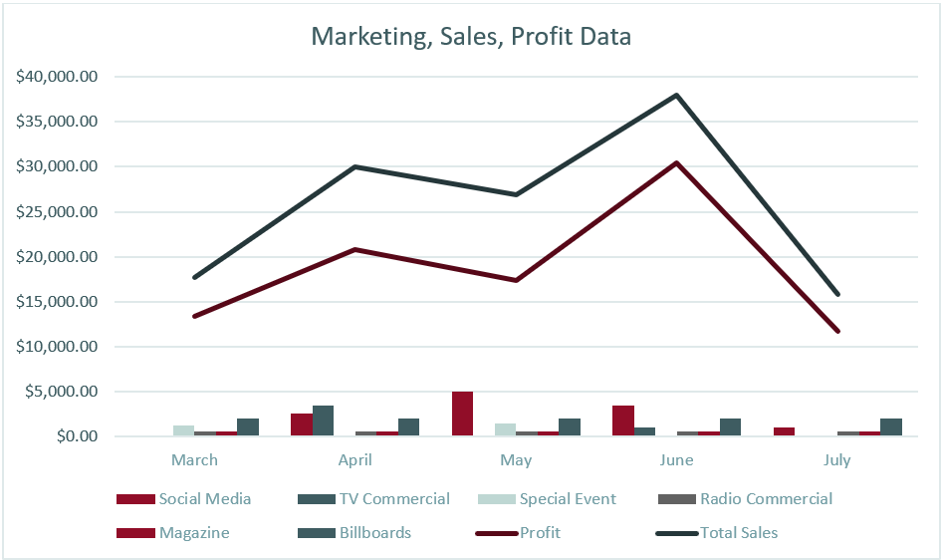
Discussion
Looking at how much marketing contributed to the profit of this company, do you think this company will survive without a marketing strategy? Why or why not?
Notes:
No, month of July sales were not good. Possible answers- Only marketed on billboard, magazine, radio commercial (these are consistent monthly expenses so probably no change and people can become used to that advertisement and not pay attention to it anymore) and very little social media. Did not market on TV.

Slide 11
Think-Pair-Share
Bill started a sailboat company that is very successful. In a podcast interview, he was asked, “What is the secret of your success?” Bill replied, “Keeping down the cost of sails.”
What does he mean?

Slide 12
Points to Consider about Marketing
Marketing is used to advertise the value of a product or service to potential customers or clients.
Marketing creates and communicates awareness of what is being offered.
Marketing depends on the type of product and the audience.
Bring down the cost of sales. The higher the cost of sales the more your profit is affected.

Slide 13
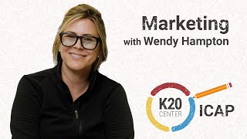
ICAP

Slide 14
Example
Name and describe your product.
Gym Membership – A premium all-access gym membership that includes unlimited group fitness classes, personal training discounts, and 24/7 access to all facilities.
Total Gross Sales = $500,000

Slide 15
Example
1. Calculate 5% of your annual gross sales for marketing
$500,000 x 0.05 = $25,000

Slide 16
Example
2. Allocate 60% of marketing expenses to all 12 months in the table.
$25,000 x 0.60 = $15,000
$15,000 ÷ 12 = $1250 per month

Slide 17
Example
3. Allocate an additional 40% of marketing expenses to your peak sales months.
$25,000 x 0.40 = $10,000
$10,000 ÷ 1 = $10,000
*divide by the number of peak months

Slide 18
Example
The total gross sales for a gym membership is $500,000. To keep a “Top-of-Mind Awareness” and an even playing field with the competition, this company will need to spend $1,250 each month with an additional $10,000 in January, the gym’s peak season.

Slide 19
POMS
What was the “point of most significance” about the cost of sales and marketing?
What stood out to you most about the lesson on Cost of Sales & Marketing.

