Slide 2

Monotheistic Religions
Abrahamic Religions

Slide 3
Essential Question
How do the connections and distinctions between Judaism, Christianity, and Islam shape our understanding of history, belief systems, and cultural interactions?

Slide 4
Learning Objectives
Analyze and compare the origins, beliefs, sacred texts, key figures, and practices of Judaism, Christianity, and Islam.
Synthesize and present key similarities and differences about the shared heritage and distinct traditions of Abrahamic religions.

Slide 5
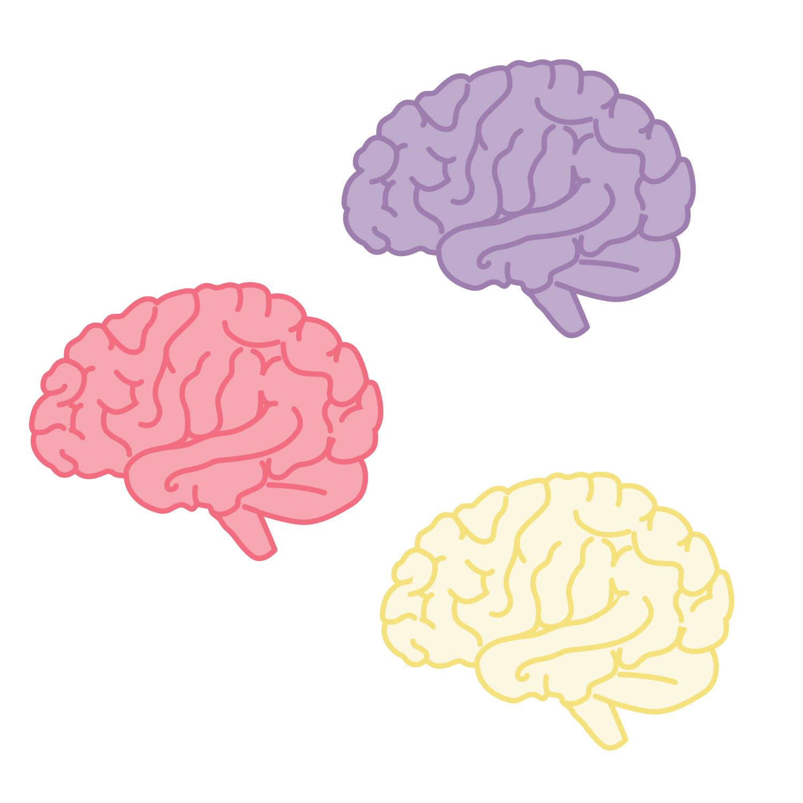

Collective Brain Dump
With your group, brainstorm everything you know about Christianity, Islam, and Judaism.
Notes:
K20 Center. (n.d.). Collective brain dump. Strategies. https://learn.k20center.ou.edu/strategy/111
K20 Center. (2021, September 21). K20 Center 5 minute timer [Video]. YouTube. https://www.youtube.com/watch?v=EVS_yYQoLJg

Slide 6

Unraveling the Abrahamic Threads
Historical files on monotheistic religions have been stolen!
You must recover historical details and trace connections and differences between monotheistic religious traditions.
In your group, decide who will read the dossier for each religion.

Slide 7

Jigsaw
Use your dossier and other resources as needed to research one key aspect from the list below:
  Origins
  Sacred Texts
  Beliefs about God
  Prophets and Key Figures
  Practices and Rituals
  Ethical Teachings
  Historical Interactions
Notes:
K20 Center. (n.d.). Jigsaw. Strategies. https://learn.k20center.ou.edu/strategy/179

Slide 8
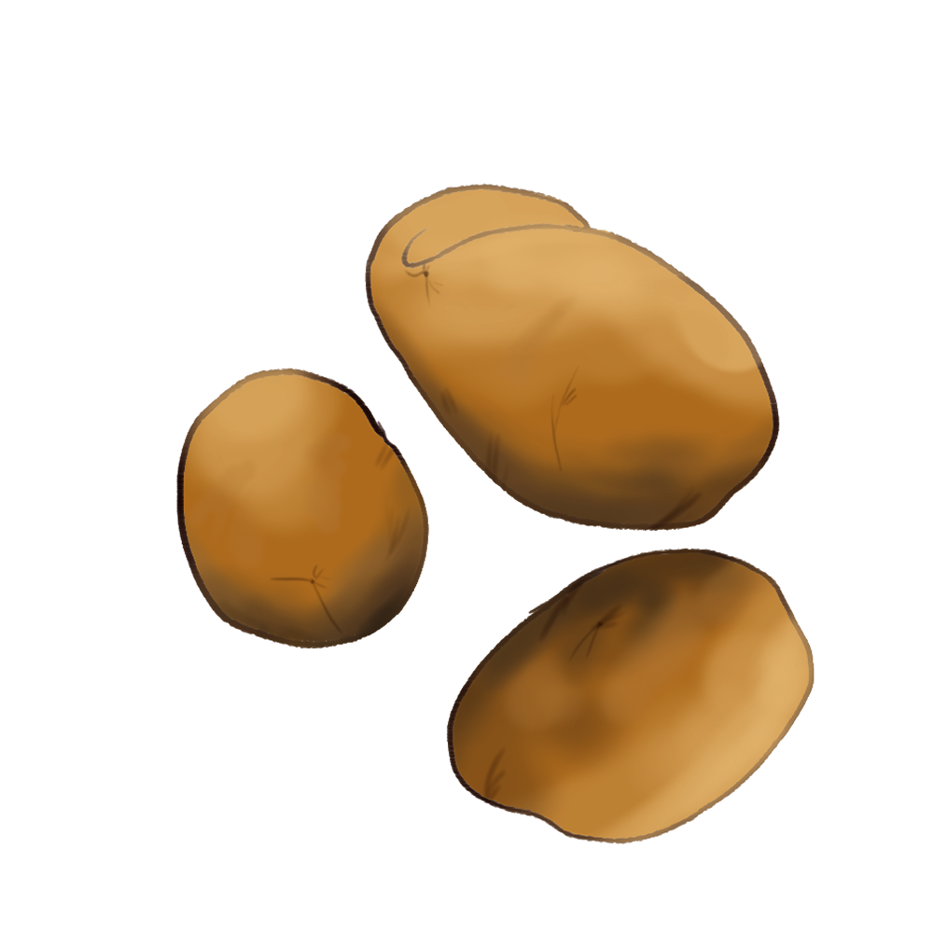
Hot Potato Information Gathering
Divide into groups by your assigned dossier.
When you receive the ball, share key findings about your assigned religion.
Pass the ball to another group member, who should continue to share out more information related to the topic.
Continue until the next subject is called out.
Notes:
K20 Center. (n.d.). Hot potato. Strategies. https://learn.k20center.ou.edu/strategy/4465

Slide 9
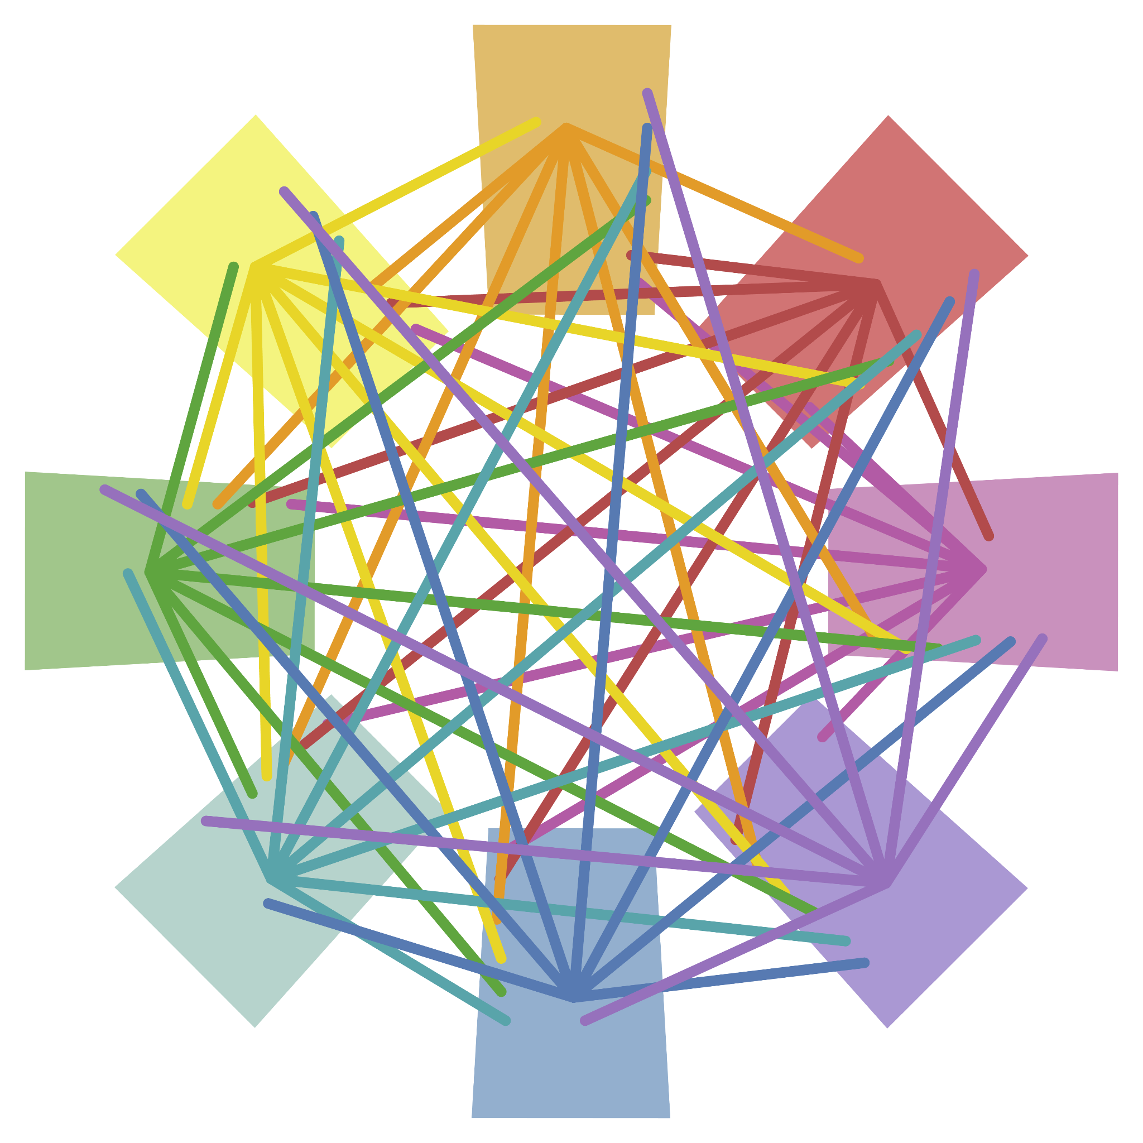
Contribute to a Slide
Find your slide in the Key Notes Shared Slides document.
Develop a slide that shares key information and images relevant to your religion.
Remember that your contribution will be shared with all your classmates.
Notes:
K20 Center. (n.d.). Detective board. Strategies. https://learn.k20center.ou.edu/strategy/3530

Slide 10
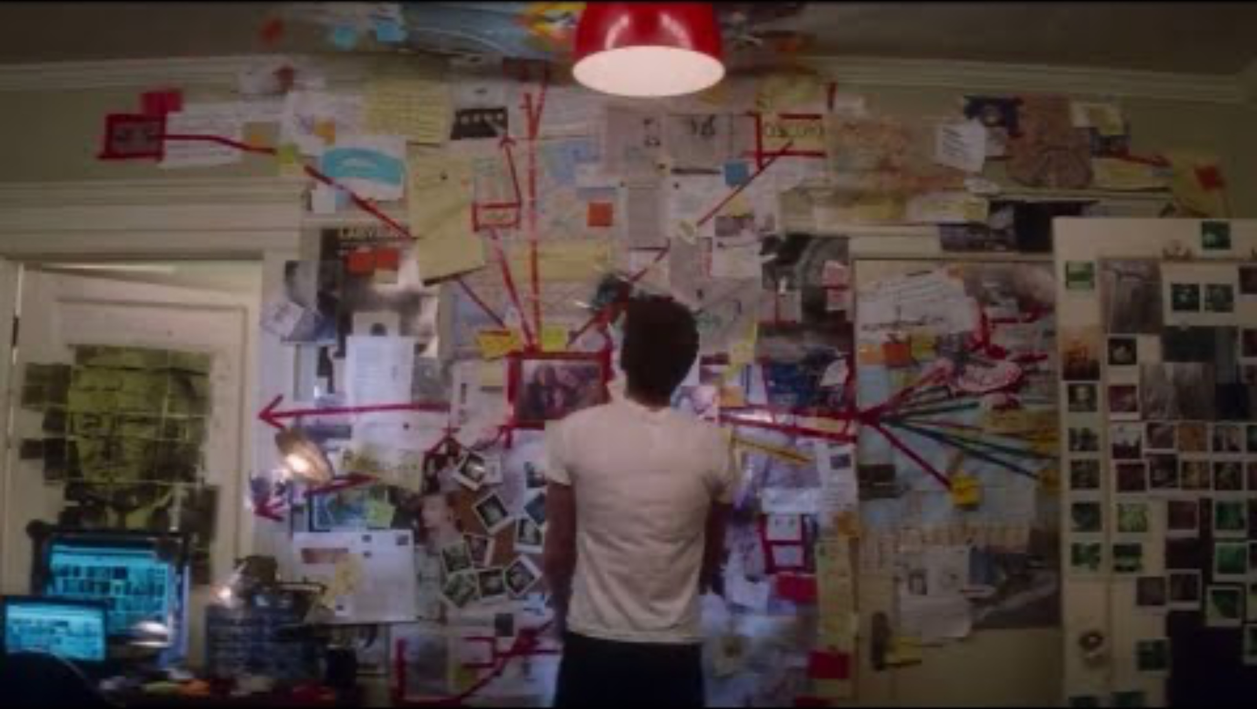
What is a Detective Board?
Notes:
Winchester, L. J. (2021, March 5). Peter makes an evidence board | The Amazing Spider-Man 2 (2014) [Video]. YouTube. https://www.youtube.com/watch?v=Afyd92nr558

Slide 11
Detective Board
Each member of your group should have completely read one dossier.
Complete additional research on your assigned religion, if necessary.
Notes:
K20 Center. (n.d.). Detective board. Strategies. https://learn.k20center.ou.edu/strategy/3530

Slide 12
Prepare Your Detective Boards
Designate one poster for each religion: Islam, Christianity, and Judaism.
Add key information about the religions to designated posters.
Identify connections between the religions. Illustrate these connections by connecting concepts with yarn.
Prepare to present.
Notes:
K20 Center. (n.d.). Detective board. Strategies. https://learn.k20center.ou.edu/strategy/3530

Slide 13
Presentation Time
Share your completed Detective Boards.
Notes:
K20 Center. (n.d.). Detective board. Strategies. https://learn.k20center.ou.edu/strategy/3530

Slide 14
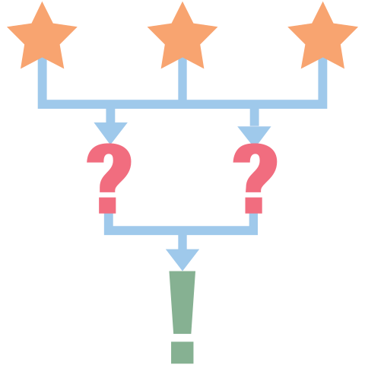
3-2-1
What are 3 things you learned?
What are 2 things you are still considering?
What was 1 thing you found most surprising or impactful during your investigation?
Notes:
K20 Center. (n.d.). 3-2-1. Strategies https://learn.k20center.ou.edu/strategy/117

