Slide 2
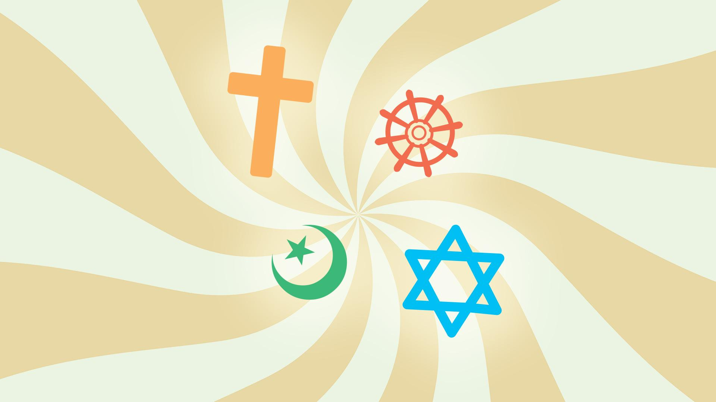
Monotheistic Religions

Slide 3
Essential Question
How do the connections and distinctions between Judaism, Christianity, and Islam shape our understanding of history, belief systems, and cultural interactions?

Slide 4
Lesson Objectives
Analyze and compare the origins, beliefs, sacred texts, key figures, and practices of Judaism, Christianity, and Islam
Synthesize and present key similarities and differences about the shared heritage and distinct traditions of Abrahamic religions.

Slide 5
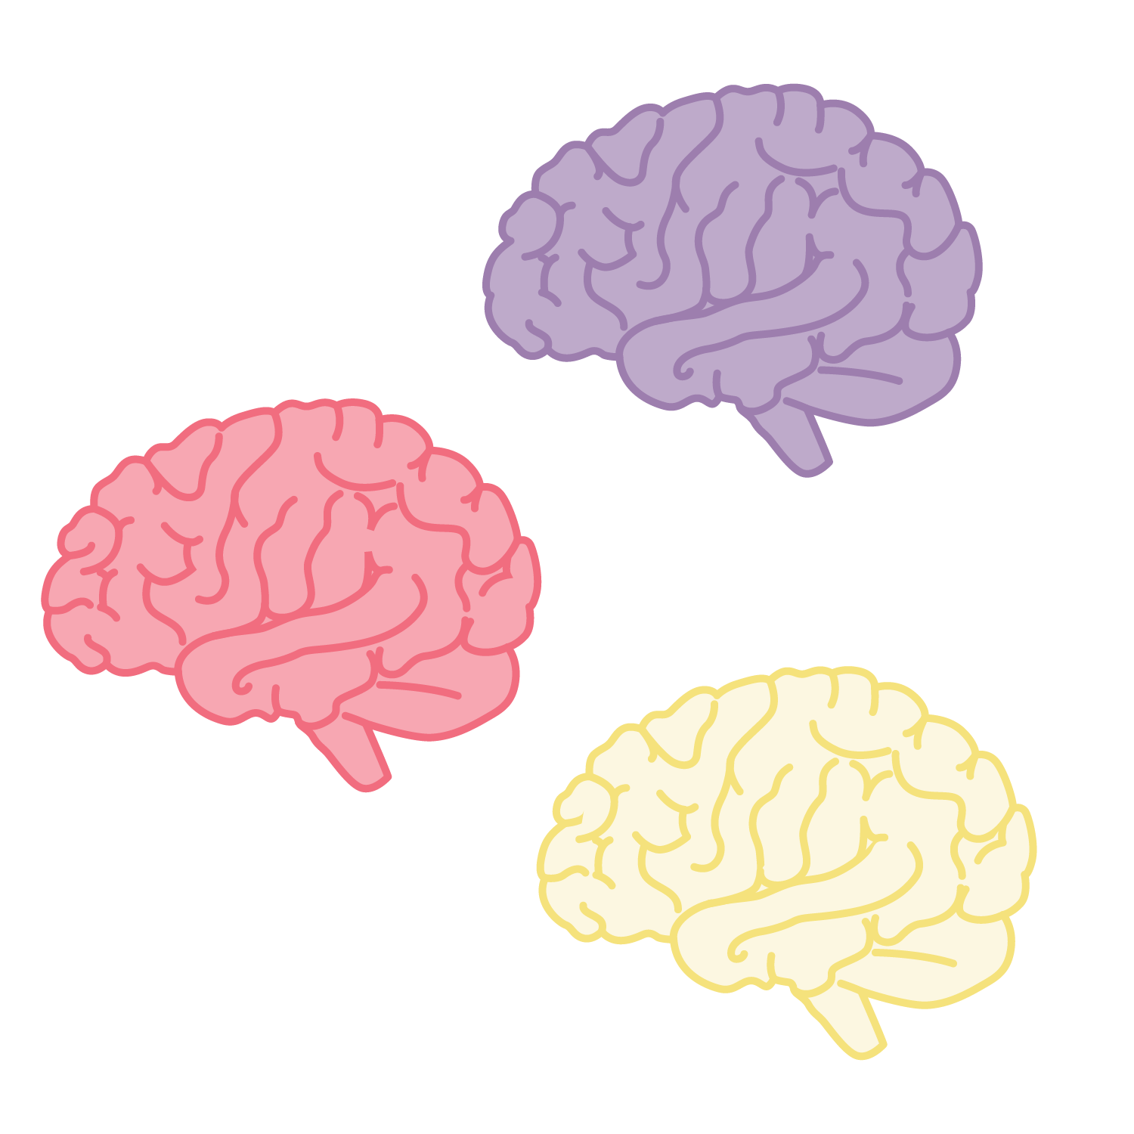

Collective Brain Dump
With your group, brainstorm everything you know about Christianity, Islam, and Judaism.

Slide 6
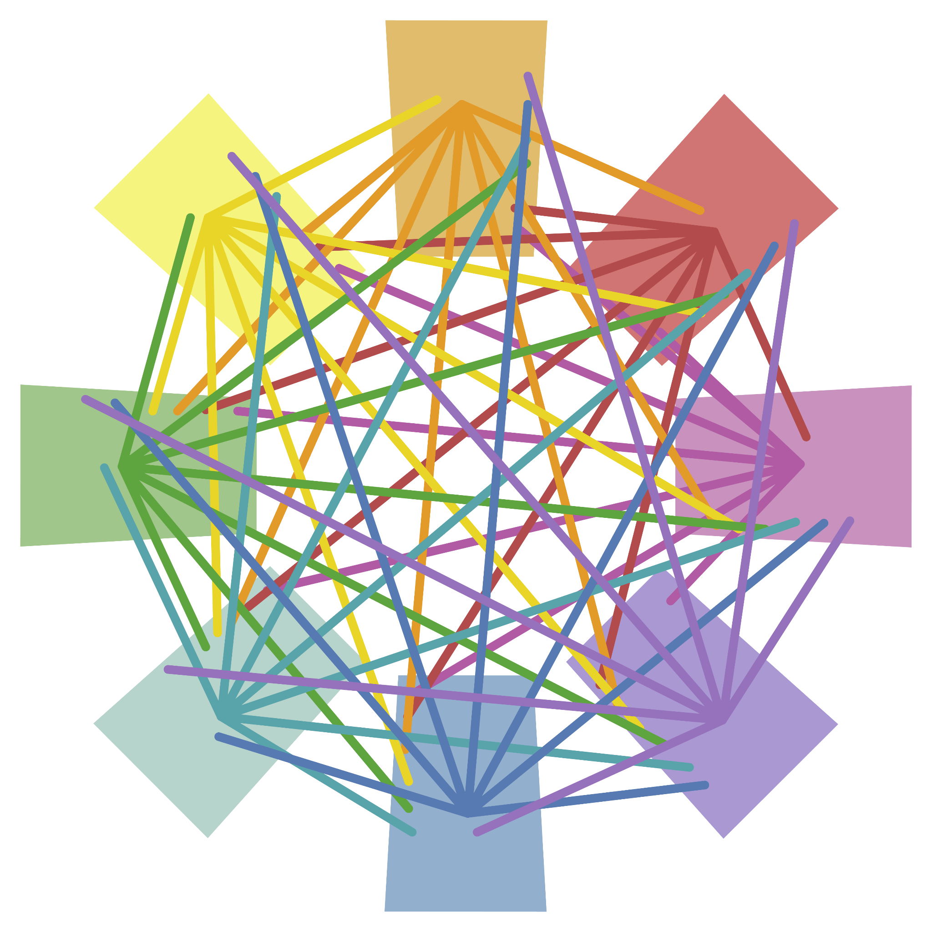
Unraveling the Abrahamic Threads

Slide 7

Jigsaw
Use your dossier and other resources as needed to research a key aspect from the list below:
  Origins
  Sacred Texts
  Beliefs about God
  Prophets and Key Figures
  Practices and Rituals
  Ethical Teachings
  Historical Interactions

Slide 8
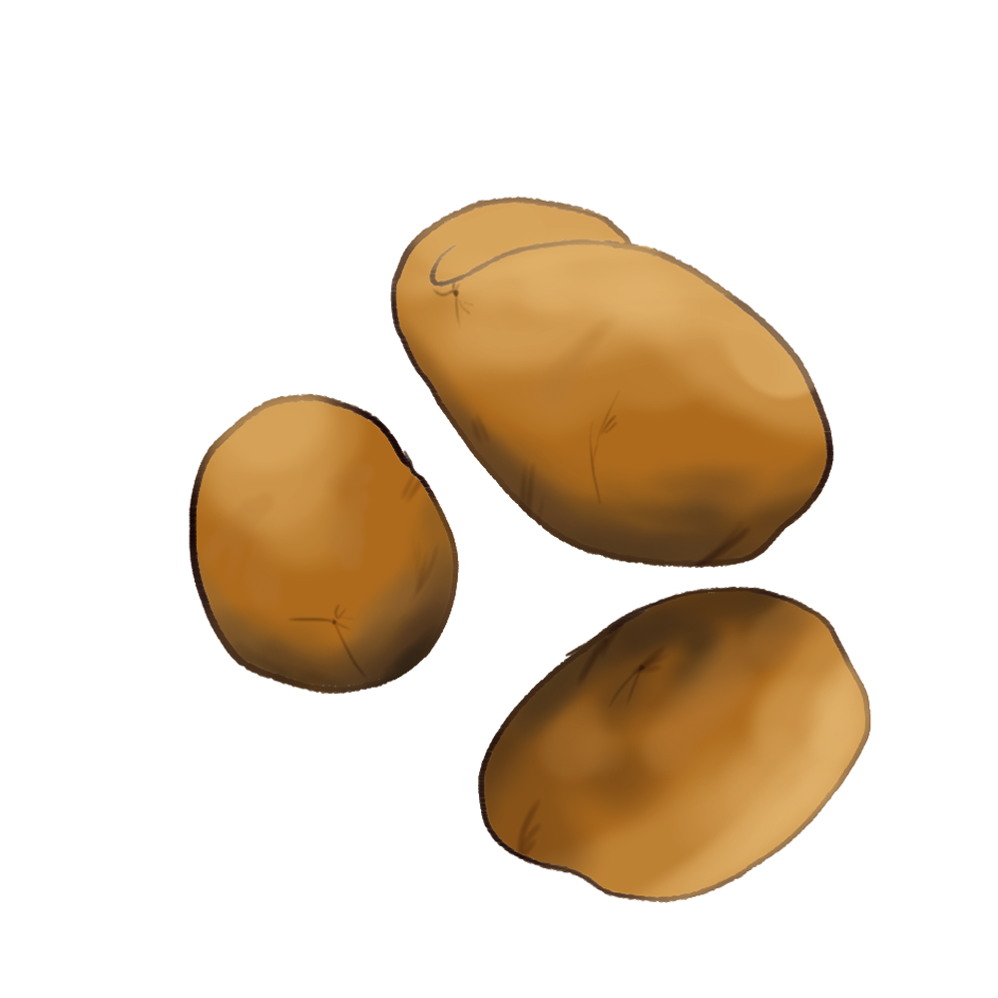
Hot Potato Information Gathering
Divide into groups by religion and be prepared to discuss with peers in your group when your group number is called.
Pass the ball to anyone to add information when the first contributor is done. Continue until instructor calls next subject.

Slide 9
Contribute to a Slide
Go to your page in the slides document and develop a slide that captures key information and/or images relevant to your topic.
Your contribution will be shared among all students to complete this assignment.

Slide 10
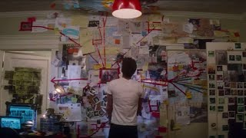
Detective Board
Each group will create a conspiracy board, BUT FIRST:
  Each member will do a deep read of one dossier.
  Complete additional research as needed.
  Complete a slide over assigned key area.

Slide 11
Prepare Your Detective Boards
Work as a group with three posters, one for each religion.
Create connections between each religion using yarn and the shared slides to which everyone has contributed.
Be prepared to present.

Slide 12
Presentation Time
This slide is intentionally blank.

Slide 13

3-2-1
What are 3 things you learned?
What are 2 things you are still considering?
What was 1 thing you found most surprising or impactful during your investigation?

