Slide 1

Dragon Delivery

Slide 2
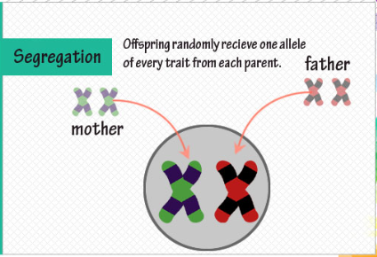
Mendel’s Law of Segregation

Slide 3
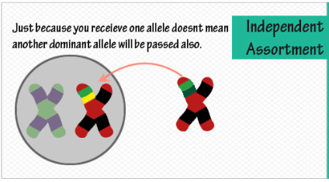
Mendel’s Law of Independent Assortment
Different traits sort independently

Slide 4

Codominant traits
Codominant traits occur when two types of alleles are equally dominant.
Heterozygous for codominant traits results in a blending of the two traits.

Slide 5
Sex-influenced traits
Sex-influenced traits appear more often in one sex than the other.
The genes for sex-influenced traits are on the autosomes not the sex chromosomes.
Sex-influenced traits are influenced by both genes and hormones, not just genes.

Slide 6
Sex-linked traits
Sex-linked traits are located on the sex chromosomes.
Most sex linked traits are determined by genes found on the X chromosome, not the Y chromosome. This is because the Y chromosome bears very few genes in comparison to the X chromosome which bears a normal complement of genes.
If you are male and have one gene on the X chromosome, it is expressed whether it is dominant or recessive.
Many times females can be carriers of a gene that causes a disorder, but not necessarily have the disorder. This is because one of the two X’s is normal and suppresses the recessive trait.
Males tend to get the disease or disorder that is carried on a sex chromosome.

Slide 7
Sex-limited traits
Genes present in both sexes but only expressed in one sex. Although the genotype may be the same for male and female the phenotypes are different. Sex-limited traits occur on autosomes NOT sex chromosomes.

Slide 8
Pictures from:
https://www.google.com/search?q=principle+of+segregation&espv=210&es_sm=91&source=lnms&tbm=isch&sa=X&ei=GflbUpfTBsT02gXHj4GIDQ&ved=0CAkQ_AUoAQ&biw=1309&bih=614&dpr=1#facrc=_&imgdii=_&imgrc=kp7VZ0XHbdFu7M%3A%3B4BuloVPhVqFB-M%3Bhttp%253A%252F%252Fwww.dbriers.com%252Ftutorials%252Fwp-content%252Fuploads%252F2012%252F04%252FDihybridGraphic1.jpg%3Bhttp%253A%252F%252Fwww.dbriers.com%252Ftutorials%252F2012%252F04%252Fmendels-law-of-segregation-assortment-simplified%252F%3B600%3B900

