Slide 2
Unmasking Metaphors
Golden Shovel Poetry

Slide 3
Essential Question
How do authors use metaphors and poetic forms to convey meaning?

Slide 4
Lesson Objectives
Identify and interpret metaphors for meaning.
Apply your knowledge of metaphors and poetic form to create your own Golden Shovel poem.

Slide 5
Magnetic Statements
For each image, walk to the situation sign that feels most like the image to you.
Think about it like this: “This [situation] makes me feel like this [image].”
Once you are at your situation sign, discuss with your group why you made that connection.
Notes:
K20 Center. (n.d.). Magnetic statements. Strategies. https://learn.k20center.ou.edu/strategy/166

Slide 6
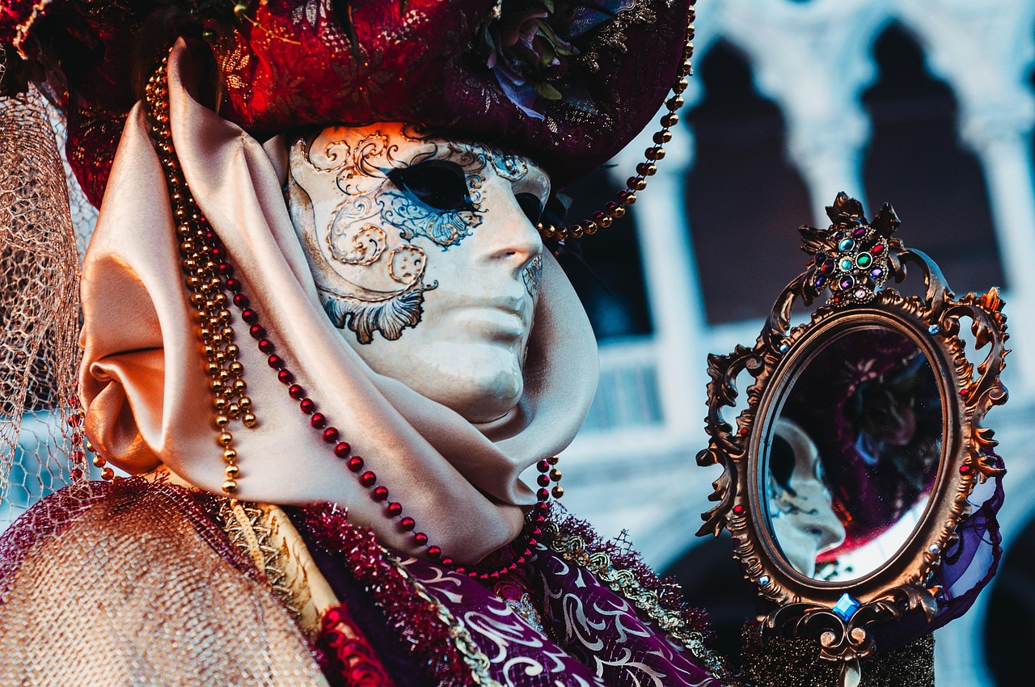
Notes:
HelenJank. (2021, February 10). Mask [Photograph]. Pixabay. https://pixabay.com/photos/mask-carnival-venice-costume-6003323/

Slide 7
Notes:
NoName_13. (2020, May 10). Birds [Photograph]. Pixabay. https://pixabay.com/photos/birds-flying-freedom-ducks-heaven-5159711/

Slide 8
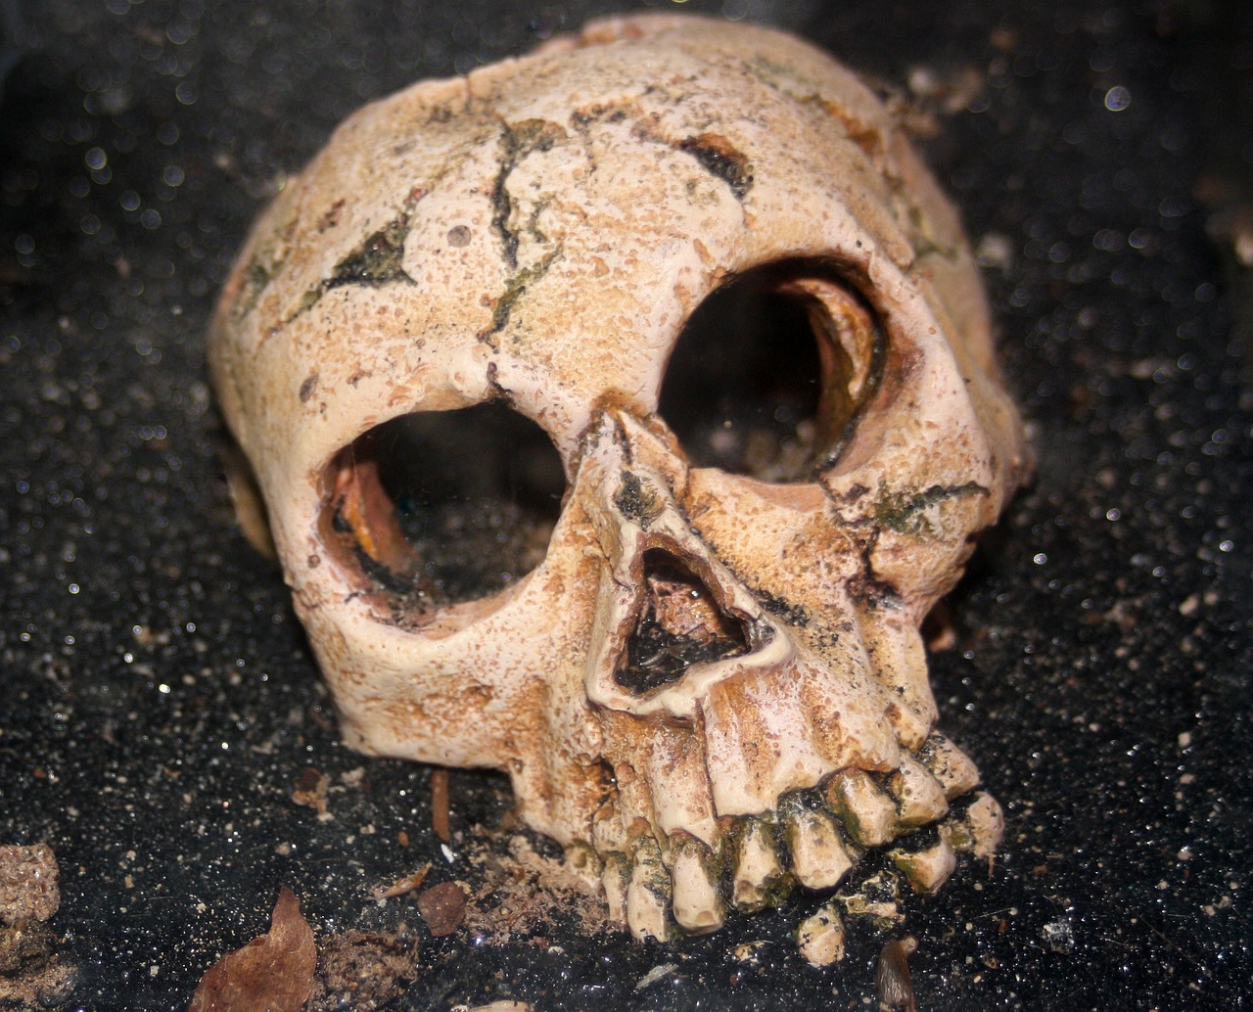
Notes:
steinchen. (2014, January 10). Skull [Photograph]. Pixabay. https://pixabay.com/photos/skull-skeleton-human-242172/

Slide 9
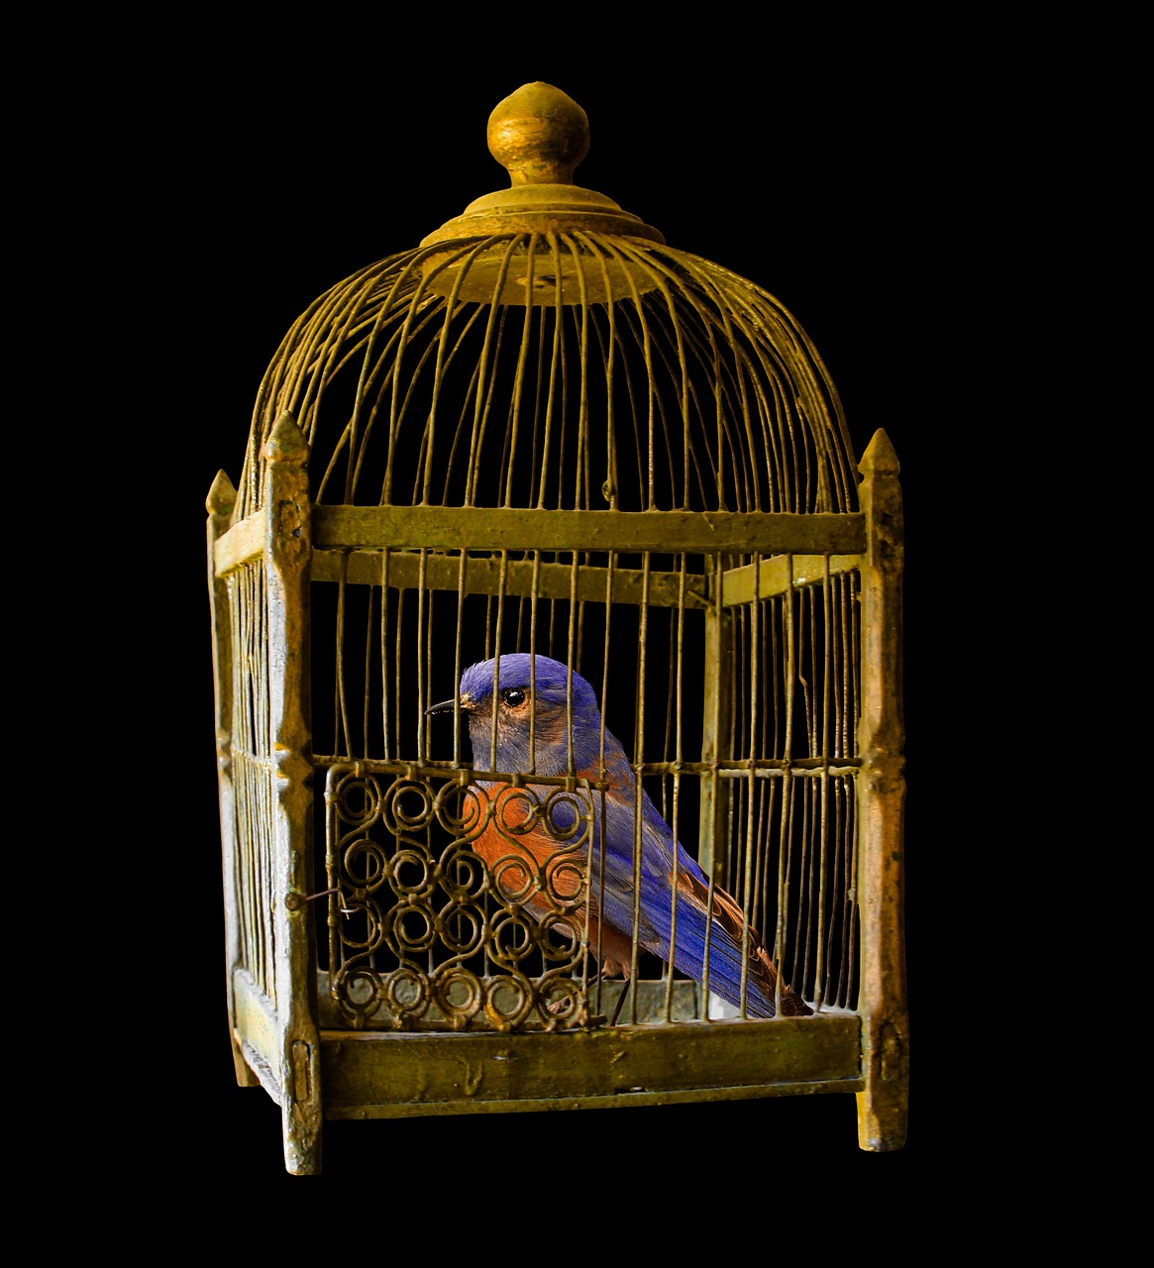
Notes:
garten-gg. (2016, February 29). Cage [Photograph]. Pixabay. https://pixabay.com/photos/cage-gold-bird-jail-locked-1226738/

Slide 10
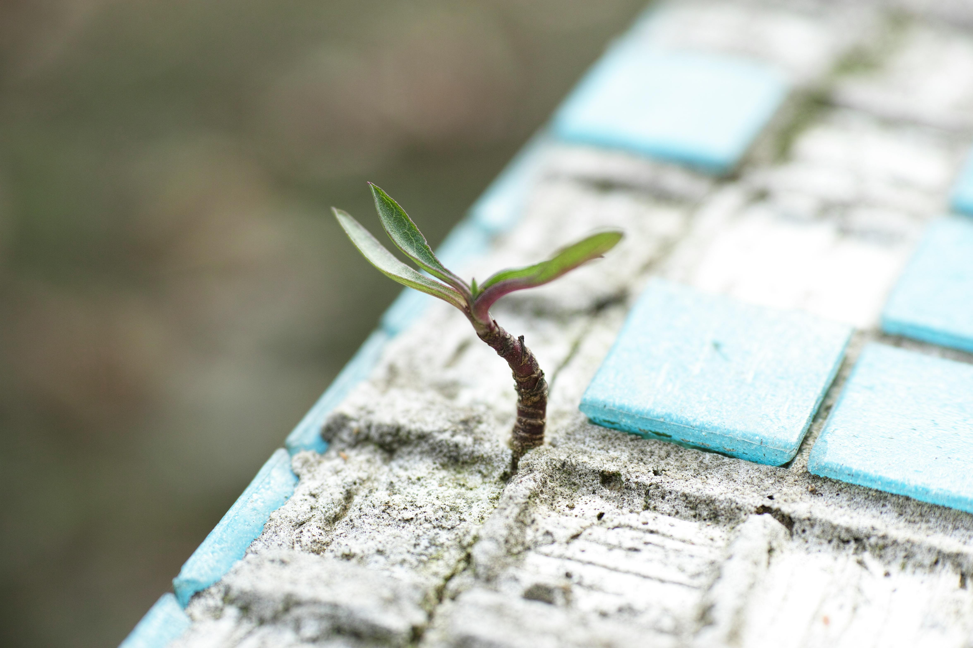
Notes:
Engin Akyurt. (2015, October 27). Green leafed plant on sand [Photograph]. Pexels. https://www.pexels.com/photo/green-leafed-plant-on-sand-1438404/

Slide 11
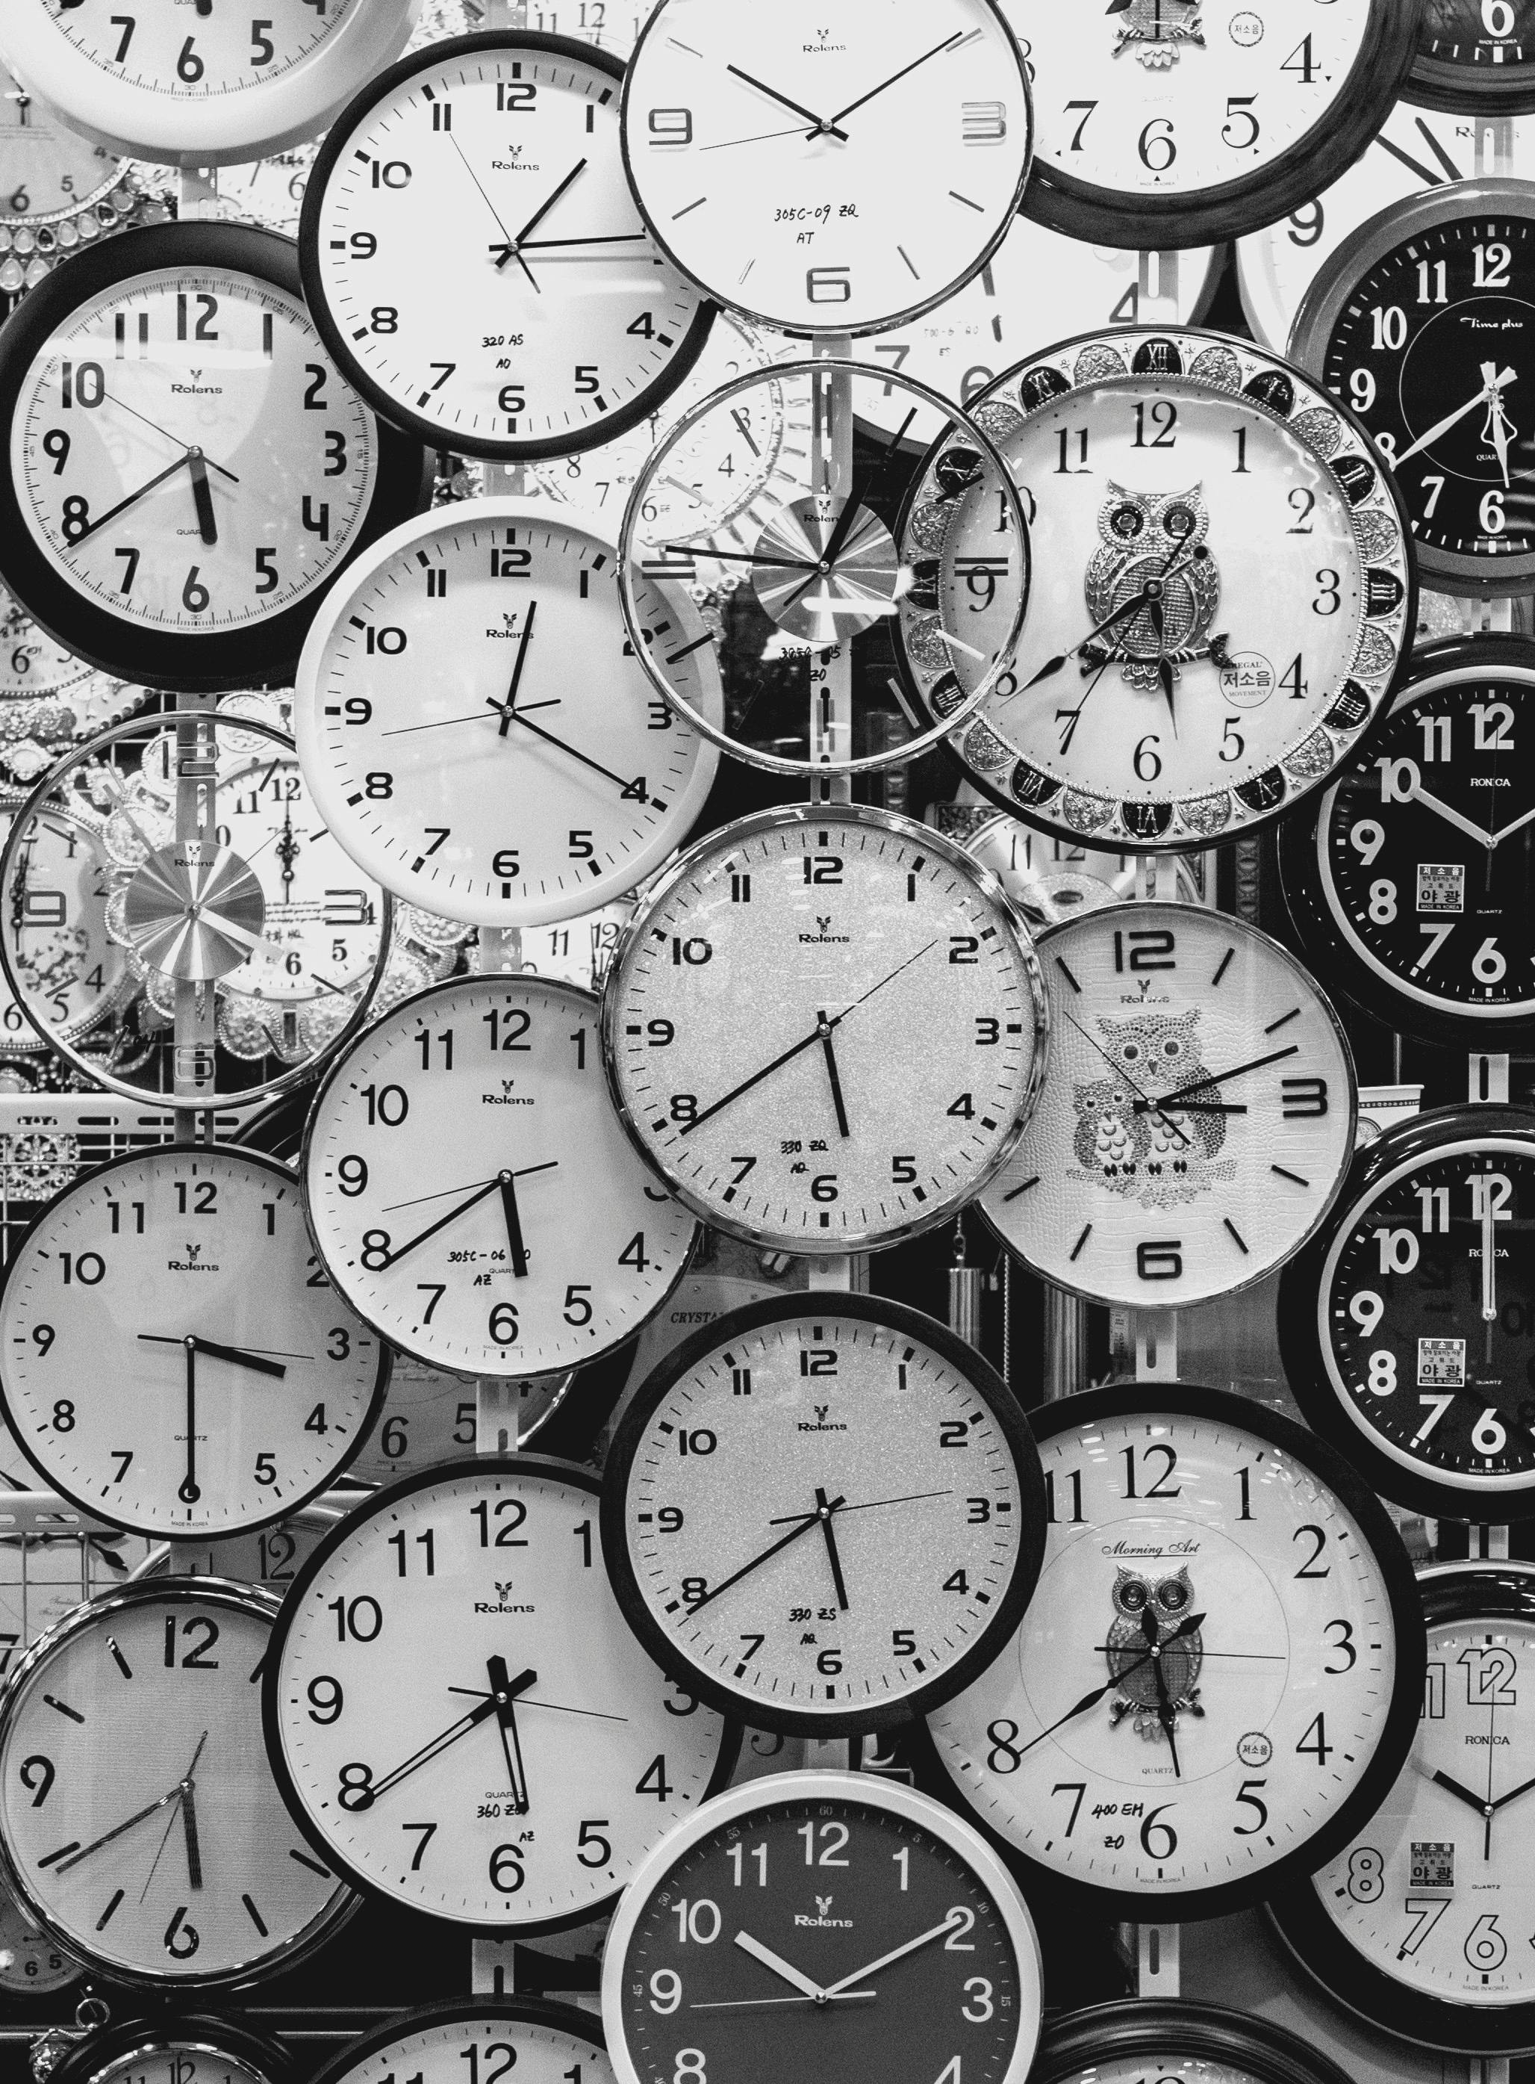
Notes:
Andrey Grushnikov. (2017, September 14). Clocks [Photograph]. Pexels. https://www.pexels.com/photo/black-and-white-photo-of-clocks-707676/

Slide 12
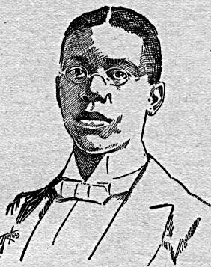
Poetic Moments
Title: We Wear the Mask
Author: Paul Laurence Dunbar (1872–1906)
Date: 1896
Notes:
Wood, N. B. (1897). White side of a black subject [Sketch]. Wikimedia Commons. https://commons.wikimedia.org/wiki/File:Paul_Laurence_Dunbar.jpg
Dunbar, P. L. (1896). We wear the mask. CommonLit. https://www.commonlit.org/en/texts/we-wear-the-mask

Slide 13
Without Words
Highlight the following text in each of the following lines of the poem:
[1] We wear the mask that grins and lies,
[4] With torn and bleeding hearts we smile,
[14] But let the world dream otherwise,
For one of the highlighted phrases, illustrate what you think the phrase is trying to get you to imagine.
Notes:
K20 Center. (n.d.) Without words. Strategies. https://learn.k20center.ou.edu/strategy/4845

Slide 14
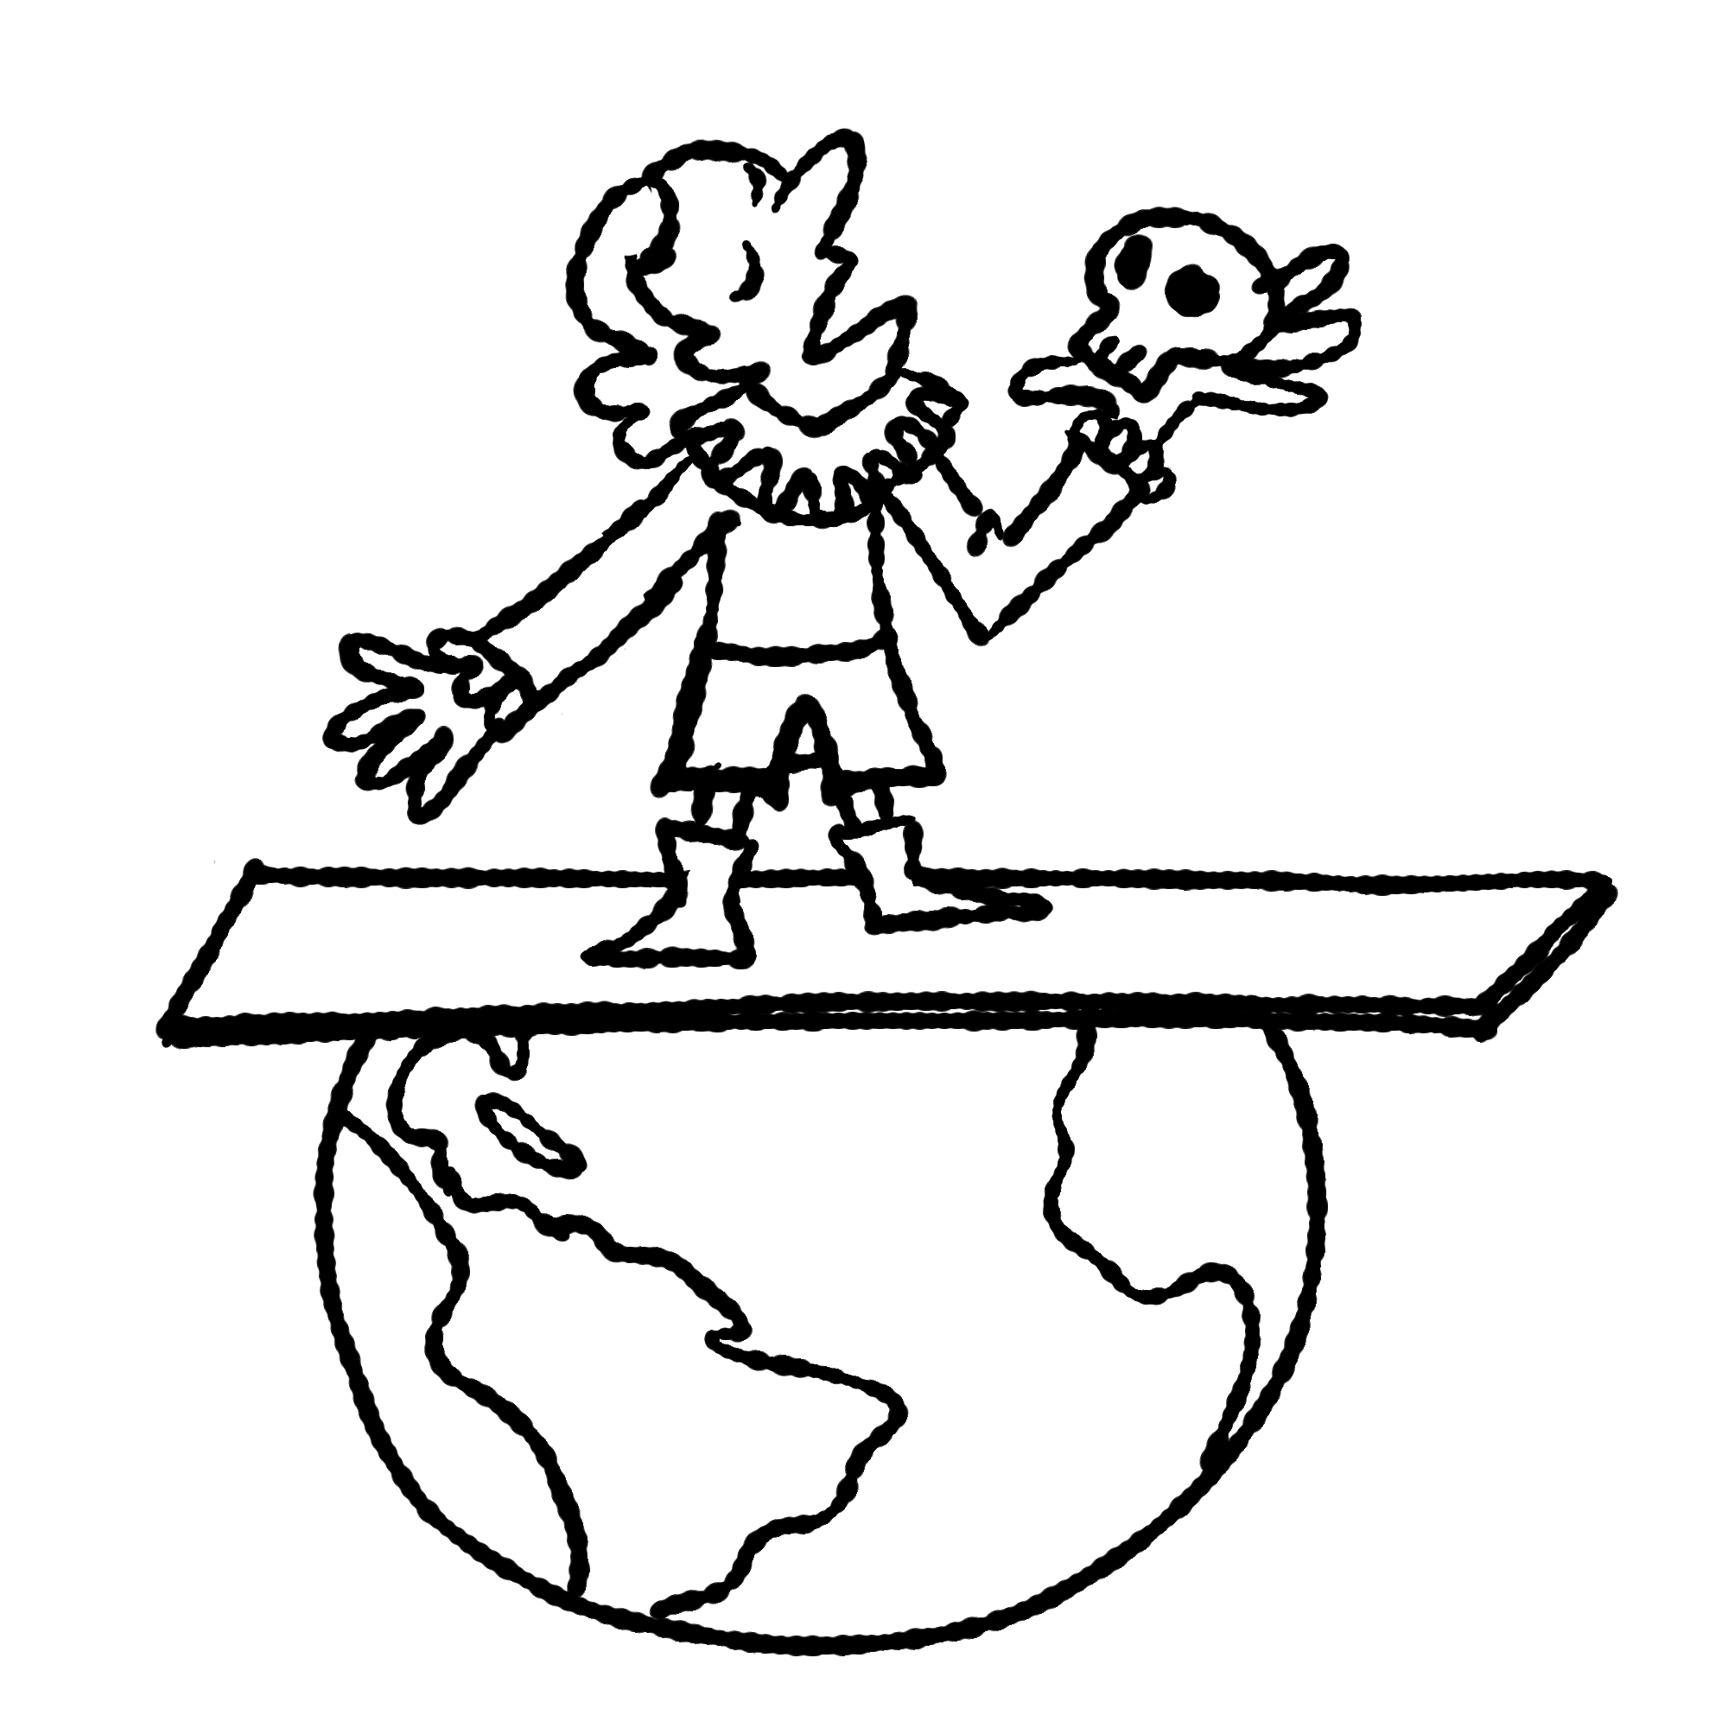
Without Words: Example
Illustrate what you think your highlighted phrase is trying to get you to imagine.
“All the world’s a stage, and all the men and women merely players”
– As You Like It,
William Shakespeare
Notes:
K20 Center. (n.d.) Without words. Strategies. https://learn.k20center.ou.edu/strategy/4845

Slide 15
What Does It Mean?
Under your illustration, write your response to the following question:
What idea do you think the author is trying to get you to understand by using this phrase?
When you are done writing, discuss your answer with your group.

Slide 16
Theme Statement
Create a theme statement that…
Is a complete sentence.
Conveys meaning.
Is universal (applies to many people/situations).
Example: “The power of friendship can help people overcome adversity.”
Notes:
K20 Center. (2021, September 21). K20 Center 3 minute timer. [Video]. YouTube. https://www.youtube.com/watch?v=iISP02KPau0

Slide 17
Card Matching
Match each vocabulary word with its definition.
Notes:
K20 Center. (n.d.). Card matching. Strategies. https://learn.k20center.ou.edu/strategy/1837

Slide 18
Card Matching
Vocabulary | Definition
Metaphor | creatively compares two things that are not alike but have something in common; there are many different types.
Extended Metaphor | a creative comparison that continues throughout a series of sentences or even an entire poem.
Notes:
K20 Center. (n.d.). Card matching. Strategies. https://learn.k20center.ou.edu/strategy/1837

Slide 19
Card Matching
Vocabulary | Definition
Direct Metaphor | compares two things that are not alike by directly stating that one thing is another.
Implied Metaphor | suggests a comparison without directly stating it; it hints at the comparison rather than being obvious.
Simile | compares two things that are not alike using a connecting word such as “like” or “as.”
Notes:
K20 Center. (n.d.). Card matching. Strategies. https://learn.k20center.ou.edu/strategy/1837

Slide 20
Note Catcher
During the following video, look for examples of each of these vocabulary words.
Write examples of each vocabulary word on your Note Catcher handout.

Slide 21
The Art of the Metaphor
Notes:
TED-Ed. (2012, September 24). The art of the metaphor [Video]. YouTube. https://www.youtube.com/watch?v=A0edKgL9EgM

Slide 22
New Style of Poetry
Teen Tuesday: Golden Shovel poetry
Notes:
North Vancouver City Library (2020, April 28). Teen Tuesday: Golden Shovel poetry [Video]. YouTube. https://www.youtube.com/watch?v=bBvLj5reRmI

Slide 23
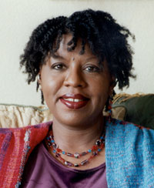
Poetic Moments
Title: Jabari Unmasked
Author: Nikki Grimes (1950– )
Date: 2017
Notes:
Grimes, N. (2006). Nikki Grimes [Photograph]. Wikipedia. https://en.wikipedia.org/wiki/File:Press72.jpg
Grimes, N. (2017). Jabari unmasked. CommonLit. https://www.commonlit.org/en/texts/jabari-unmasked

Slide 24
Why-Lighting
Highlight 5 different metaphors. These can be any of the following:
Similes
Direct Metaphors
Implied Metaphors
Extended Metaphors
In the margins, write what each one is comparing.
Notes:
K20 Center. (n.d.) Why-lighting. Strategies. https://learn.k20center.ou.edu/strategy/128

Slide 25
Poetic Reflection
On the back of your handout, write a response for Questions 1–2.
You will later write a theme statement.
Notes:
K20 Center. (2021, September 21). K20 Center 10 minute timer. [Video]. YouTube. https://www.youtube.com/watch?v=9gy-1Z2Sa-c

Slide 26
Theme Statement
Create a theme statement that…
Is a complete sentence.
Conveys meaning.
Is universal (applies to many people/situations).
Example: “The power of friendship can help people overcome adversity.”
Notes:
K20 Center. (2021, September 21). K20 Center 3-minute timer. [Video]. YouTube. https://www.youtube.com/watch?v=iISP02KPau0

Slide 27
Poetry Writing: Expectations
Create your own Golden Shovel poem using your knowledge of metaphors and the Golden Shovel format.
Your poem should be at least 10 lines long.
Your poem should include at least 2 metaphors.
Don’t forget to:
Bold the last word of each line.
Circle the metaphors you used.

Slide 28
Poetry Writing: Getting Started
Begin by finding a poem or song lyric that you want to reference.
Then pick a line or section from that piece you want to use.
Remember, each word from your selection will become the end of each line of your poem.

Slide 29
Poetry Writing: Title
Use the following format for titling your Golden Shovel poem:
[Poem Title]
after “[Original Poem/Song Title]” by [Original Author]
by [Your Name]

Slide 30
Writing Time
At least 10 lines
Bold the last word of each line.
At least 2 metaphors
Circle your metaphors.
[Poem Title] after “[Original Poem/Song Title]” by [Original Author] by [Your Name]

Slide 31
Metaphor Reflection
For each metaphor, answer the following:
What type of metaphor is it?
What two things is it comparing?
What do you want your reader to understand from this metaphor?

