Slide 2
It’s A Crime!
U.S. Government
Law Lesson

Slide 3
It’s a Crime!
A crime possibly occurred in our class.
If you were a witness to this crime, please state what you just saw happen as clearly as possible.

Slide 4
Your Rights as a Suspect
As you watch the following video, write down on a scratch piece of paper what your rights are if you are arrested for a crime. These rights are guaranteed by the Constitution.
What are Miranda rights? Miranda rights explained

Slide 5
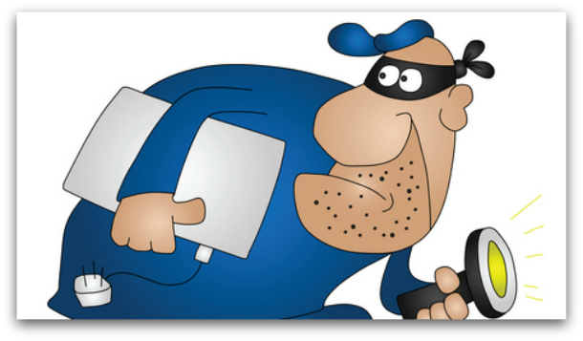
Your Rights as a Suspect
What are your Miranda rights?
What will happen to our “theft suspect” if his Miranda rights are never given to him?

Slide 6
Two Column Notes Page Setup
Guiding Questions | Main Ideas
What are the important facts for investigators to learn during a criminal investigation? a) What is the difference between circumstantial and direct evidence? b) Explain probable cause when police obtain a search warrant.

Slide 7
Mock Trial Participants
For the Defense:
Defense Attorney
Chris Archer - defendant
Dean Jesse Johnson - witness for defense
Dr. Jordan Mitchell - witness for defense
For the Prosecution:
District Attorney
Pat Smith - witness for prosecution
Dr. Alex Richards - witness for prosecution
Tyler Johnson - witness for prosecution

Slide 8
Mock Trial Participants
Presiding Judge
Jury Members

Slide 9
Evaluation
On a sheet of notebook paper, write down the sentence, “I used to think, but now I know . . .”
Write down what you knew or thought you knew about the criminal justice process before this lesson.
Then write what you have learned or know now by participating in this lesson.
Also answer the question, “Is it important to know how the criminal justice process works? Why or why not? “

