Slide 2
Is 350 Good?
Standard 7: Credit History and Borrowing Money
A Lesson for Financial Literacy

Slide 3
Essential Questions
What does a lender consider when offering a loan?
Why is a credit score important?

Slide 4
Lesson Objective
By the end of this lesson, we will understand credit scores and their impact on borrowing money.

Slide 5
What does this cartoon mean?

Slide 6
Definition of Collateral
Collateral: Something that is pledged as security for the repayment of a loan. Collateral can be taken as repayment by the lender if the borrower defaults on (doesn’t pay back) the loan.
Notes:
Source: Dictionary.com. (n.d.). Collateral. Definitions. http://www.dictionary.com/browse/collateral

Slide 7
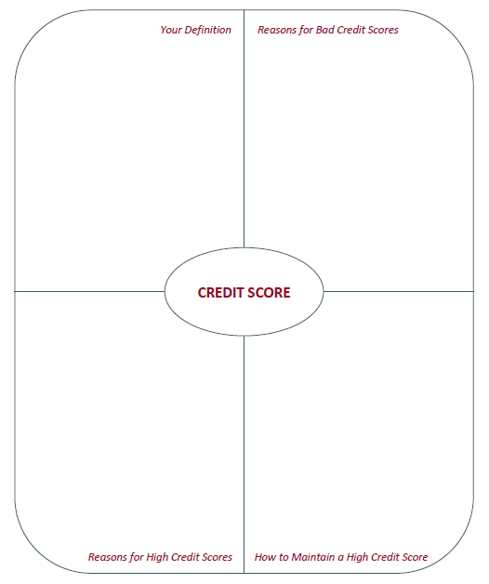
Frayer Model

Slide 8
Is “350” good?
What does it mean to have a credit score of 350?

Slide 9
Lenders look at your debt-to-income ratio.
John wants a loan for a new motorcycle. The bank wants to know ALL his monthly debt and his gross monthly income. This is what John tells them. Is John a good risk for a loan?
Monthly Debt
Apartment Rent | $450
Utilities | $50
Visa Card | $100
Total | $600
Monthly Income
Restaurant Job | $1,500
Part-time Grocery Store Job | $500
Total | $2,000

Slide 10
Financial Terms to Remember
Lender
Borrower
Collateral
Credit score
Interest rate
Credit history
Credit application
Debt-to-income ratio

