Slide 2
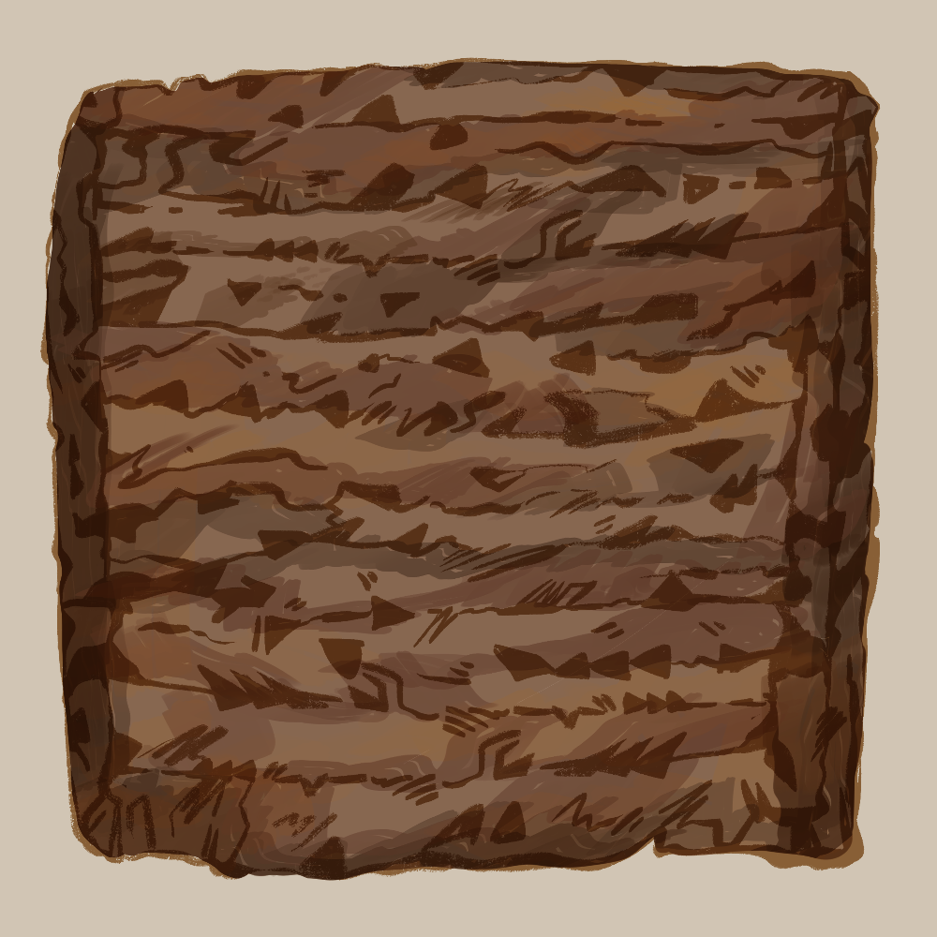
Wedges and Words
Cuneiform and the Ancient World

Slide 3
Essential Question
What can ancient writing systems like cuneiform teach us about human communication today?

Slide 4
Lesson Objectives
Understand the role cuneiform had in communication in Mesopotamia.
Demonstrate knowledge of Alphabetic Cuneiform.

Slide 5
Cuneiform
Notes:
The Daily Bellringer. (2022, December 4). Cuneiform. YouTube. [video] https://www.youtube.com/watch?v=MZwaGU6dOH8

Slide 6
Caption This
With your group, create a 1-3 sentence caption for the images on the next four slides.
Be sure to describe what you see and what sticks out as important.
Notes:
K20 Center. (n.d.). Caption this. Strategies. https://learn.k20center.ou.edu/strategy/82

Slide 7
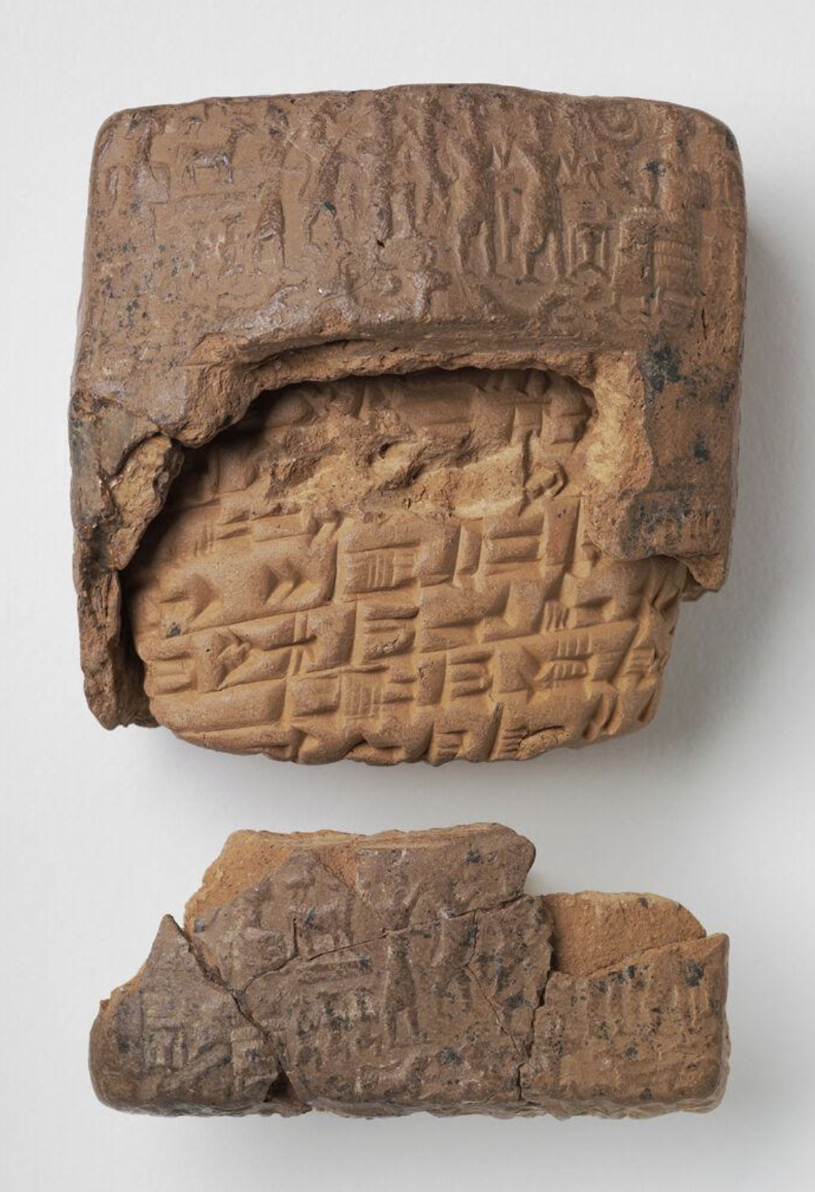
Caption This
Notes:
K20 Center. (n.d.). Caption this. Strategies. https://learn.k20center.ou.edu/strategy/82
The Harvard Art Museums. (2000). Cuneiform tablet and envelope: Old Assyrian letter. The Harvard Art Museums. Retrieved from https://harvardartmuseums.org/collections/object/146548.

Slide 8
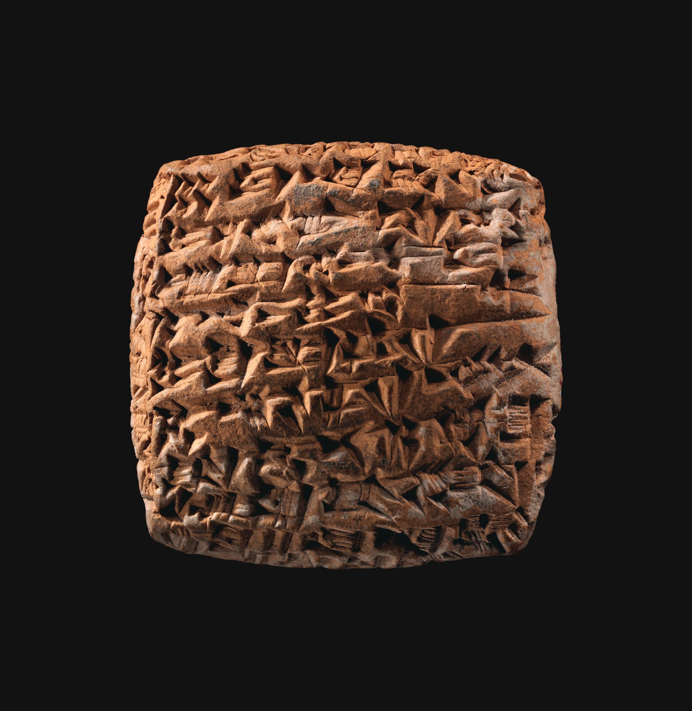
Caption This
Notes:
Cuneiform tablet. The Metropolitan Museum of Art. (n.d.). https://www.metmuseum.org/art/collection/search/325858
K20 Center. (n.d.). Caption this. Strategies. https://learn.k20center.ou.edu/strategy/82

Slide 9
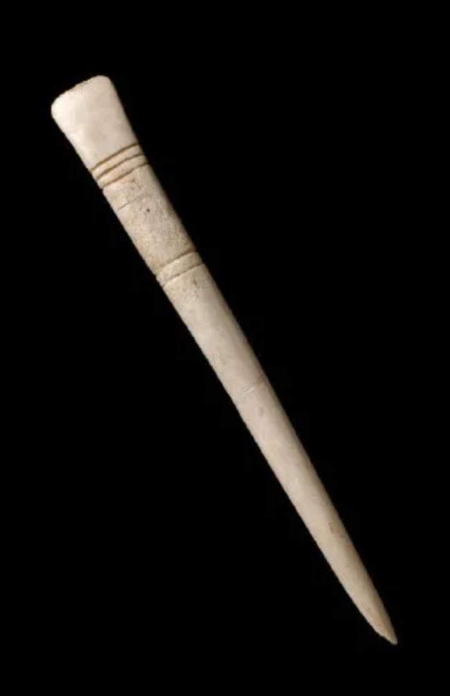
Caption This
Notes:
K20 Center. (n.d.). Caption this. Strategies. https://learn.k20center.ou.edu/strategy/82
Sumerians. A brief history of writing. (2019, May 26). http://historyofwriting.learncalligraphy.co.uk/the-sumerians/

Slide 10
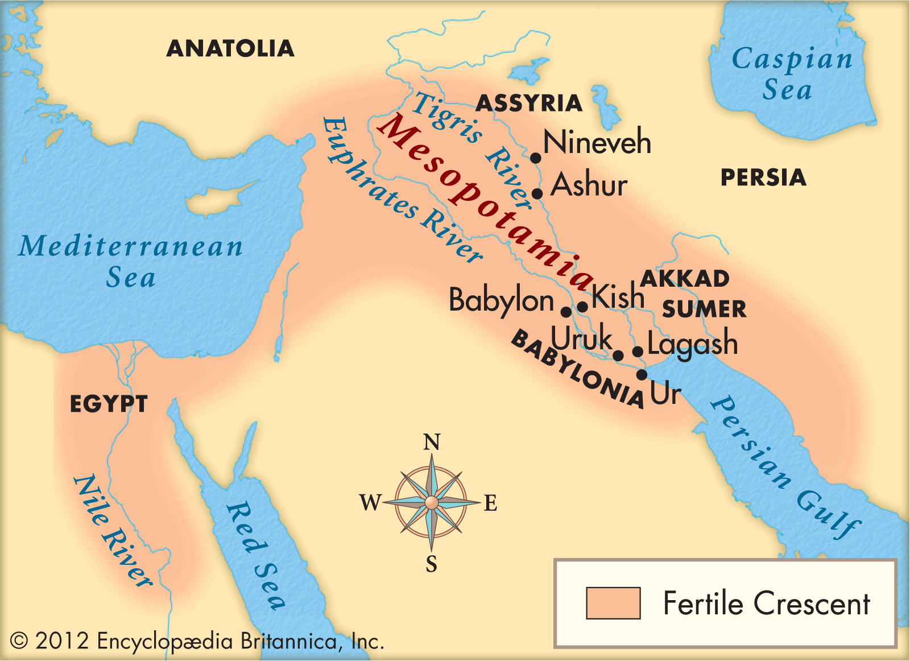
Caption This
Notes:
Encyclopædia Britannica, inc. (2025). Mesopotamia. Encyclopædia Britannica. https://kids.britannica.com/kids/article/Mesopotamia/353456
K20 Center. (n.d.). Caption this. Strategies. https://learn.k20center.ou.edu/strategy/82

Slide 11
Important Vocabulary
Translate (verb)
Express the sense of (words or text) in another language.
Transliterate (verb)
Write or print (a letter or word) using the closest corresponding letters of a different alphabet or script.

Slide 12
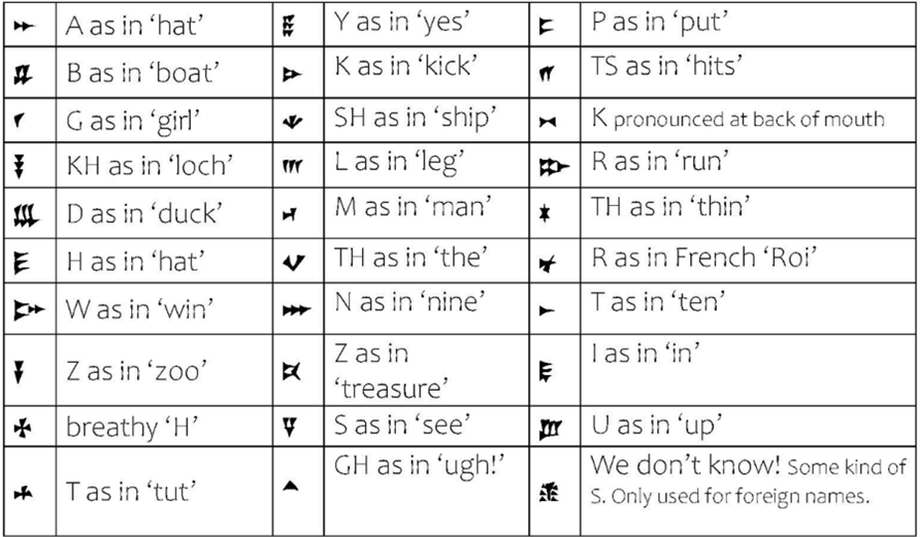
Alphabetic Cuneiform Chart
Notes:
Adapted from CREWS Project at the University of Cambridge.

Slide 13
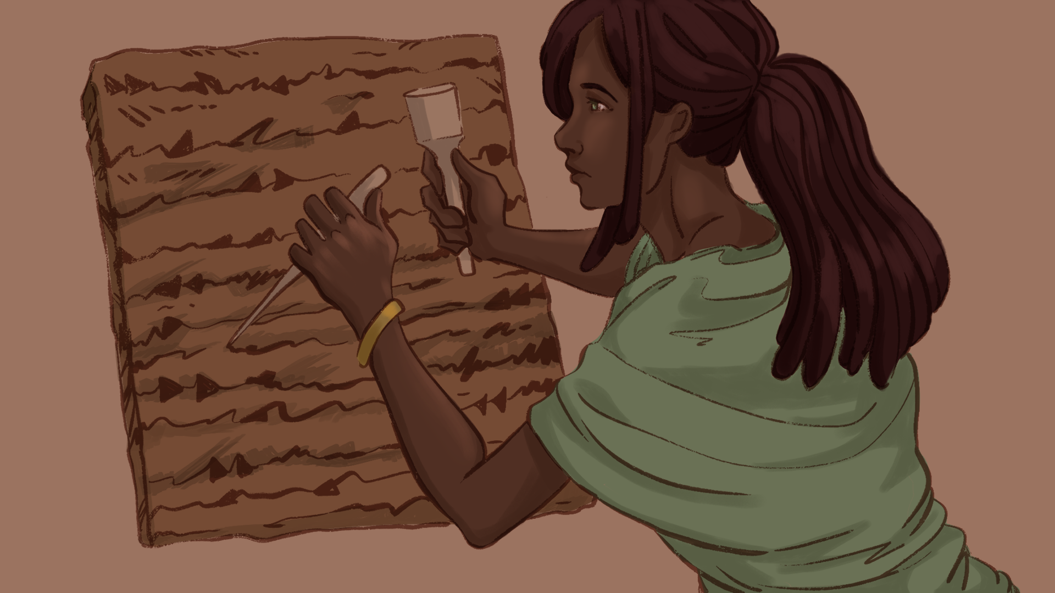
Crack the Code!
Hidden around the room are 8 slips of paper containing parts of a mystical message from the ancient past.
Find each slip.
Use your Cuneiform Chart to transliterate the word into English.
Leave the slip where you found it!
Add the English word on the correct space based on the second number.
Repeat until you fill in all the spaces.

Slide 14
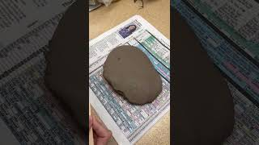
How to Stamp Clay
Be the first to stamp your answer!
Transliterate your Riddle answer.
Use popsicle sticks to stamp your clay.
Check your work with your teacher to see if your team is the winner!
Writing in Cuneiform
Notes:
K20 Center. (n.d.). Writing in cuneiform. Video. Writing in Cuneiform

Slide 15
Crack the Code!
Hidden around the room are 8 slips of paper containing parts of a mystical message from the ancient past.
Find each slip.
Use your Cuneiform Chart to transliterate the word into English.
Leave the slip where you found it!
Add the English word on the correct space based on the second number.
Repeat until you fill in all the spaces. Now stamp your clay!

Slide 16
Writing and Books
Get assigned one of the following sections and write the title on your handout:
Hebrew script + Scroll
Nepalese script + Leporello
Lettering sketch + Typeface design
Specimens, catalogs, typeface specimens
Notes:
Łubocki, J. M. (n.d.). Writing and books at the National Museum of Wrocław. Google Arts & Culture. https://artsandculture.google.com/story/7QWxHkBam8ko9A

Slide 17
Writing and Books
Access the website listed below:
Type in https://k20.ou.edu/cuneiform
Complete your handout.
Read through your assigned section.
Write a 2-3 sentence summary.
Notes:
Łubocki, J. M. (n.d.). Writing and books at the National Museum of Wrocław. Google Arts & Culture. https://artsandculture.google.com/story/7QWxHkBam8ko9A

Slide 18
Jigsaw
Teach the section you read to your group members.
Write down notes from their sections on your handout.
Notes:
K20 Center. (n.d.). Jigsaw. Strategies. https://learn.k20center.ou.edu/strategy/179

Slide 19
Bad Yelp Review
Earliest known complaint: A clay tablet from c. 1750 BCE, discovered in Ur (modern Iraq), records a customer’s message to a copper merchant named Ea‑nāṣir—now housed at the British Museum.
Customer: A man named Nanni wrote in Akkadian cuneiform, complaining about the poor quality of copper delivered, a misdirected shipment, and rude treatment toward his messenger.

Slide 20
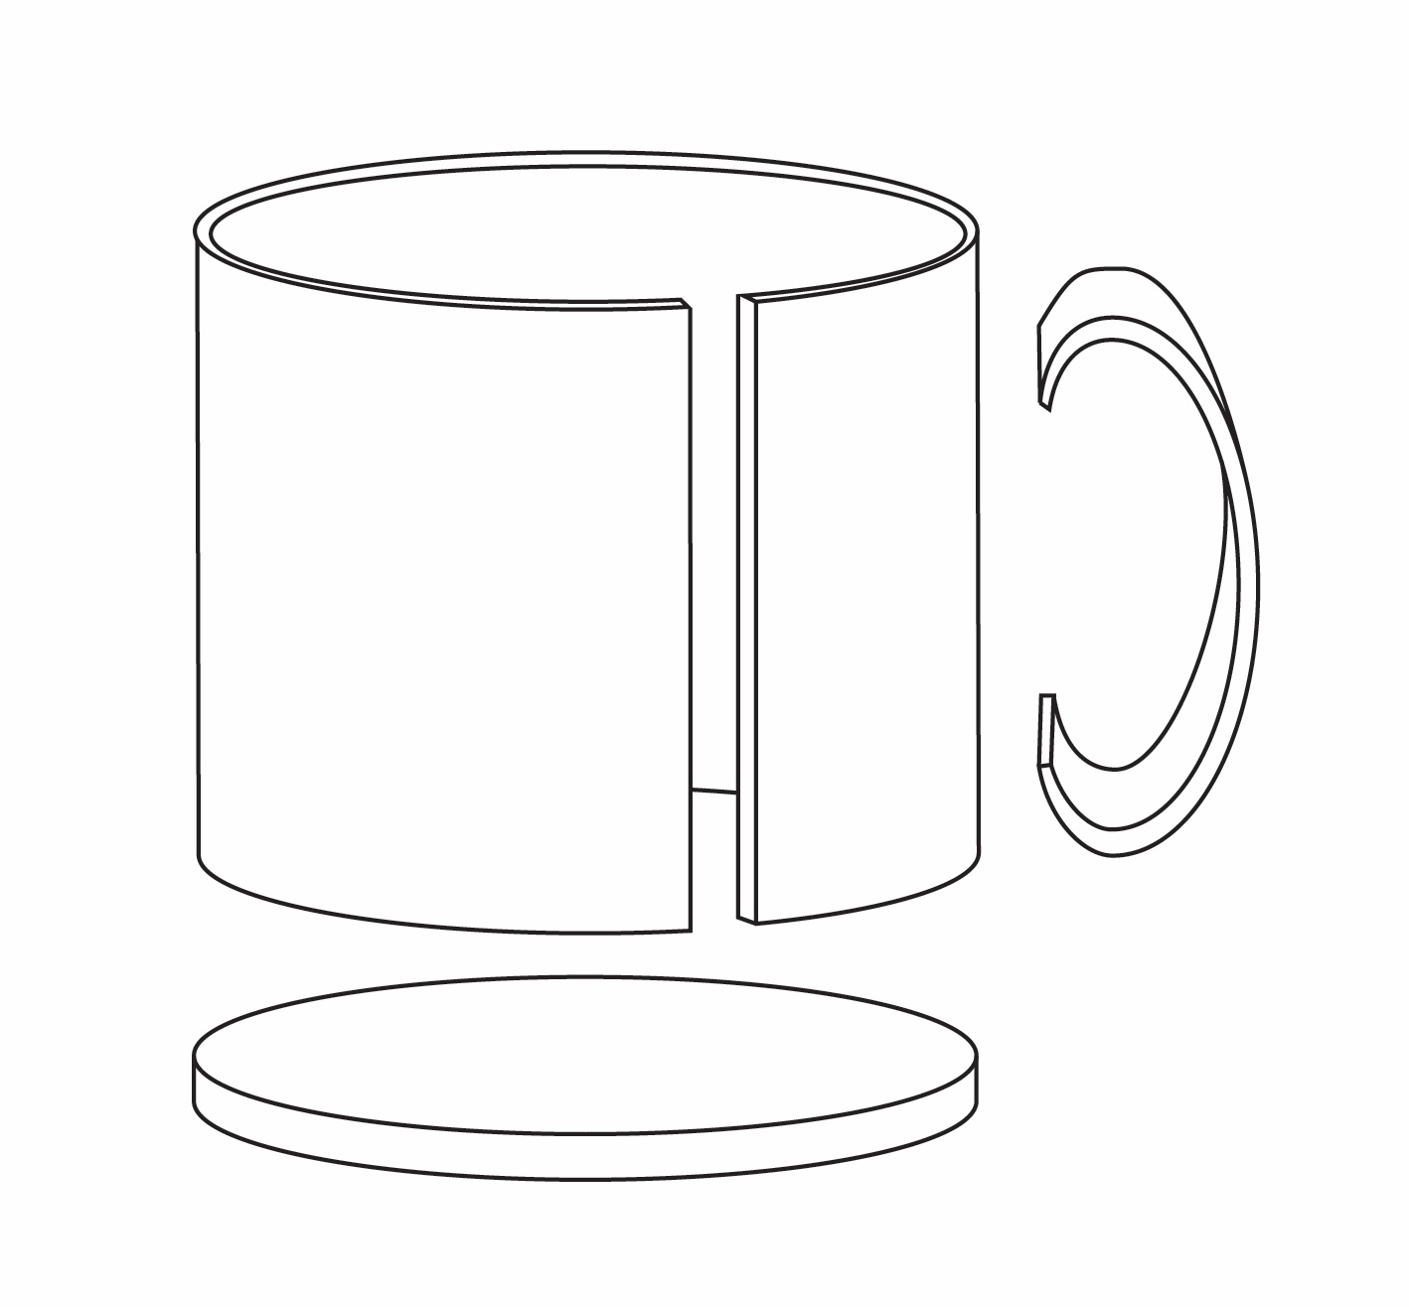
Cuneiform Project
Map your mug project using the Graphic Organizer handout.
Use the Mug Template handout to shape your clay.
After your clay is in 3 parts, stamp your cuneiform message.
Build your mug.
Add any additional 3D designs!
Notes:
Harmon, J. (2025). Mug Template [personal image].
Harmon, J. (2025). Mug Model [personal image].

Slide 21
Venn Diagram
With a partner, create and fill in a Venn Diagram that compares cuneiform writing to modern.
Similarities
Cuneiform
Modern
Notes:
K20 Center. (n.d.). Venn diagram. Tech Tools.https://learn.k20center.ou.edu/tech-tool/689

