Slide 2
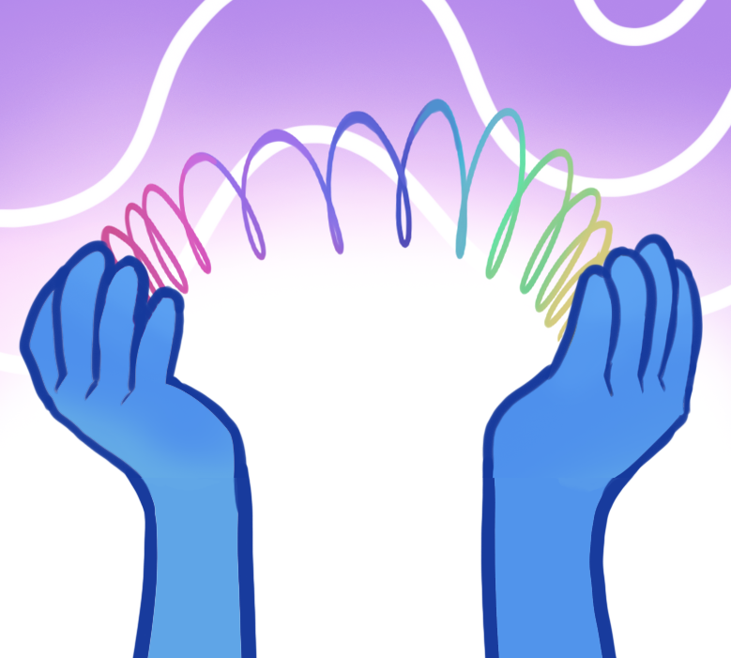
Beyond the Slinky
Qualitative Characteristics of Waves

Slide 3
Essential Question:
What is a wave?

Slide 4
Lesson Objectives:
Investigate how waves behave when they interact with different materials.
Analyze and differentiate how waves are produced, transmitted, absorbed, and reflected.
Use evidence to explain how wave behavior depends on the type of wave and the material it interacts with.

Slide 5
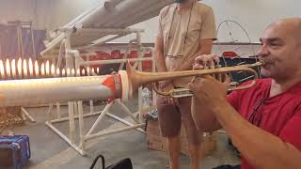
Notes:
Alves, M. (2023). Tubo de Rubens [Video]. YouTube. https://www.youtube.com/watch?v=9EQAYUrJItc

Slide 6

Elbow Partners
What did you notice in the video?
What questions do you have about it?
Notes:
K20 Center. (n.d.). Elbow partners. Strategies. https://learn.k20center.ou.edu/strategy/116

Slide 7
Wave Stations
Visit each station and follow the directions to conduct the investigation.
Record your observations on your handout.
Be sure to clean up your station for the next group.

Slide 8
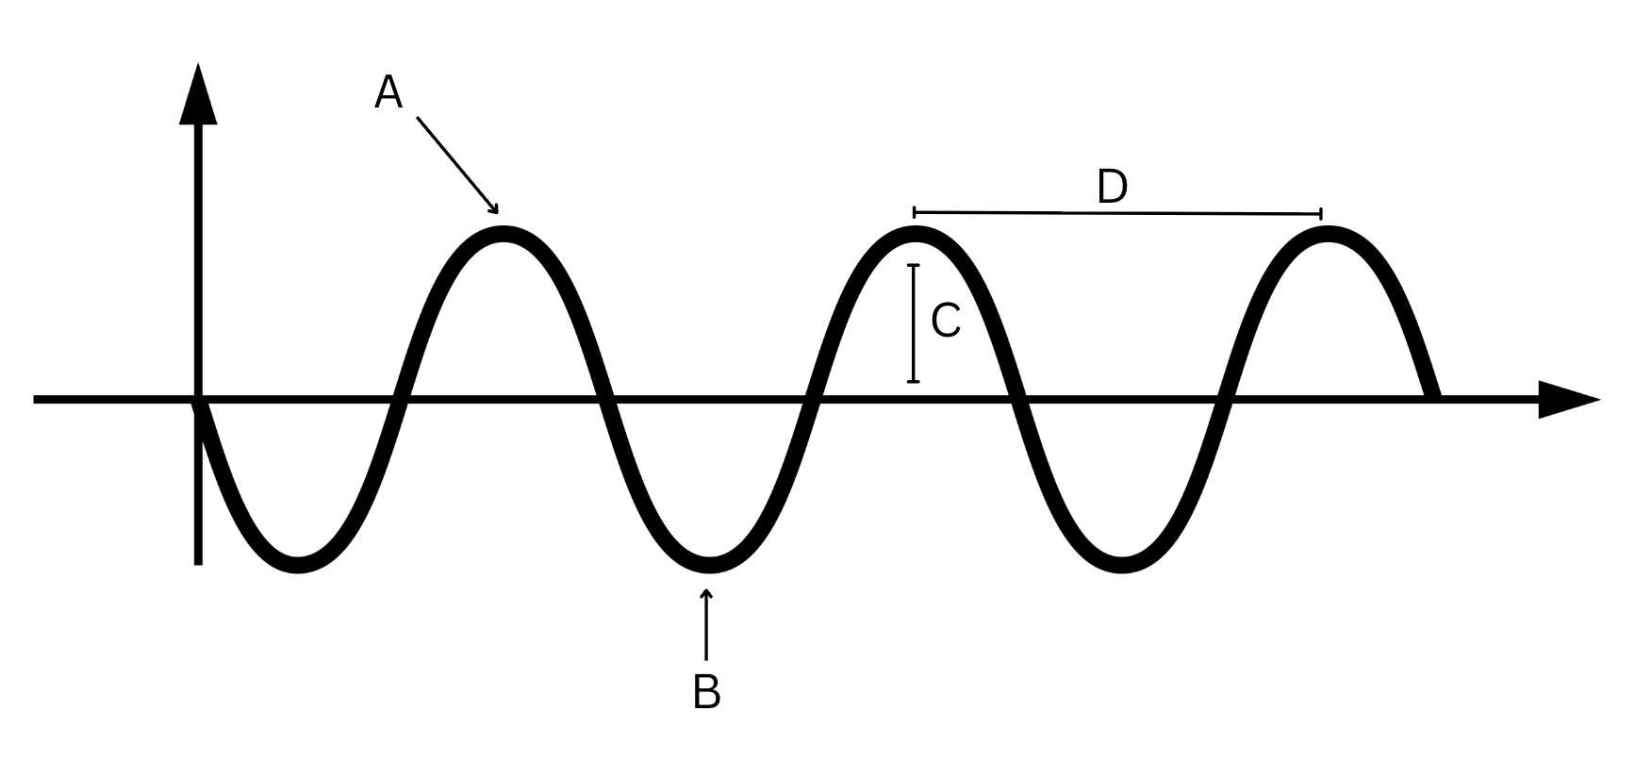
Wave Notes

Slide 9
Wave Notes
Reflection: when a wave bounces off an object or boundary.
Absorption: when a wave loses energy when passing through a material
Transmission: when a wave passes through a material without losing energy

Slide 10
Wave Behavior Example
Behavior | Lab Station Example | Evidence/Observations
Reflected
Absorbed
Transmitted

Slide 11
Notes:
Alves, M. (2023). Tubo de Rubens [Video]. YouTube. https://www.youtube.com/watch?v=9EQAYUrJItc

Slide 12

I Think/ We Think
What medium is the trumpet sounds traveling through to create the fire sound wave?
Notes:
K20 Center. (n.d.). I think / we think. Strategies. https://learn.k20center.ou.edu/strategy/141

Slide 13
Designing for Sound
Imagine you are a designer of a new set of headphones.
Explain why it is important to consider the materials that the headphones are made of.
Develop a model that illustrates how the material of the headphones impacts sound wave behavior.

Slide 14

Triangle-Square-Circle
Triangle—Write down three things you learned about waves.
Square—Write a connection to your life about waves or sound.
Circle—Write down two questions you have about waves.
Notes:
K20 Center. (n.d.b.). Triangle-square-circle. Strategies. https://learn.k20center.ou.edu/strategy/65

