Slide 2
Behind the Mask

Slide 3
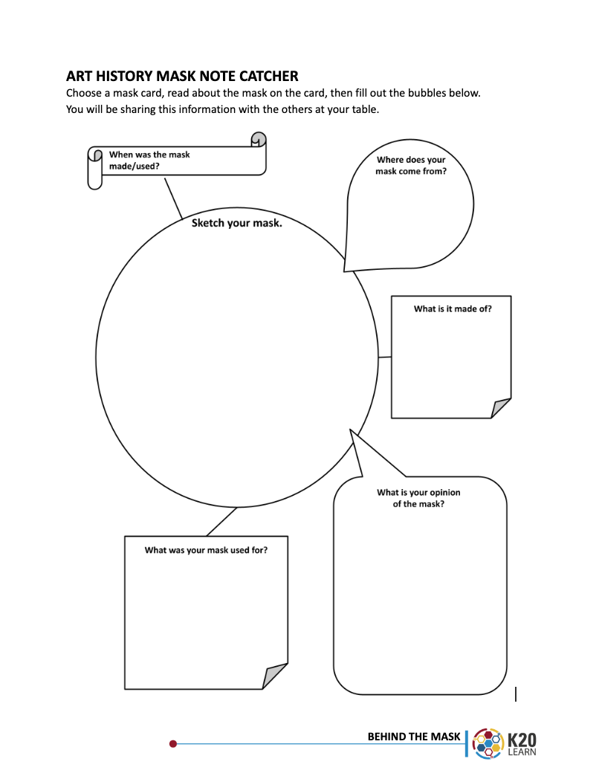
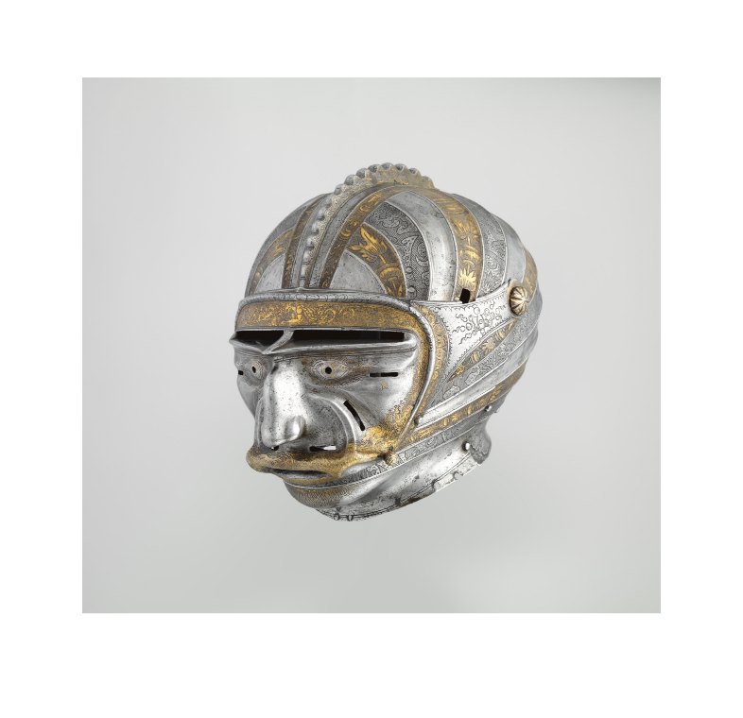
Art History
Masks
Read your card.
Fill in the Note Catcher.
Share at your table.
Share with the class.

Slide 4
Abstract Thinking & Self Reflection

Slide 5
Notes:
Kline, F. (1956). Buttress [Painting]. The Museum of Modern Art, New York, NY.

Slide 6
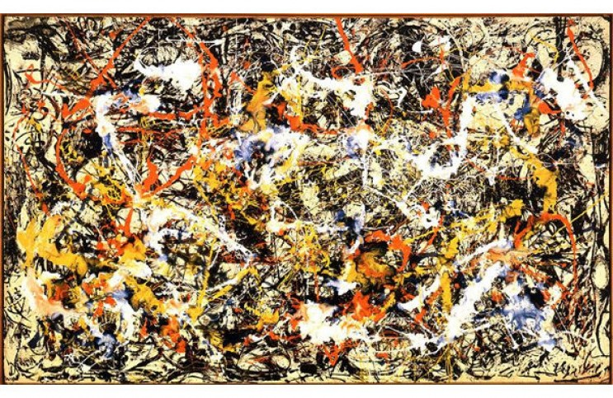
Notes:
Pollock, J. (1965). Convergence [Painting]. Albright-Knox Art Gallery, Buffalo, NY.

Slide 7
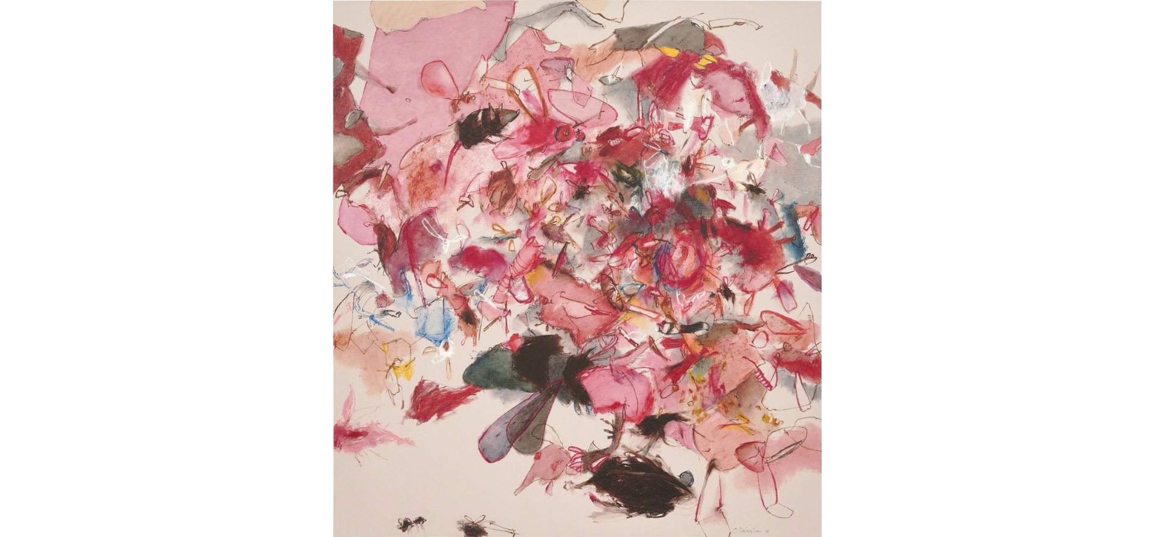
Notes:
Ay Tjoe, C. (2018). Myriad of ‘paste’ [Mixed media on canvas]. In ART iT. https://www.art-it.asia/en/u/admin_expht_e/0dkgoehvetczsiqwcrwp/

Slide 8
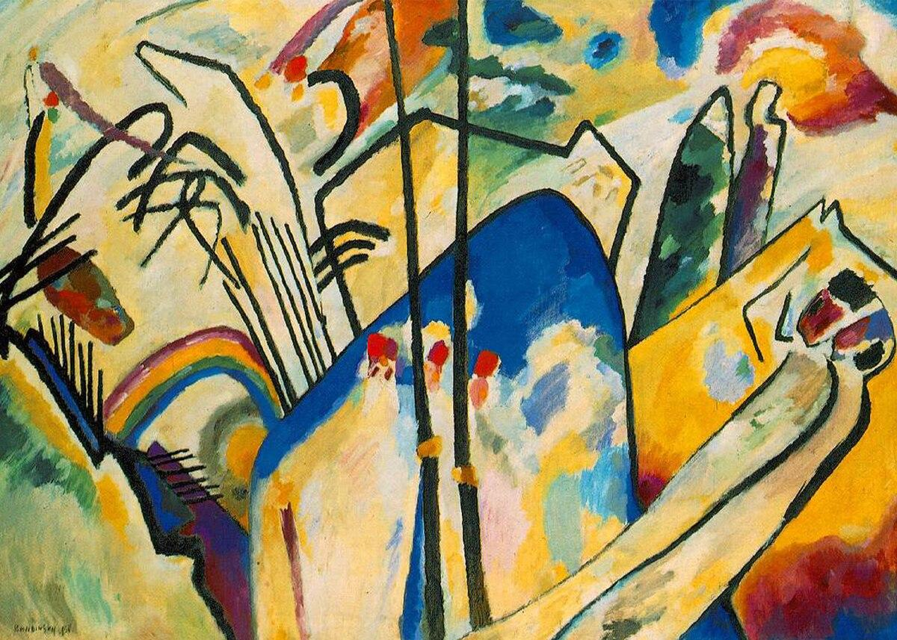
Notes:
Kandinsky, W. (1911). Composition IV [Painting]. Kunstsammlung Nordrhein-Westfalen, Düsseldorf, Germany. https://commons.wikimedia.org/wiki/File:Vassily_Kandinsky,_1911_-_Composition_No_4.jpg

Slide 9
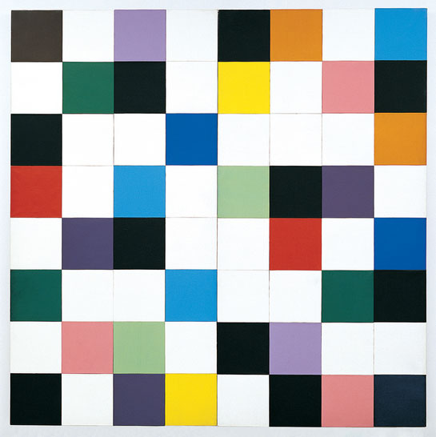
Notes:
Kelly, E. (1951). Colors for a Large Wall [Oil on canvas, 64 panels]. The Museum of Modern Art, New York, NY. https://www.moma.org/collection/works/80528

Slide 10
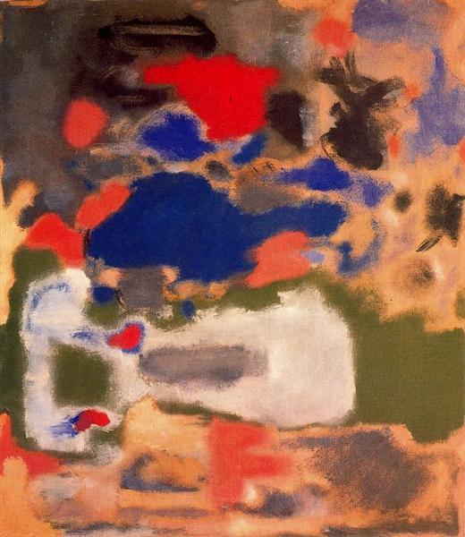
Notes:
Rothko, M. (1948). Untitled [Oil on canvas]. Fondation Beyeler, Riehen/Basel, Switzerland.
https://www.fondationbeyeler.ch/en/beyeler-collection/work?tx_wmdbbasefbey_pi5%5Bartwork%5D=300&cHash=597f67c41c04215423173530897a8400

Slide 11
Abstract Art
The definition of abstract art is art that is open to interpretation. No matter what the artist was feeling or thinking as they were making these art pieces, you are able to look at them and come to your own conclusions on what they are or represent.

Slide 12
Two Types of Thinking
Concrete deals with facts and observations- the tangible. Processing information like "the sky is blue" and memorizing math facts are examples of concrete thinking.
Abstract goes beyond facts- considering the intangible. This fluid movement of thought allows us to view the blue sky and ask "why is it blue," and to use the math facts memorized to solve complex equations.
Notes:
Abstract Thinking helps us solve problems and communicate effectively. For example:
Considering others’ point of view
Predicting something based on thought and observation
Creating something open to interpretation
Exploring various options in a situation

Slide 13
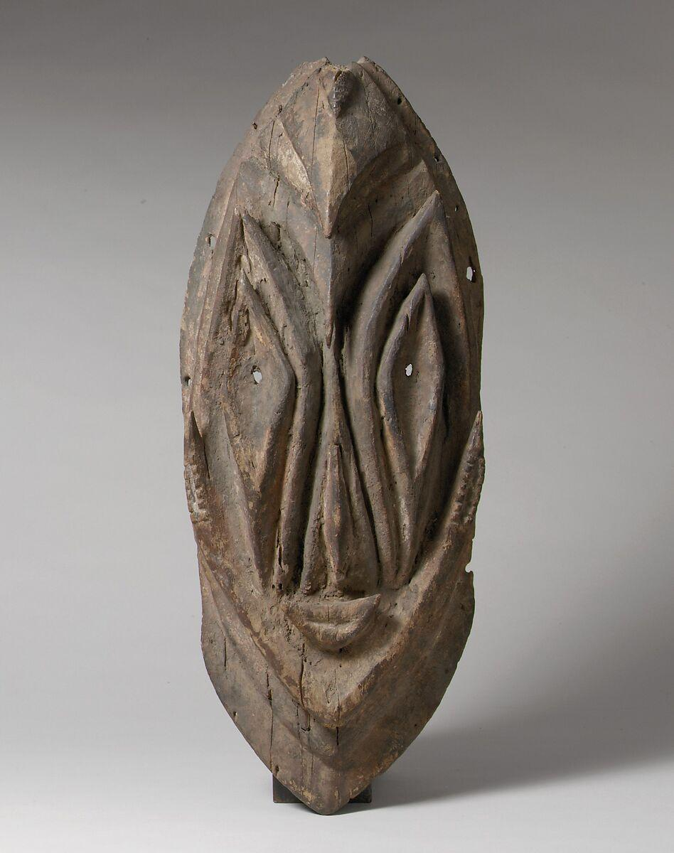
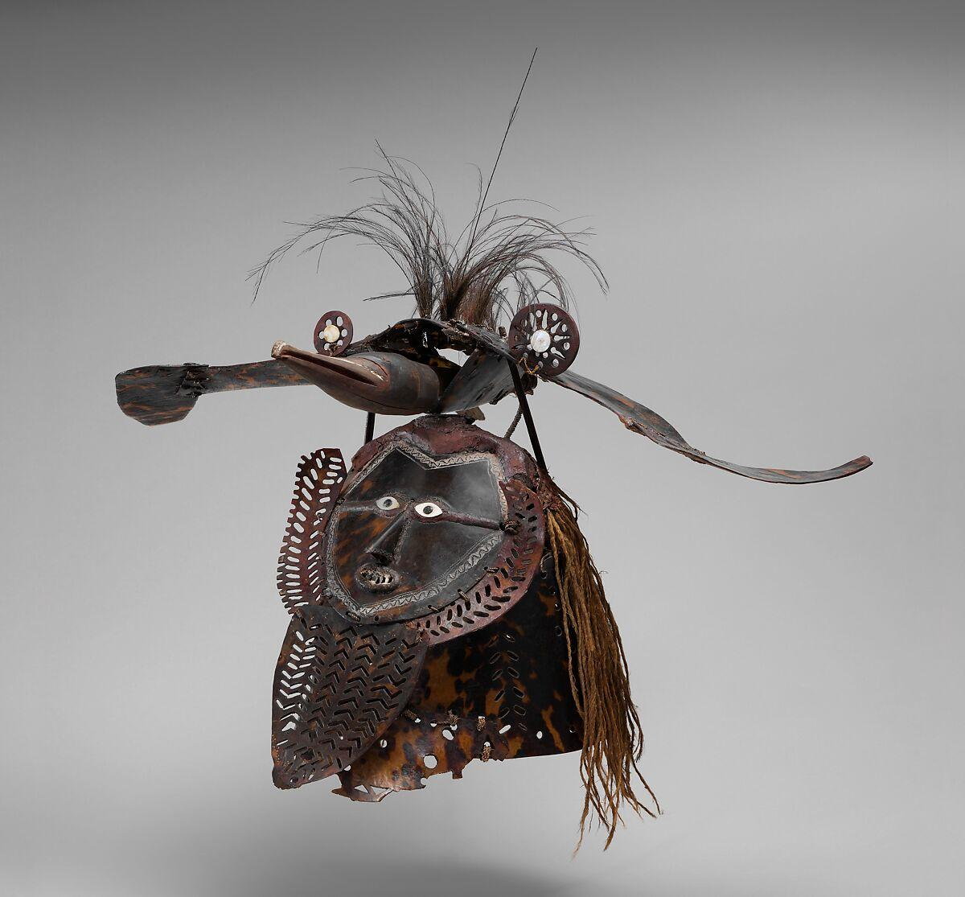
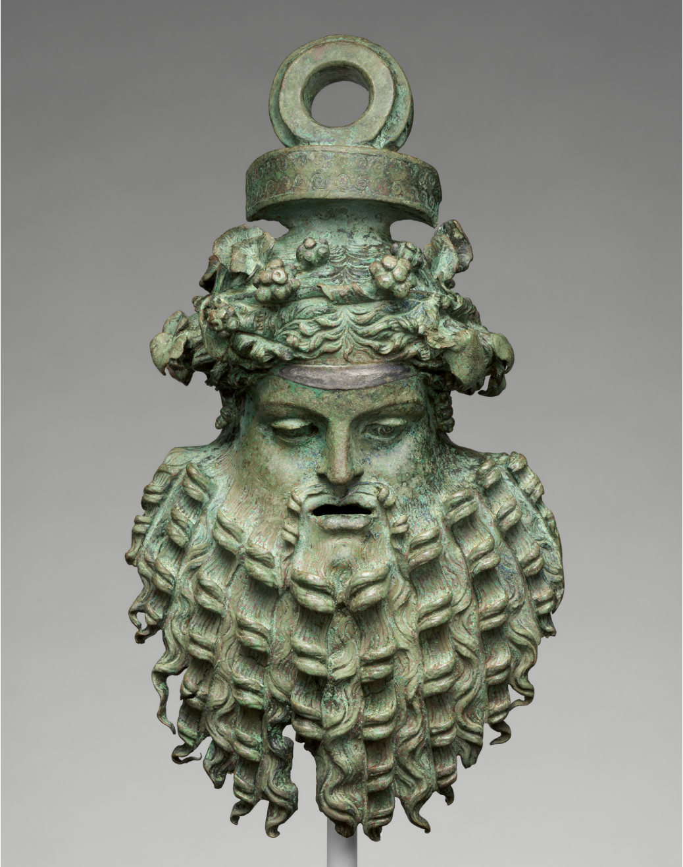
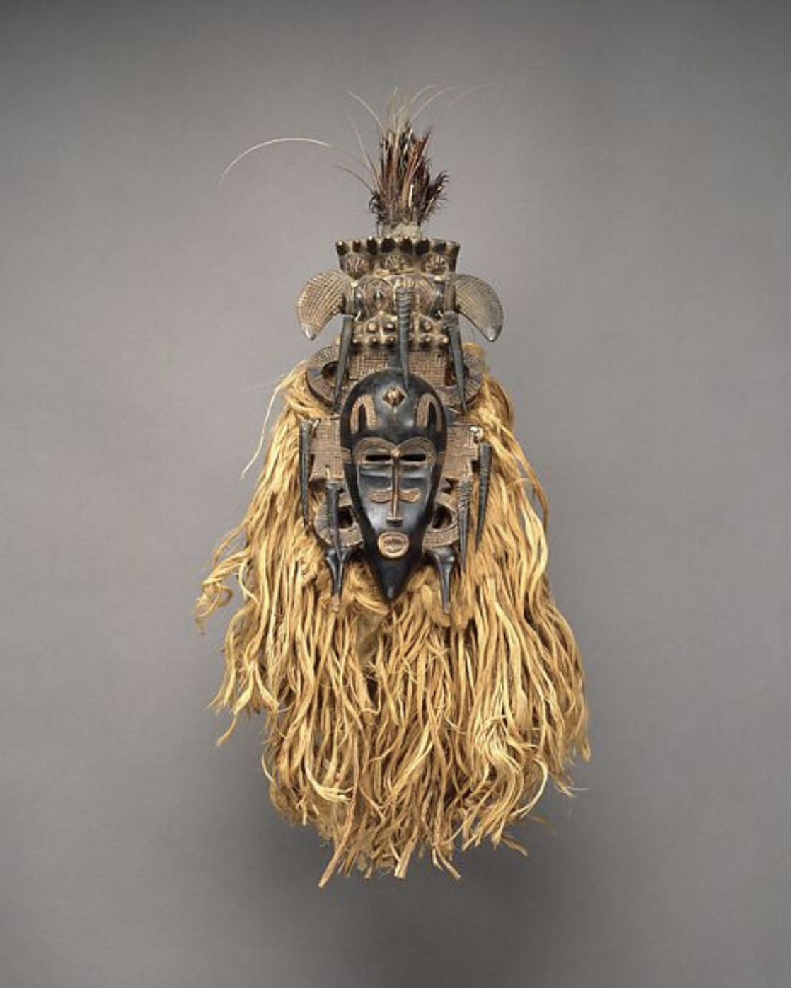
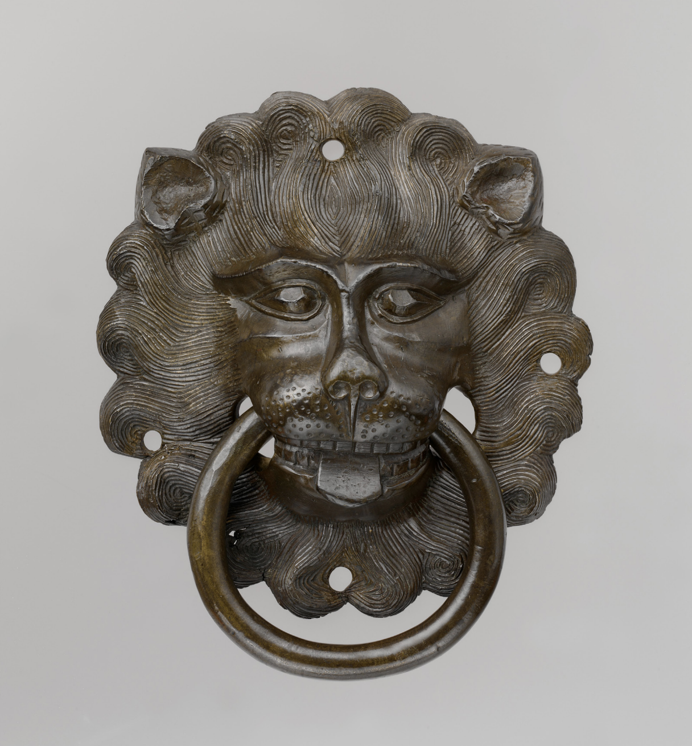
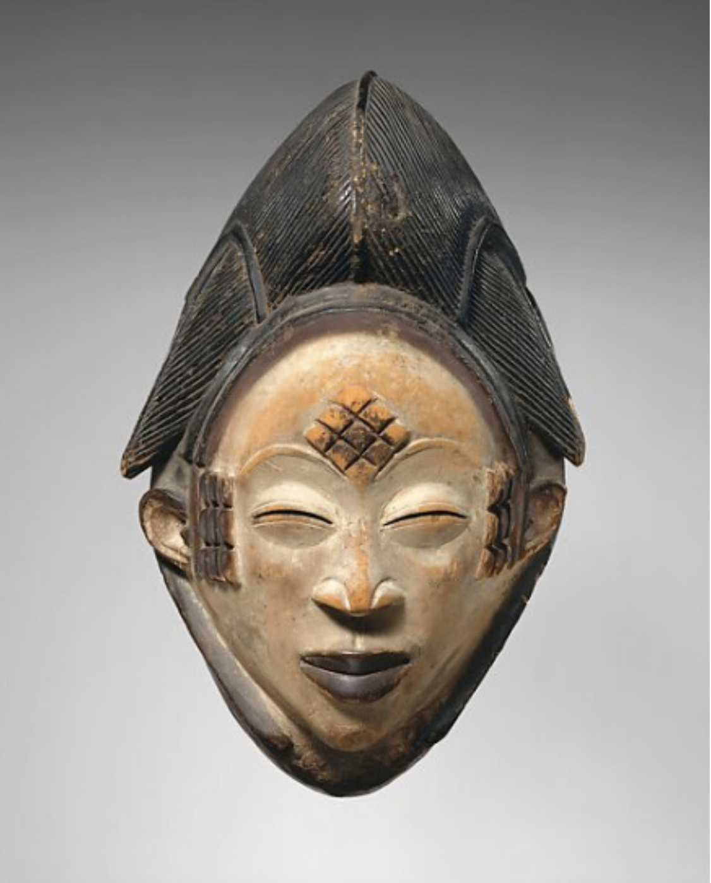
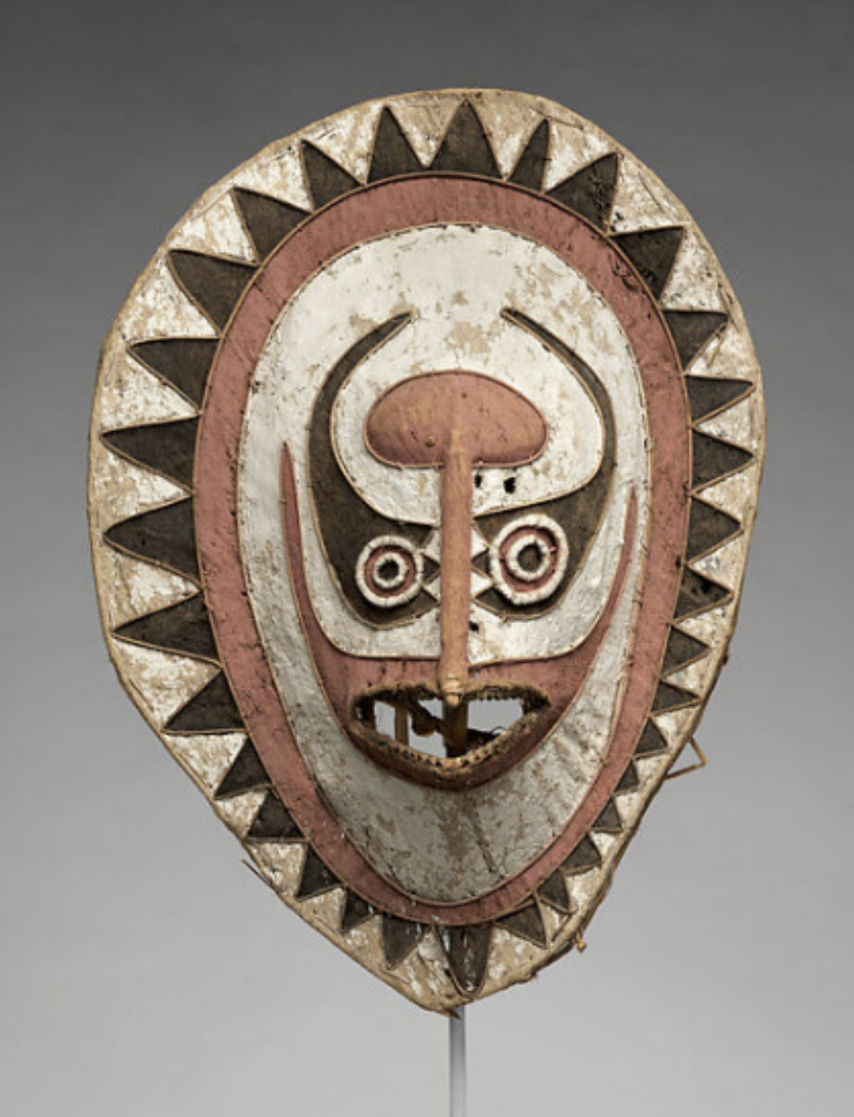
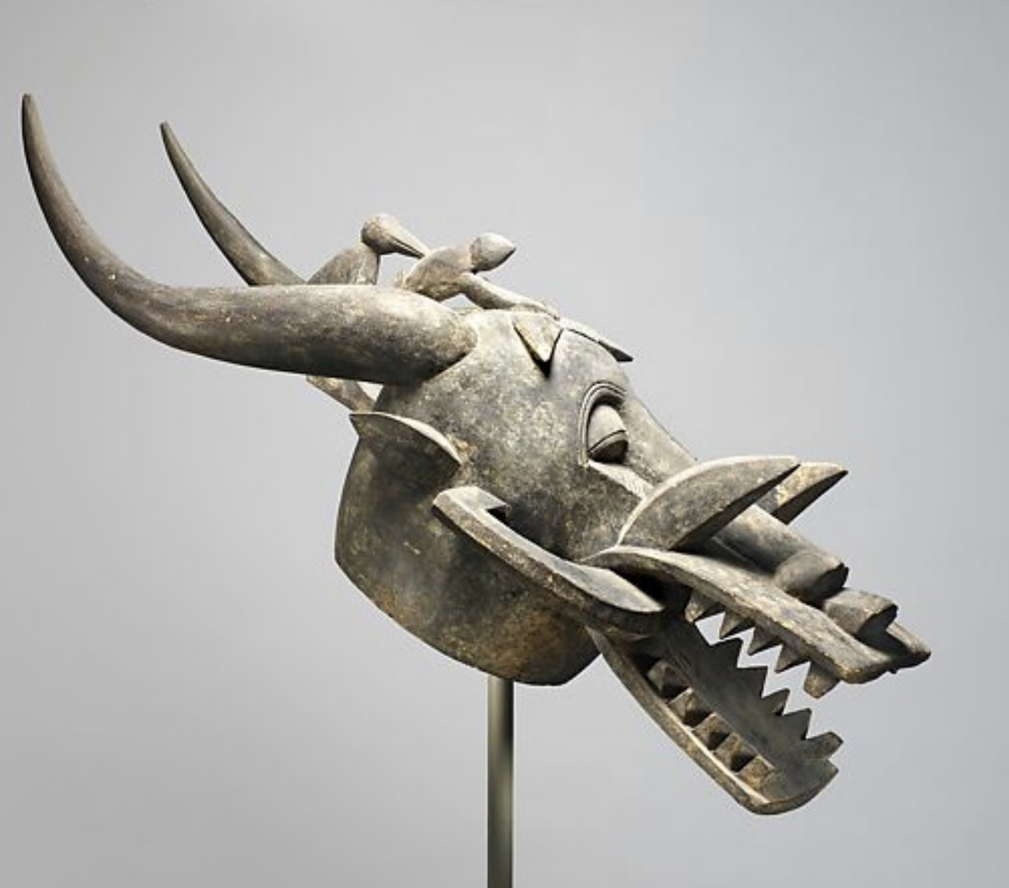
How was abstract thinking demonstrated in the masks we viewed from art history?

Slide 14
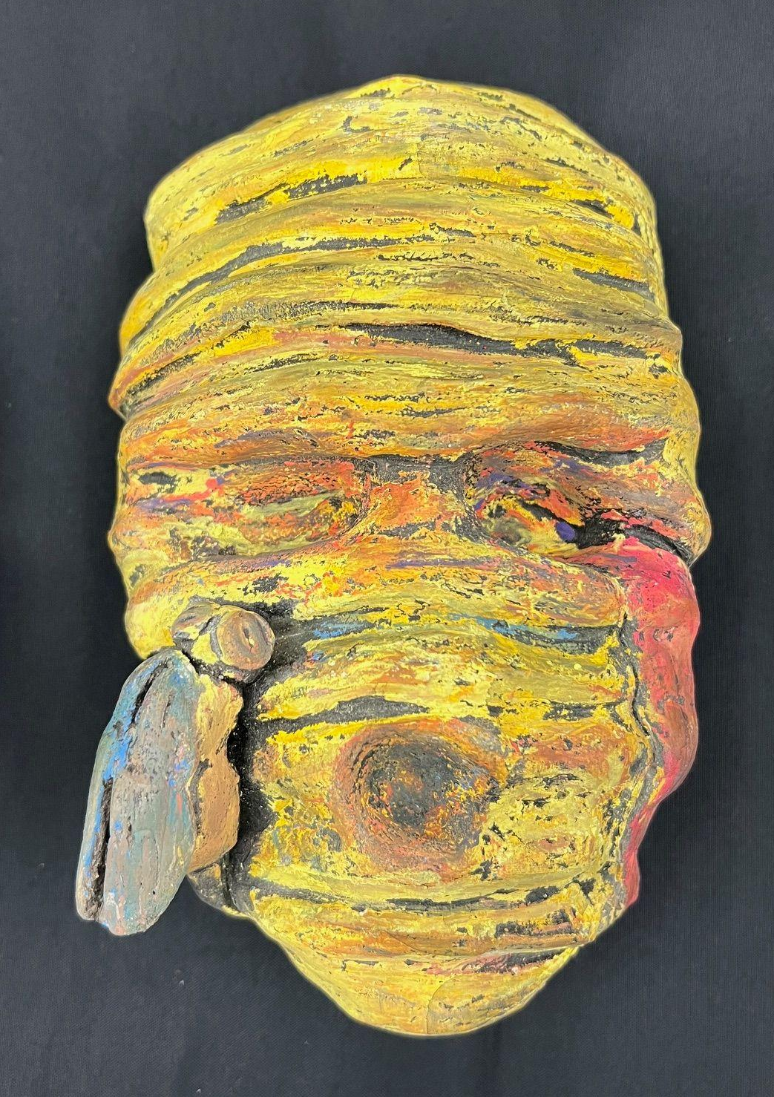
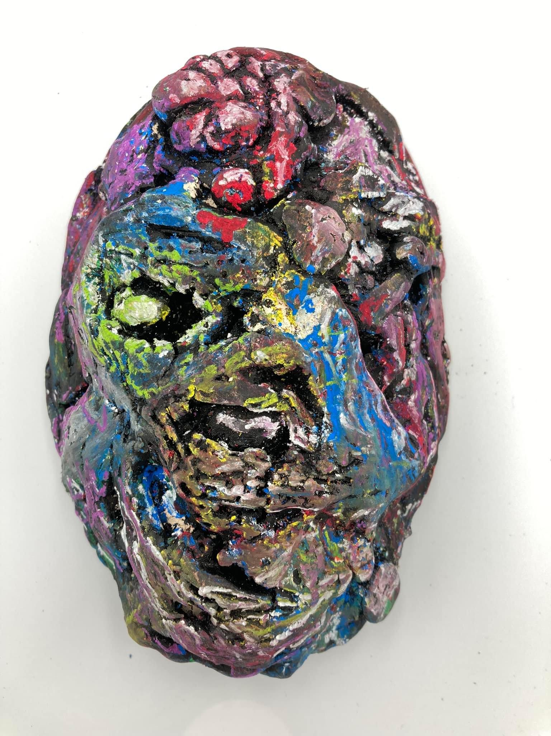
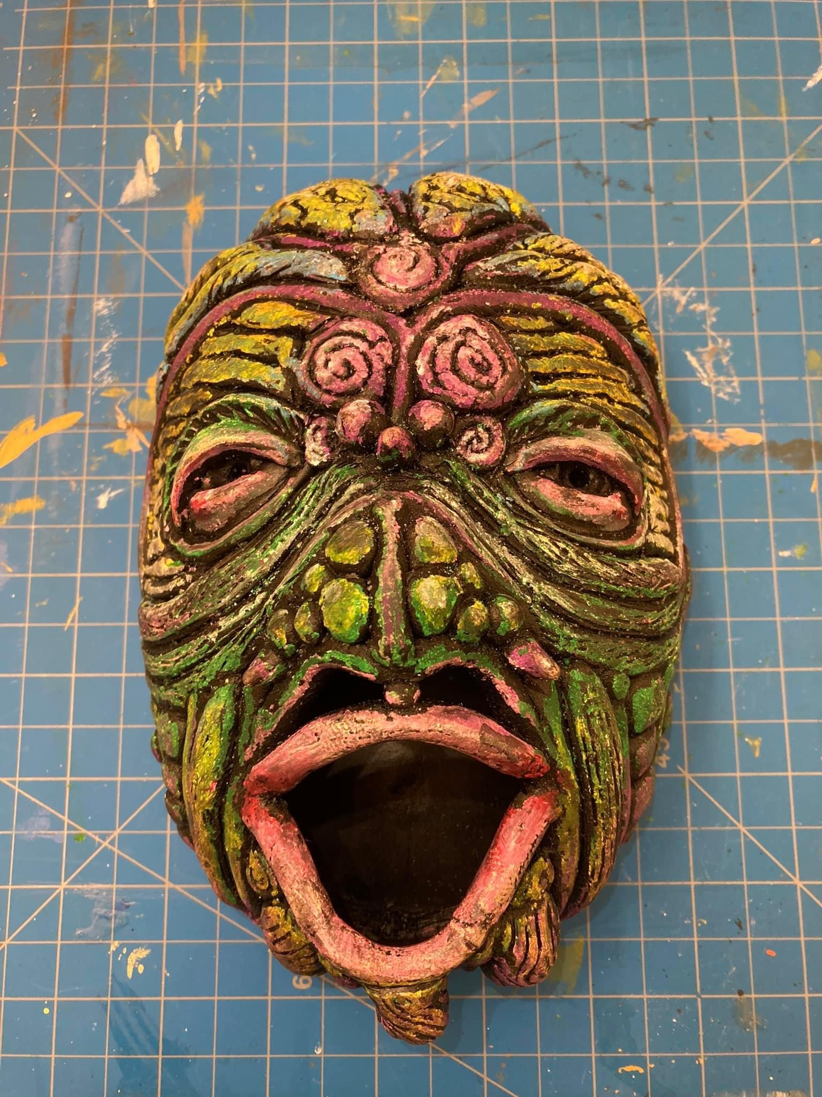
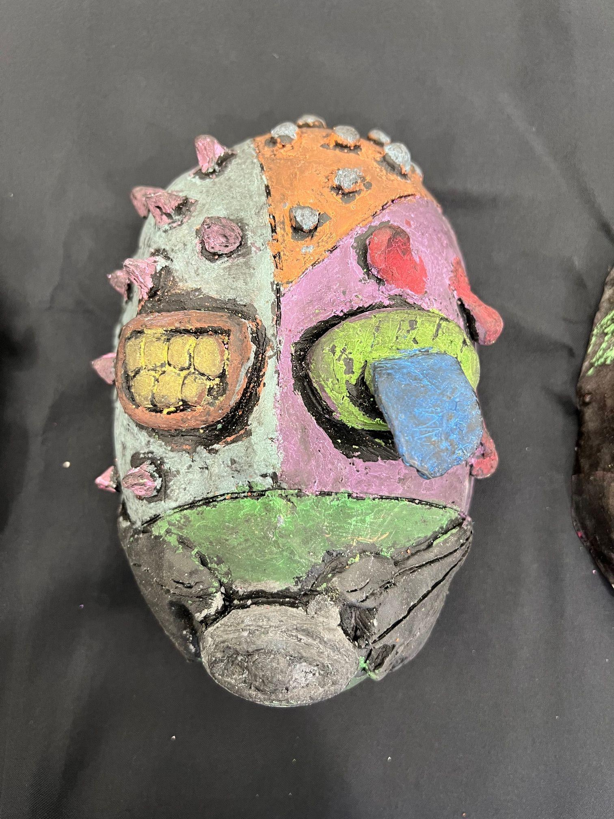
Masks
Abstract representation of YOURSELF

Slide 15
SELF REFLECTION
Find the essence of who you are.
You will do a REFLECTIVE PRACTICE to help you figure it out.

Slide 16
Reflective Practice Steps
DESCRIBE: From the outside, what do you see?
FEELINGS: How do you feel? What are your thoughts, emotions, etc.?
EVALUATE: What works? What doesn’t? Do your insides match your outsides? Inner conflict?
ANALYZE: Why?
CONCLUSION: Draw conclusions based on the information you’ve discovered.
ACTION PLAN: How can I represent this visually?

Slide 17
The Psychology of Color
Notes:
Color is a powerful way to abstractly represent emotions. As you show each slide with the color and word associations…point out that it’s the imagery and other elements of art and design that bring these associations to life.

Slide 18
RED
Strength Power
Courage Vibrant
Stimulating Energizing
Love
Passion Anger
Notes:
Ask for students to volunteer visual information that clarifies when red is representing love vs anger.
For example, red with curvy lines would signal a romantic feeling, but harsh jagged lines would signal anger.
Do this sort of discussion and brainstorming about color and imagery pairings for each slide.

Slide 19
ORANGE
encouragement optimism
self-confidence warmth happiness
enthusiasm rejuvenation
vitality pessimism superficiality
Notes:
Orange paired with yellow is more happy feeling than orange paired with brown.
Orange with diagonal lines radiating upward would show warmth or vitality.

Slide 20
YELLOW
intellect logic creative new ideas uplifting illuminating
Hope happiness fun
warm playfulness anxiety
apprehension impatience cowardice judgemental

Slide 21
GREEN
nature balance
growth harmony healing
stability security
self-reliance money/wealth prestige
rebirth freshness
greed jealousy selfishness

Slide 22
BLUE
trust serenity peace
loyalty integrity
predictability calming wisdom
Sincere reserved
quiet mature conservative
boring rigid

Slide 23
PURPLE
imagination spirituality
high ideals creative individual
immature impractical
thoughts understanding supportive
dignity wealth
royalty beauty superiority

Slide 24
Bring to mind an emotion you feel often
Describe an image that represents how it feels.
For example: When embarrassed, often our faces flush: What does the heat of that feel like? Is it a melting sensation? Or something more violent like an explosion? Melting and exploding are things you can show visually-- whereas embarrassment is much harder to.

Slide 25
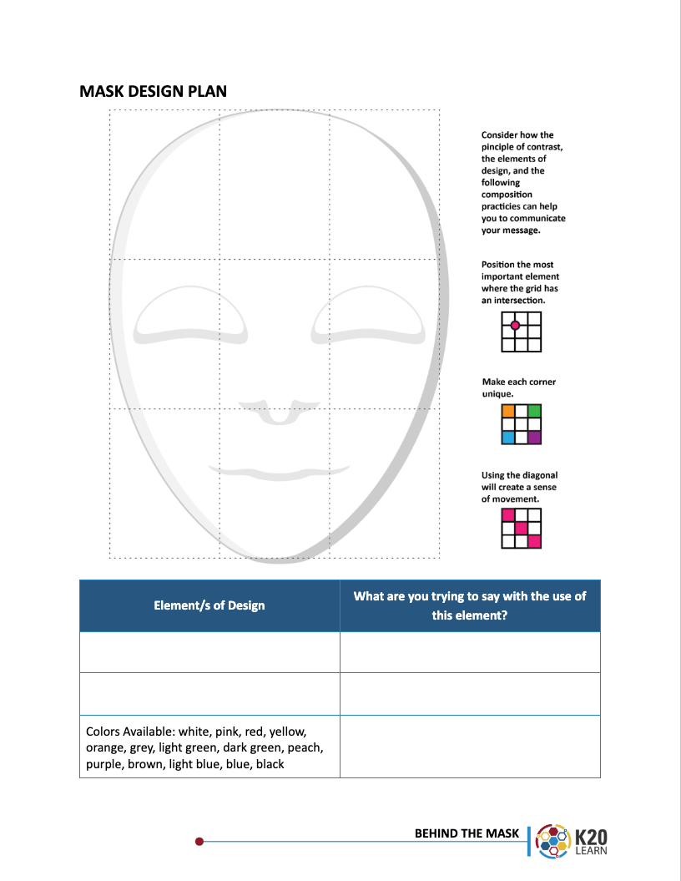
Mask
Design Plan
Sketch your ideas

Slide 26
Make your mask!

Slide 27
Mask Making Steps to Follow
Press a slab of clay into a mask shape using a mask form.
Create a 3D design on top of this base.
The ENTIRE mask needs to be covered with 3D design(s). No carving into the mask, or painting the design on later.
It is up to you if you want to cut out eye holes or a mouth hole, or even have any facial features at all.

Slide 28
Coloring Masks
We will NOT be glazing or painting these masks.
After the first bisque fire, you will color them with oil pastels.
Paint over the entire mask with black india ink.
The oil in the pastels will resist the water in the ink, leaving the black only in the crevices and areas you didn't cover with color.

Slide 29
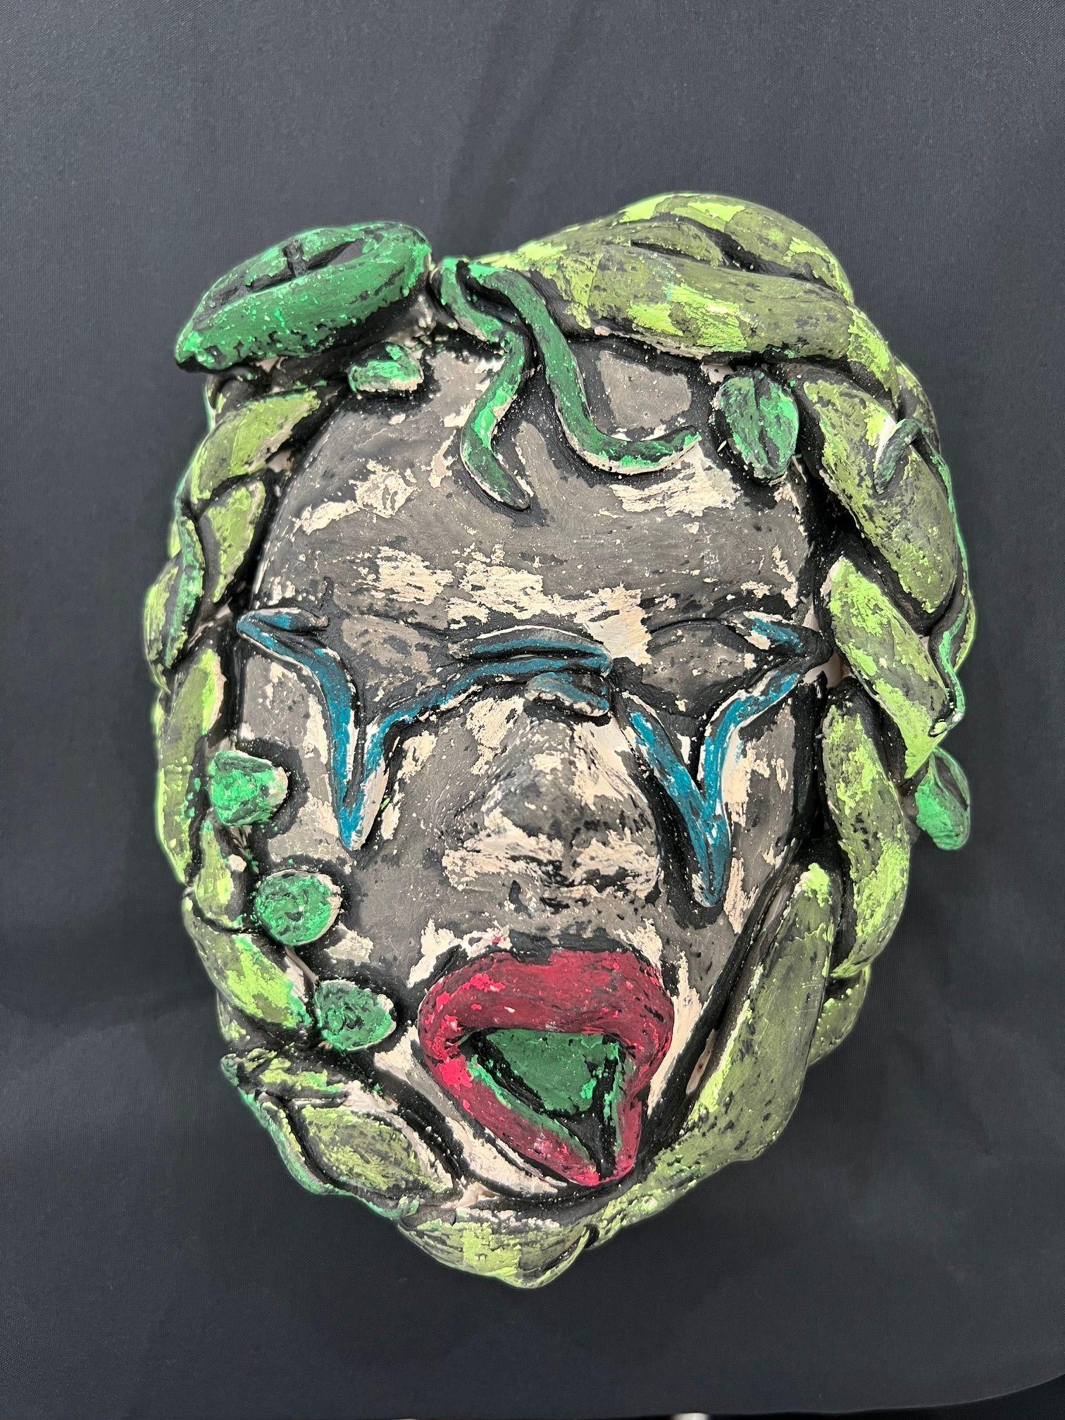
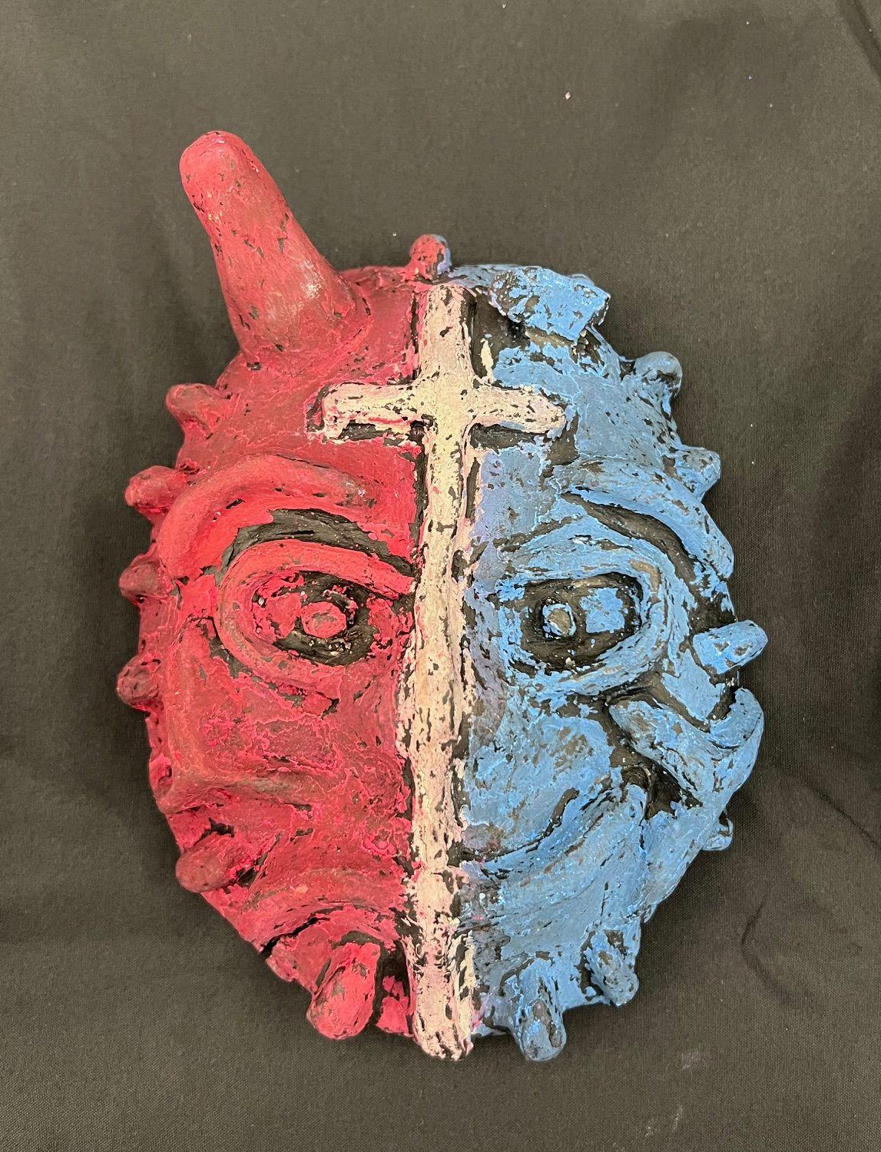
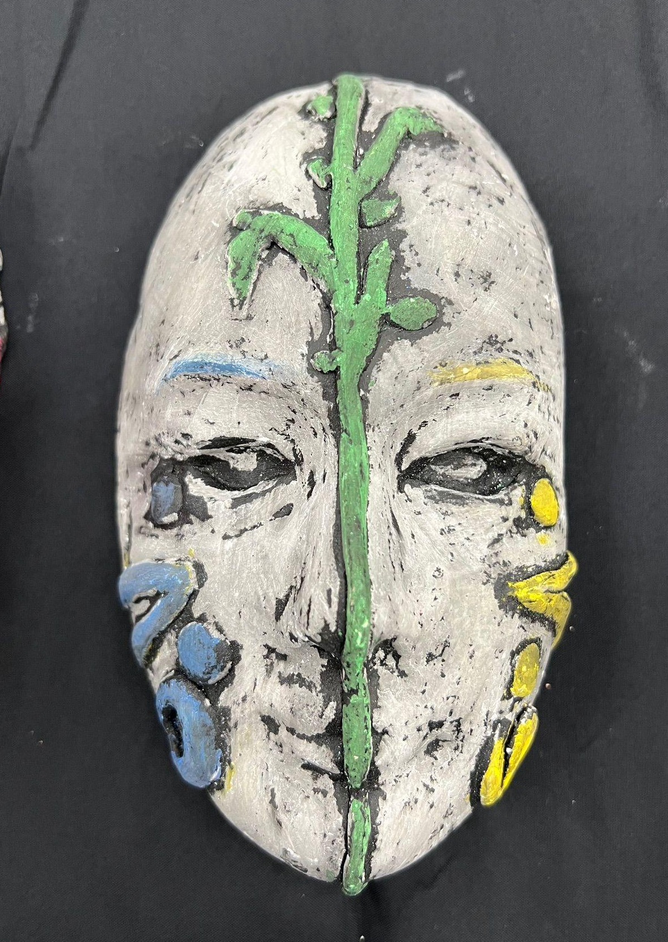
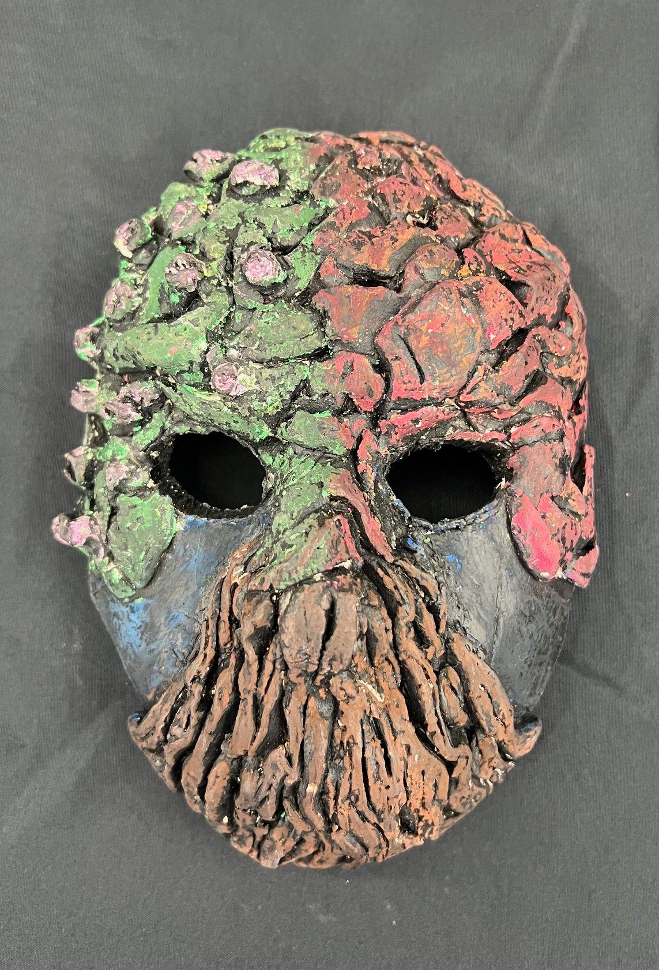
Examples

Slide 30
Rubric
EFFORT created a QUALITY project. | 25
The student PARTICIPATED every day. | 25
The mask is 95% covered with a 3D DESIGN. | 30
This piece shows a CREATIVE ABSTRACT representation. | 10
Oil pastels and ink cover the ENTIRE mask (no bare clay). | 10

Slide 31
Artist Statement
Title your mask.
Describe what the big ideas behind the design are.
Explain how you made it.
Talk about your goals.
Explain how the process of making it has influenced you.

Slide 32
Gallery Walk
As you view the masks, consider and write down one thing you learned about yourself and/or others in the class through these works of art.

Slide 33
Always, Sometimes, Never
For each statement displayed, decide if you believe it is always, sometimes, or never true and why.
Be prepared to share your reasoning.

Slide 34
Our identities are fixed and unchanging.

Slide 35
People wear ‘masks’
to protect parts of themselves.

Slide 36
We only show parts of our true selves in different situations.

Slide 37
Everyone wears a metaphorical mask at some point.

Slide 38
Wearing a mask can help someone feel more powerful or safe.

Slide 39
Taking off a mask is the same as being your real self.

Slide 40
We choose our masks as carefully as we choose our clothes.

Slide 41
Art should look like the thing it represents.

Slide 42
Abstract art can express personal identity more clearly than realistic art.

Slide 43
Art helps us discover things about ourselves we didn’t know.

