Slide 1
Wait…What?! When Memory and Reality Don’t Match
Memory and the Mandela Effect

Slide 2
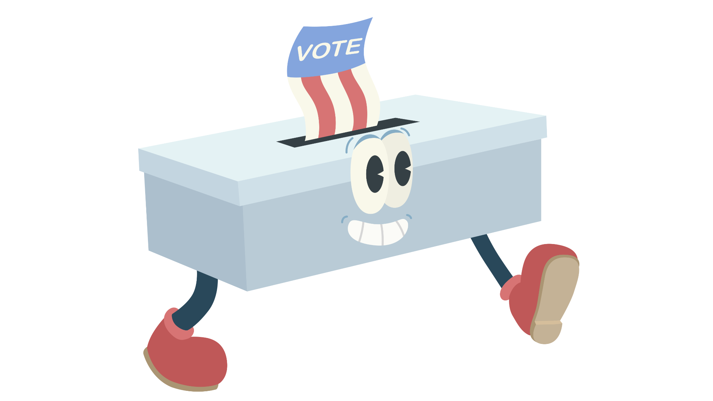
Walking Vote
Everyone will start in the middle.
As you are presented with two images, walk towards the side of the room you believe is correct.
LEFT
RIGHT
B
A

Slide 3
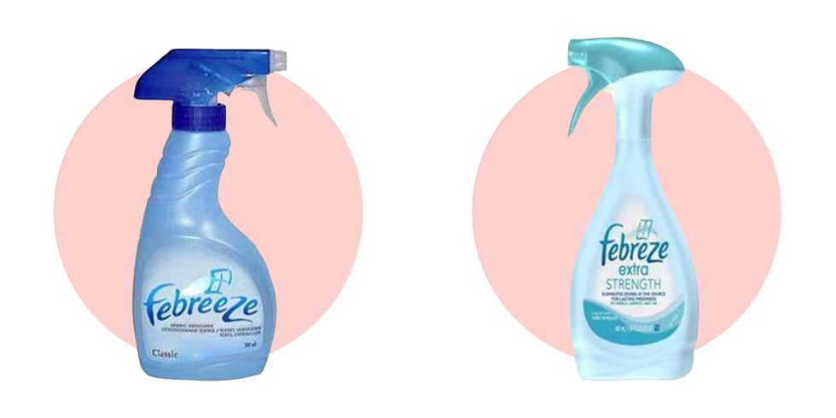
Which is the correct one?
A
B
Notes:
Febreze
Quinn, K. (2019, September 13). 40 Mandela Effect examples that will blow your mind. Good Housekeeping. https://www.goodhousekeeping.com/life/entertainment/g28438966/mandela-effect-examples/

Slide 4
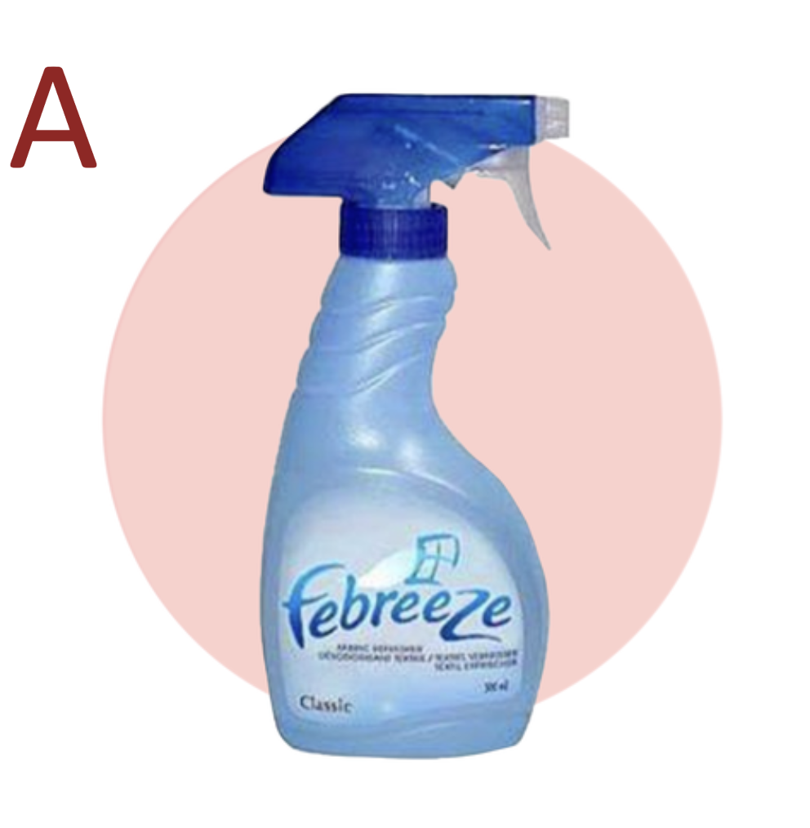
Notes:
Quinn, K. (2019, September 13). 40 Mandela Effect examples that will blow your mind. Good Housekeeping. https://www.goodhousekeeping.com/life/entertainment/g28438966/mandela-effect-examples/

Slide 5
Which is the correct one?
A
B
Notes:
Oscar Mayer
Quinn, K. (2019, September 13). 40 Mandela Effect examples that will blow your mind. Good Housekeeping. https://www.goodhousekeeping.com/life/entertainment/g28438966/mandela-effect-examples/

Slide 6
Notes:
Quinn, K. (2019, September 13). 40 Mandela Effect examples that will blow your mind. Good Housekeeping. https://www.goodhousekeeping.com/life/entertainment/g28438966/mandela-effect-examples/

Slide 7
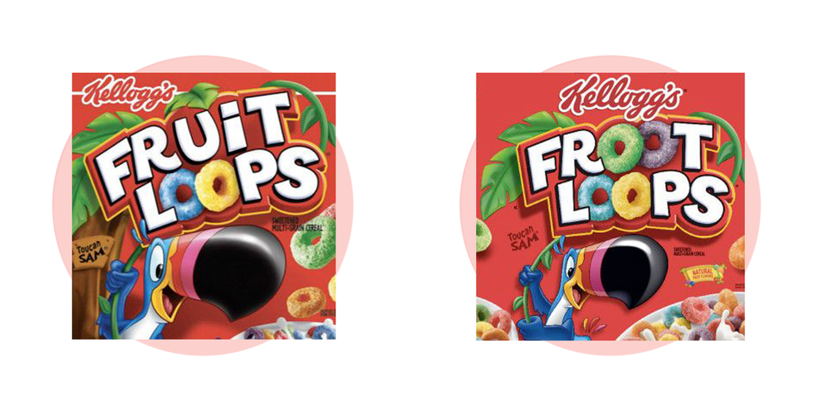
Which is the correct one?
A
B
Notes:
Froot Loops
Quinn, K. (2019, September 13). 40 Mandela Effect examples that will blow your mind. Good Housekeeping. https://www.goodhousekeeping.com/life/entertainment/g28438966/mandela-effect-examples/

Slide 8
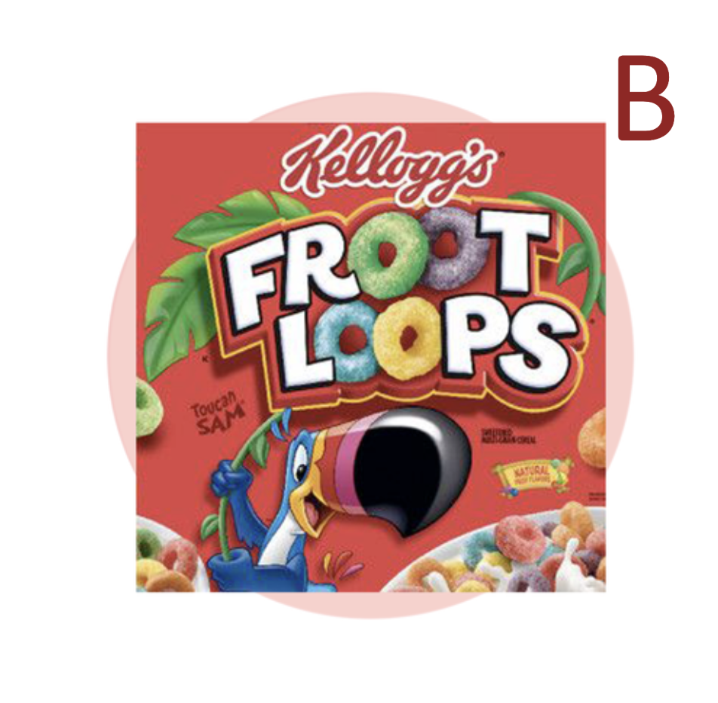
Notes:
Quinn, K. (2019, September 13). 40 Mandela Effect examples that will blow your mind. Good Housekeeping. https://www.goodhousekeeping.com/life/entertainment/g28438966/mandela-effect-examples/

Slide 9
Which is the correct one?
A
B
Notes:
Pikachu's Tail
Quinn, K. (2019, September 13). 40 Mandela Effect examples that will blow your mind. Good Housekeeping. https://www.goodhousekeeping.com/life/entertainment/g28438966/mandela-effect-examples/

Slide 10
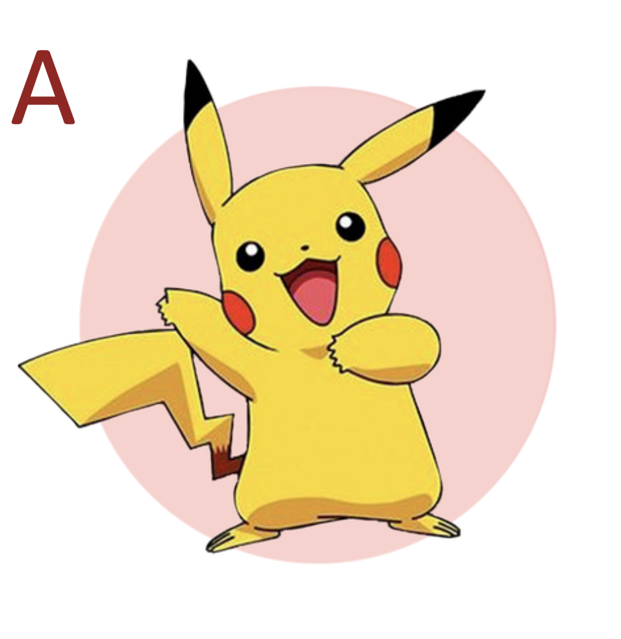
Notes:
Quinn, K. (2019, September 13). 40 Mandela Effect examples that will blow your mind. Good Housekeeping. https://www.goodhousekeeping.com/life/entertainment/g28438966/mandela-effect-examples/

Slide 11
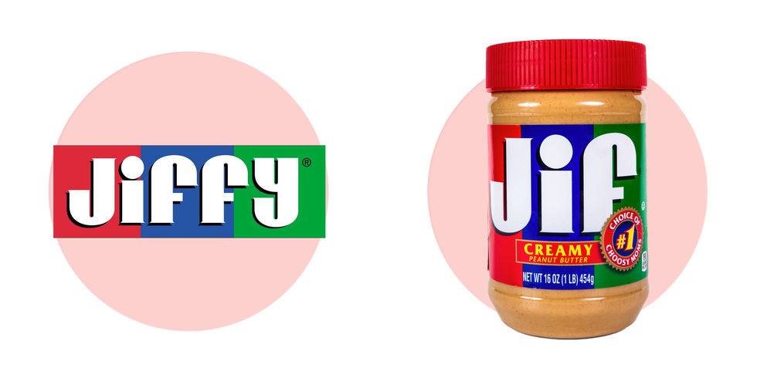
Which is the correct one?
A
B
Notes:
Jif, Not "Jiffy"
Quinn, K. (2019, September 13). 40 Mandela Effect examples that will blow your mind. Good Housekeeping. https://www.goodhousekeeping.com/life/entertainment/g28438966/mandela-effect-examples/

Slide 12
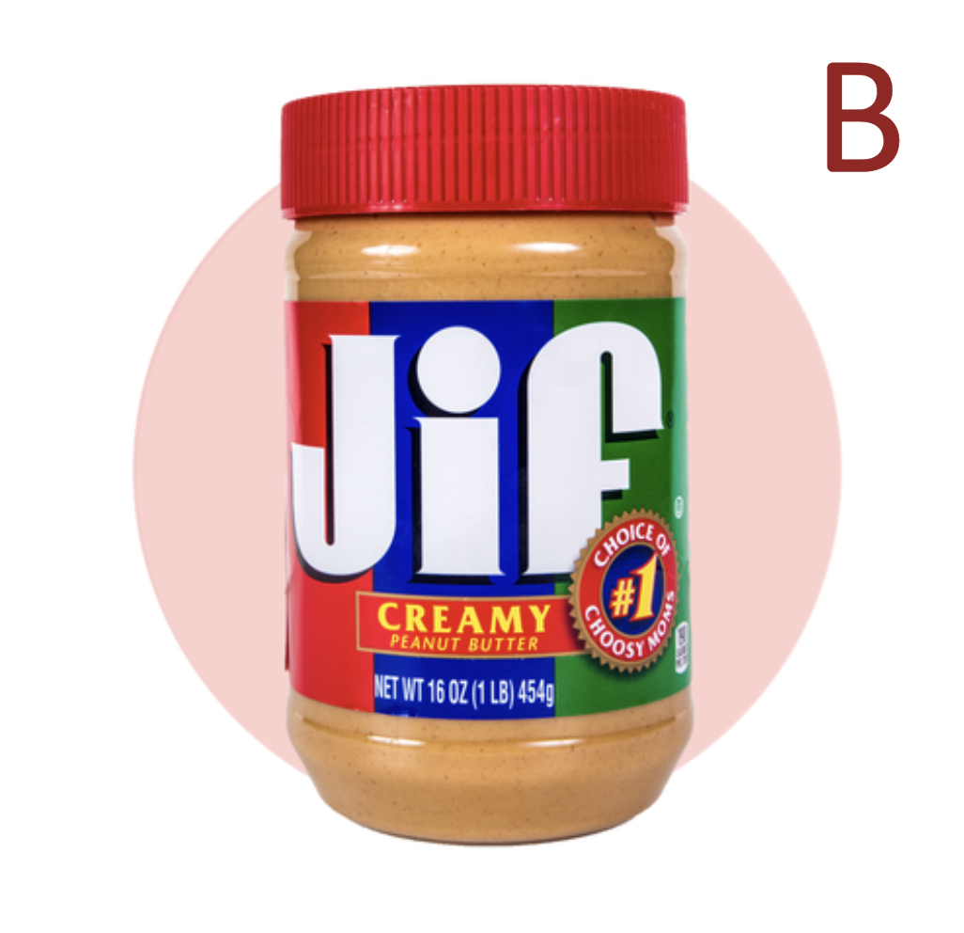
Notes:
Quinn, K. (2019, September 13). 40 Mandela Effect examples that will blow your mind. Good Housekeeping. https://www.goodhousekeeping.com/life/entertainment/g28438966/mandela-effect-examples/

Slide 13
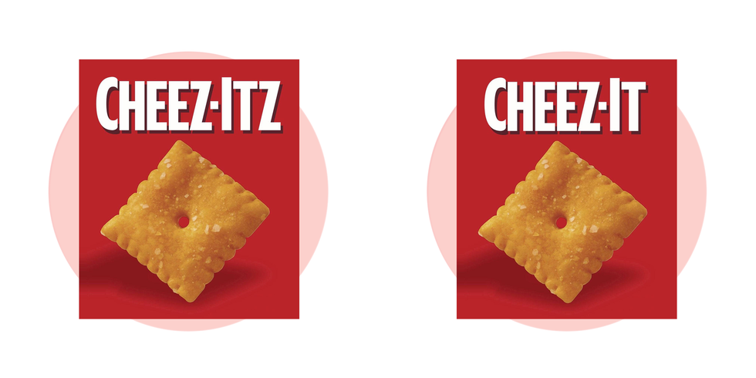
Which is the correct one?
A
B
Notes:
Cheez-It or Cheez-Itz?
Quinn, K. (2019, September 13). 40 Mandela Effect examples that will blow your mind. Good Housekeeping. https://www.goodhousekeeping.com/life/entertainment/g28438966/mandela-effect-examples/

Slide 14
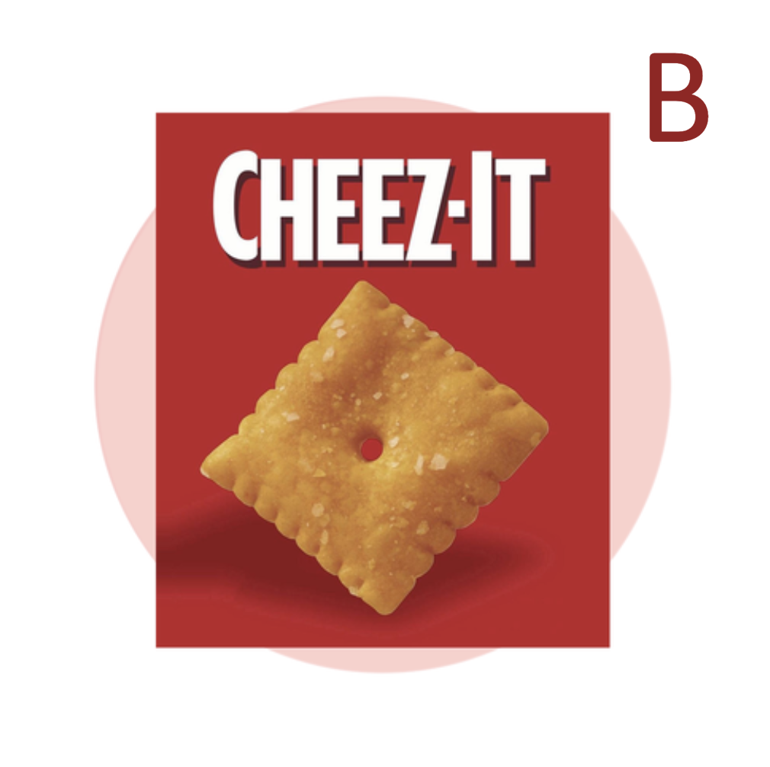
Notes:
Quinn, K. (2019, September 13). 40 Mandela Effect examples that will blow your mind. Good Housekeeping. https://www.goodhousekeeping.com/life/entertainment/g28438966/mandela-effect-examples/

Slide 15
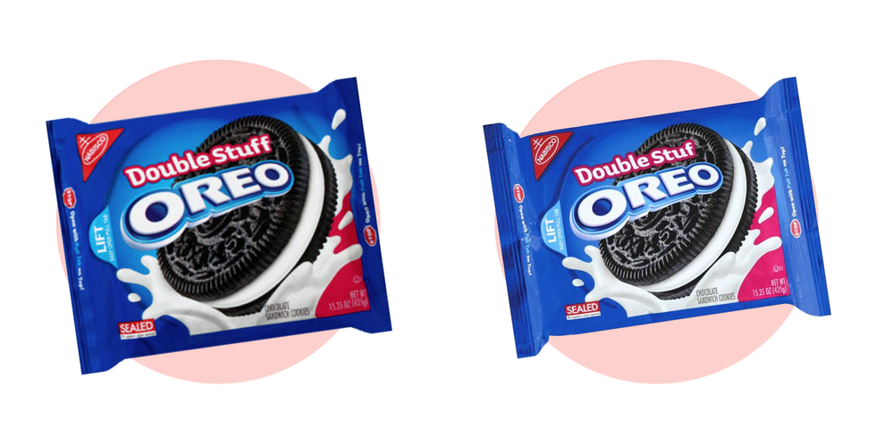
Which is the correct one?
A
B
Notes:
Double "Stuf" Oreos
Quinn, K. (2019, September 13). 40 Mandela Effect examples that will blow your mind. Good Housekeeping. https://www.goodhousekeeping.com/life/entertainment/g28438966/mandela-effect-examples/

Slide 16
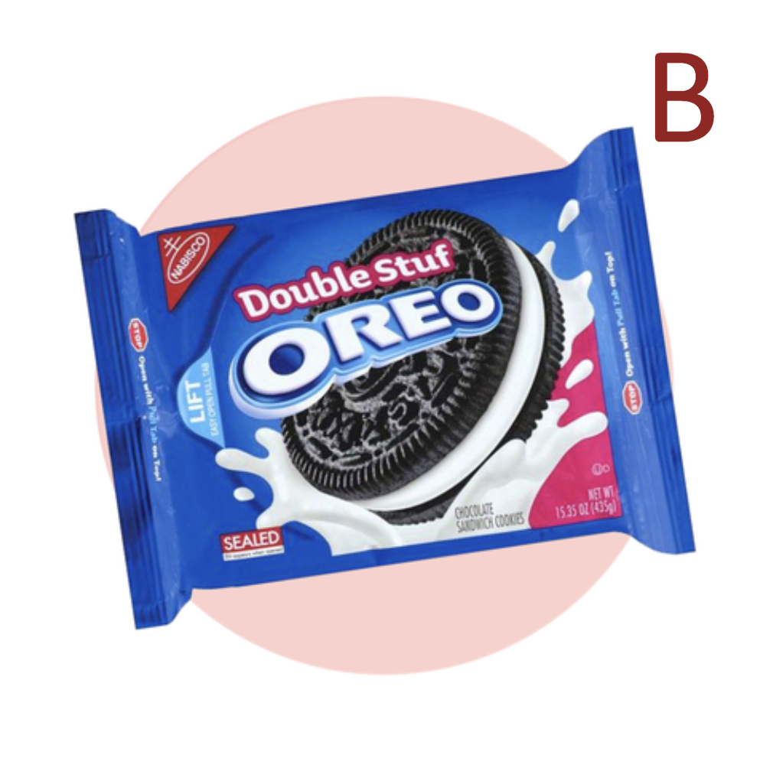
Notes:
Quinn, K. (2019, September 13). 40 Mandela Effect examples that will blow your mind. Good Housekeeping. https://www.goodhousekeeping.com/life/entertainment/g28438966/mandela-effect-examples/

Slide 17
Walking Vote Debrief
What do you think is happening here?
Why do so many people remember the same 'wrong' thing?

Slide 18
Essential Question
How do our brains trick us into creating false memories?

Slide 19
Lesson Objectives
Understand factors that influence memory and recall.
Make connections between the memory process and the Mandela Effect.

Slide 20
Memory Exercise
A set of words will be read out loud to you, as these words are read to you try seeing how many you can remember.
Do not write the words down, just listen as they are read out loud.

Slide 21
Exercise 1
Cat | Cow
Dog | River
Fish | Grass
Horse | Lake
Bird | Tree
Snake | Plant

Slide 22
Memory Exercise–Your Turn!
Take out a piece of paper and jot down as many words as you remember.

Slide 23
How many did you get correct?
Who got the most correct?
What was easy about this task, what was difficult?
Cat | Cow
Dog | River
Fish | Grass
Horse | Lake
Bird | Tree
Snake | Plant

Slide 24
Exercise 2
Retrieval | Encoding
Storage | Sensory Memory
Long-Term Memory | Short-Term Memory
False Memory | Confabulation
Amnesia | Reconstructive Memory Hypothesis
Misinformation | Mandela Effect

Slide 25
Memory Exercise–Your Turn!
Take out a piece of paper and jot down as many words as you remember.

Slide 26
How many did you get correct?
How many did you get correct this round?
Was this easier or harder? Why?
Retrieval | Encoding
Storage | Sensory Memory
Long-Term Memory | Short-Term Memory
False Memory | Confabulation
Amnesia | Reconstructive Memory Hypothesis
Misinformation | Mandela Effect

Slide 27
Memory Exercise Debrief
Which set of words was easier to remember?
What connections or techniques did you use in order to remember more of the words?
Were there patterns you noticed that helped you remember the words?

Slide 28
What is an annotation?
Annotation is a comment that explains in greater detail words or phrases that may be confusing or unknown to the reader; to add notes to a text by giving explanation or making connections to other topics.

Slide 29
Annotating Text
As you read through the Memory, Misinformation, and the Mandela Effect handout, highlight or underline the following:
Unknown words or phrases
Words that summarize the reading
Phrases from the reading that seem important

Slide 30
Honeycomb Harvest
Each hexagon has one of the following on it:
Vocabulary
Definition
Example
With your group, organize these into groups to determine their relationships and how they all connect with each other

Slide 31
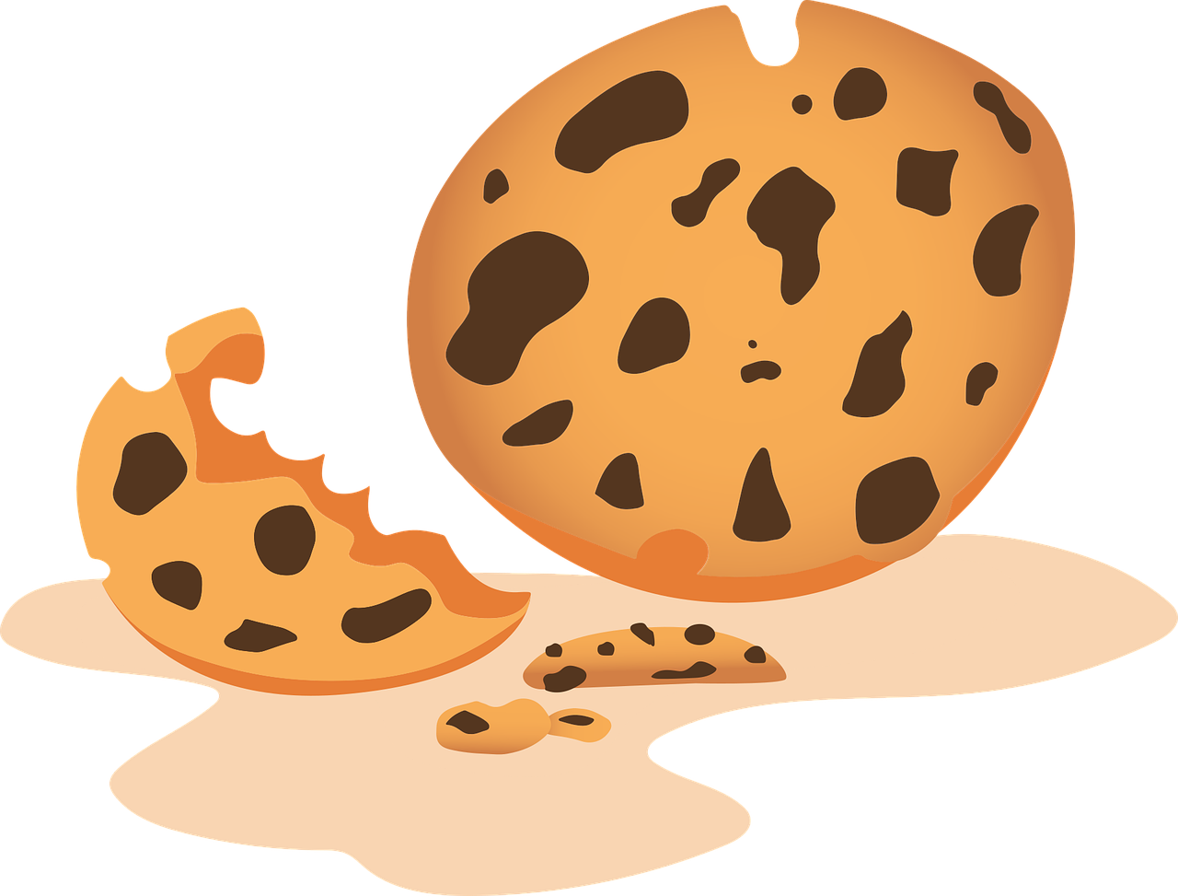
Example Honeycomb Harvest
e
food
d
B
a
b
D
c
apple
f
F
C
Egg-
plant
banana
E
cookie
donut
A
Notes:
https://pixabay.com/illustrations/teacher-apple-school-elementary-1202735/
https://pixabay.com/vectors/banana-bunch-fruit-food-bananas-25339/
https://pixabay.com/vectors/cookie-dessert-snack-biscuits-6035822/
https://pixabay.com/vectors/donut-snack-dessert-sweet-sugary-5985274/
https://pixabay.com/vectors/aubergine-egg-plant-food-greens-1298730/
https://pixabay.com/vectors/vegetables-fruits-food-artichoke-155616/

Slide 32
Egg-
plant
cookie
A
E
c
apple
e
C
a
donut
D
d
banana
f
B
F
b
food

Slide 33
Notes:
K20 Center. (n.d.). 15-minute timer [Video]. YouTube. https://www.youtube.com/watch?v=m3zT2IxZQaw&list=PL-aUhEQeaZXLMF3fItNDxiuSkEr0pq0c2&index=13

Slide 34
Create Your Own Mandela Effect
With your group, choose a familiar brand, quote, story, popular lyric, image, etc. to create your own Mandela Effect.
You can create this image using Canva, Google slides or Draw, or using paper.
Once you have created your images, move them to a Google or Powerpoint slide and submit them.

Slide 35
Walking Vote
Everyone will start in the middle.
When your image comes up, one person from your group will present to the class.
LEFT
RIGHT
B
A

Slide 36
Claim, Evidence, and Reasoning (CER-ER)
Prompt: How can memory explain the Mandela Effect? Do you think the Mandela effect is real? Why or why not?
Develop a claim based on the question prompt
Write down two text evidence—quotes or statements from the reading or textbook—that supports your claim.
Provide two reasonings regarding how the evidence supports your claim.

