Slide 2
Building Blocks
Understanding Matrices

Slide 3
Essential Question
How are matrices used to organize information and solve real-world problems?

Slide 4
Learning Objectives
Analyze and summarize real-world applications of matrices.
Collaborate to share, refine, and demonstrate understanding of matrix concepts.

Slide 5


ABC Graffiti
Write as many words beginning with each letter of the alphabet as you can to answer the prompt below.
After the timer goes off, take your markers, move to the next chart, and continue to add more words.
  Try to come up with new words as you go!
2 Minute K20 Timer
Prompt: Write as many Matrix or matrix-related words as you can.
Notes:
K20 Center. (n.d.). ABC graffiti. Strategies. https://learn.k20center.ou.edu/strategy/96
K20 Center. (2021, September 21). 2 Minute Timer. YouTube [Video]. https://www.youtube.com/watch?v=HcEEAnwOt2c&list=PL-aUhEQeaZXLMF3fItNDxiuSkEr0pq0c2&index=4

Slide 6

Matrix Mix: Real-World Connection
Each group will receive one article from the Matrix Mix handout.
Read your article carefully as a group.
Come up with 1–2 hashtags that summarize the main idea of your article. Be creative but clear!
Notes:
K20 Center. (n.d.). GramIt. Strategies. https://learn.k20center.ou.edu/strategy/2554

Slide 7

ABC Graffiti | Revisited
Using what you learned from the reading, add more words!
1 Minute K20 Timer
Prompt: Write as many Matrix or matrix-related words as you can.
Notes:
K20 Center. (n.d.). ABC graffiti. Strategies. https://learn.k20center.ou.edu/strategy/96
K20 Center. (2021, September 21). 1 Minute Timer. YouTube [Video]. https://www.youtube.com/watch?v=6ilD555O_RE&list=PL-aUhEQeaZXLMF3fItNDxiuSkEr0pq0c2&index=2

Slide 8

30-Second Spotlight
You’ll have 30 seconds to explain the real-world application of matrices from your group’s article.
Focus of your spotlight:
  What is your real-world example about?
  How were matrices used?
  Why is it important or interesting?
Notes:
K20 Center. (n.d.). 30 second spotlight. Strategies. https://learn.k20center.ou.edu/strategy/3748

Slide 9
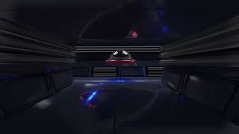
Matrices in Computer Graphics
Matrices in Computer Graphics
Notes:
K20 Center. (2022, July 21). Matrices in computer graphics. YouTube [Video]. https://www.youtube.com/watch?v=g8sMoZ2fgZw&t=1s

Slide 10
Square Puzzle
Work with your partner to complete the puzzle.
Cut out all 9 square tiles.
Rearrange the tiles to form one large square so that touching sides show equivalent values.
When you think you’ve solved it, raise your hand for a quick check.
If something doesn’t match, keep adjusting until it all fits!

Slide 11
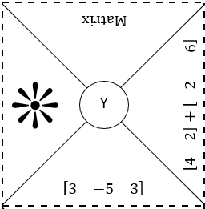
Square Puzzle: Step One
*Top left corner of puzzle

Slide 12
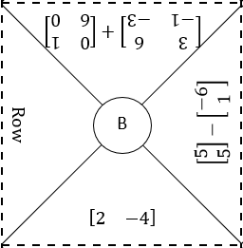
Square Puzzle: Step Two
*Top left corner and top middle of puzzle

Slide 13

POMS
What was the most meaningful or surprising thing you learned about matrices, and why did it stand out to you?
Notes:
K20 Center. (n.d.). Poms: Point of most significance. Strategies. https://learn.k20center.ou.edu/strategy/101​​​​​​​

