Slide 2
ANATOMICAL TERMS
Biology

Slide 3
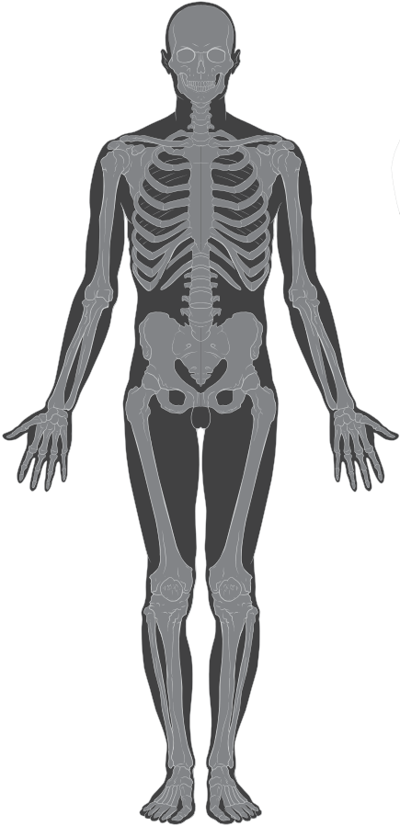
Distal
Away from the center (trunk).
Ex: The foot is distal to the hip.
distal

Slide 4
Proximal
Closer to the center (trunk).
Ex: The knee is proximal to the foot.
proximal

Slide 5
Lateral
medial
Away from the midline.
Ex: The hip is lateral to the spine.
lateral
Medial
Closer to the midline.
Ex: The clavicle is medial to the spine.

Slide 6
Anterior
To the front.
Ex: The nose is anterior to the ear.
anterior

Slide 7
Posterior
The back side.
Ex: The gluteus maximus is located on the posterior side of the body.
posterior

Slide 8
Superior
Above (closer to the head)
Ex: The head is superior to the shoulder bone.
superior

Slide 9
Inferior
Below (closer to the feet)
Ex: The shoulder bone is inferior to the head.
inferior

Slide 10
Ventral
Closer to the front, or underside, of the body.
Ex: The chest is ventral to the spine.
ventral

Slide 11
Dorsal
Closer to the back, or topside, of the body.
Ex: The gluteus maximus is dorsal to the naval.
dorsal

