Slide 2

Connect the Dots
Drawing the Line Between Pronouns and Their Antecedents for
Perfect Agreement

Slide 3
Essential Questions
How do clear pronoun-antecedent relationships prevent confusion in writing?
How will understanding the relationship between pronouns and antecedents improve ACT performance?

Slide 4
Lesson Objectives
Identify correct use of pronouns in relation to their antecedents.
Analyze whether pronouns and their antecedents match in number, gender, and person.
Determine whether pronoun/antecedent references are ambiguous.
Apply pronoun knowledge through ACT-style practice.

Slide 5


Who Are You?
Partner A’s Role
Repeatedly ask “Who are you?” for the full 60 seconds. Ask the question over and over.
Partner B’s Role
Answer with one-word nouns only (no adjectives or phrases!) Examples: "Student," "Sister," "Athlete," "Friend," "Leader.”
Give a different noun each time the question is asked.
Think quickly; don't overthink the answers.
After Round 1, switch roles.
Notes:
Start the Timer
Set timer for 60 seconds
Partner A begins asking the question
Switch Roles/Start timer over

Slide 6
Connecting the Dots
What is one thing you found surprising about this activity?
What part of speech replaces the nouns you just listed?
What is it called when a pronoun refers to a noun?
"A pronoun without a clear antecedent is like a bridge without a destination – it leaves the reader lost in the middle of nowhere."
Notes:
Quote is attributed to Mark Twain.

Slide 7
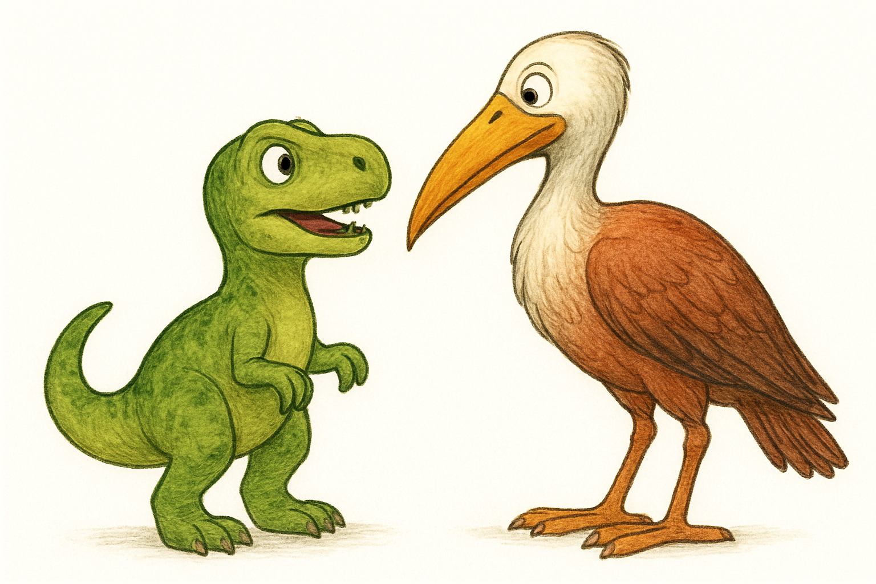
What’s another word for antecedent?
Predecessor, anterior, what-came-before, aforementioned, parent, prior, previous…
Notes:
ChatGPT. (2025). Dinosaur and bird facing each other in dialogue [AI-generated image]. OpenAI. https://chat.openai.com/

Slide 8
Connect the Dots
Connect the pronoun to its antecedent.
She, a dedicated student, completes her assignments on time.

Slide 9

Categorical Highlighting
Stay with your original partner.
Retrieve a Pronoun Errors handout and four highlighters (different colors) for each of you.
Highlight the error in each sentence according to its type:
  number disagreement
  gender disagreement
  person disagreement
  vague or ambiguous references
Draw a line connecting the sentences that have the same type of error.

Slide 10

Gallery Walk Posters
Create a poster with chart paper and
markers that includes the following:
  Choose a name inspired by your group letter (A, B, C, or D).
  Identify the Four Types of Errors:
    number disagreement
    gender disagreement
    person disagreement
    vague or ambiguous references
  Write your group’s own definition of each type of error.
  Create an original example sentence showing each type of error.

Slide 11


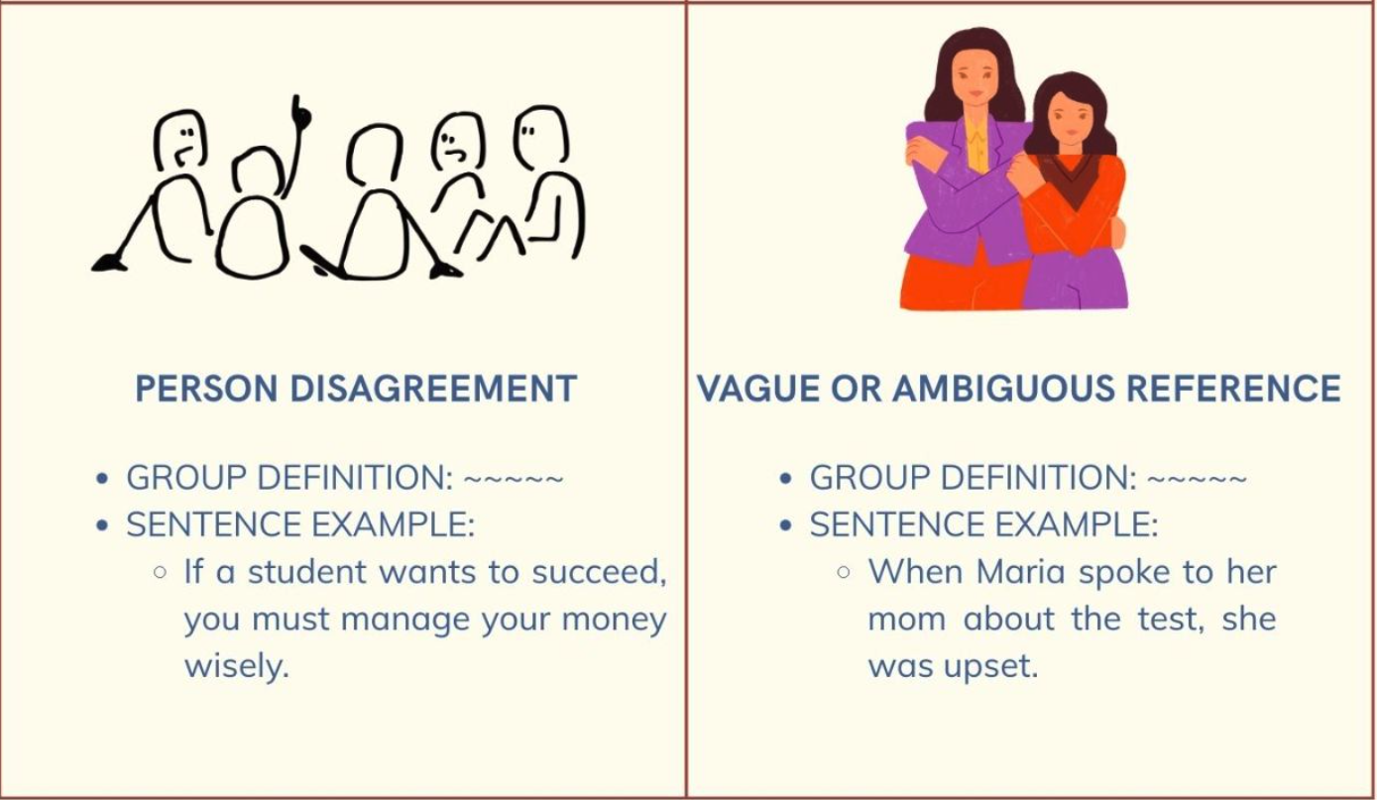
Poster Example
Group X: Joey, Sam, Madelaine, and Elias
Notes:
Canva. (2026). Pronoun Errors Poster [Digital image generated by AI]. Canva AI.

Slide 12
Example Sentence
Read the sentence below to yourself.
Think about its meaning.
“Police help dog bite victim; he was clearly shaken.”

Slide 13
Sleuth the Sentence
Interpret the sentence: Provide all the possible options. Investigate! Evaluate context clues, use logical reasoning, and analyze the grammar. Report Findings What did the author mean? What is the evidence? Why did the ambiguity occur? How can the sentence be clarified?
“Police help dog bite victim; he was clearly shaken.”
Police (A)
help
dog (B) victim (C)
bite
Notes:
K20 Center. (n.d.). Claim, evidence, reasoning (CER). Strategies. https://learn.k20center.ou.edu/strategy/156
Remember not to read this out loud to students so as to not provide any additional context clues.
Conduct a discussion.

Slide 14
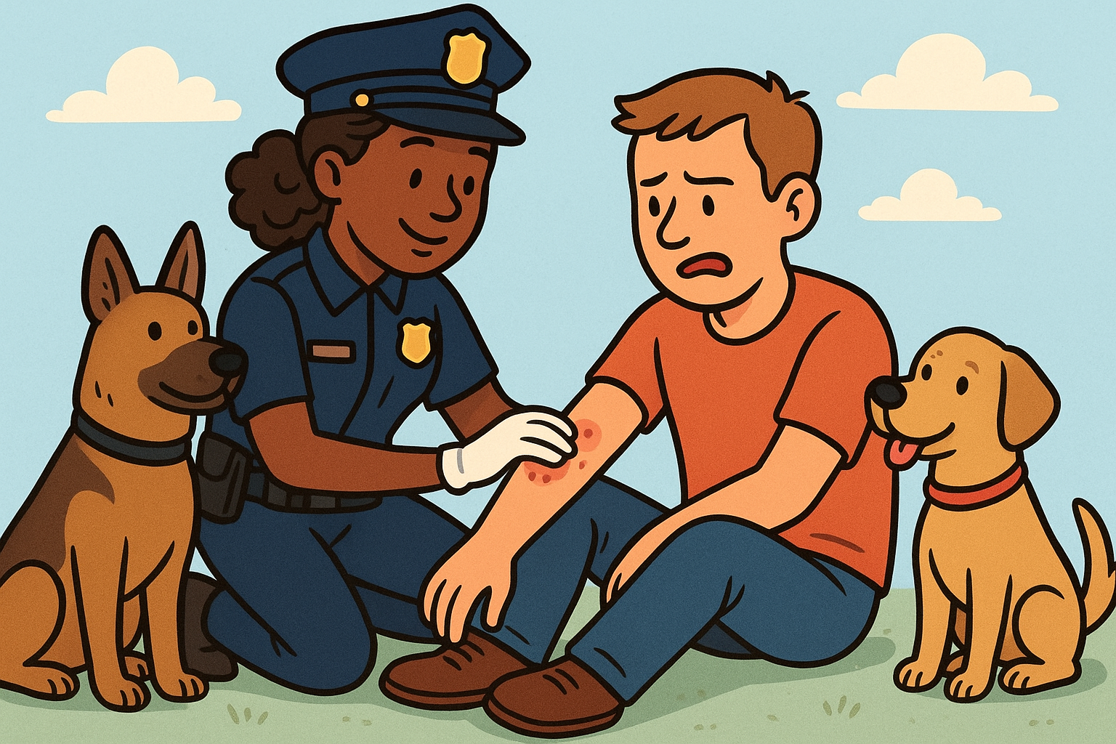
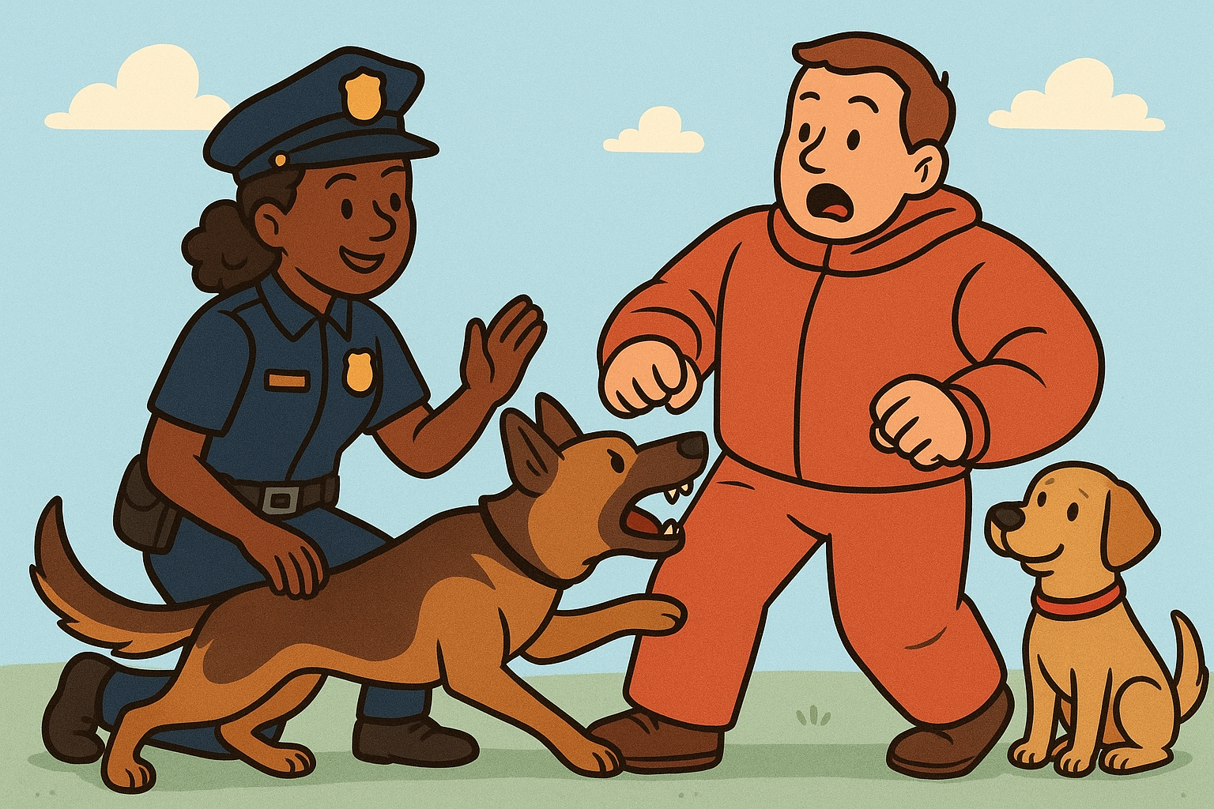
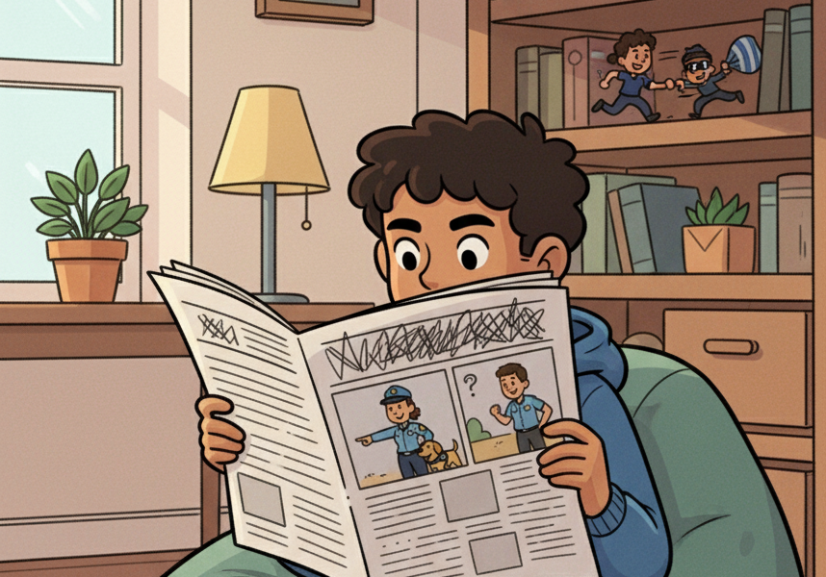
Comic Strip Analyzer
Panel 1 “Police help dog bite victim; he was clearly shaken.” | Panel 2 Police assist a person who was bitten by a dog. | Panel 3 Police assist a dog in biting a person. | Panel 4 Evidence: It’s absurd to think a police officer would help a dog bite someone. Conclusion: Panel 2 has the correct interpretation.
Notes:
ChatGPT. (2025). Police assist a dog bitten by a person [AI-generated image]. OpenAI. https://chat.openai.com/
ChatGPT. (2025). Police assist a person bitten by a dog [AI-generated image]. OpenAI. https://chat.openai.com/
Gemini. (2025. Youth reading a newspaper [AI-generated image]. Gemini. https://gemini.google.com

Slide 15
Ambiguous Texts
INSTRUCTION MANUAL
Assembly Instructions—
Step 5:
Place the mounting bracket onto the base panel and align it with the pre-drilled holes. Insert the screws through it and tighten them with the hex wrench. Make sure it is firmly secured before attaching it to the frame. If it becomes loose during installation, remove it and reapply the adhesive strip to it before reinstalling it.
SOCIAL MEDIA POST
Just got back from lunch with Sarah and told her about my sister. She said she thinks she should definitely talk to her about it before she makes any decisions. Really hope she takes her advice! 🤞
TEXT MESSAGE
hey! so i saw Jake with his brother at the mall and he told him that he really needs to return his jacket before he gets mad. he said he'd do it tomorrow but idk if he actually will lol

Slide 16

3-2-1
What are three things you learned from the Grammar Forensics activity?
What are two questions you still have about the pronoun-antecedent questions you might encounter on the ACT test?
What is one thing you found interesting?

Slide 17
Who’s Doing What?
The ACT tests whether you should use a subject or object pronoun.
Role | Definition | Example
Subject | Does the action | He threw the ball.
Object | Receives the action | The ball hit her.
Remember, "I" can only be used as a subject and "me" can only be used as an object.

Slide 18
Subject Pronouns vs. Object Pronouns
 | Singular | Plural
1st person | I | we
2nd person | you | you
3rd person | she he it one | they
 | Singular | Plural
1st person | me | us
2nd person | you | you
3rd person | her him it one | them

Slide 19
Pronoun Case
Case refers to whether a pronoun is used as a subject or an object.
Subject Pronouns (Doer of actions) | Object Pronouns (Receiver of actions)
Who | Whom
I | Me
He/She | Him/Her
We | Us
They | Them

Slide 20
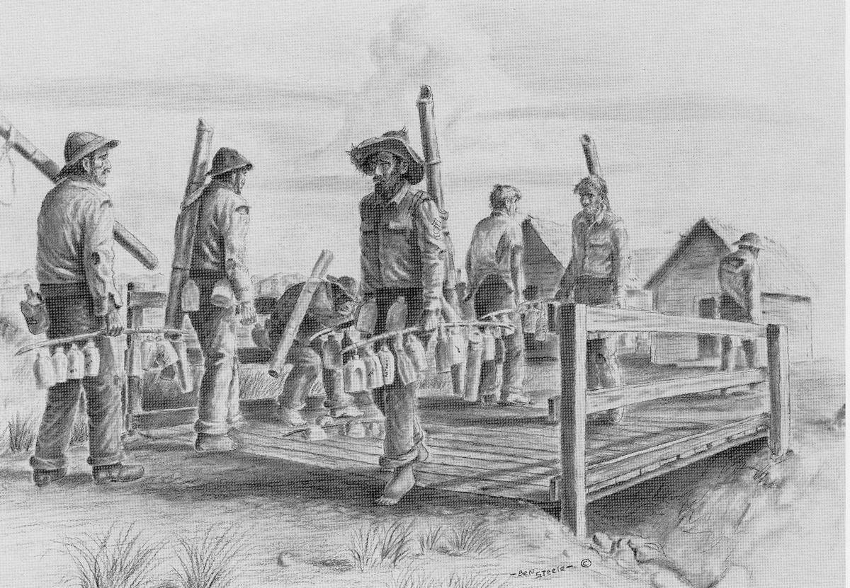
Possessive Pronouns
Possessive Pronouns vs. Contractions
  its (possessive) vs. it’s (it is / it has)
  their (possessive) vs. they're (they are)
  vs. there (place)
  your (possessive) vs. you're (you are)
  whose (possessive) vs. who's (who is)
Other key concepts
  Possessive pronouns show ownership (e.g., mine, yours, his, hers, its, ours, theirs)
  Contractions are shortened forms of words or phrases created by omitting letters. They are marked with an apostrophe and typically used in informal speech and writing.
Notes:
Contractions are often made of a noun/pronoun and a verb: We’re happy when you’re on time. Negative contractions are formed by combining a verb with the word not: We can’t go Saturday. Modal verbs also form contractions when they are combined with have: We could’ve left early today.
Steele, B. (n.d.). Ben Steele’s drawings [Drawings]. American Experience | PBS. https://www.pbs.org/wgbh/americanexperience/features/bataan-ben-steeles-drawings/

Slide 21
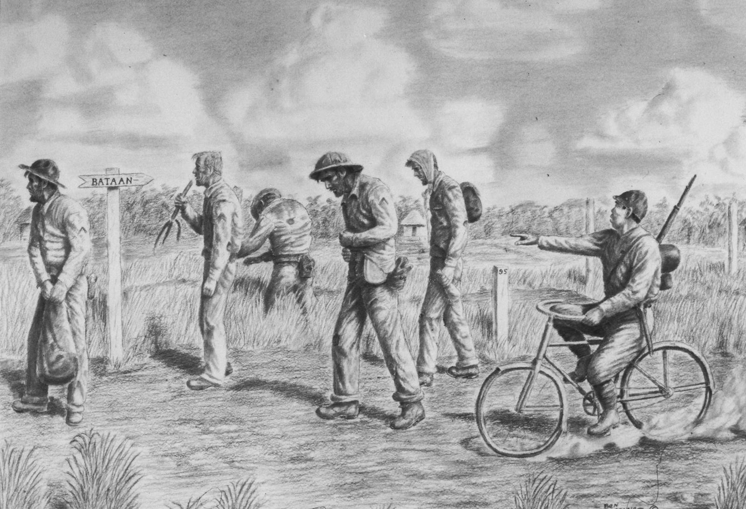
Demonstrative Pronouns
Agreement:
  The ACT tests whether the demonstrative
  pronoun agrees in number with the noun
  it refers to:
    Singular: this, that
    Plural: these, those
Context:
  The choice between "this/these" and "that/those" can also depend on context:
    "this/these" can refer to something close (physically, emotionally, or temporally)
    "that/those" can refer to something farther away.
Notes:
Steele, B. (n.d.). Ben Steele’s drawings [Drawings]. American Experience | PBS. https://www.pbs.org/wgbh/americanexperience/features/bataan-ben-steeles-drawings/

Slide 22
Pronoun Review–Sounds Right? Sounds Off?
When someone visits Paris for the first time, you should see the Eiffel Tower.
The committee members voiced their concerns about the new policy.
When you read the instructions carefully, one can avoid making simple mistakes.
Each of the students submitted their application before the deadline.
Notes:
*address the “their” → his or her

Slide 23
Pronoun Review, continued
Every doctor must renew his license every two years.
In the novel, it describes a world where technology controls every aspect of daily life.
The documentary follows three travelers as they adjust to life in America.
Both of the sisters brought their friends to the party.

Slide 24

ACT Practice:
A Road of Endless Horrors: The Bataan Death March
The passage you are about to read is modeled after the ACT English subtest.
A true English passage would have 10 questions that test a variety of grammar and writing skills.
This passage is only 5 questions and focuses solely on Pronoun Antecedent agreement.
4 Minute K20 Timer
Notes:
Pass out the ACT Questions handout and set the timer. Remind students that part of the instruction is to develop a sense of time, and that four minutes will pass very quickly!
K20 Center. (2021, September 21). 4 Minute Timer. YouTube. https://www.youtube.com/watch?v=kpCsfuvzQeY&list=PL-aUhEQeaZXLMF3fItNDxiuSkEr0pq0c2&index=6
ACT. (n.d.). ACT Education Corp. https://www.act.org/

Slide 25
#1 Explanation
Why B is correct: "He" is a singular pronoun that correctly agrees with the singular antecedent "Tony Reyna," and "was" is the correct singular past tense verb form. Why other answers are incorrect: A. NO CHANGE (They was) - INCORRECT. This contains two errors: "they" is plural but the antecedent "Tony Reyna" is singular, and "was" doesn't agree with the plural pronoun "they." Even if "they" were correct, the sentence would require "were." C. It was - INCORRECT. "It" is used for things or animals, not people. Tony Reyna is a person, so "he" is the appropriate pronoun choice. D. They were - INCORRECT. While "they were" shows correct subject-verb agreement, "they" is a plural pronoun that doesn't agree with the singular antecedent "Tony Reyna." The pronoun must be singular to match its antecedent.

Slide 26
#2 Explanation
Why G is correct: "The prisoners" is plural, correctly requiring the plural verb "were." This maintains proper agreement between the plural subject and plural verb. Why other answers are incorrect: F. NO CHANGE (The prisoners was forced) - INCORRECT. "The prisoners" is a plural noun phrase (indicating multiple people), so it requires the plural verb "were," not the singular verb "was." This is a subject-verb agreement error. H. The prisoner was forced - INCORRECT. While "prisoner was" shows correct singular subject-verb agreement, changing to the singular "prisoner" contradicts the context. The passage discusses 75,000 POWs, which is clearly plural, not a single prisoner. J. The prisoner were forced - INCORRECT. This combines a singular noun "prisoner" with a plural verb "were," creating a subject-verb agreement error. Additionally, the singular form contradicts the passage's reference to 75,000 people.

Slide 27
#3 Explanation
Why B is correct: Replacing the vague "that" with the specific noun phrase "that sight" creates a clear antecedent. Additionally, "realize" is more precise than "knew" in this context. Why other answers are incorrect: A. NO CHANGE (that's when I knew) - INCORRECT. The demonstrative pronoun "that" is ambiguous. It could refer to seeing Major Ivy, the bayonet wounds, or the realization of danger. Ambiguous pronoun references confuse readers. C. that's when we knew - INCORRECT. This changes the point of view from first-person singular ("I") to first-person plural ("we"), which is inconsistent with Gordon speaking about his own experience. It also keeps the ambiguous "that." D. that's when I knew they had - INCORRECT. Changing "we" to "they" shifts the meaning entirely

Slide 28
#4 Explanation
Why J is correct: This maintains consistent first-person plural point of view throughout Beck's description. Both "us" and "we" are first-person plural pronouns that appropriately represent Beck's personal experience as part of the prisoner group. Why other answers are incorrect: F. NO CHANGE (they'd herd you in there. You defecated) - INCORRECT. This creates an inconsistent POV by switching from first-person ("us") to second-person ("you"). Beck is describing his own experience, so first-person should be maintained throughout. G. they'd herd us in there. You defecated - INCORRECT. While "us" correctly maintains first-person point of view, switching to "you defecated" creates inconsistency. The passage should maintain the same perspective throughout the quote. H. they'd herd you in there. We defecated - INCORRECT. Starting with "you" (second-person) and then switching to "we" (first-person) creates the opposite problem. The point of view must remain consistent.

Slide 29
#5 Explanation
Why A is correct: "Who" is the correct relative pronoun because it serves as the subject of the clause "who put him." "Who" is the subject form; "whom" is the object form. The Japanese forces are performing the action of putting. Why other answers are incorrect: B. whom put him - INCORRECT. "Whom" is the object form of the relative pronoun and cannot be used as the subject of a clause. Since the pronoun is doing the action (putting), "who" is required. C. him was picked up by the Japanese, who put he - INCORRECT. "Him" cannot be used as a subject (should be "he"), and "he" cannot be used as an object (should be "him"). Both pronouns are in the wrong case. D. he was picked up by the Japanese, who put he - INCORRECT. While "he was picked up" is correct, "who put he" is wrong because "he" is in the subject case but needs to be in the object case ("him") after the verb "put."

Slide 30
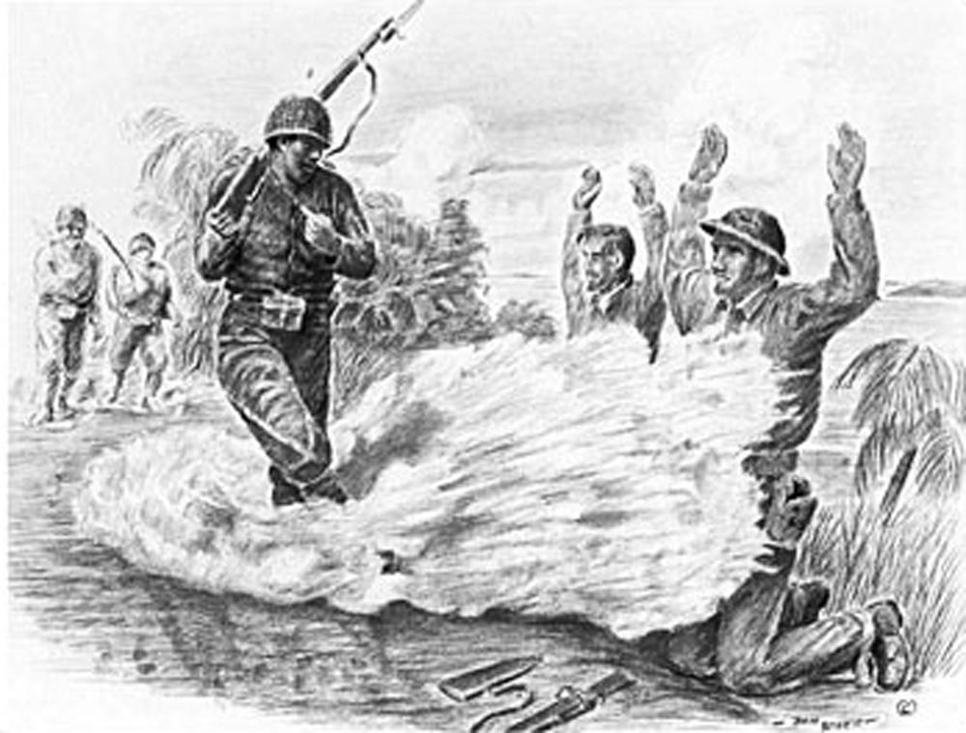
Choose Your Adventure
Read the following prompts and
choose one to write a short
narrative:
“The Impossible Choice”
“What I Saw Someone Else Do”
“The Story We Tell Differently”
“The Friend Who Got Me Through”
Notes:
Steele, B. (n.d.). Ben Steele’s drawings [Drawings]. American Experience | PBS. https://www.pbs.org/wgbh/americanexperience/features/bataan-ben-steeles-drawings/

Slide 31
Narrative Requirements
Choose your perspective: Write in either first person (I, me, my, mine, we, us, ours) OR third person (he, she, they, them, the student). You must remain consistent throughout your entire narrative.
Highlight your work: Use yellow to highlight all pronouns and blue to highlight their referents or antecedents (or choose two colors that work for you).
Length: 1-2 pages, double-spaced

Slide 32




Final Reflection
Choose an emoji to indicate your understanding of pronouns, antecedents, and how they impact your understanding of those types of questions on the ACT. Place that emoji at the top of your narrative.
Emoji Reflection

Slide 33
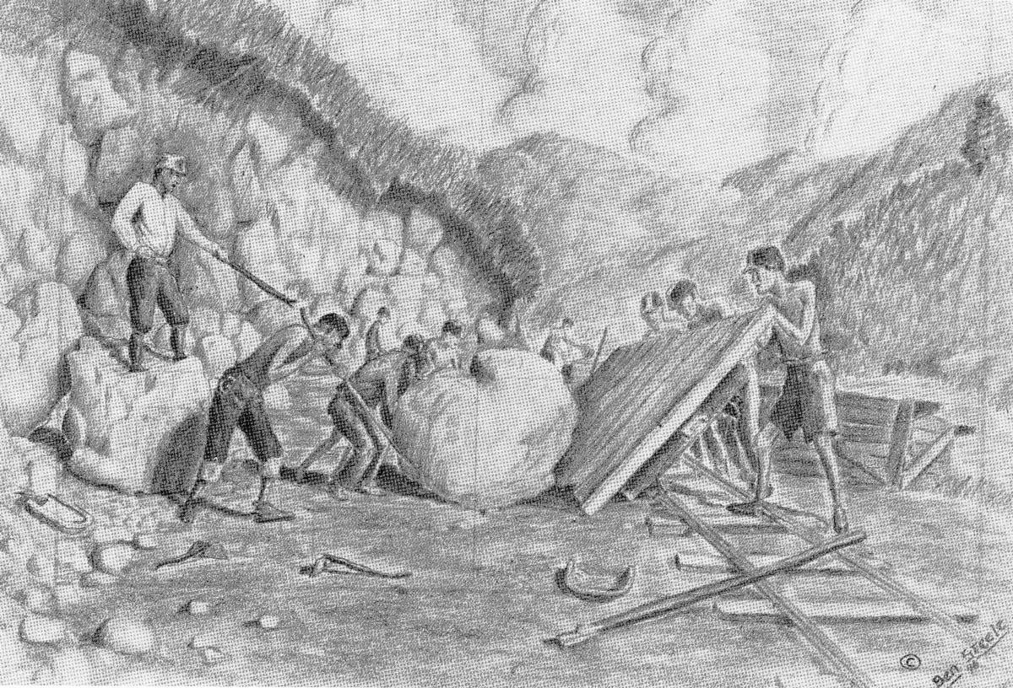
Notes:
Steele, B. (n.d.). Ben Steele’s drawings [Drawings]. American Experience | PBS. https://www.pbs.org/wgbh/americanexperience/features/bataan-ben-steeles-drawings/

Slide 34
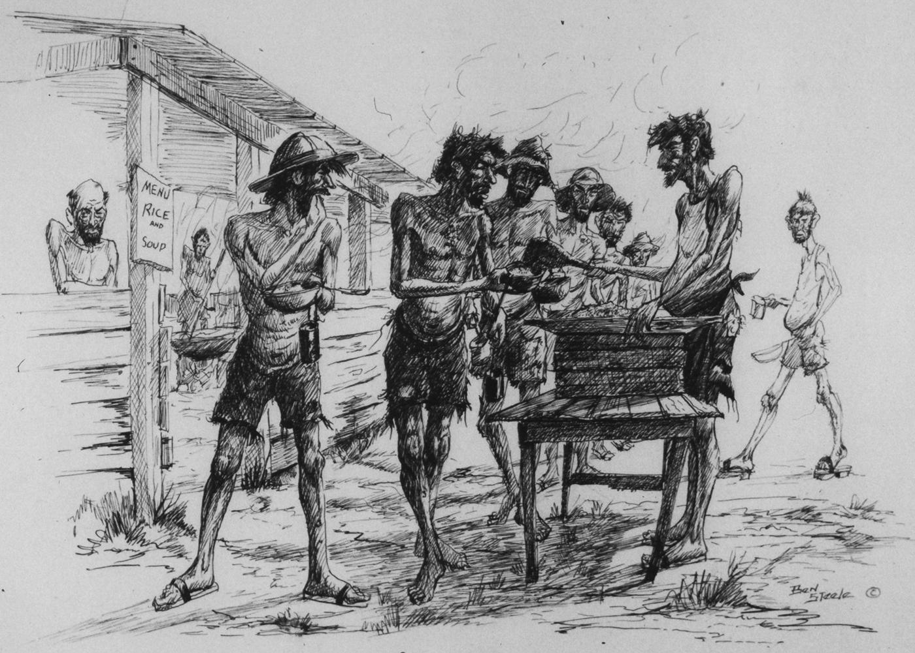
Notes:
Steele, B. (n.d.). Ben Steele’s drawings [Drawings]. American Experience | PBS. https://www.pbs.org/wgbh/americanexperience/features/bataan-ben-steeles-drawings/

Slide 35
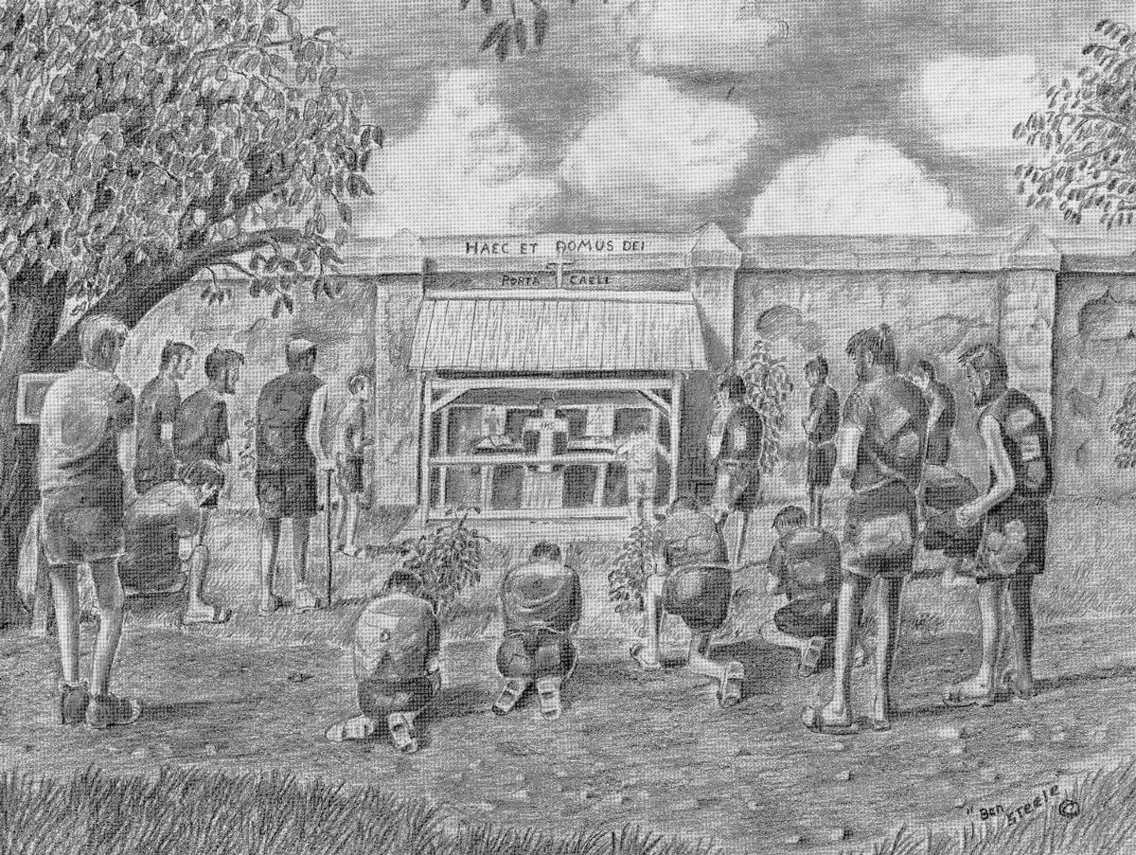
Notes:
Steele, B. (n.d.). Ben Steele’s drawings [Drawings]. American Experience | PBS. https://www.pbs.org/wgbh/americanexperience/features/bataan-ben-steeles-drawings/

Slide 36
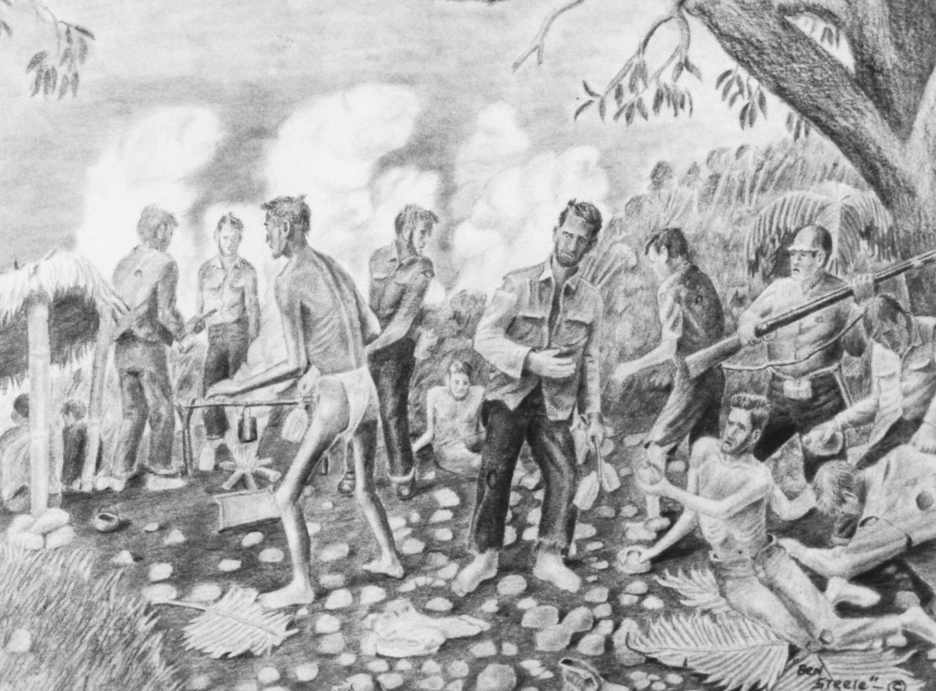
Notes:
Steele, B. (n.d.). Ben Steele’s drawings [Drawings]. American Experience | PBS. https://www.pbs.org/wgbh/americanexperience/features/bataan-ben-steeles-drawings/

Slide 37
Notes:
Steele, B. (n.d.). Ben Steele’s drawings [Drawings]. American Experience | PBS. https://www.pbs.org/wgbh/americanexperience/features/bataan-ben-steeles-drawings/

