Slide 2
Consider the following questions. . .
What makes writing appealing to a reader?
How can we, as writers, paint a picture in our readers' minds?

Slide 3
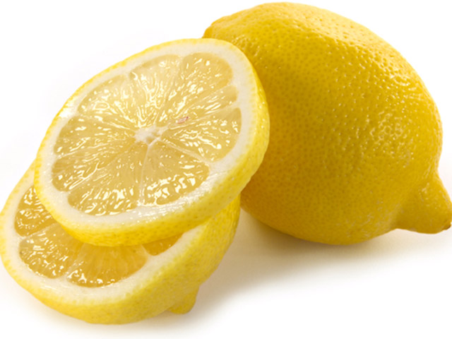
Describe TASTE in 5 words/phrases
1.
2.
3.
4.
5.

Slide 4
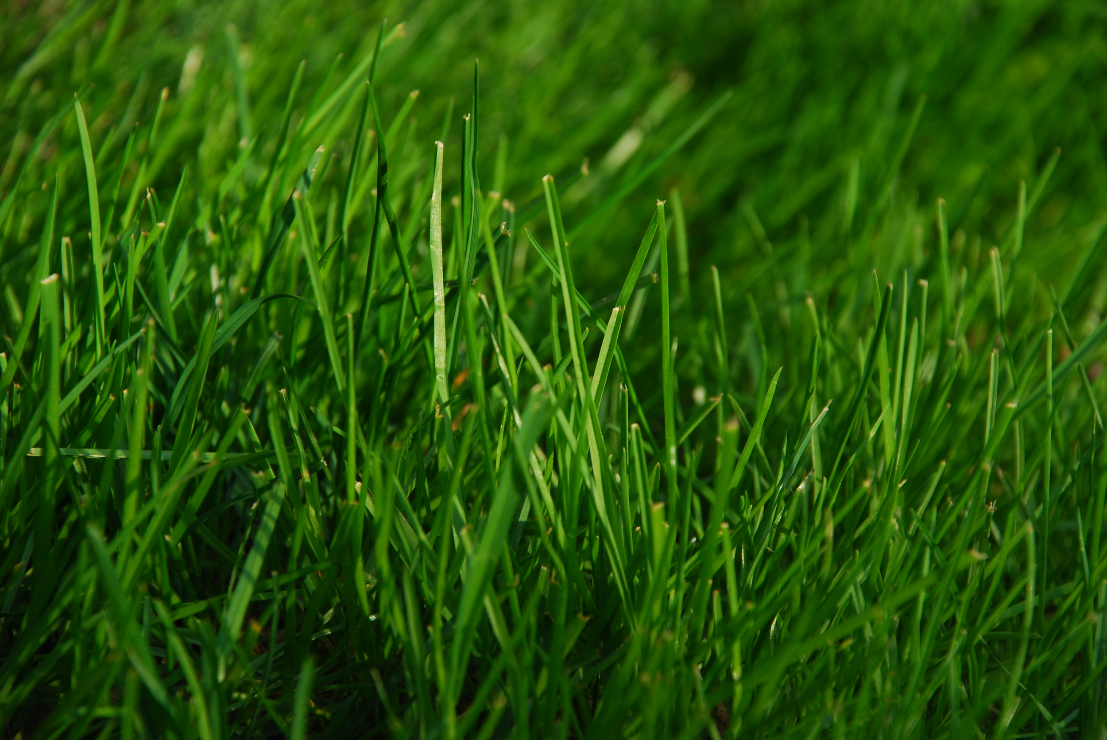
Describe SIGHT in 5 words/phrases
1.
2.
3.
4.
5.

Slide 5
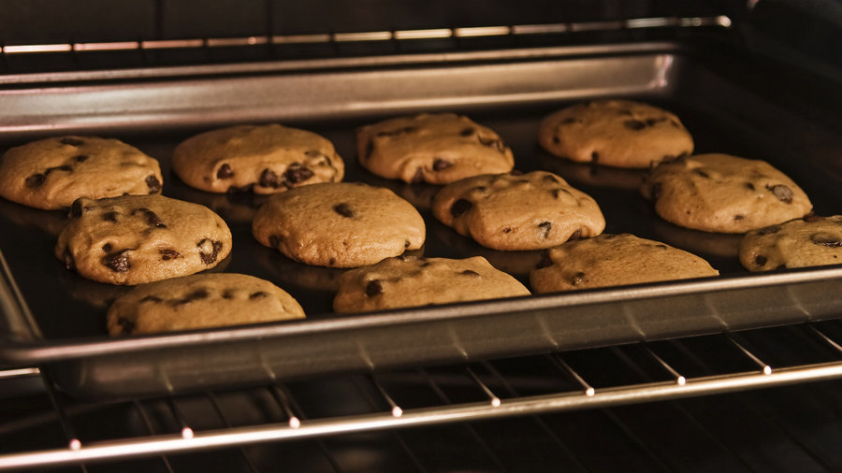
Describe SMELL in 5 words/phrases
1.
2.
3.
4.
5.

Slide 6
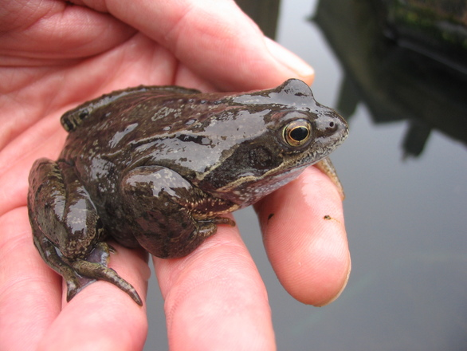
Describe TOUCH in 5 words/phrases
1.
2.
3.
4.
5.

Slide 7
Describe SOUND in 5 words/phrases
1.
2.
3.
4.
5.

Slide 8
Sensory Rewriting, Part 1
Example: The old man stood in the grass and relaxed as the sun went down. | The grass caressed his feet and smile softened his eyes. A hot puff of air brushed against his wrinkled cheek as the sky paled yellow, then crimson, and within a breath, electric indigo.

Slide 9
“The Dinner Party”
What makes the style of this short story either appealing and/or not appealing to the reader?
How could you,as a writer, paint a clearer picture of specific elements in the story?

Slide 10
Sensory Rewriting, Part 2
On the blank paper provided, use the descriptive sentences you wrote from pg. 3 as inspiration to rewrite “The Dinner Party” by Mona Gardner. You may take creative license with this rewritten story, choosing to keep as much or as little of the original descriptions, adding your own where you see fit. For this rewritten version, there are two requirements:
-the basic plot structure should remain similar
-the length should be comparable

