Slide 2
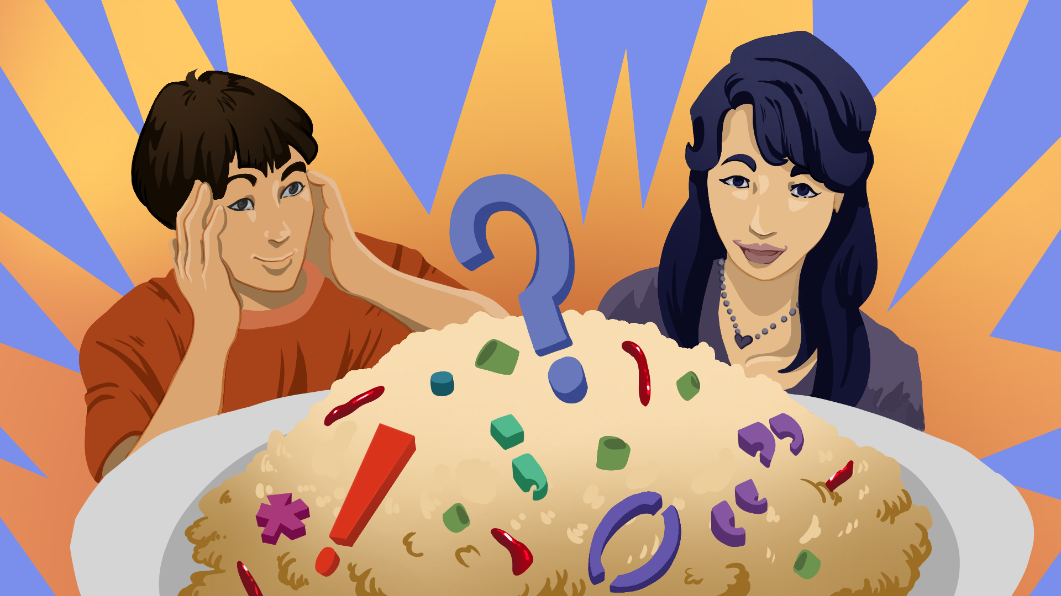
Jump to the Recipe
Punctuation Culmination

Slide 3
Essential Questions
How does using accurate punctuation impact writing?
What are the key elements of a blog?

Slide 4
Learning Objectives
Showcase writing using correct grammar and mechanics while being capable of intentionally deviating from the standard to achieve a desired effect.
Demonstrate accurate use of apostrophes, commas, colons, dashes, ellipses, and semicolons.
Discover the key elements to a blog by writing a personal food blog.

Slide 5
Anticipation Guide
Read each statement on the Anticipation Guide.
Choose your level of agreement with each statement.
Notes:
K20 Center. (n.d.). Anticipation Guide. Strategies. https://learn.k20center.ou.edu/strategy/58

Slide 6
Fold the Line
Line up according to how much you agree or disagree with the following statements.
1s start at the left followed by 2s and so on…
Notes:
K20 Center. (n.d.). Fold the line. Strategies. https://learn.k20center.ou.edu/strategy/171

Slide 7
Fold the Line
I feel confident in my ability to use punctuation effectively.
Notes:
K20 Center. (n.d.). Fold the line. Strategies. https://learn.k20center.ou.edu/strategy/171

Slide 8
Fold the Line
I know a lot about blogging.
Notes:
K20 Center. (n.d.). Fold the line. Strategies. https://learn.k20center.ou.edu/strategy/171

Slide 9
Fold the Line
Punctuation is important for good communication.
Notes:
K20 Center. (n.d.). Fold the line. Strategies. https://learn.k20center.ou.edu/strategy/171

Slide 10
Fold the Line
I use online recipes when cooking.
Notes:
K20 Center. (n.d.). Fold the line. Strategies. https://learn.k20center.ou.edu/strategy/171

Slide 11
Fold the Line
Knowing how to use punctuation correctly makes writing/reading more engaging.
Notes:
K20 Center. (n.d.). Fold the line. Strategies. https://learn.k20center.ou.edu/strategy/171

Slide 12
Fold the Line
Reading food blogs is more interesting than reading a cookbook.
Notes:
K20 Center. (n.d.). Fold the line. Strategies. https://learn.k20center.ou.edu/strategy/171

Slide 13
Blogging Conventions
Read and highlight important parts about Blog Writing.
Discuss with your group what you learned about blogging.

Slide 14
Research Scavenger Hunt
Find 4 examples of blogs.
Use the provided URL links or find your own.
Use the Blog Writing handout to help find examples of blogging conventions for each chosen blog.
Fill in your handout with the appropriate evidence.

Slide 15
Rorschach Test
Navigate to the Google Form: [INSERT URL]
Respond to each photo with 1-2 words.
Notes:
K20 Center. (n.d.). Google forms. Tech Tools. https://learn.k20center.ou.edu/tech-tool/2341
K20 Center. (n.d.). EdWordle. Tech Tools. https://learn.k20center.ou.edu/tech-tool/693

Slide 16
Rorschach Test
Get five different colored sticky notes.
Look at the image and write the first word(s) that come to your mind.
Place your sticky note beside the corresponding punctuation mark on the board.
Goal: Let’s try to understand our initial gut reactions to grammar so that we can help alleviate any pain points.
Notes:
K20 Center. (n.d.). Sticky bars. Strategies. https://learn.k20center.ou.edu/strategy/129

Slide 17
Write the first word that comes to mind.

Slide 18
Write the first word that comes to mind.

Slide 19
Write the first word that comes to mind.

Slide 20
Write the first word that comes to mind.

Slide 21
Write the first word that comes to mind.

Slide 22
Rorschach Reflections
Complete your handout.
Create your own word cloud reflecting on any/all of your experiences with grammar/punctuation.
Write an example of how you normally use grammar/punctuation when texting.
With a partner, create your own rules!

Slide 23
Group Discussion
What is the difference between using punctuation in text messages vs formal writing?

Slide 24
Rules Review: Dashes
Rule | Example | Explanation
Interruptions/Appositives: Like a comma, the dash, is used to mark an interruption. | The Chicago Triathlon—a race of endurance, strength, and skill—is difficult to complete. | Two dashes or two commas can be used interchangeably; however, never use just one of each.
Afterthoughts: The dash can also be used to stress a word or phrase at the end of a sentence. | Danny’s sense of humor is unlike anyone else’s in the family—sarcastic and intelligent. | Notice that the dash is used to give extra information. It makes the description “sarcastic and intelligent” stand out more clearly and adds emphasis.

Slide 25
Rules Review: Dashes
Hyphen - | En Dash – | Em Dash —
•The hyphen is used to join words together to create compound words. short-lived | •The En dash is used to show a range of numbers or dates: 1985–2003 N •The en dash is the width of an “N.” | •The Em dash is used to separate sets of words—such as interjections or parenthetical phrases—for emphasis. Knowing how to use these—these important punctuation marks—will help your writing stand out. M •The em dash is the width of an “M.”

Slide 26
Rules Review: Semi-colons
Rule | Example | Explanation
The semicolon is used to separate two complete sentences. | Julie works hard for her family; she provides them with everything they need, especially food. | Use semicolons to join two clearly related independent clauses in place of a comma and a coordinating conjunction.
The semicolon is used between conjunctive adverbs and transitional phrases. | I enjoy cooking; however, I don’t like cleaning. | Use a semicolon between related sentences when the second sentence starts with either a conjunctive adverb or a transitional expression.

Slide 27
Rules Review: Colons
Rule | Example | Explanation
The colon is used after a complete sentence followed by a list. | I need a lot of groceries: pasta, cheese, cream, chicken, spinach, and a salad. | Colons are most often used to introduce lists, but should be avoided if the list follows a verb or preposition.
The colon is used to separate two complete sentences when the second sentence explains or restates an idea in the first. | Cooking is complicated: sometimes it’s just easier to ask your mom. | Colons are used to illustrate the main point of the sentence by restating or further explaining the first clause.

Slide 28
Rules Review: Colons
Rule | Example | Explanation
The colon is used at the end of a complete sentence followed by an afterthought. | Fettuccine has a high calorie count: 1100 calories. | Colons are used before a noun or noun phrase.

Slide 29
Rules Review: Parentheses
Rule | Example | Explanation
Parentheses are used to hold extra information or side comments. | I have a favorite cookbook (my grandmother’s) that I use at the holidays. | Parentheses can insert personal thoughts or background information that adds context, but aren’t necessary for the sentence to make sense.
Parentheses can help clarify, explain, or give an example. | Gather your ingredients: parmesan cheese(2 cups), cream (1 cup), and butter (1 stick). | Parentheses give specific details—like amounts or descriptions—that clarify or expand on the words just before them.

Slide 30
Rules Review: Parentheses
Rule | Example | Explanation
Parentheses sometimes hold random thoughts. | Remember to preheat the oven (a step many people forget). | Parentheses can enclose side notes or extra information that aren’t essential to the main sentence, but add helpful or interesting details.
Parentheses are used for numbers or letters in an outline or list. | Do you want to eat A) out, B) here, or C) at Mom’s? | Parentheses help clearly organize choices or steps by setting apart letters or numbers in a list format.

Slide 31
Rules Review: Parentheses
Important to Remember: Parentheses are used to mark an interruption.
(If a full sentence is inside parentheses, put the period or other punctuation inside the parentheses, like this.)
If just part of a sentence is in parentheses, (put the punctuation outside), like this.

Slide 32
Rules Review: Apostrophes
The apostrophe is: used to show ownership.
Singular Possession | Plural Possession | Irregular Possession
If there is one owner, use ‘s. | If there is more than one owner, use s’. | Words that are plural without adding the “s,” form the possessive by adding ‘s.
Kelsey’s cookies were amazing! | The chefs’ entrees are being judged. | The children’s cooking competition is starting at noon.

Slide 33
Rubric
Navigate to Magicschool.ai.
Create an “Educator” account.
Click on “Sign-up for free.”
Select “Educator.”
Complete all prompts.
Select “Create a Rubric.”
Notes:
K20 Center. (n.d.). Magicschool ai. Tech Tools. https://learn.k20center.ou.edu/tech-tool/3416

Slide 34
Rubric
Make it a 4-point scale rubric.
Add this objective:
12.5.W.2 Students will demonstrate command of Standard American English (i.e., grammar, mechanics, and usage) in writing, presentations, and/or multimodal literacies to convey specific meanings and ideas, intentionally departing from standard usage to achieve a specific effect.
Add this description:
Write a food blog using a variety of different forms of punctuation correctly.
Add details to the “Additional Customization” from your notes.
Notes:
K20 Center. (n.d.). Magicschool ai. Tech Tools. https://learn.k20center.ou.edu/tech-tool/3416

Slide 35
Write Your Own Blog
Navigate to Canva.com.
In the search bar, type in “food blog.”
Select your favorite template and hit “customize.”
Start creating your content! Follow your Rubric and Planning Guide to make sure you have the following:
Anecdote
Descriptive recipe
Basic step-by-step recipe
Notes:
K20 Center. (n.d.). Canva. Tech tools. https://learn.k20center.ou.edu/tech-tool/612

Slide 36
Peer Review
Swap your Food Blog with your Rubric creation partner’s.
Read the whole blog.
Mark corrections on each others’ blogs.
After correcting your blog mistakes, choose 2 error patterns and create a meme that includes the rule or the error/correction
Example: One student overuses commas.
Notes:
K20 Center. (n.d.). Make a meme. Tech Tools. ttps://learn.k20center.ou.edu/tech-tool/2178

Slide 37
Make a Meme
Choose 2-3 error patterns your peer review partner pointed out and make memes out of them.
Your meme should include:
Either an “example/nonexample” or sample sentence depicting the rule.
An image related to your chosen text.
When adding your meme to the class Padlet, make sure in the comments to explain the grammar rule you’re depicting.
Notes:
K20 Center. (n.d.). Make a meme. Tech Tools. https://learn.k20center.ou.edu/tech-tool/2178
K20 Center. (n.d.). What Do You Meme?. Strategies. https://learn.k20center.ou.edu/strategy/984
K20 Center. (n.d.). Padlet. Tech Tool. https://learn.k20center.ou.edu/tech-tool/1077

Slide 38
Make a Meme
Navigate to makeameme.org.
Choose a template and add your sentence.
Next, upload your meme on Padlet.
Click “Generate Meme.”
Copy image link.
Go to <insert Padlet URL>
Click the button.
Click the button to add your image link.
+
Notes:
K20 Center. (n.d.). Make a meme. Tech Tools. https://learn.k20center.ou.edu/tech-tool/2178
K20 Center. (n.d.). What Do You Meme?. Strategies. https://learn.k20center.ou.edu/strategy/984
K20 Center. (n.d.). Padlet. Tech Tool. https://learn.k20center.ou.edu/tech-tool/1077

