Slide 2
Why Do We Pay Taxes?
Personal Financial Literacy

Slide 3
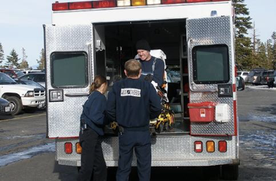
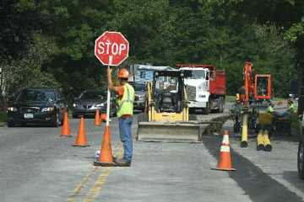
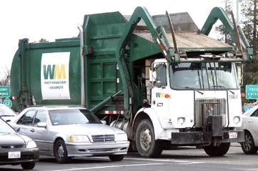
Notes:
Coolcaesar. (2005) EMTs loading a patient [Image]. In Wikimedia Commons. Retrieved from https://en.wikipedia.org/wiki/File:EMTs_loading_a_patient.jpg; coolcaesar. (2005). US garbage truck [Image]. In Wikimedia Commons. Retrieved from https://commons.wikimedia.org/wiki/File:US_Garbage_Truck.jpg; Waits, C. (2011). Road construction. In Flickr. Retrieved from https://www.flickr.com/photos/chriswaits/6245329787

Slide 4
Essential Questions
Why do we pay taxes?
How are our tax dollars spent?

Slide 5
Tax Funding Levels
Local Level - The city council and mayor determine a budget for local services at the community level. This is based on the tax dollars received for local services.
State Level - The state legislature determines a budget for funding services that benefit all Oklahomans. Primary funding comes from state income taxes.
Federal Level - The U.S. Congress determines a budget for federal services that affect all citizens. Primary funding comes from federal income taxes.

Slide 6
Why - Lighting Activity
Read the handout assigned to you.
Circle at least three important facts as you read.
For each circled fact, write in the margin WHY you think it is important to know.

Slide 7
Jigsaw Group Work
With your group, share the facts you circled as important.
Explain why you circled those facts based upon what you wrote in the margins of the text.
With your group, determine the FIVE most important facts to share.
Prepare a chart of face facts to present to the class.

Slide 8
Artifact Activity
Examine the artifacts in the folder. These are documents that include a collection of taxes.
Artifact 1 - What type of document is this? Where do you see taxes collected? What type of taxes are collected?
Artifact 2 - What type of document is this? Where do you see taxes collected? What type of taxes are collected?
Artifact 3 - What type of document is this? How are taxes collected?

Slide 9
Researching Your Community
Find out information about the community service or program assigned to you.
Answer the questions about this community service.
Be prepared to share the information you researched.

Slide 10
Creating at “Tax” Dictionary
Create your own dictionary for the terms below. Define these terms by how they were used in the lesson, using your own words.
Local State Federal Sales Tax Property Tax Income tax Revenue Revenue Shortfall | 9. Intergovernmental Issue 10. City Ordinances Budget 11. Progressive Tax 12. Regressive Tax 13. OK State 14. Flat Tax 15. National Debt 16. Federal Budget Deficit

