Slide 2
English Is Hard
7th and 8th grade ELA

Slide 3
Guiding Questions
How do language patterns affect word knowledge?
Why might learning proper pronunciation be important?

Slide 4
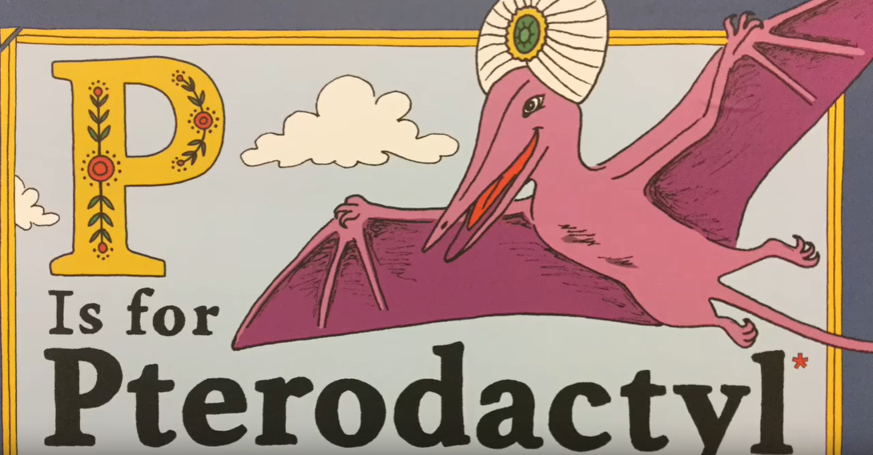
P is for Pterodactyl: The Worst Alphabet Book Ever
Source: Mr. Paulson Reads (March 25, 2019). PifP. Youtube. Retrieved from https://www.youtube.com/watch?v=05WDZHddoKw

Slide 5
Class Discussion
Were there any words that surprised you?
Did seeing the spelling of a word and then hearing the pronunciation surprise you?
How do you know how to pronounce new words? Do you sound them out?
What would happen if you sounded out any of the words from the book?
How do you learn how to pronounce words that do not follow phonics rules?

Slide 6
Brainstorm
What words start with a letter that does not use the letter’s sound?
Schwarzenberger, Michael (5 October 2014). Wood Cube. Pixabay. Retrieved from https://pixabay.com/photos/wood-cube-abc-cube-letters-473703/

Slide 7
ABC Graffiti Poster
ABCDEFGHIJKLM
NOPQRSTUVWXYZ
Label your poster with the letters A through Z in 2–3 columns.
Brainstorm any words that begin with a letter that does not make its own sound.
Write those words beside the letter they begin with.
Complete as many as you can.
Bdellium
Czar, Czech
Pterodactyl
Gnocchi, Gnome, Gnat
Wren, Write
Mnemonic

Slide 8
What is a digraph?
digraph (dī-ɡraf) noun: A combination of two letters representing one sound, as in ph and ey.
Source: Oxford (n.d.). Digraph. Lexico Dictionaries | English. Retrieved from https://www.lexico.com/en/definition/digraph
For example, cz makes a z sound (as in czar).

Slide 9
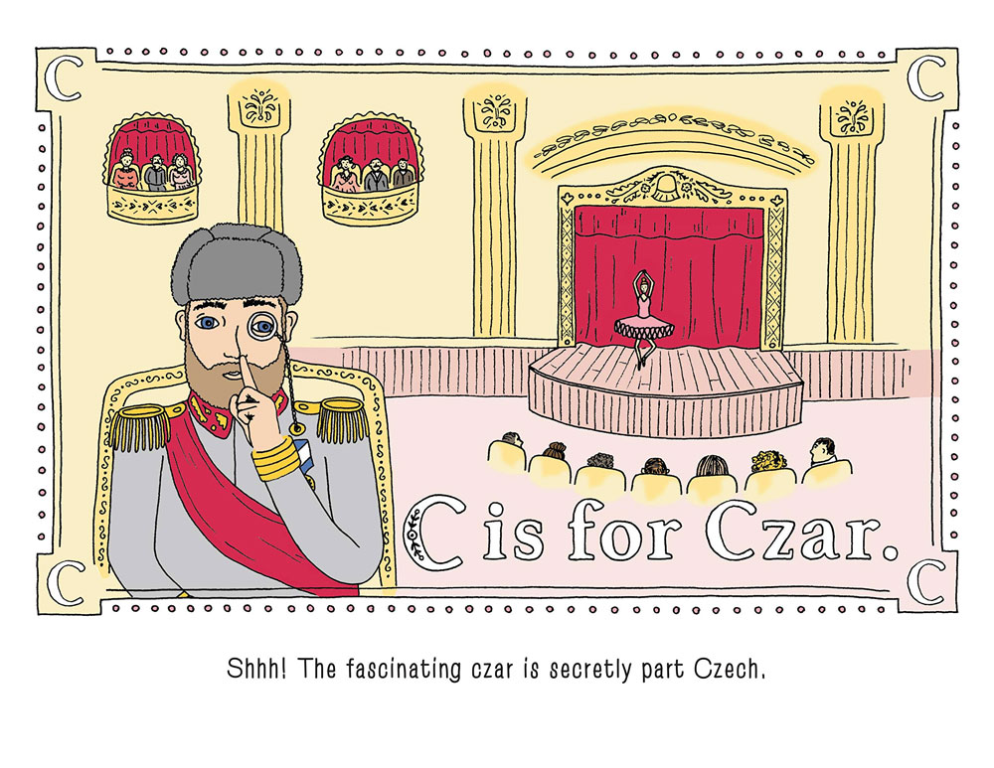
P is for Pterodactyl: The Sequel
Create a page for an ABC book of digraphs.
Illustrate the page.
Use at least one digraph word in a sentence.
Source: Haldar, R., Carpenter, C., & Beddia, M. (2018). P Is for Pterodactyl: The Worst Alphabet Book Ever. Sourcebooks Jabberwocky. Retrieved from http://www.dudeiwantthat.com/entertainment/books/p-is-for-pterodactyl-the-worst-alphabet-book-ever.asp

Slide 10
Read Aloud
We will go in ABC order.
Stand up and read your page when it is your letter’s turn.

Slide 11
Anchor Charts
On your chart:
Create a rule for how to pronounce your chosen digraph.
Write a sentence using a word that contains that digraph.
Illustrate the poster using the sentence as a guide.

Slide 12
Chant It, Sing It, Rap It
With your group:
Create a chant, song, or rap that teaches the audience how to pronounce your digraph correctly.

