Slide 2
Notation for NASA, Part 2
Operations With Scientific Notation

Slide 3
Essential Question:
How can we use very large or very small numbers?

Slide 4
Lesson Objectives
Multiply and divide numbers using scientific notation.
Describe the role of gravity in the solar system.
Determine the scale properties of objects in the solar system.

Slide 5

Fiction in the Facts
Your group will visit five posters.
At each poster, you will read three statements:
  Two statements are true; one is false.
Identify the false statement and then write 1–2 sentences explaining your thinking.
Notes:
K20 Center. (n.d.). Fiction in the facts. Strategies. https://learn.k20center.ou.edu/strategy/60

Slide 6
Fiction in the Facts
On a piece of paper, create the following table:
Poster | False | Reasoning
Notes:
K20 Center. (n.d.). Fiction in the facts. Strategies. https://learn.k20center.ou.edu/strategy/60

Slide 7
Fiction in the Facts
Visit each poster and complete your table.
Poster | False | Reasoning
Record the Poster Number
Record the False Statement Number
Write 1–2 Sentences
Notes:
K20 Center. (n.d.). Fiction in the facts. Strategies. https://learn.k20center.ou.edu/strategy/60

Slide 8
Fiction in the Facts: Poster 1
Read each of the following statements and decide which one is false.
You could fit about a million Earths inside of the sun.
The Sun makes noise, but we can’t hear it because sound can’t travel that far.
The Sun is the coldest star in the galaxy.
Notes:
K20 Center. (n.d.). Fiction in the facts. Strategies. https://learn.k20center.ou.edu/strategy/60

Slide 9
Fiction in the Facts: Poster 1
The Sun is not cold at all! It is actually extremely hot and not even close to being the coldest star.
You could fit about a million Earths inside of the sun.
The Sun makes noise, but we can’t hear it because sound can’t travel that far.
The Sun is the coldest star in the galaxy.
Notes:
K20 Center. (n.d.). Fiction in the facts. Strategies. https://learn.k20center.ou.edu/strategy/60

Slide 10
Fiction in the Facts: Poster 2
Read each of the following statements and decide which one is false.
Saturn’s rings are made of tiny bits of ice and rock.
You could float on Jupiter if you had a big enough raft.
Some of Jupiter’s moons are bigger than Earth’s Moon.
Notes:
K20 Center. (n.d.). Fiction in the facts. Strategies. https://learn.k20center.ou.edu/strategy/60

Slide 11
Fiction in the Facts: Poster 2
You can not float on Jupiter. It is a gas giant with no solid surface.
Saturn’s rings are made of tiny bits of ice and rock.
You could float on Jupiter if you had a big enough raft.
Some of Jupiter’s moons are bigger than Earth’s Moon.
Notes:
K20 Center. (n.d.). Fiction in the facts. Strategies. https://learn.k20center.ou.edu/strategy/60

Slide 12
Fiction in the Facts: Poster 3
Read each of the following statements and decide which one is false.
The same side of the Moon always faces Earth.
There’s a secret Moon base hidden on the dark side.
Astronauts left footprints on the Moon that are still there today.
Notes:
K20 Center. (n.d.). Fiction in the facts. Strategies. https://learn.k20center.ou.edu/strategy/60

Slide 13
Fiction in the Facts: Poster 3
There is no secret Moon base—sorry! The “dark side” just means the side we do not see; it is not a secret.
The same side of the Moon always faces Earth.
There’s a secret Moon base hidden on the dark side.
Astronauts left footprints on the Moon that are still there today.
Notes:
K20 Center. (n.d.). Fiction in the facts. Strategies. https://learn.k20center.ou.edu/strategy/60

Slide 14
Fiction in the Facts: Poster 4
Read each of the following statements and decide which one is false.
It would take about 6–9 months to travel to Mars.
Astronauts can grow taller in space.
People have already landed on Mars.
Notes:
K20 Center. (n.d.). Fiction in the facts. Strategies. https://learn.k20center.ou.edu/strategy/60

Slide 15
Fiction in the Facts: Poster 4
Humans have not landed on Mars yet—but NASA is working on it!
It would take about 6–9 months to travel to Mars.
Astronauts can grow taller in space.
People have already landed on Mars.
Notes:
K20 Center. (n.d.). Fiction in the facts. Strategies. https://learn.k20center.ou.edu/strategy/60

Slide 16
Fiction in the Facts: Poster 5
Read each of the following statements and decide which one is false.
Earth is the only planet we know of that has liquid water on the surface.
The sky is blue because space reflects off the oceans.
From space, Earth looks like a blue marble.
Notes:
K20 Center. (n.d.). Fiction in the facts. Strategies. https://learn.k20center.ou.edu/strategy/60

Slide 17
Fiction in the Facts: Poster 5
The sky is blue because of the way sunlight scatters in our atmosphere—not because of ocean reflection.
Earth is the only planet we know of that has liquid water on the surface.
The sky is blue because space reflects off the oceans.
From space, Earth looks like a blue marble.
Notes:
K20 Center. (n.d.). Fiction in the facts. Strategies. https://learn.k20center.ou.edu/strategy/60

Slide 18

Painting a Picture
There are 2 stations:
  Libra – Multiplication Examples
  Aries – Division Examples
You are trying to figure out the pattern for multiplying and the pattern for dividing numbers written in scientific notation.
Notes:
K20 Center. (n.d.). Painting a picture. Strategies. https://learn.k20center.ou.edu/strategy/1331

Slide 19
Painting a Picture
Visit the 2 Constellation Stations:
  Libra and Aries.
At each station:
  Copy each problem (and its work).
  Look for patterns.
  Record what you notice.
  Try to write a rule using the pattern you noticed.
Notes:
K20 Center. (n.d.). Painting a picture. Strategies. https://learn.k20center.ou.edu/strategy/1331

Slide 20
Painting a Picture: Discussion
Compare with a neighbor what you noticed.
Share your multiplication and division rules.
Notes:
K20 Center. (n.d.). Painting a picture. Strategies. https://learn.k20center.ou.edu/strategy/1331

Slide 21
Multiplying Numbers in Scientific Notation
Multiply the decimal numbers (coefficients).
Add the exponents.
Rewrite the result in scientific notation.
  Remember the number before the decimal point should be 0–9.

Slide 22
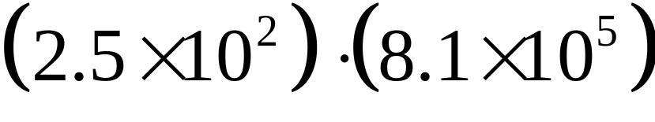

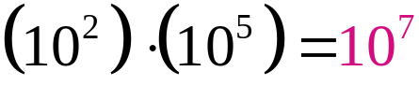
Example
Step 1)
Step 2)
Step 3) | Is 20.25 ×10⁷ written in scientific notation? Why or why not?

Slide 23
Rewriting Numbers in Scientific Notation
Move the decimal in the number so there is only one nonzero digit before it.
Count the number of places and note the direction you moved the decimal.

Slide 24
Rewriting Numbers in Scientific Notation
Change the exponent.
  If you moved the decimal left, add the number of places to the exponent.
  If you moved the decimal right, subtract the number of places from the exponent.

Slide 25
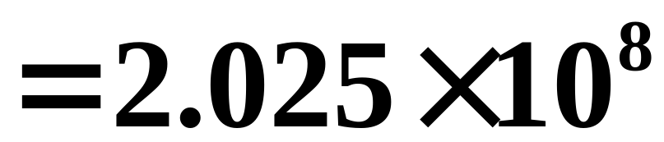
Example
How could we write 20.25 ×10⁷ in scientific notation?
left one, so add one

Slide 26
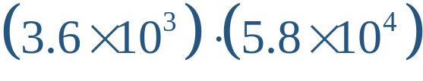
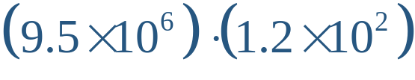
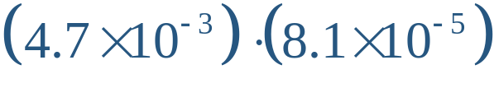
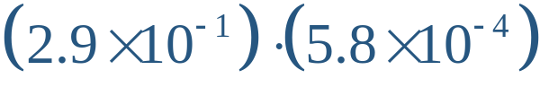
Examples
Write each product in scientific notation. Round each answer to two decimal places.
(a) | (b)
(c) | (d)
Notes:
K20 Center. (n.d.). Painting a picture. Strategies. https://learn.k20center.ou.edu/strategy/1331

Slide 27
Examples
Write each product in scientific notation. Round each answer to two decimal places.
(a) 2.09 × 10⁸ | (b)
(c) | (d)
Notes:
K20 Center. (n.d.). Painting a picture. Strategies. https://learn.k20center.ou.edu/strategy/1331

Slide 28
Examples
Write each product in scientific notation. Round each answer to two decimal places.
(a) 2.09 × 10⁸ | (b) 1.14 × 10⁹
(c) | (d)
Notes:
K20 Center. (n.d.). Painting a picture. Strategies. https://learn.k20center.ou.edu/strategy/1331

Slide 29
Examples
Write each product in scientific notation. Round each answer to two decimal places.
(a) 2.09 × 10⁸ | (b) 1.14 × 10⁹
(c) 3.81 × 10^{–7} | (d)
Notes:
K20 Center. (n.d.). Painting a picture. Strategies. https://learn.k20center.ou.edu/strategy/1331

Slide 30
Examples
Write each product in scientific notation. Round each answer to two decimal places.
(a) 2.09 × 10⁸ | (b) 1.14 × 10⁹
(c) 3.81 × 10^{–7} | (d) 1.68 × 10^{–4}
Notes:
K20 Center. (n.d.). Painting a picture. Strategies. https://learn.k20center.ou.edu/strategy/1331

Slide 31
Dividing Numbers in Scientific Notation
Divide the decimal numbers (coefficients).
Subtract the exponents.
Rewrite the result in scientific notation.
  Remember the number before the decimal point should be 0–9.

Slide 32
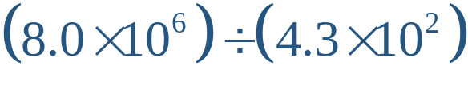
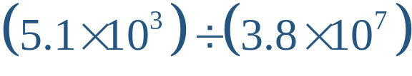
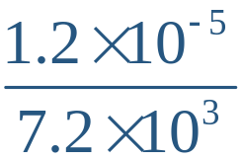
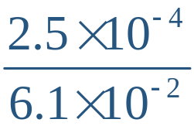
Examples
Write each quotient in scientific notation. Round each answer to two decimal places.
(a) | (b)
(c) | (d)
Notes:
K20 Center. (n.d.). Painting a picture. Strategies. https://learn.k20center.ou.edu/strategy/1331

Slide 33
Examples
Write each quotient in scientific notation. Round each answer to two decimal places.
(a) 1.86 × 10⁴ | (b)
(c) | (d)
Notes:
K20 Center. (n.d.). Painting a picture. Strategies. https://learn.k20center.ou.edu/strategy/1331

Slide 34
Examples
Write each quotient in scientific notation. Round each answer to two decimal places.
(a) 1.86 × 10⁴ | (b) 1.34 × 10^{–4}
(c) | (d)
Notes:
K20 Center. (n.d.). Painting a picture. Strategies. https://learn.k20center.ou.edu/strategy/1331

Slide 35
Examples
Write each quotient in scientific notation. Round each answer to two decimal places.
(a) 1.86 × 10⁴ | (b) 1.34 × 10^{–4}
(c) 1.67 × 10^{–9} | (d)
Notes:
K20 Center. (n.d.). Painting a picture. Strategies. https://learn.k20center.ou.edu/strategy/1331

Slide 36
Examples
Write each quotient in scientific notation. Round each answer to two decimal places.
(a) 1.86 × 10⁴ | (b) 1.34 × 10^{–4}
(c) 1.67 × 10^{–9} | (d) 4.10 × 10^{–3}
Notes:
K20 Center. (n.d.). Painting a picture. Strategies. https://learn.k20center.ou.edu/strategy/1331

Slide 37

I Notice, I Wonder
You are about to watch a video of Donna Shirley
sharing her experience of working with NASA and
the Mars Rover.
Keep in mind the following questions
as you watch the video:
  What did you notice?
  What do you wonder?
Notes:
K20 Center. (n.d.). I notice, I wonder. Strategies. https://learn.k20center.ou.edu/strategy/180

Slide 38
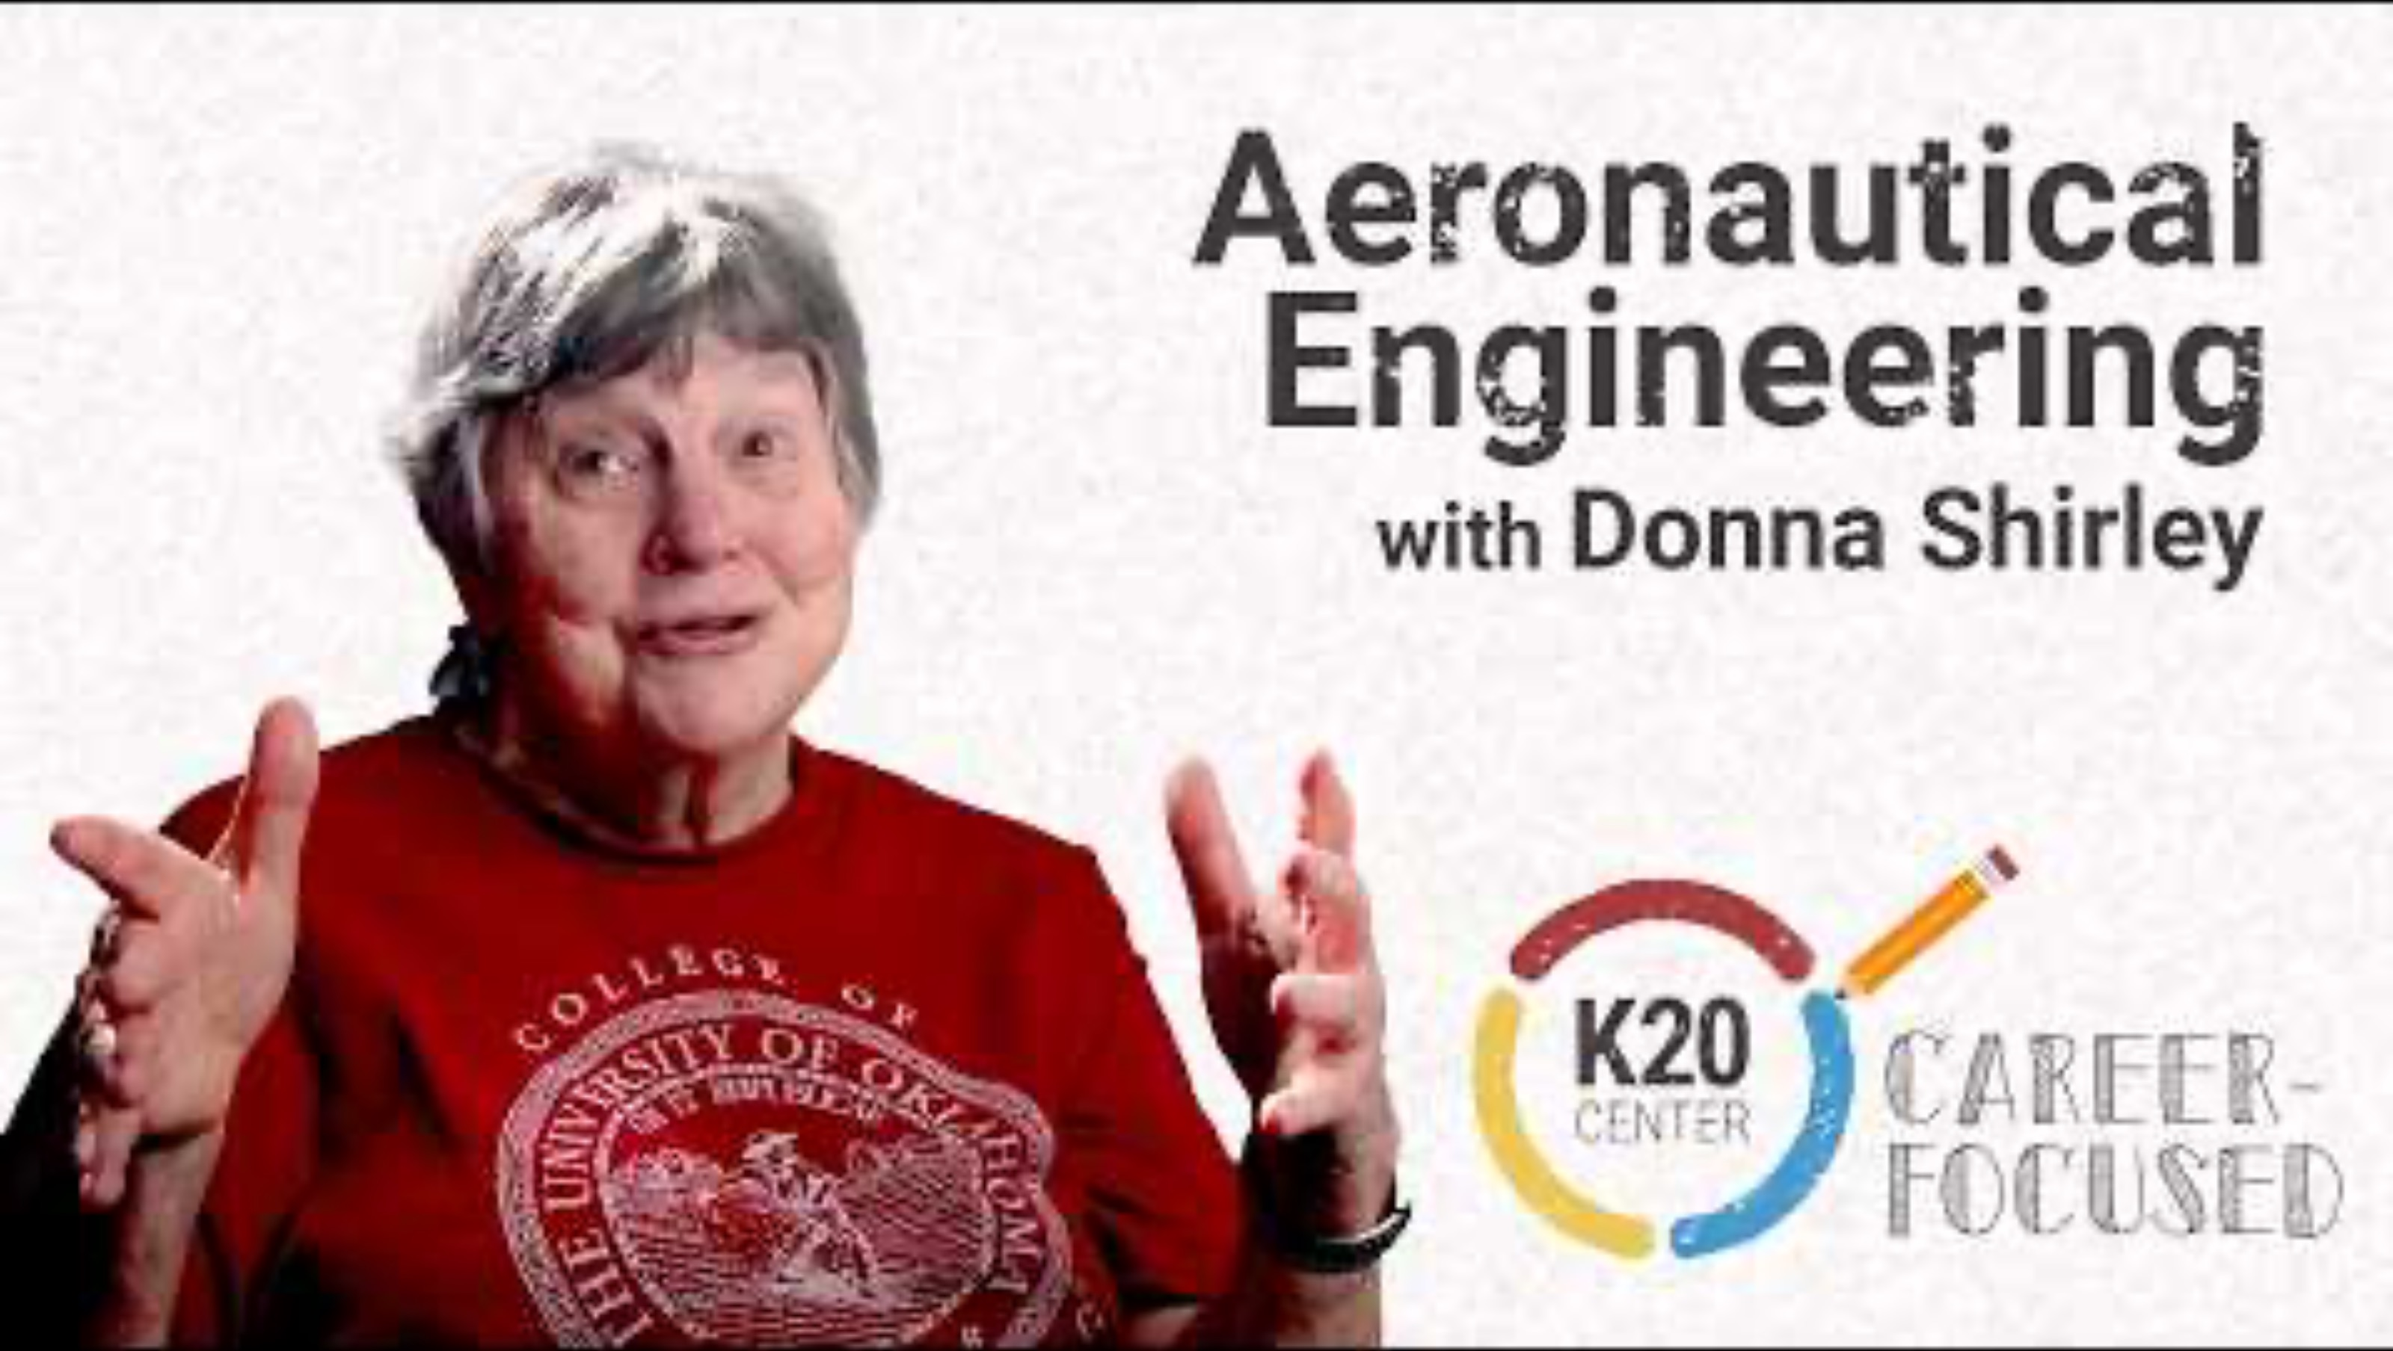
Aeronautical Engineering
Notes:
K20 Center. (2026, August 24). Aeronautical engineering [Video]. YouTube. https://www.youtube.com/watch?v=AJU_9xttgIE

Slide 39
I Notice, I Wonder: Discussion
What did you notice?
What do you wonder?
  Donna Shirley helped send rovers to Mars,
  which is really far from Earth—about 225,000,000 kilometers! Why would using scientific notation be helpful for working with numbers this big?
Notes:
K20 Center. (n.d.). I notice, I wonder. Strategies. https://learn.k20center.ou.edu/strategy/180

Slide 40
Mission Analysis
Congratulations! Your mission has been approved!
You now need to plan for the upcoming mission.

Slide 41
Mission Analysis
Use your knowledge of multiplying and dividing numbers in scientific notation to efficiently create a plan for the space mission.
Every calculation will bring you one step closer to takeoff.

Slide 42
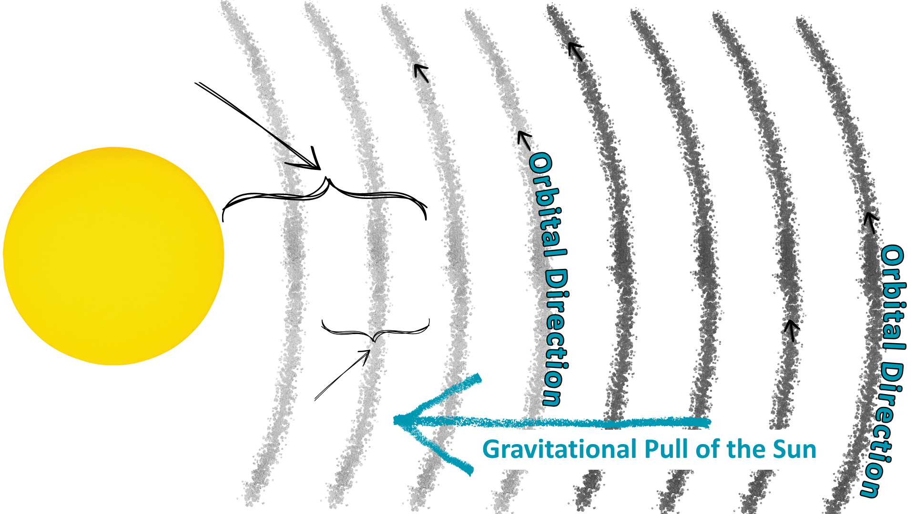
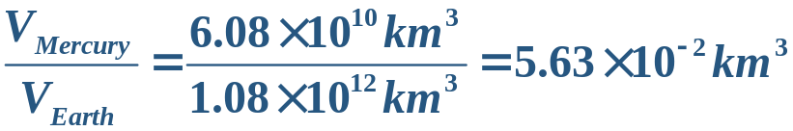
Model Sketch (Sample Response)
1.5 × 10⁸ km
Sun
Mercury
Earth
7.7 × 10⁷ km

Slide 43
Model Sketch
(Question With Sample Response)
How does gravity influence the motion of your planet/moon in the solar system?
Gravity keeps the planet/moon in orbit around the Sun. Without it, the planet would just fly off into space. It also affects how fast the planet moves and how strong the pull is on objects on the surface.

Slide 44
Final Reflection
How did using scientific notation help you understand the scale of space?
What surprised you the most about the distances, sizes, or gravity that you calculated?

Slide 45

How Am I Feeling? What Am I Thinking?
Draw a line, dividing your paper into 2 sections.
On one side, draw a picture/symbol/emoji that represents how you feel about what
you learned.
On the other side, write a sentence about what you are thinking about what you learned.
Notes:
K20 Center. (n.d.). How am I feeling? What am I thinking? Strategies. https://learn.k20center.ou.edu/strategy/187

