Slide 2
If You Give a Mouse a Cookie
Conditional Mood Sentences

Slide 3
Essential Questions
Why do the rules of language matter?
What is the purpose of learning and applying grammar skills?

Slide 4
Sticky Bars
What kind of cookie is your favorite? Choose one:
Oatmeal Raisin | Chocolate Chip | Peanut Butter | Sugar Cookie | White Chocolate

Slide 5
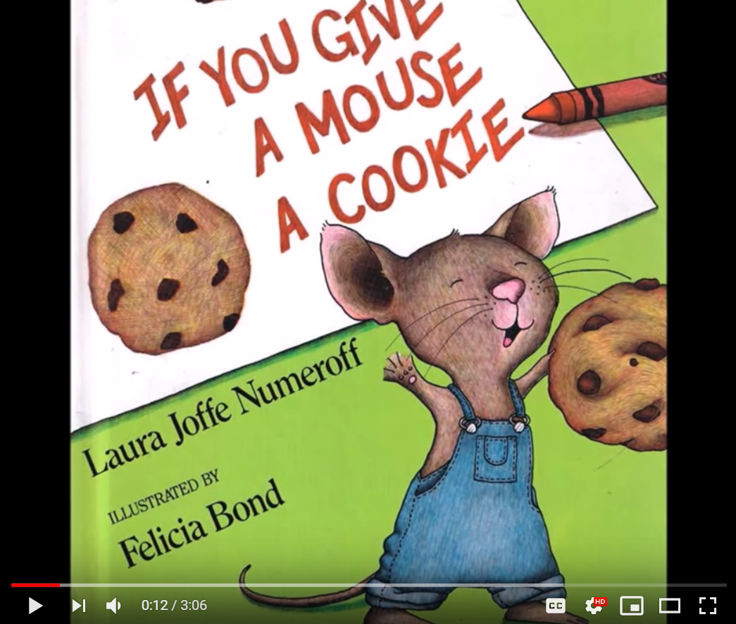
If You Give a Mouse a Cookie
As you listen to the story, consider these questions:
What sentence structure does the author repeat?
How might a sentence in the conditional mood be structured?
Source: The Teacher's Library (September 2, 2015). If You Give a Mouse a Cookie. Youtube.com. Retrieved from https://www.youtube.com/watch?v=QCDPkGjMBro
Notes:
Read the book to your class. Or, if a physical copy is not available, use the online reading linked above.
Sources:
Numeroff, L. J., & Bond, F. (2015). If You Give a Mouse a Cookie. New York: Laura Geringer Books, an imprint of HarperCollins Publishers.
The Teacher's Library. (2015, September 2). If You Give a Mouse a Cookie! READ ALOUD! [Video]. YouTube. https://www.youtube.com/watch?v=QCDPkGjMBro

Slide 6
Can you find your conditional partner?
Sentences in the conditional mood have a
condition and a result.
If _____________, then _____________.
If a condition is met, then this result will happen.
If this happens, then that results.
That should happen, if this happens first.

Slide 7
Conditional Mood
Indicates a conditional state; in other words, one condition must be met before something else can happen.
Word Clues:
If
May/Might
Can/Could
Will/Would
For example: If I can get tickets, I will go to the concert.
(I can’t legally go to the concert without tickets.)
Notes:
Freepik. (n.d.). Tickets. Flaticon. https://www.flaticon.com/free-icon/tickets_320416?term=ticket&page=1&position=8

Slide 8
Conditional Mood Examples
If you speed down the highway,
you might get a ticket.
When a baby is crying,
it probably needs a bottle.
We will go to the store,
if we are in the neighborhood.
Your health suffers
when you smoke.
Notes:
Explain that one half of the sentence is the “condition” and the other half is the result of the condition. For example, “If you speed down the highway” is the condition, and “you might get a ticket” is the result.

Slide 9
With a Partner:
Define the conditional mood in your own words.
Write examples of conditional mood sentences.
Freepik. (n.d.). Dominoes. Flaticon. Retrieved from https://www.flaticon.com/free-icon/dominoes_2228422

Slide 10
On Your Own:
Complete the handout by writing your own conditional sentences.
Freepik. (n.d.). Dominoes. Flaticon. Retrieved from https://www.flaticon.com/free-icon/dominoes_2228422

Slide 11
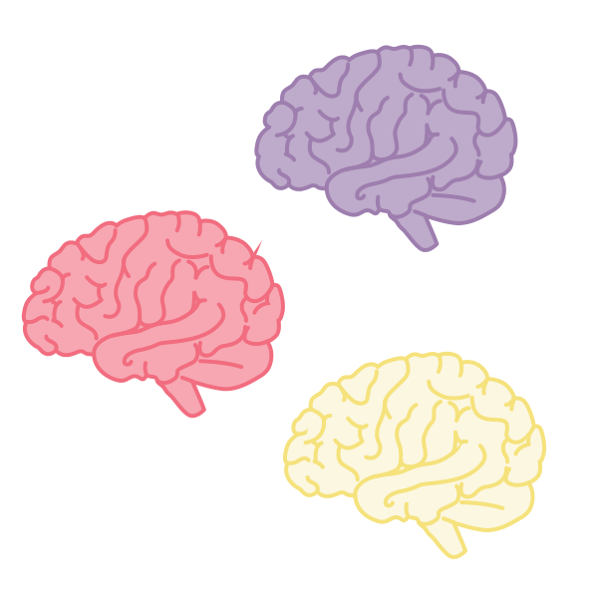
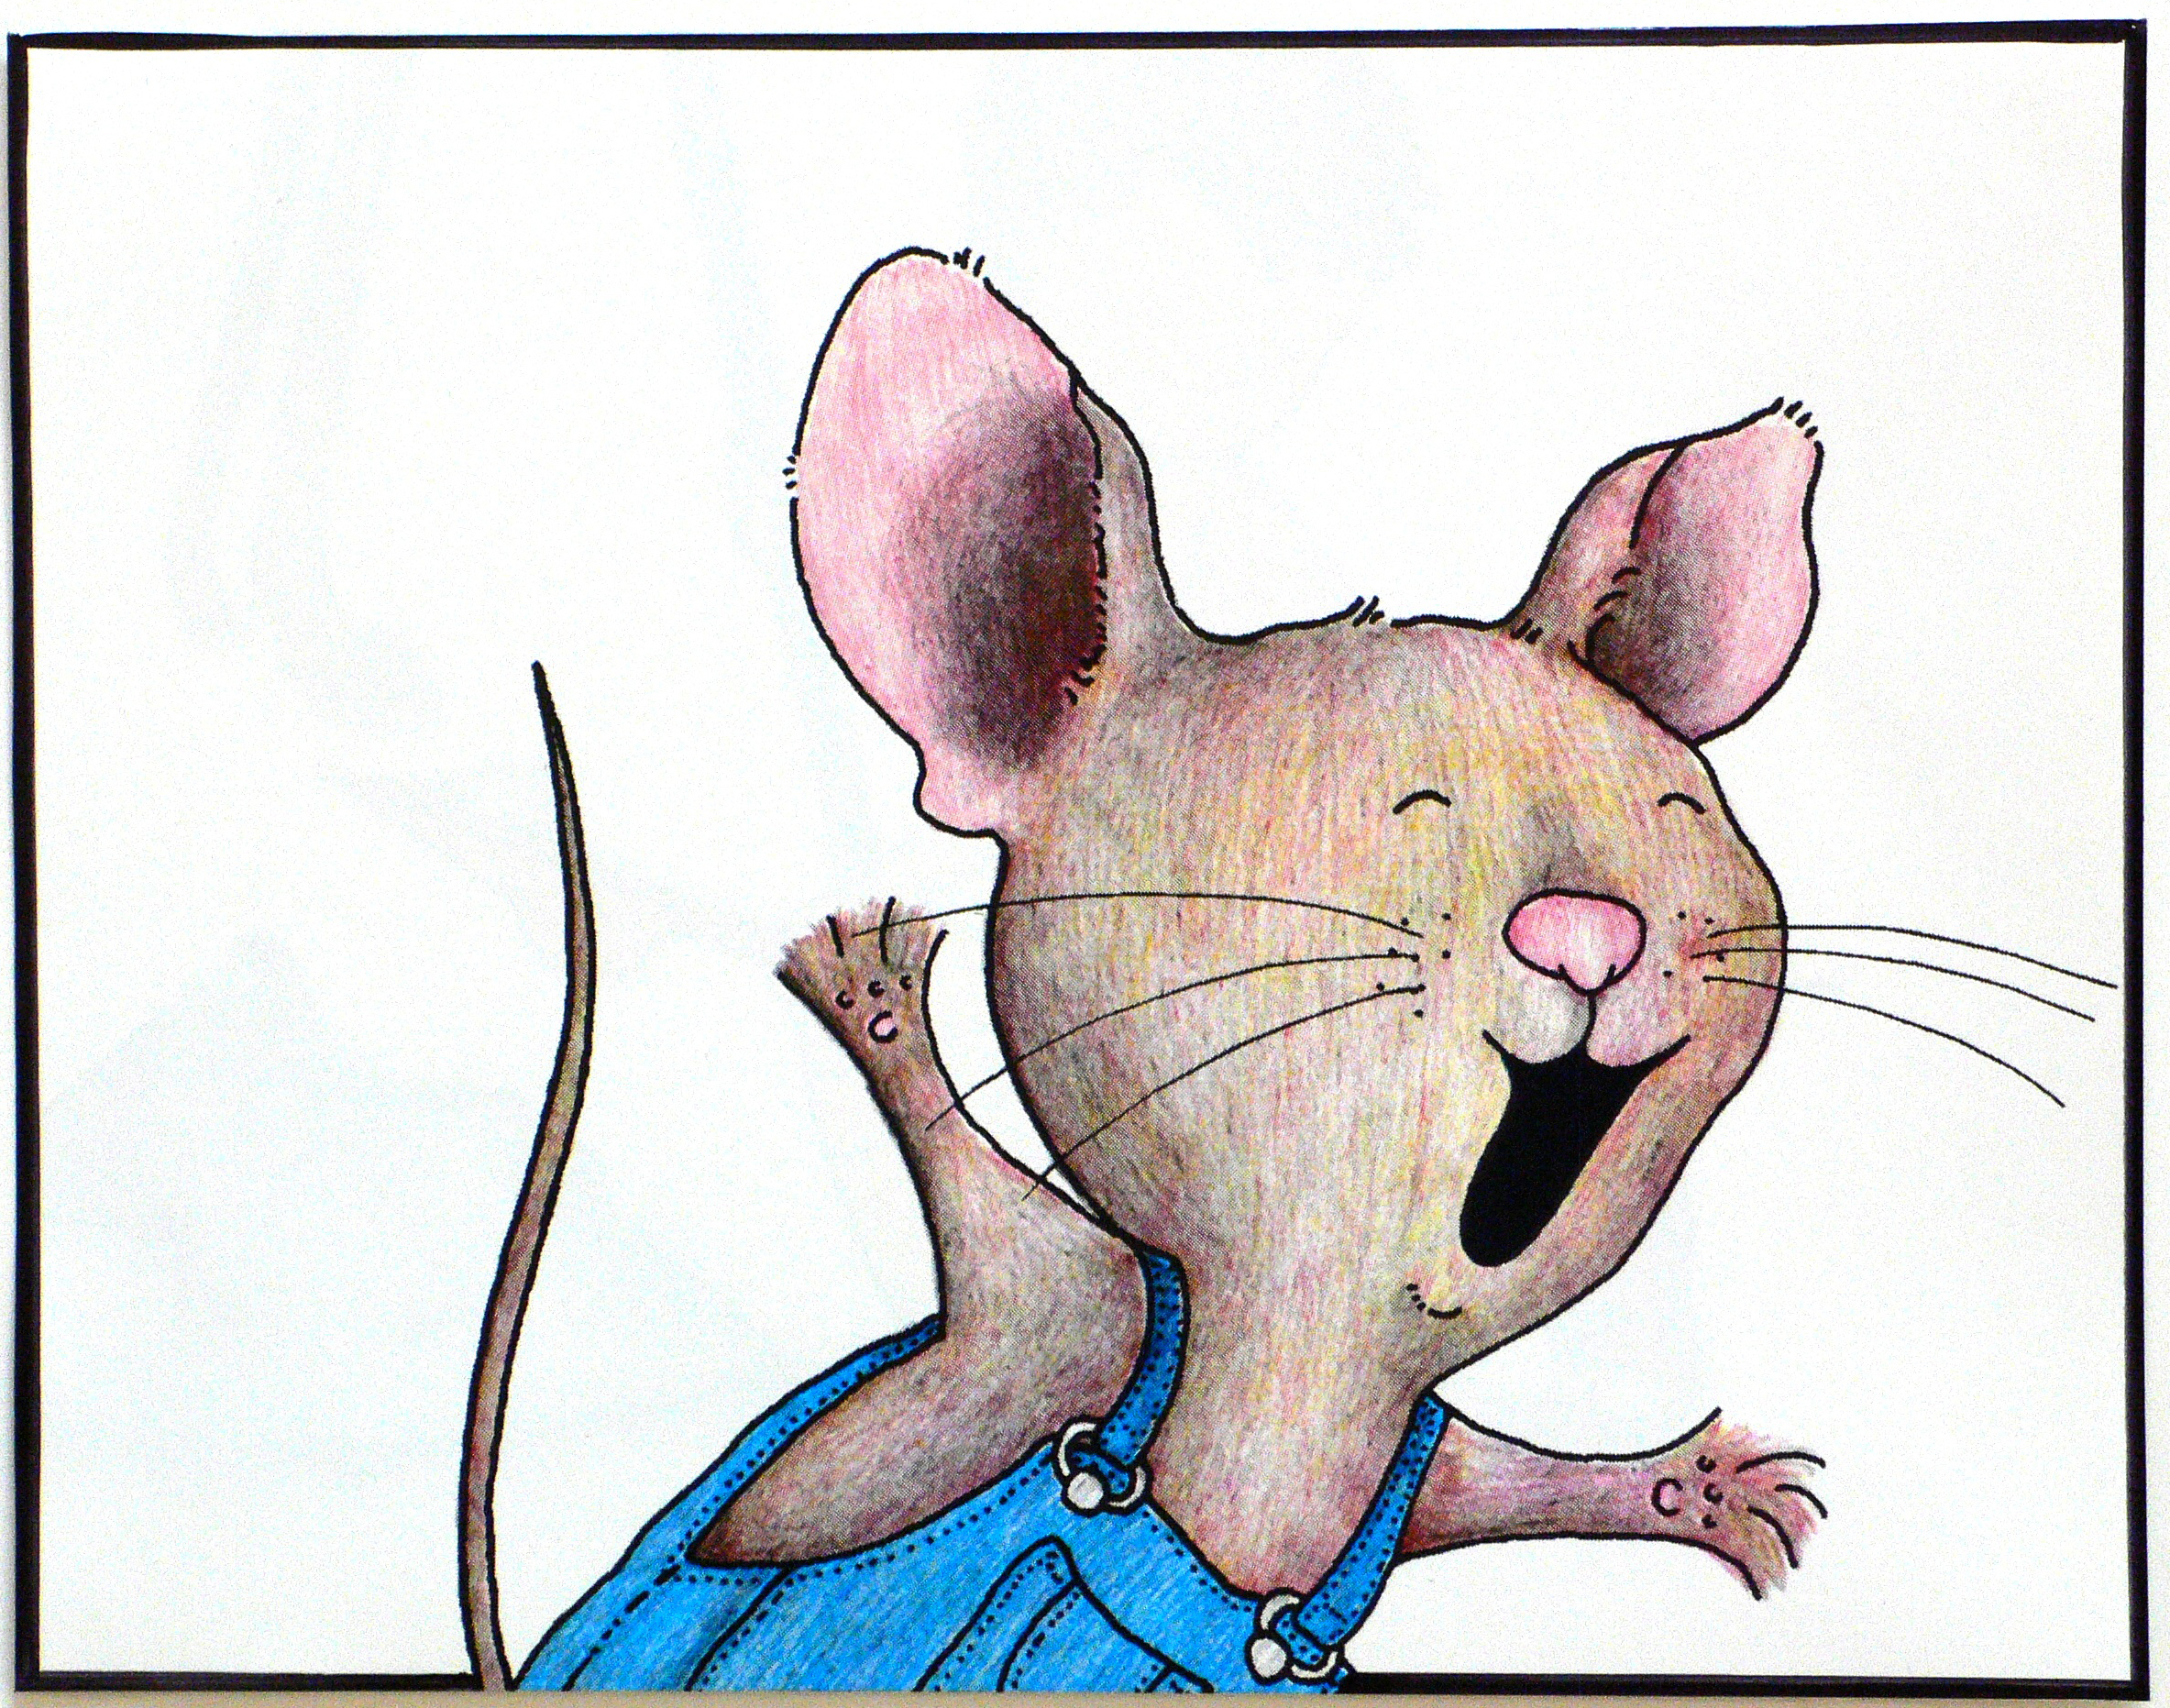
Collective Brain Dump
With your group, brainstorm two story ideas like If You Give a Mouse a Cookie. Use conditional sentences.
Notes:
Bond, Felicia. (2013, May 5). If You Give a Mouse a Cookie, illustrated by Felicia Bond. Wikimedia Commons. https://commons.wikimedia.org/wiki/File:If_You_Give_a_Mouse_a_Cookie_(11),_illustrated_by_Felicia_Bond.JPG

Slide 12
Create a Chain Story
With your story idea:
Create a sequence of events that build upon each other in the story to a conclusion.
Use as many conditional sentences as possible.
Each group member is to contribute at least two sentences to the story.
Give your story a title.

Slide 13
Create a Chain Story
Write a story idea at the top of the page. Begin the story with another conditional sentence to continue the story.
Pass the paper to each group member and repeat. Create a sequence of events that build on each other to a conclusion.
Each group member should write at least two sentences.

