Slide 2
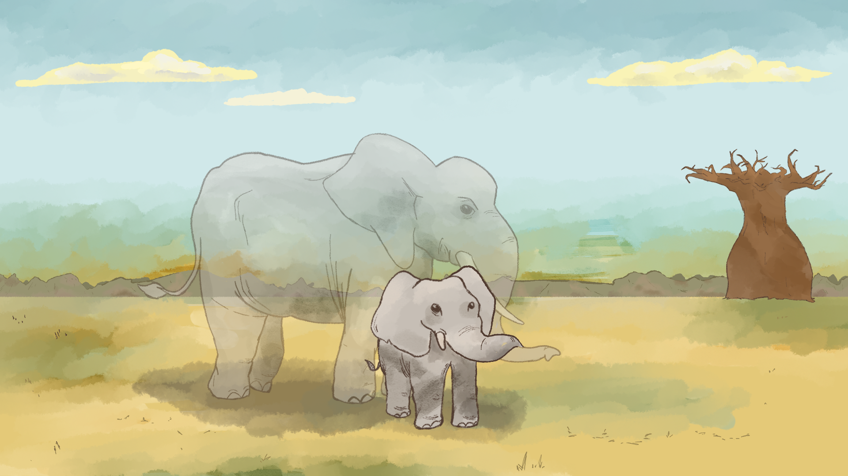
When Giants Disappear
Elephant Conservation

Slide 3
Essential Question
How do human actions impact elephant populations, and why does protecting elephants matter for the health of entire ecosystems?

Slide 4
Lesson Objectives:
Analyze the ecological role of elephants by interpreting population data and evaluating the impact of human behaviors on elephant ecosystems.
Develop a research-based solution to a major threat facing elephants, including a clear action plan that reflects ecological understanding and conservation strategies.
Create a presentation that advocates for elephant conservation, using reasoning, symbolism, and emotional appeal to engage an audience.

Slide 5

Still Pictures
With your group use the image to develop a unified gesture that represents your interpretation of the image.
One person from your group will explain the gesture and interpretation.
Notes:
K20 Center. (n.d.). Still pictures. Strategies. https://learn.k20center.ou.edu/strategy/4960

Slide 6

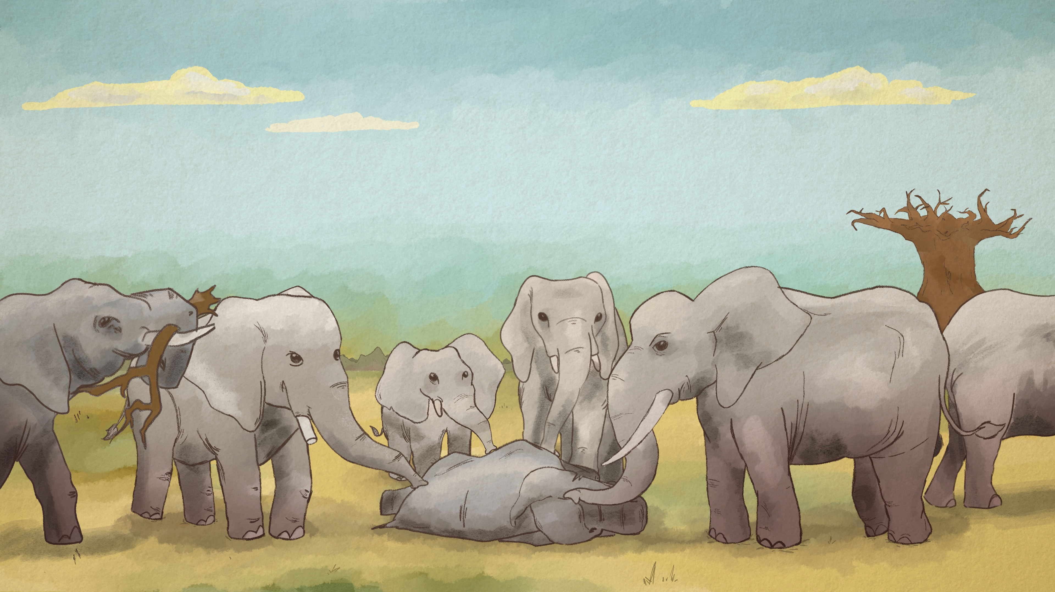
Notes:
K20 Center. (2021, September 21). K20 Center 2-minute timer [Video]. YouTube. https://www.youtube.com/watch?v=HcEEAnwOt2c

Slide 7

Status of Elephants
As a group, decide which of the provided articles you want to read
  The Status of African Elephants
  The Status of Asian Elephants
Read the article together. Discuss what you think it is saying.
Notes:
K20 Center. (2021, September 21). K20 Center 4-minute timer [Video]. YouTube. https://www.youtube.com/watch?v=kpCsfuvzQeY

Slide 8
Still Pictures
After you read, develop an individual gesture that represents your interpretation of the reading.
One person from your group will explain the gesture and interpretation.
Notes:
K20 Center. (n.d.). Still pictures. Strategies. https://learn.k20center.ou.edu/strategy/4960
K20 Center. (2021, September 21). K20 Center 2-minute timer [Video]. YouTube. https://www.youtube.com/watch?v=HcEEAnwOt2c

Slide 9
Elephant Exploration Stations
Complete the task at each station. Be sure that you are choosing the resources related to the Elephant you have read about
Station 1: Deep Read
Station 2: Mini Research
Station 3: Data Analysis

Slide 10
Exploration Research Question
With your group, think about everything you have learned from the stations.
Develop a research question about elephant conservation and determine what resources you plan to use.

Slide 11

Elephants Mind Map
Notes:
K20 Center. (n.d.) Inside out. Strategies. https://learn.k20center.ou.edu/strategy/93

Slide 12
Elephants Mind Map
Elephant Ecological Role
Notes:
K20 Center. (n.d.) Inside out. Strategies. https://learn.k20center.ou.edu/strategy/93

Slide 13
Elephants Mind Map
Impact of Elephant Extinction
Elephant Ecological Role
Notes:
K20 Center. (n.d.) Inside out. Strategies. https://learn.k20center.ou.edu/strategy/93

Slide 14
Elephants Mind Map
Why does this matter?
Impact of Elephant Extinction
Elephant Ecological Role
Notes:
K20 Center. (n.d.) Inside out. Strategies. https://learn.k20center.ou.edu/strategy/93

Slide 15
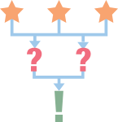
3-2-1
3 skills, responsibilities, or tasks used by conservation scientists.
2 things that surprised or interested you.
1 question you still have about conservation or wildlife careers.
Notes:
K20 Center. (n.d.). 3-2-1. Strategies. https://learn.k20center.ou.edu/strategy/117

Slide 16
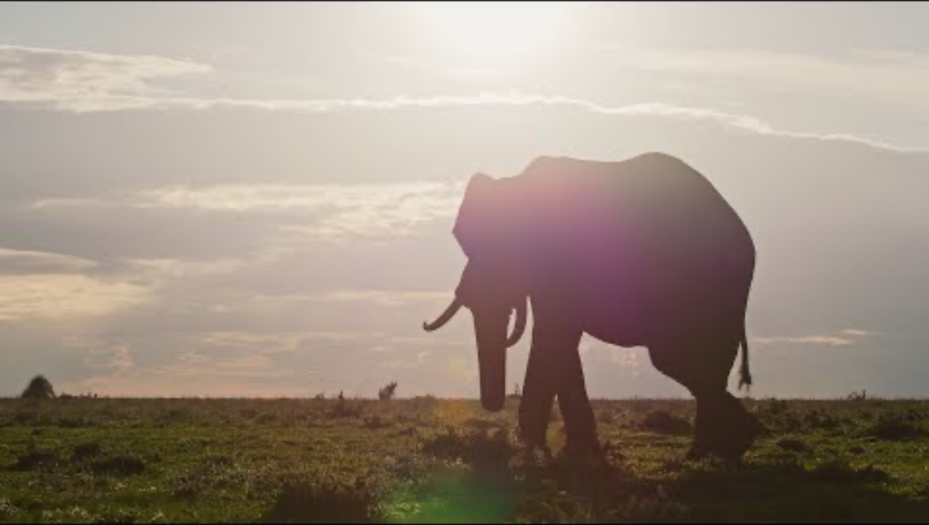
Conservation Science with Dr. Chase LaDue and Thomas Sharp
Notes:
https://www.youtube.com/watch?v=mRJDRNEoFIc

Slide 17

Elephant Conservation Project
With your group you will develop a video where you are trying to persuade the public to take action on a threat impacting elephant survival.
This can be framed as a social media campaign, a video letter to the UN, or a persuasive speech for a public awareness event.

Slide 18

Video Critique
As you watch the videos, provide specific feedback about things that are Glow (things they have done well) and Grow (areas that need improvement).
Use the rubric to help you provide specific areas.
Notes:
K20 Center. (n.d.). Glow and grow. Strategies. https://learn.k20center.ou.edu/strategy/4962

Slide 19

Still Pictures
With your group, choreograph a 30-60 second performance that summarizes what you have learned.
  Each group member will create a different individual gesture and a word associated with the gesture.
Come up with a cadence or motto that you will recite at the end of your performance as a whole group.
Notes:
K20 Center. (n.d.). Still pictures. Strategies. https://learn.k20center.ou.edu/strategy/4960
K20 Center. (2021, September 21). K20 Center 10 minute timer [Video]. YouTube. https://www.youtube.com/watch?v=9gy-1Z2Sa-c

Slide 20

Exit Ticket: Reflection
On your paper answer the questions using complete sentences.
Reflect on your performance of your gesture and your words.
Provide specific examples and details from your performance to support your answer.
Notes:
K20 Center. (n.d.). Bell ringers and exit tickets. Strategies. https://learn.k20center.ou.edu/strategy/125

