Slide 2
Can You Tell Me Tales?
Themes in Literature

Slide 3
Essential Questions
How are ideas from our past still relevant today?
How can opinions change as a result of investigation and conversation?

Slide 4
Learning Objectives
Pre-flect and reflect on reading two Canterbury tales.
Metacognitively reflect on your learning.
Reformulate the text by creating a video retelling the tale and adapting it to modern times.

Slide 5
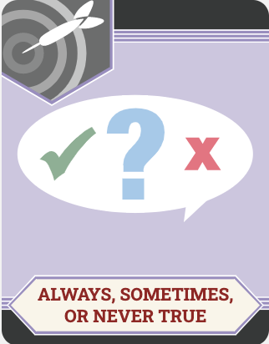
Always, Sometimes, Never True
Label each statement with one of the following:
  Always True
  Sometimes True
  Never True.
Include your reasons for selecting each label.
Notes:
Instructor/Facilitator Notes:
Have students read through each statement, then label each as always true, sometimes true, or never true. Underneath each statement, ask students to right down their reasoning for the label.
Allow time for students to share out their thoughts and labels of the statements.

Slide 6

Think-Pair-Share
After you complete the anticipation guide, with a partner:
  Share your responses.
  Choose the best response or collaborate together to create a shared response.
Notes:
Optional: Partners can then be paired with another set of partners (to form a group of four) and further collaborate to choose the best response or create a new shared response.

Slide 7
Two-Column Notes
In the Text it says:
My reaction to the text:
Notes:
Students can use the attachment, or create their own in a notebook or on plain paper.

Slide 8
Your Turn to Read:
Half of the class reads “The Wife of Bath’s Tale”
The other half reads “The Pardoner, his Prologue, and his Tale”
Read with a partner or independently.

Slide 9
Let’s Revisit

Slide 10
Always, Sometimes, Never True
Re-evaluate your responses from the beginning of the lesson.
Make any changes you would like to since reading the story.
Notes:
Instructor/Facilitator Notes:
Ask students to return to their Always, Sometimes, Never True activity from the beginning of the lesson. Tell them to re-evaluate their responses and make any changes they would like after reading the story.

Slide 11
What has Changed?: Write, Pair, Share
Based on your Anticipation Guide & Two-Column notes, has your opinion changed? Why or why not?
Provide a written response for why your opinion has or has not changed after reading the tale. (Responses should include evidence from the text.)
Compare your responses with a partner.

Slide 12

Remix
Find a new partner who read the other tale.
As you share about the theme statements from the Anticipation Guide, feel free to make changes and add additional notes.
Notes:
OpenClipart. (2019, November 18). DJ. FreeSVG. https://freesvg.org/dj

Slide 13
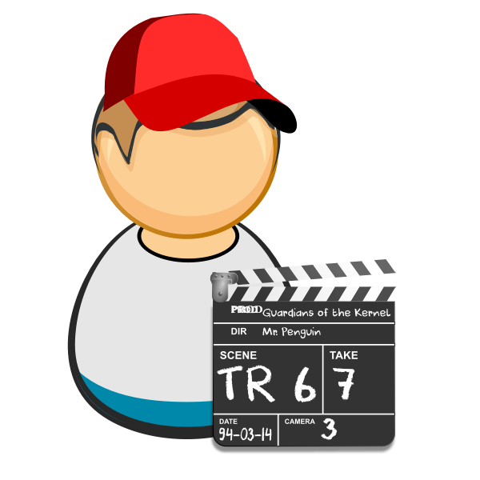
Perform It!
In groups of 3–4, create a video or live performance that retells and reformulates the tale you read. Make it relevant to today!
Notes:
Vedran. (n.d.). Clapperboard guy. FreeSVG. https://freesvg.org/clapperboard-guy.

Slide 14
Perform It!
Notes:
Vedran. (n.d.). Clapperboard guy. Clapperboard guy | Free SVG. https://freesvg.org/clapperboard-guy.

Slide 15

Exit Ticket
Reflect: How could the themes from the reading be relevant today?
Did your opinions change after you read the tale?

