Slide 2
Can You Tell Me Tales?
Themes in Literature

Slide 3
Essential Questions:
How are ideas from our past still relevant today?
How can opinions change as a result of investigation and conversation?

Slide 4
Learning Objectives:
Students will pre-flect and reflect on reading two Canterbury tales.
Students will metacognitively reflect on their learning.
Students will reformulate the text by creating a video re-telling the tale and adapting it to modern times.

Slide 5
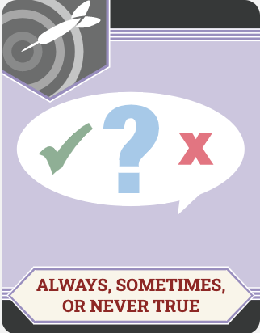
Always, Sometimes, Never True
Label each statement with one of the following:
Always True
Sometimes True
Never True
Include your reasons for selecting each label
Notes:
Instructor/Facilitator Notes:
Have students read through each statement, then label each as always true, sometimes true, or never true. Underneath each statement, ask students to right down their reasoning for the label.
Allow time for students to share out their thoughts and labels of the statements.

Slide 6
Think, Pair, Share
After you complete the anticipation guide, with a partner:
Share your responses
Choose the best response or collaborate together to create a shared response
Notes:
Optional: Partners can then be paired with another set of partners(to form a group of four) and further collaborate to choose the best response or create a new shared response.

Slide 7
Two Column Notes
In the Text it says:
My reaction to the text:
Notes:
Students can create their own in a notebook, or on plain paper. Also there is an attachment to this lesson of one already created

Slide 8
Your Turn to Read:
Half of the class reads “The Wife of Bath’s Tale”
The other half reads “The Pardoner, his Prologue, and his Tale”
Read with a partner or independently.

Slide 9
Let’s Revisit

Slide 10
Always, Sometimes, Never True
Re-evaluate your responses from the beginning of the lesson
Make any changes you would like to since reading the story
Notes:
Instructor/Facilitator Notes:
Ask students to return to their Always, Sometimes, Never True activity from the beginning of the lesson. Tell them to re-evaluate their responses and make any changes they would like after reading the story.

Slide 11
What has Changed?: Write, Pair, Share
Based on your Anticipation Guide & Two Column notes, has your opinion changed? Why or why not?
Provide a written response for why your opinion has or has not changed after reading the tale. (Responses should include evidence from the text)
Compare your responses with a partner.

Slide 12
Remix
Find a new partner who read the opposite Tale as you.
As you share about the theme statements from the Anticipation Guide, feel free to make changes and add additional notes.
Notes:
https://freesvg.org/dj

Slide 13
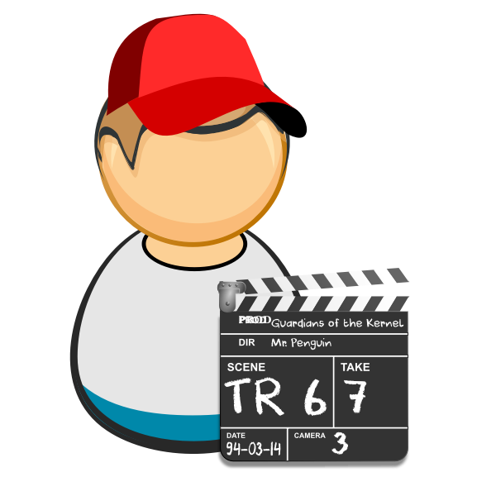
Perform it!
In groups of 3-4, create a video or live performance that retells and reformulates the tale you read. Make it relevant to today!
Notes:
Vedran. (n.d.). Clapperboard guy. Clapperboard guy | Free SVG. https://freesvg.org/clapperboard-guy.

Slide 14
Perform it!
Notes:
Vedran. (n.d.). Clapperboard guy. Clapperboard guy | Free SVG. https://freesvg.org/clapperboard-guy.

Slide 15
Exit Ticket
Reflect: How could the themes from the reading be relevant today? Did your opinions change after you read the tale?

