Slide 2
Mastering Manual Mode, Part 2
All About That Glass

Slide 3
Essential Question
What is the main focus element of an image?

Slide 4
Lesson Objectives
Students will be able to perform the following tasks:
Compare images taken with different lenses;
Contrast prime and zoom lenses;
Interpret lens specifications;
Select appropriate lenses for specific scenarios.

Slide 5
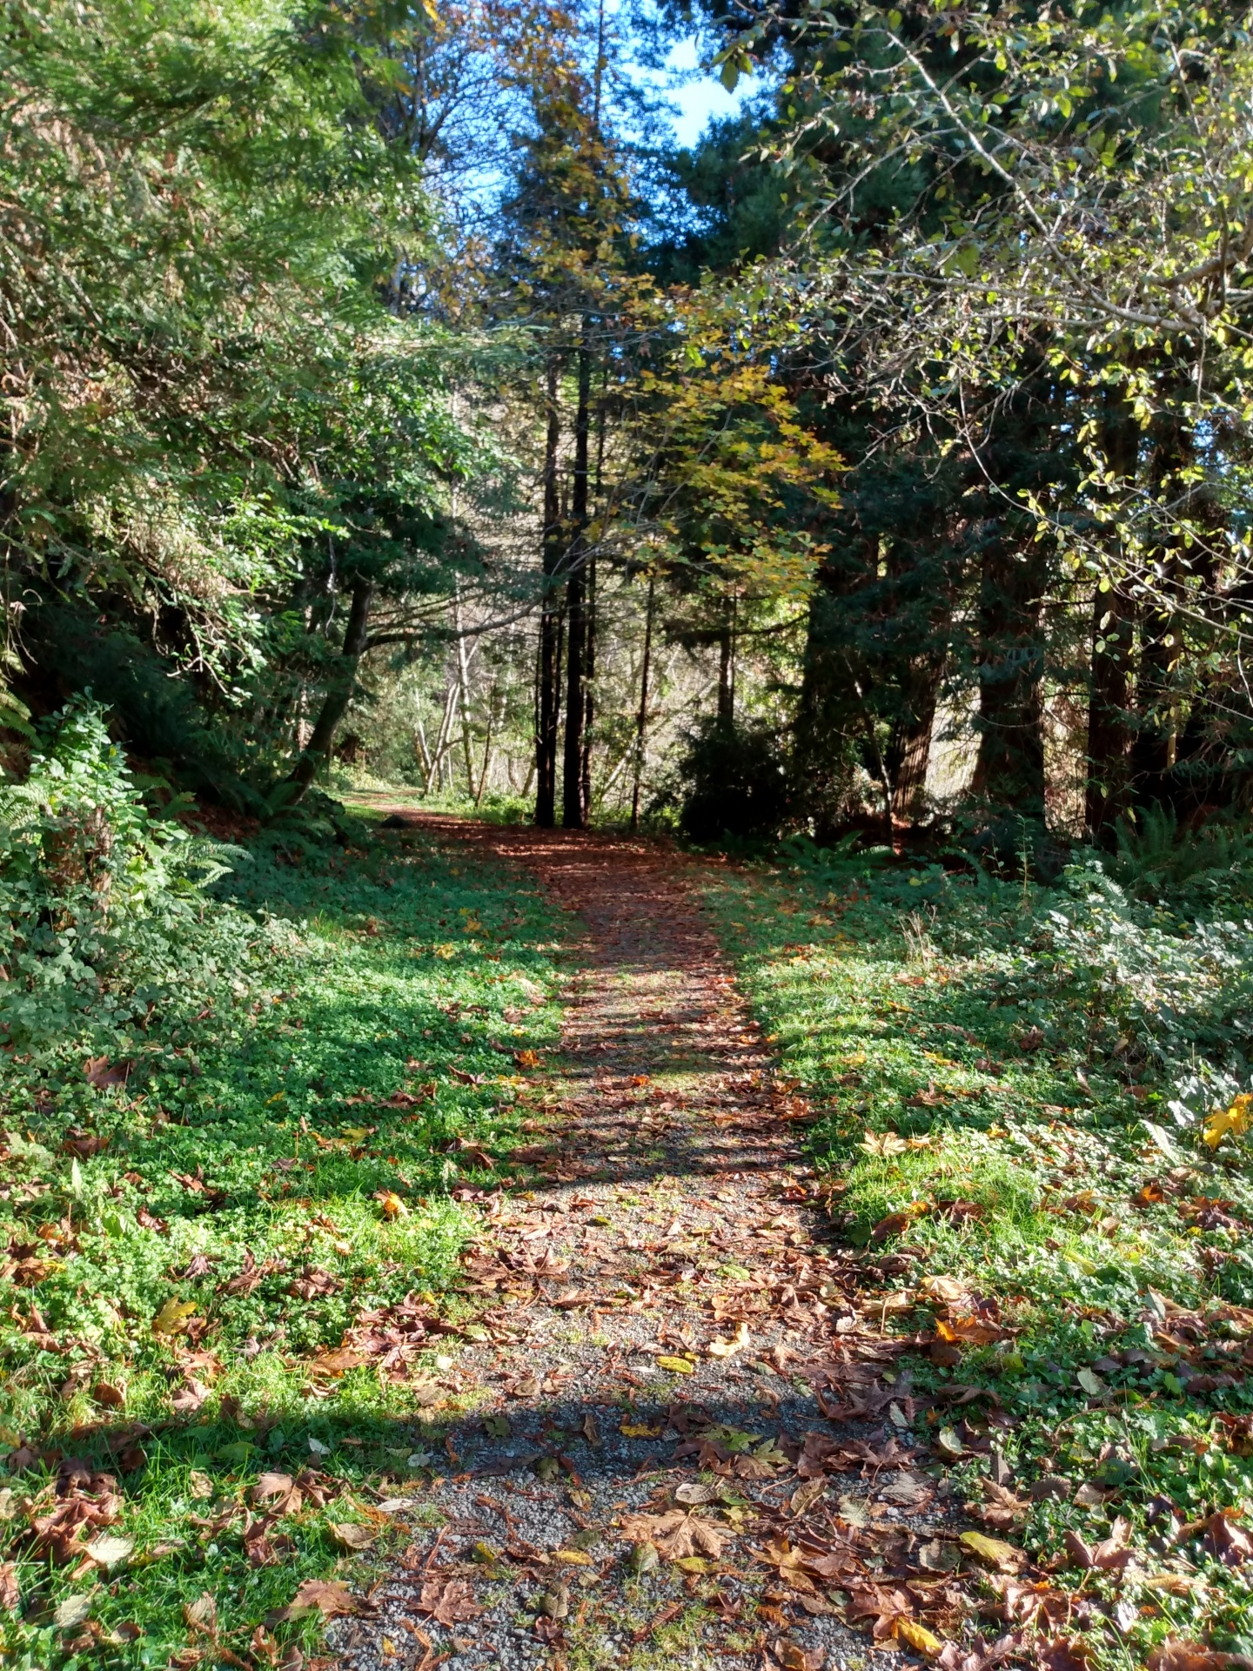
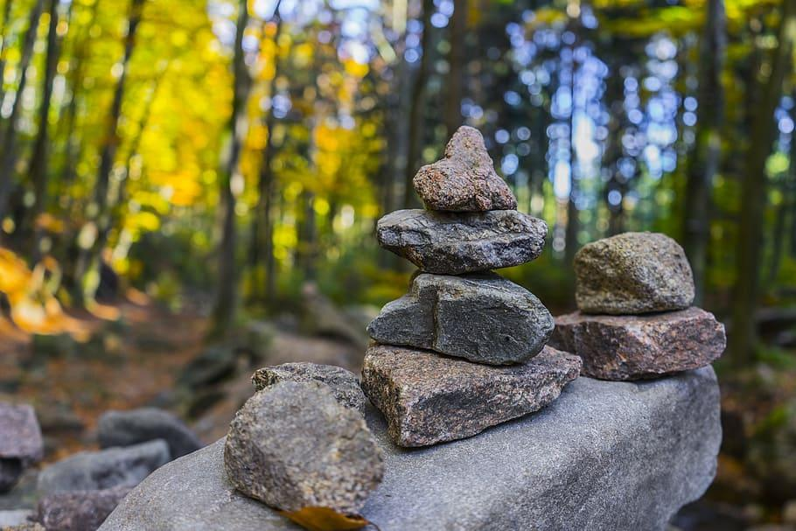
Image Comparison
Notes:
Miloserdoff, M. (n.d.). Focus [Photograph]. Source. https://www.publicdomainpictures.net/en/view-image.php?image=319241
Piqsels (n.d.). Stone stack with blurred background [Photograph]. Source. https://www.piqsels.com/en/public-domain-photo-frrjq

Slide 6

Frayer Model
Focal Length - How zoomed-in or out does the image appear?
  This affects how close or far away the image feels from the viewer.
Depth of Field - How in focus does the image appear?
  Examine from front to back.
Bokeh – Do the out of focus areas appear in the background of an image?

Slide 7
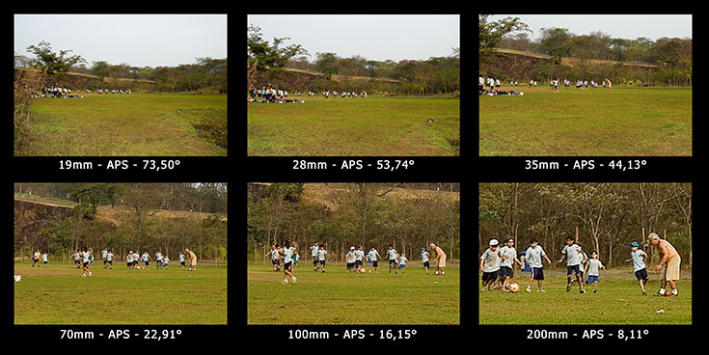
Focal Length
How zoomed-in or zoomed-out does the image appear? This affects how close or far away the image feels from the viewer.
Notes:
Mahain. (2005). Ilustracaodistfocalkw1.jpg [Photographs]. Source. https://commons.wikimedia.org/wiki/File:Ilustracaodistfocalkw1.jpg

Slide 8
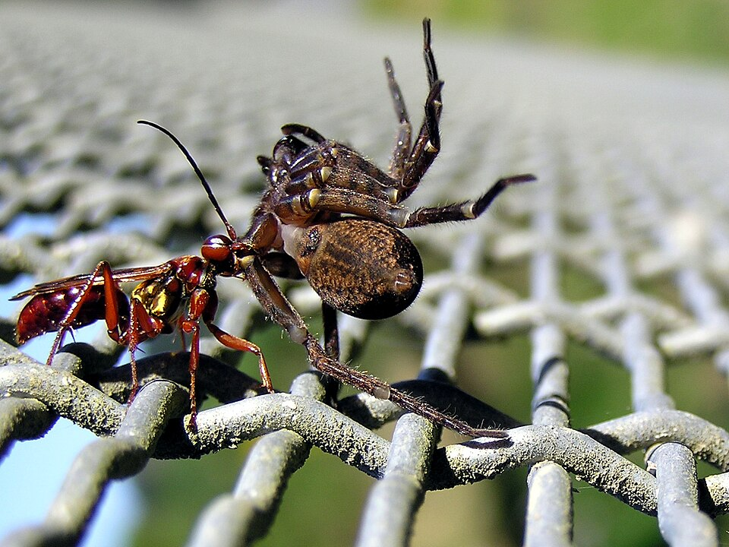
Depth of Field
Does the amount of the image appear sharp or in focus from front to back?
Notes:
Willis, T.. (2007). Wasp and spider 02.jpg [Photograph]. Source. https://commons.wikimedia.org/wiki/File:Wasp_and_spider_02.jpg

Slide 9
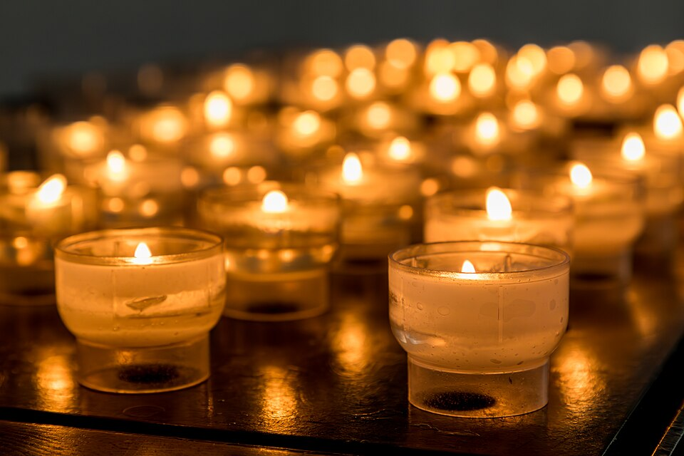
Bokeh
How is the visual quality of the out-of-focus areas? Pay particular attention to how light sources are rendered in the background.
Notes:
Rabich, D. (2018). Dülmen, Heilig-Kreuz-Kirche -- 2018 -- 1429.jpg [Photograph]. Source. https://commons.wikimedia.org/wiki/File:D%C3%BClmen,_Heilig-Kreuz-Kirche_--_2018_--_1429.jpg

Slide 10
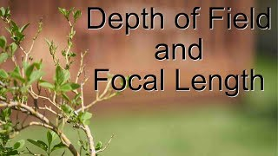

Slide 11

Venn Diagram 1
Reference your Frayer Models.
Types of lenses:
Wide Lens
Narrow Lens

Slide 12

Gallery Walk
Examine the photos.
Use clues (bokeh, background focus, field of view) to determine the following:
            The type of lens used
          wide/narrow
          prime/zoom
        The focal characteristics
          short/long
Record your reasoning in the Gallery Walk Response Sheet.

Slide 13
Performance Task
Use your Scenario Information Sheet and the Equipment Cost Sheet to select the following items for a wedding shoot with a $3,000 budget:
Camera body
Lens (or lenses) suitable for wedding conditions
ND Filter (for controlling exposure in bright light
Reflector (for managing natural light on subjects)
Panel Light (for shaded or indoor shots)

Slide 14
Performance Task
What lenses will give you the best results for portraits compared to wide venue shots?
What focal lengths are ideal for weddings?
Does your lens choice support filters and is your ND filter the correct size?
Will your panel lighting need power, portability, or diffusion features?
How does your reflector help in bright outdoor conditions?

Slide 15

3-2-1
On your 3-2-1 handout, answer the following questions:
  What are three things you learned in this lesson?
  What are two questions you still have?
  What is one thing you found interesting?

