Slide 2

Bell Ringer
List all the fairytales you know.
What do they have in common?
Notes:
K20 Center. (n.d.). Bell ringers and exit tickets. Strategies. https://learn.k20center.ou.edu/strategy/125

Slide 3

Once Upon a Perspective
Connecting Evidence to Argument

Slide 4
Essential Questions
How can the point of view in a fairy tale change the way we interpret the story?
What stereotypes are commonly found in traditional fairy tales and how do they influence readers?

Slide 5
Learning Objectives
Analyze traditional fairy tales to identify themes, character roles, and cultural messages.
Present and critique group arguments defending fairytale characters.

Slide 6

Agreement Circles
Read the statement and decide your stance.
Choose a circle.
  Outer circle = disagree (stay in place)
  Inner circle = agree (take one step to the middle)
Find a partner or small group from different circles.
Present your reasons and listen to theirs.
Notes:
K20 Center. (n.d.). Agreement circles. Strategies. https://learn.k20center.ou.edu/strategy/157

Slide 7

Agreement Circles
Fairy tales always have a happy ending.
K20 1-minute Timer
Notes:
K20 Center. (n.d.). Agreement circles. Strategies. https://learn.k20center.ou.edu/strategy/157
K20 Center. (2021, September 21). 1 Minute Timer. YouTube. https://www.youtube.com/watch?v=6ilD555O_RE&list=PL-aUhEQeaZXLMF3fItNDxiuSkEr0pq0c2&index=2

Slide 8
Agreement Circles
All villains in fairy tales are evil with no good in them.
K20 1-minute Timer
Notes:
K20 Center. (n.d.). Agreement circles. Strategies. https://learn.k20center.ou.edu/strategy/157
K20 Center. (2021, September 21). 1 Minute Timer. YouTube. https://www.youtube.com/watch?v=6ilD555O_RE&list=PL-aUhEQeaZXLMF3fItNDxiuSkEr0pq0c2&index=2

Slide 9
Agreement Circles
Fairy tales teach important life lessons.
K20 1-minute Timer
Notes:
K20 Center. (n.d.). Agreement circles. Strategies. https://learn.k20center.ou.edu/strategy/157
K20 Center. (2021, September 21). 1 Minute Timer. YouTube. https://www.youtube.com/watch?v=6ilD555O_RE&list=PL-aUhEQeaZXLMF3fItNDxiuSkEr0pq0c2&index=2

Slide 10
Agreement Circles
The main character in a fairy tale is always brave and kind.
K20 1-minute Timer
Notes:
K20 Center. (n.d.). Agreement circles. Strategies. https://learn.k20center.ou.edu/strategy/157
K20 Center. (2021, September 21). 1 Minute Timer. YouTube. https://www.youtube.com/watch?v=6ilD555O_RE&list=PL-aUhEQeaZXLMF3fItNDxiuSkEr0pq0c2&index=2

Slide 11
Agreement Circles
Fairy tales are only for little kids.
K20 1-minute Timer
Notes:
K20 Center. (n.d.). Agreement circles. Strategies. https://learn.k20center.ou.edu/strategy/157
K20 Center. (2021, September 21). 1 Minute Timer. YouTube. https://www.youtube.com/watch?v=6ilD555O_RE&list=PL-aUhEQeaZXLMF3fItNDxiuSkEr0pq0c2&index=2

Slide 12
Agreement Circles
The good characters are always rewarded in the end.
K20 1-minute Timer
Notes:
K20 Center. (n.d.). Agreement circles. Strategies. https://learn.k20center.ou.edu/strategy/157
K20 Center. (2021, September 21). 1 Minute Timer. YouTube. https://www.youtube.com/watch?v=6ilD555O_RE&list=PL-aUhEQeaZXLMF3fItNDxiuSkEr0pq0c2&index=2

Slide 13
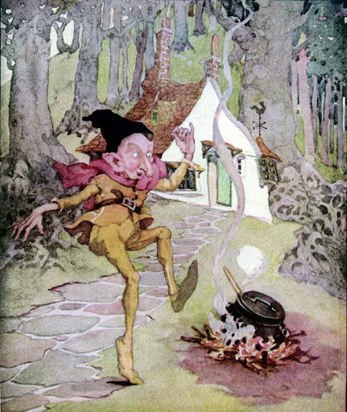
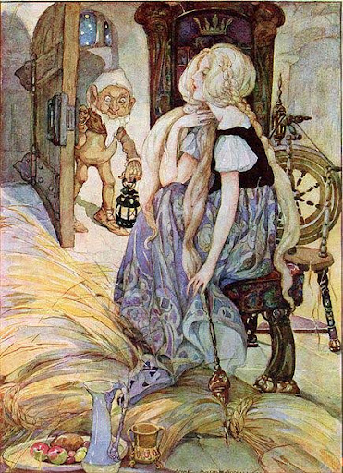
Happily Ever After…
Until…
Notes:
Anderson, A. (2010). Rumplestiltskin . Wikimedia Commons. Retrieved from https://commons.wikimedia.org/wiki/File:Rumplestiltskin_-_Anne_Anderson.jpg.
Anderson, A. (2009). The Miller’s Daughter. Wikimedia Commons. Retrieved from https://commons.wikimedia.org/wiki/File:The_Miller%27s_Daughter_by_Anne_Anderson.jpg?uselang=en#Licensing

Slide 14
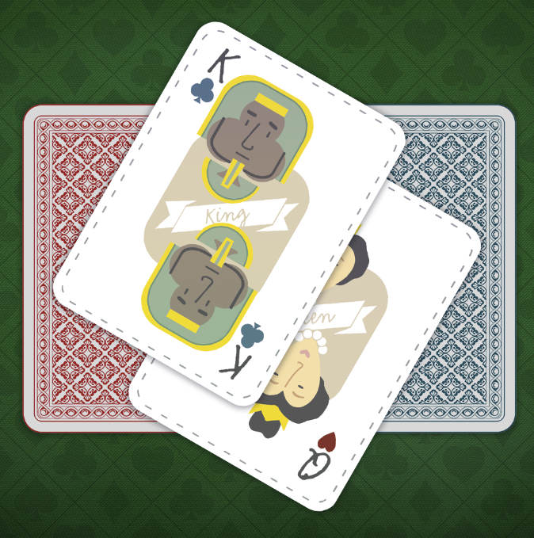
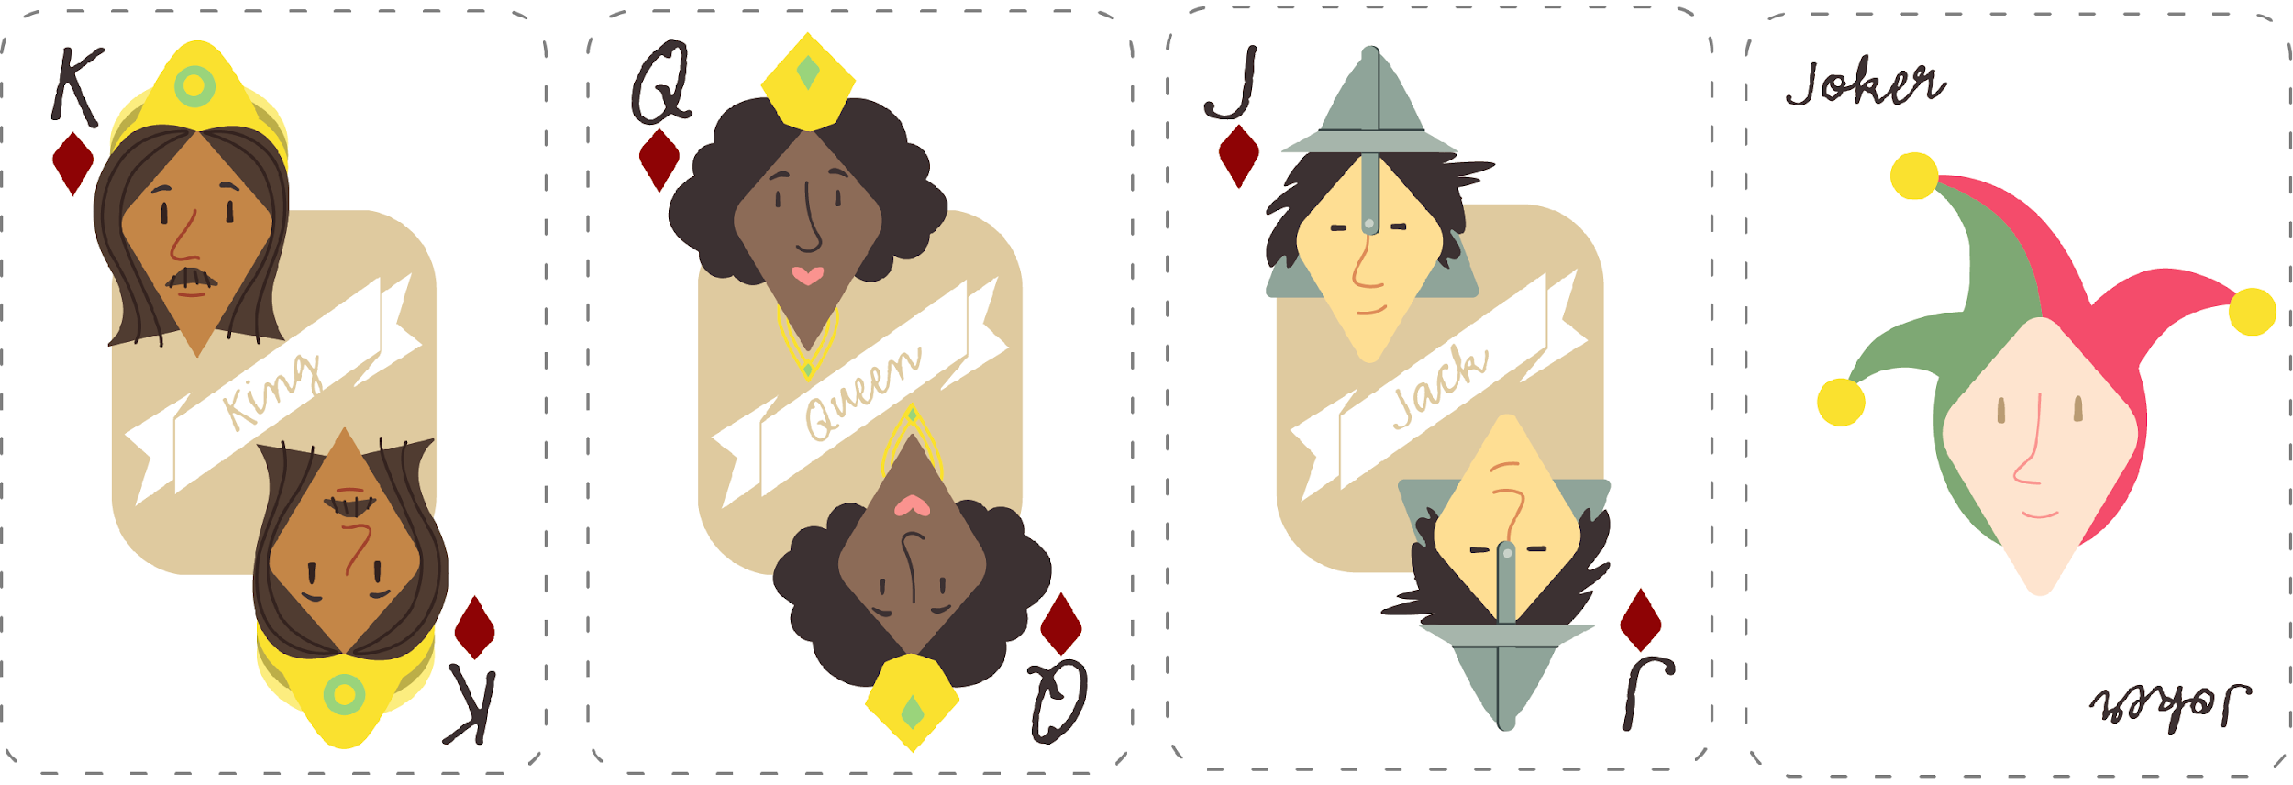
Defend Your Character’s Honor!
King
The King
Queen
The Miller’s
Daughter
Jack
The Miller
Joker
Rumpelstiltskin
Notes:
K20 Center. (n.d.). Group Shuffle. Strategies. https://learn.k20center.ou.edu/strategy/4441

Slide 15

The Story of Rumpelstiltskin
Read the story silently to yourself.
As you read, complete the CUS and Discuss strategy.
  CIRCLE any mention of your character.
  UNDERLINE any actions taken by your character.
  STAR any emotions or important adjectives that describe your character.
Notes:
K20 Center. (n.d.). CUS and discuss. Strategies. https://learn.k20center.ou.edu/strategy/162

Slide 16
Character Grouping
Find your classmates with matching cards.
Move to form a small group.
Discuss the words or phrases you identified in the story.
Notes:
K20 Center. (n.d.). Group Shuffle. Strategies. https://learn.k20center.ou.edu/strategy/4441
K20 Center. (n.d.). CUS and discuss. Strategies. https://learn.k20center.ou.edu/strategy/162

Slide 17
The Imaginary People’s Court
The Miller’s Daughter/Queen: Charged with child abandonment, child endangerment, and fraud.
The King: Impeached for accepting illegal tax contributions, abuse of power, and unlawful imprisonment.
The Miller: Charged with tax fraud, reckless endangerment, bribery, and defamation.
Rumpelstiltskin: Charged with attempted kidnapping, exploitation, and extortion.

Slide 18

What are the charges?
Child Abandonment – When a parent leaves a child alone without making sure they are safe, especially for a long time.
Child Endangerment – Putting a child in a dangerous or unsafe situation.
Fraud – Telling a lie or going along with a lie to get something you want.
Breach of Contract – Not keeping a promise that was part of an important agreement.

Slide 19
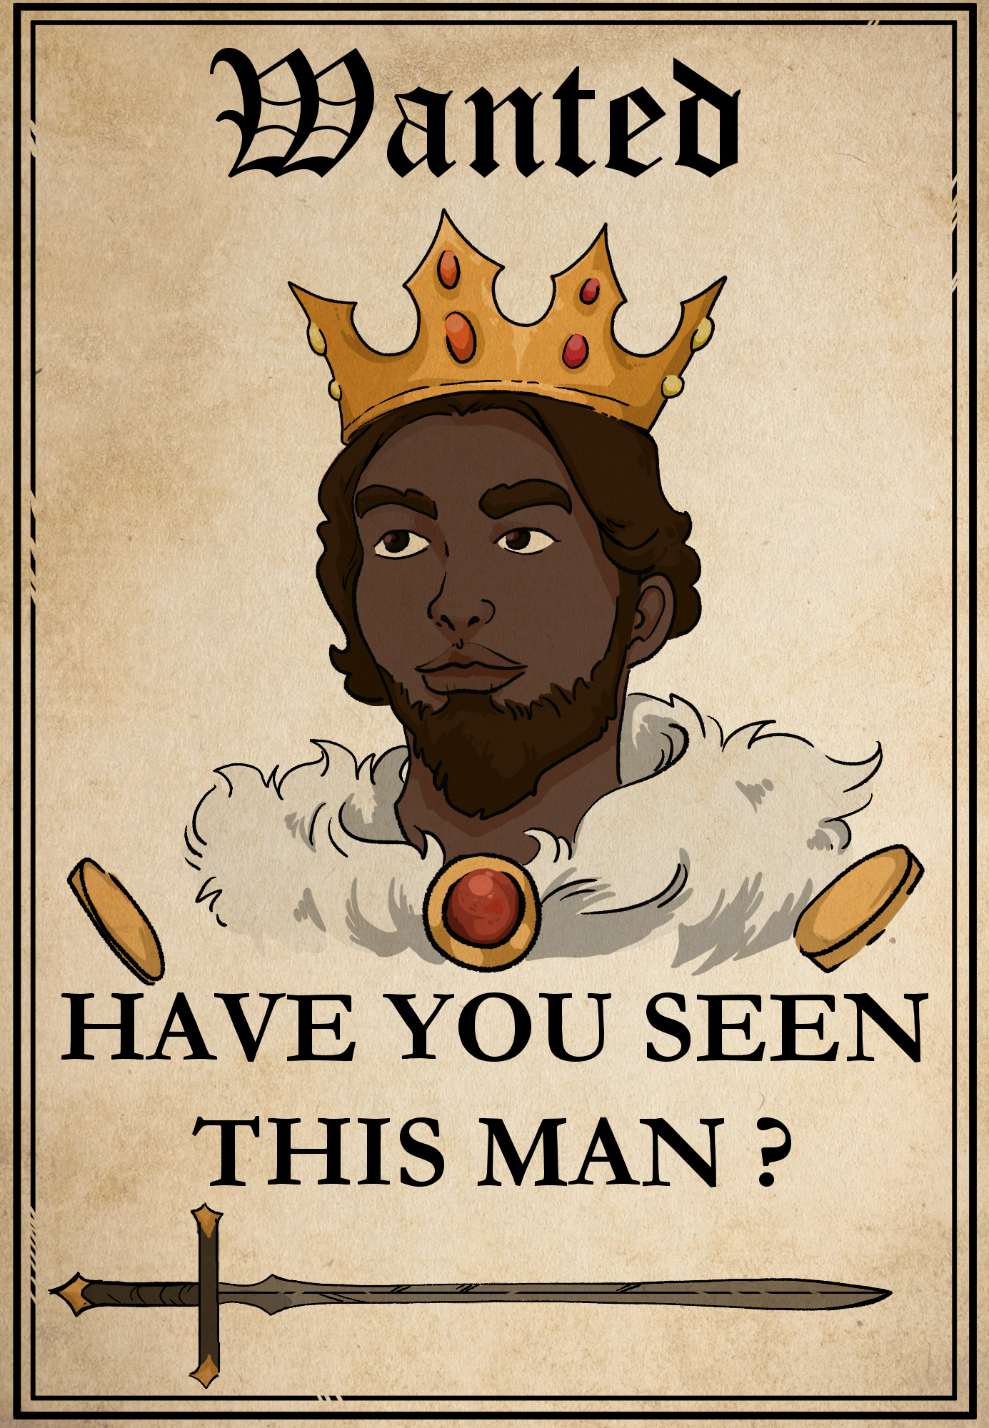
What are the charges?
Illegal Tax Contributions – A leader or person in power takes money or valuable things from people in a way that’s not fair.
Abuse of Power – Someone using their your position or role to hurt others instead of helping.
Unlawful Imprisonment – Keeping someone locked up or trapped when they have not done anything wrong.

Slide 20
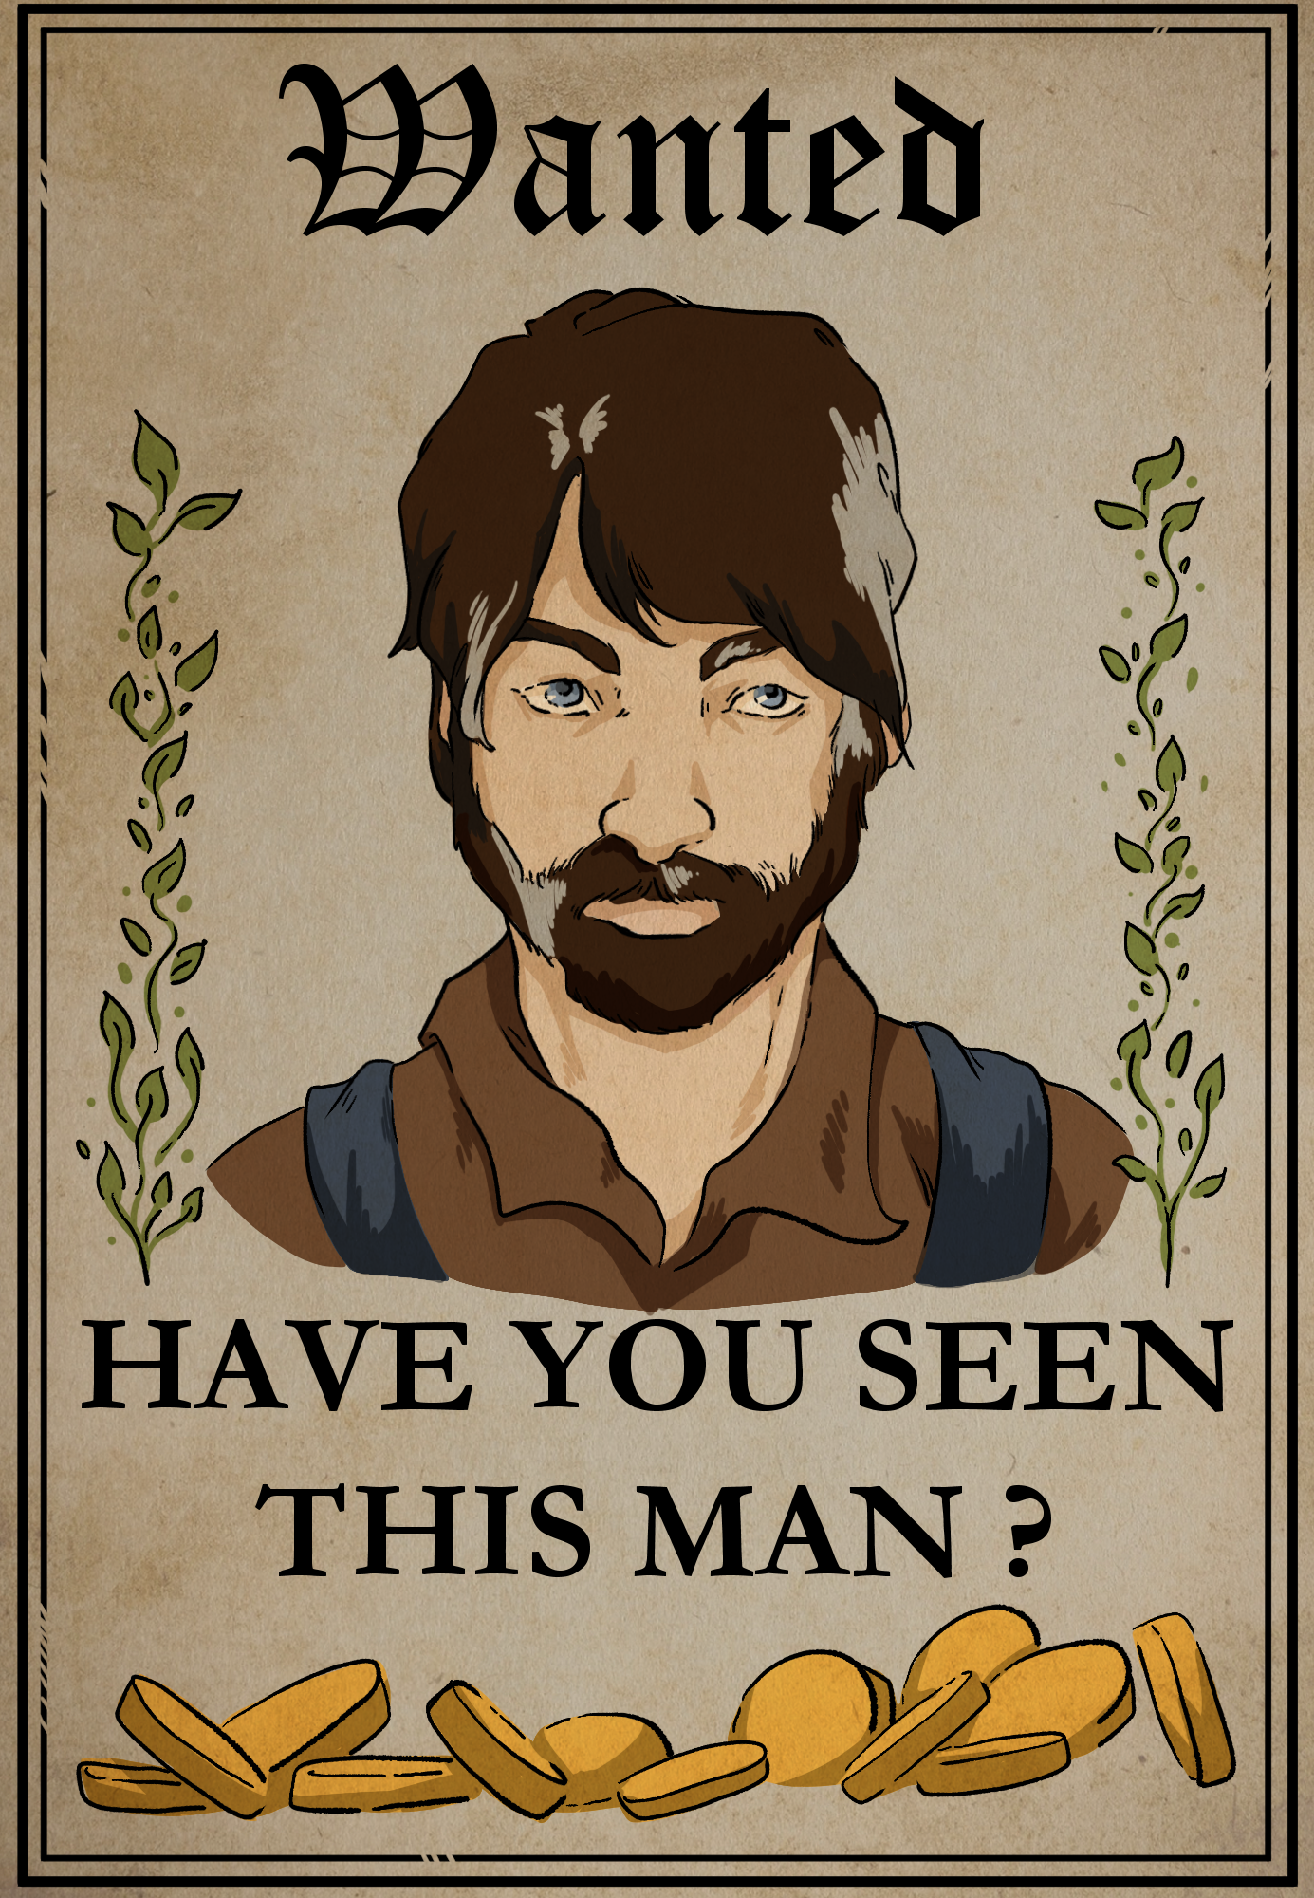
What are the charges?
Tax Fraud – Lying about money or gold to avoid paying what is owed in taxes.
Reckless Endangerment – Doing something that puts someone else in serious danger.
Bribery – Giving money or favors to someone to try to get them to do something they shouldn’t do.
Defamation – Spreading a false story that causes trouble or hurts the reputation of another.

Slide 21
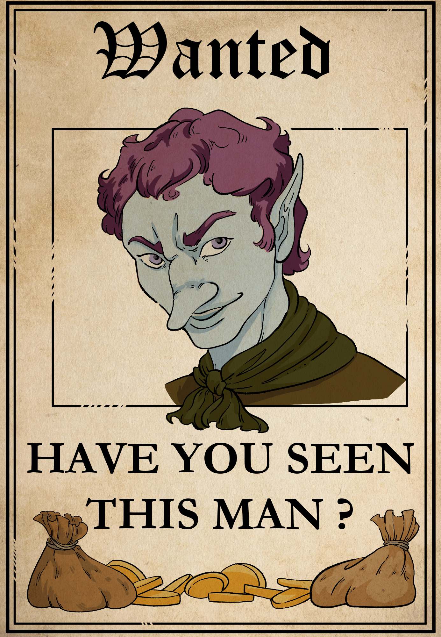
What are the charges?
Attempted Kidnapping – Trying to take a child who belongs to someone else.
Exploitation – Treating someone unfairly or using them when they are scared, confused, or in a tough situation.
Extortion – Pressuring someone to give up something they care about by threatening them.

Slide 22

CER Example
Claim – Recess is an important part of the day for students.
Evidence – A study from the local Health Department shows that physical activity during the school day helps improve focus and behavior in the classroom.
Reasoning – When students get a break to move around and talk with friends, they come back to class feeling more refreshed and ready to learn. Recess helps them burn off energy and reduces stress, which leads to better learning and fewer distractions.
Notes:
K20 Center. (n.d.). Claim, evidence, reasoning (CER). Strategies. https://learn.k20center.ou.edu/strategy/156

Slide 23
Legal Team
Fill out the CER for your character in order to prove their innocence.
Use information from the story about your character as well as details from your group discussion to craft your argument.
Share your CER with the group and create a collaborative defense.
Choose a spokesperson for your group, known as the lead defense attorney, to present your case.

Slide 24

Glow and Grow Peer Feedback
As your group listens to the arguments, write on a sticky note one Glow and one Grow statement per presentation. Think about the following:
Glow
What is one part of the argument that really stood out or impressed you?
What evidence or reasoning was especially convincing or well-explained?
Grow
What part of the argument could be clearer or more detailed?
Is there a piece of evidence that was missing or could have made the claim stronger?
Notes:
K20 Center. (n.d.). Glow and Grow. Strategies. https://learn.k20center.ou.edu/strategy/4962

Slide 25



HEAR YE! HEAR YE!
The Honorable Judge declares that court is in session.
State your character’s name and the crimes they are being accused of.
Present your argument (using your CER).
The Honorable Judge declares that court is in session.
State your character’s name and the crimes they are being accused of.
Present your argument (using your CER).

Slide 26

K20 2-minute timer
Notes:
K20 Center. (2021, September 21). 2 Minute Timer. YouTube. https://www.youtube.com/watch?v=HcEEAnwOt2c

Slide 27
Argumentative Essay
Use the following to help answer the prompt below:
Your CER
Your group’s CER
The Glow and Grow feedback your group received
Prompt: Write a 5-paragraph argumentative essay persuading someone about the innocence of your character.

Slide 28

One-Pager
Using Canva, create an infographic containing the following information:
Character’s name
Brief paragraph explaining your character’s innocence.
  At least two pieces of evidence with reasoning.
One or more images representing key concepts.
Three questions (with answers).
Notes:
K20 Center. (n.d.). One-pager. Strategies. https://learn.k20center.ou.edu/strategy/72

