Slide 2

Microbes and Manure = Biofuel
Anaerobic Respiration

Slide 3
Essential Question
Can waste be converted and used for energy?

Slide 4
Learning Objectives
Design and test a mini-gas digester to investigate how different variables affect gas production.
Collect and analyze experimental data to evaluate the effectiveness of biogas production methods.
Propose a solution for how biogas technology can be used to reduce human impacts on the environment and biodiversity.

Slide 5
Observations
Take out a piece of paper.
While you watch the demonstration, write down any observations you make.

Slide 6

What Did I Learn?
With the same piece of paper you made your observations on, take a few minutes to reflect and write down anything you have learned so far.
Notes:
K20 Center. (n.d.). What Did I Learn Today? Strategies. https://learn.k20center.ou.edu/strategy/169

Slide 7
Can you increase the rate of decomposition in the burping bottles?

Slide 8
What is a hypothesis?
A hypothesis is an educated guess or a testable statement that explains what you think will happen in an experiment.
Review the sample hypothesis.
Work with your groups to create and write down your own hypothesis on your handout.

Slide 9
Possible Digester Inputs
Input the following in your clean, empty water bottle:
Manure (cow or horse compost)
Carbon source (choose 1) : shredded newspaper, notebook paper, oatmeal, wood chips, plastic, food waste, etc.)
Liquid: Water OR apple cider vinegar
Note: Each bottle should only test one variable.

Slide 10
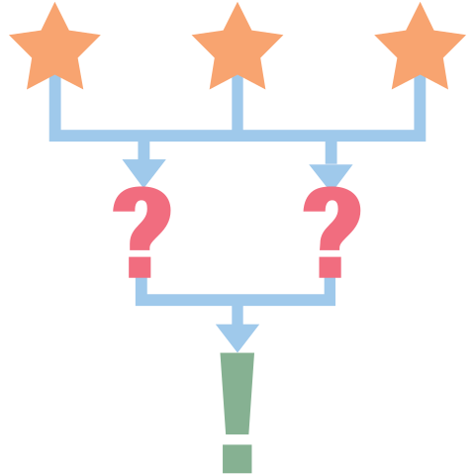
3-2-1
Take out a piece of paper and respond to the following prompts while you watch the video:
  What are three things you learned?
  What are two questions you still have?
  What is one thing you found interesting?
Notes:
K20 Center. (n.d.). 3-2-1. Strategies. https://learn.k20center.ou.edu/strategy/117

Slide 11
Reflect and Discuss
Discuss the following questions with your group:
What gas is produced in your bottles?
What happens to the gas when you release it from the bottle?
Is that gas beneficial for the environment?
How could we prevent the gas from entering the atmosphere?

Slide 12

Jigsaw
Each person in your group should be assigned a different article.
Individually read through your assigned article.
Come together as a group and discuss your article with each other. Consider the following when discussing:
  Similarities
  Differences
  Interesting points
  Anything you still have questions over
Notes:
K20 Center. (n.d.). Jigsaw. Strategies. https://learn.k20center.ou.edu/strategy/179

Slide 13
Real World Application
Spend time in your groups brainstorming ideas for the question below:
How could biogas digesters be used in and around your communities?

Slide 14

Two-Minute Paper
Take out a piece of paper for your group and together respond the following prompt:
In one paragraph or less, explain where a biogas digester is needed in our community, why it will be useful in that location, and how it will be constructed.
Notes:
K20 Center. (n.d.). Two-Minute Paper. Strategies. https://learn.k20center.ou.edu/strategy/152

Slide 15
Poster
Include the following in your poster:
A detailed and accurate description of the experiment
A detailed and accurate description of a digester
A strong hypothesis and an indication of if the hypothesis was accepted or rejected
A detailed description of the methods used in the experiment
A table or graph displaying the data collected
Three or more colors included

Slide 16

Gallery Walk
Choose one group member to stand near your poster and answer questions from other students.
As a group, move around the room and review each poster. Ask any questions you may have about the experiments to the designated student representatives.
Notes:
K20 Center. (n.d.). Gallery Walk / Carousel. Strategies. https://learn.k20center.ou.edu/strategy/118

Slide 17
Experiment Presentation
Ensure that your presentation meets the following requirements:
Completely aligns with the approved proposal
Detailed and accurate description of proposal
Detailed and accurate description of digesters
A need for digesters is presented and explained
Data is presented and used to predict an application of a digester
A minimum of seven slides
Student presenters do not just read directly off the slides, showing an understanding of the proposal
A maximum of 10 minutes

