Slide 1
K20 LEARN Logo

Slide 2
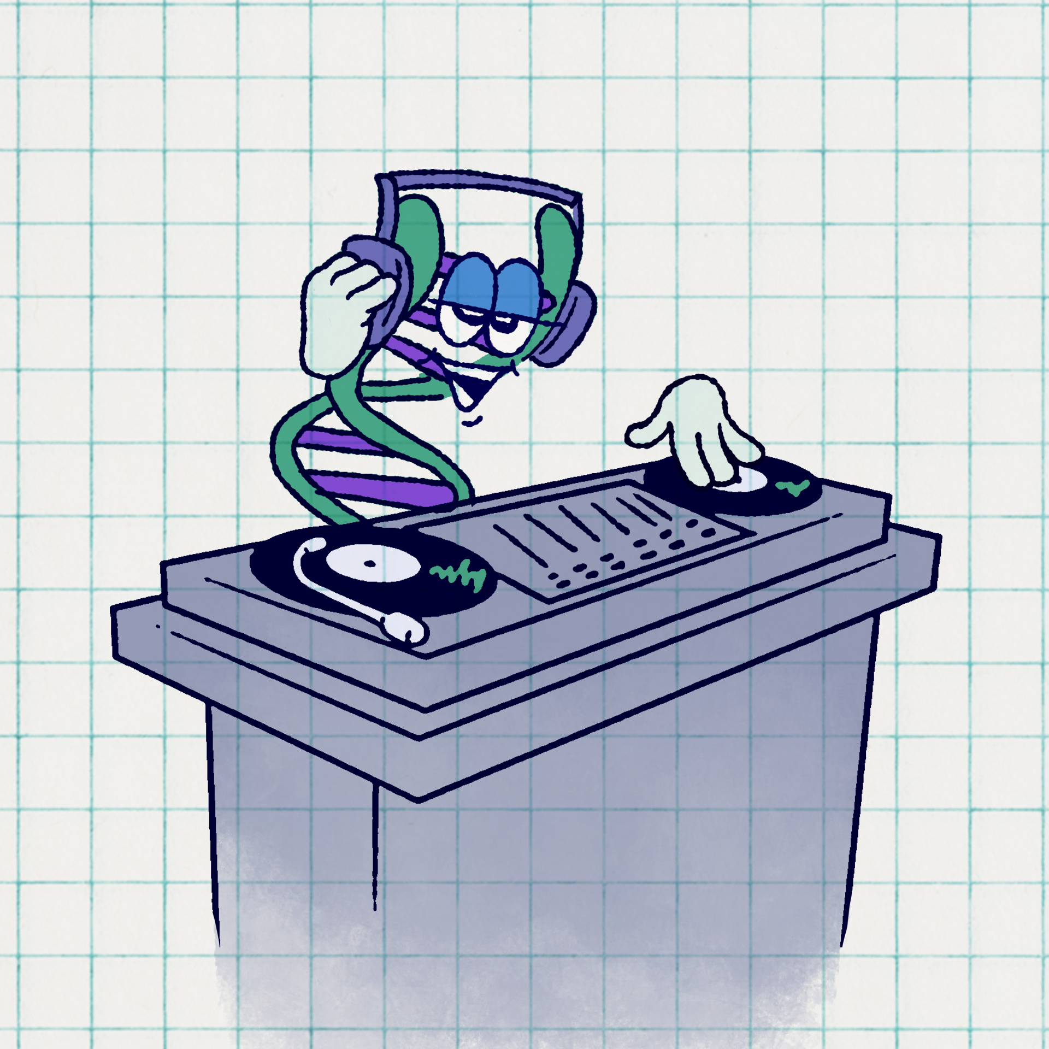
DNA Remix
How Mutations Change the Code

Slide 3
Essential Question
How do genes affect the structure and function of an organism?

Slide 4
Learning Objectives
Explain what a gene is and how it provides instructions for making proteins.
Describe what a mutation is and how it changes the DNA sequence.

Slide 5
What is a mutation?
Watch the following video.
As you watch, write down 2-3 questions on your own paper. These questions will be used in a discussion.

Slide 6
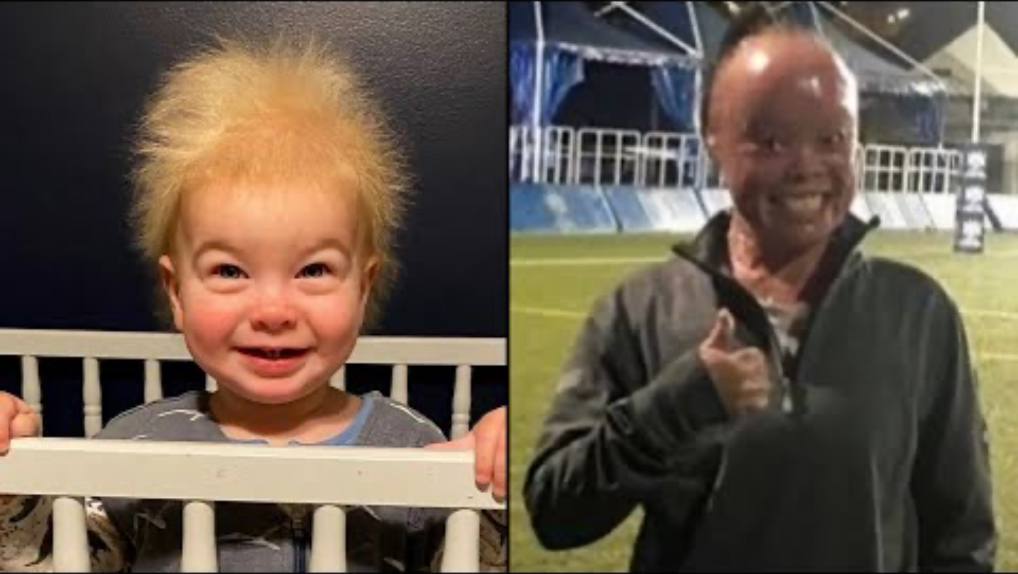
Uncombable Hair Syndrome and Other Rare Genetic Conditions
Notes:
Inside Edition. (2023, January 16). Uncombable Hair Syndrome and Other Rare Genetic Conditions. YouTube. https://www.youtube.com/watch?v=teoDWJPMHKM

Slide 7
Discussion
Pair up with a partner and share your questions.
Synthesize your questions to create 3 questions to share in the next step.

Slide 8
Discussion
Merge with another team.
Share your questions.
Synthesize your questions with the other team and select your favorite.

Slide 9
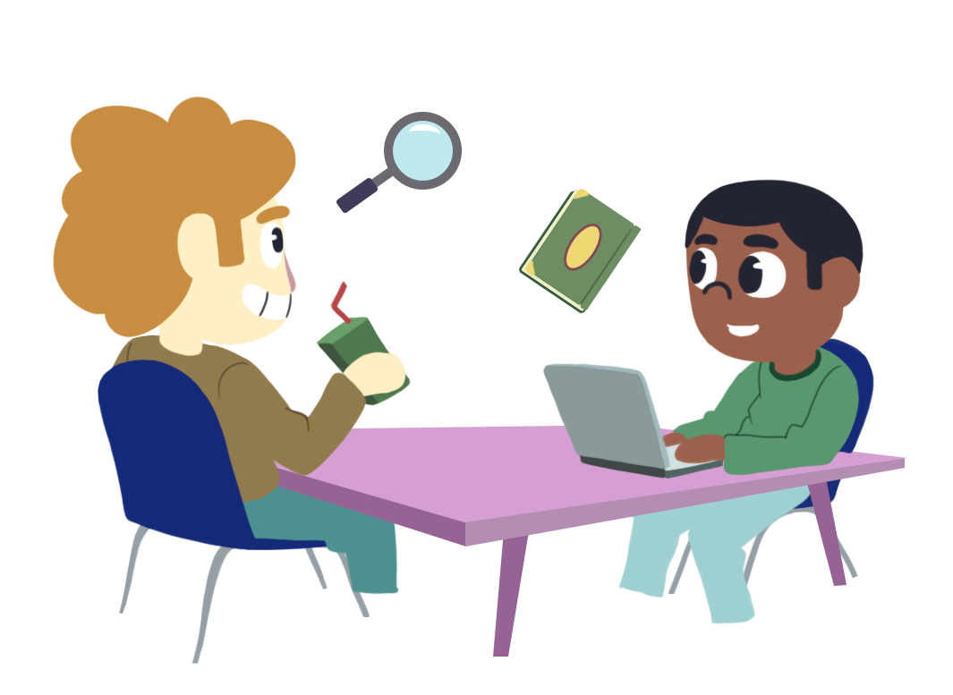
Driving Question Board
Share out your group’s favorite question.
After all groups have shared their questions, add any questions that are not represented by another group.

Slide 10
The Legend of the First Milk Drinker
Read the story.
Consider the following questions:
  Do you know of anyone who is lactose intolerant? If so, what is their experience of having lactose intolerance?

Slide 11

Inherited Traits Poll
Go to Menti.com and enter the code:
Answer the questions on the Menti.

Slide 12
Inherited Traits Poll
On your own paper, re-create the bar graph shown in the Menti results.
Consider this question:
  What do the genes look like among your class?

Slide 13
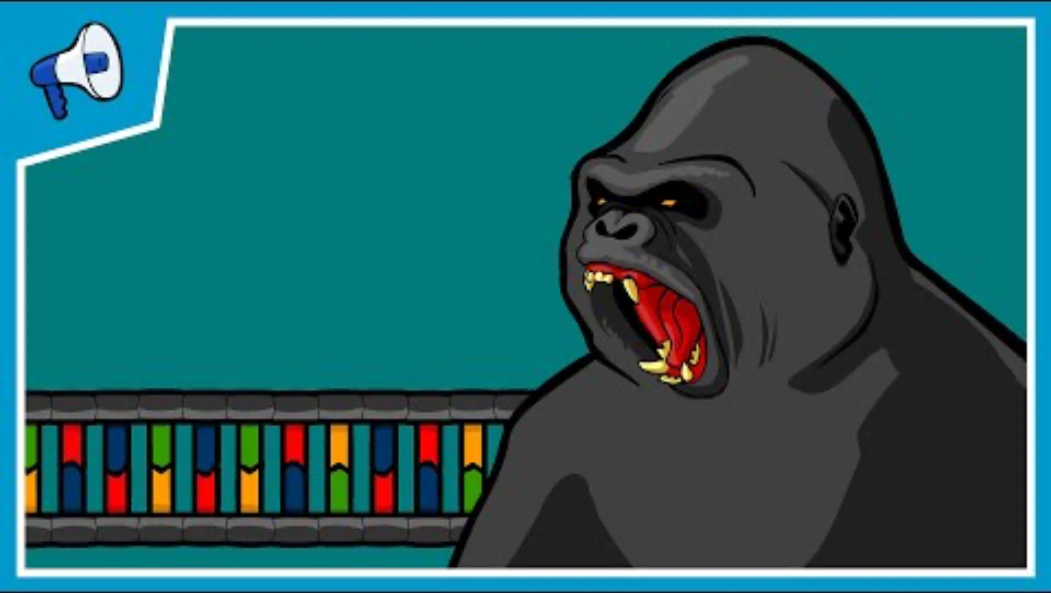
What is a gene?
Notes:
Stated Clearly. (2012). What is a gene? [YouTube Video]. In YouTube. https://www.youtube.com/watch?v=5MQdXjRPHmQ

Slide 14
What Is a Gene?
A gene is an instruction manual in your DNA.
A gene tells your body how to make proteins.

Slide 15
Traits and Inheritance
A trait is a characteristic, such as:
  Eye color
  Height
  Blood type
Inheritance is how traits are passed from parents to offspring (children) through genes.

Slide 16
DNA and Proteins
Genes are segments of DNA that give instructions to build proteins.
The bases A, T, C, and G are used in the DNA sequence.
The combination of bases creates proteins and proteins create traits.
The bases are always paired as follows:
  A and T
  C and G
A protein’s shape and size determine its function.

Slide 17
Examples of Traits in Humans
Harmful
  Sickle Cell Anemia
  Harlequin Ichthyosis
Neutral
  Freckles
  Uncombable Hair Syndrome
Beneficial
  Lactose tolerance
  Superman strength

Slide 18
What is a Mutation?
A mutation is a change in the DNA code.
A mutation can be caused by:
  Errors in the DNA replication process
  Environmental factors
  Inheritance from parents
  Random occurrence

Slide 19
Same Letters, Different Jobs
All organisms use A, C, T, and G, but when and where a protein is made decides its job.
Notes:
Grant Hayes Frazier, Defusing a Ticking Time Bomb: The Complicated Considerations Underlying Compulsory Human Genetic Editing, 10 Hastings Sci. & Tech. L.J. 39 (2019).
Available at: https://repository.uclawsf.edu/hastings_science_technology_law_journal/vol10/iss1/3

Slide 20
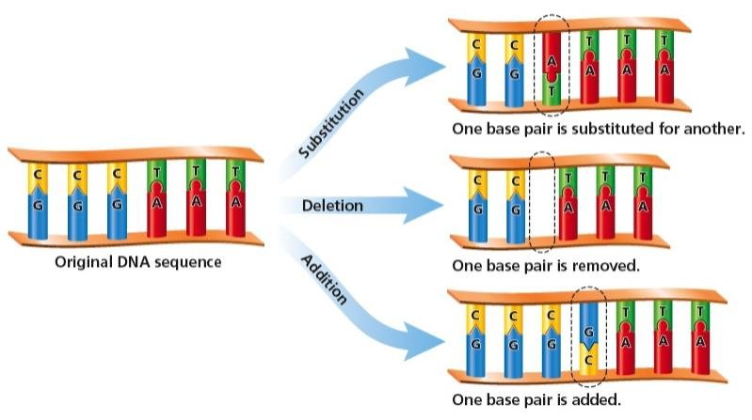
Mutations
A mutation can change the protein.
A change to the protein changes the trait.
Notes:
Grant Hayes Frazier, Defusing a Ticking Time Bomb: The Complicated Considerations Underlying Compulsory Human Genetic Editing, 10 Hastings Sci. & Tech. L.J. 39 (2019).
Available at: https://repository.uclawsf.edu/hastings_science_technology_law_journal/vol10/iss1/3

Slide 21
Mutation Slide Presentation
Your group will be randomly assigned a mutation.
Create a presentation following the information on the handout.
Be prepared to present your information to the class during group presentations.

Slide 22
Presentation Norms
Remain engaged throughout all presentations.
Do not have side conversations and put distractions away.
Only ask questions that connect to the information shared in the presentation.
Hold questions until presenters ask for them.
Clap or give kind feedback after each presentation.

Slide 23

Fiction in the Facts
On your half sheet of paper, write:
  Two true facts about mutations
  One made-up statement about mutations

