Slide 2

Teen Trivia
Developing Strong Claims

Slide 3
Essential Questions
How can I ask strong research questions that help me find clear and useful information?
What makes a claim and its evidence trustworthy, and how can I use a claim to build my own argument?

Slide 4
Learning Objectives
Identify information about teens’ well-being from scientific articles.
Develop a research question.
Create a clear thesis statement that explains your perspective and the reasons behind it.

Slide 5

Fiction in the Facts
On the next slides, you will see three statements about teens.
Two are facts, one is fiction.
Decide which one you think is fiction and be ready to explain why you think that.
Vote on which statement is fiction.
The fictional statement will be revealed, and the true statements will be connected to scientific research.
Notes:
K20 Center. (n.d.). Fiction in the facts. Strategies. https://learn.k20center.ou.edu/strategy/60

Slide 6
Round 1: Sleep
Most teens need between 8–10 hours of sleep each night.
Staying up late and sleeping in on weekends helps fix your sleep schedule.
Sleep helps your brain organize and store what you’ve learned during the day.

Slide 7
Round 1: Sleep
Most teens need between 8–10 hours of sleep each night.
Staying up late and sleeping in on weekends helps fix your sleep schedule.
Sleep helps your brain organize and store what you’ve learned during the day.

Slide 8
Round 2: Brain & Learning
The teenage brain is still developing until around age 25.
Experiences and practice can actually “rewire” the brain’s connections.
Teens can easily multitask without losing focus.

Slide 9
Round 2: Brain & Learning
The teenage brain is still developing until around age 25.
Experiences and practice can actually “rewire” the brain’s connections.
Teens can easily multitask without losing focus.

Slide 10
Round 3: Health & Focus
Drinking energy drinks helps teens focus better on learning.
Skipping breakfast can lower attention and memory during the school day.
Physical activity can improve mood and brain function.

Slide 11
Round 3: Health & Focus
Drinking energy drinks helps teens focus better on learning.
Skipping breakfast can lower attention and memory during the school day.
Physical activity can improve mood and brain function.

Slide 12
Round 4: Emotions & Stress
Teens’ emotions are completely out of their control because of “raging hormones.”
Stress can sometimes be helpful, giving extra energy to meet challenges.
Talking to a trusted person can reduce stress levels and improve problem solving.

Slide 13
Round 4: Emotions & Stress
Teens’ emotions are completely out of their control because of “raging hormones.”
Stress can sometimes be helpful, giving extra energy to meet challenges.
Talking to a trusted person can reduce stress levels and improve problem solving.

Slide 14
Round 5: Social Media & Technology
Notifications and constant alerts can make it harder to concentrate.
Using screens right before bed can delay falling asleep.
Teens are always good at spotting fake news online.

Slide 15
Round 5: Social Media & Technology
Notifications and constant alerts can make it harder to concentrate.
Using screens right before bed can delay falling asleep.
Teens are always good at spotting fake news online.

Slide 16
Round 6: Memory & Studying
Cramming the night before a test is the best way to remember information long-term.
Taking short breaks while studying can improve focus and recall.
Teaching someone else what you learned is one of the strongest ways to remember it.

Slide 17
Round 6: Memory & Studying
Cramming the night before a test is the best way to remember information long-term.
Taking short breaks while studying can improve focus and recall.
Teaching someone else what you learned is one of the strongest ways to remember it.

Slide 18


Article Jigsaw
Read your assigned article with your group.
Highlight the claim(s) in blue and pieces of evidence in yellow.
Share what you highlighted with others in your group.
  As others share, take note of what they highlighted on your handout
Make connections between the article and your life.

Slide 19

Claim Cards
Select a scribe and a spokesperson for your group.
  Scribe—person that woke up the earliest.
  Spokesperson—person that woke up the latest.
Read the claim together and discuss what evidence and reasoning supports the claim.
The scribe should write the claim on the card.
The spokesperson should share out the claim with the whole class.
Notes:
K20 Center. (n.d.). Claim cards. Strategies. https://learn.k20center.ou.edu/strategy/160

Slide 20
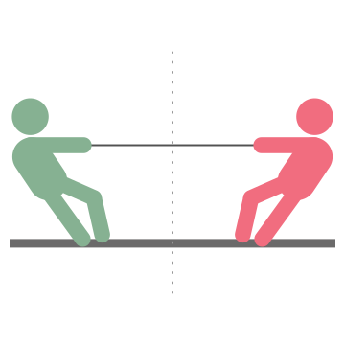
Tug-of-War
Work with your group to create tugs—pieces of evidence that support your claim.
Write each tug on a sticky note.
Place the sticky notes on the rope. Strong tugs should go toward the end of the rope, and weaker tugs should go toward the center of the rope.
Generate “What if…?” questions to trigger deeper thinking.
Notes:
K20 Center. (n.d.). Tug-of-war. Strategies. https://learn.k20center.ou.edu/strategy/98

Slide 21
Tug-of-War: Discussion
Which side had the strongest tugs?
Determine which claim you support.
Write a justification for your chosen claim using the strongest evidence to support your position.
Notes:
K20 Center. (n.d.). Tug-of-war. Strategies. https://learn.k20center.ou.edu/strategy/98

Slide 22
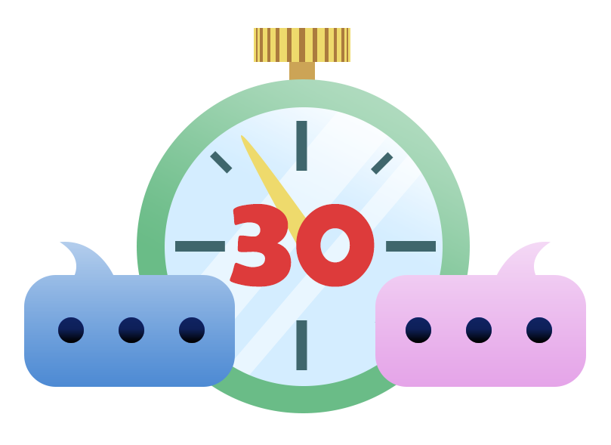
30-Second Expert
Take turns sharing what you know about the topic with your partner.
One partner should share and the other should listen, paraphrase, and ask questions.
After all questions have been answered, switch roles.
Notes:
K20 Center. (n.d.). 30-second expert. Strategies. https://learn.k20center.ou.edu/strategy/1048

