Slide 2
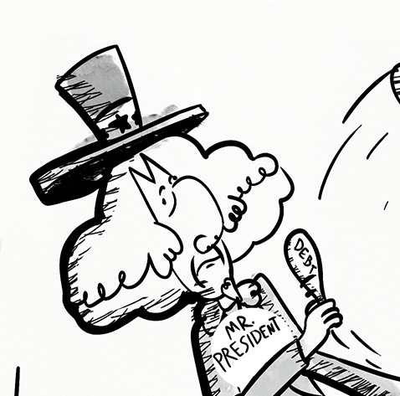
Who You Gonna Call?
Federalism in the U.S. Constitution

Slide 3
Essential Questions
How do the federal and state governments share powers within the framework of the Constitution?
How does the U.S. determine the powers and responsibilities of government at the federal and state levels?

Slide 4
Learning Objectives
Explain the structure of the U.S. Government to better understand how federal and state offices or politicians interact with each other.
Recognize and describe the advantages or disadvantages of federalism.
Apply knowledge gained from this lesson to identify which level or branch of government is responsible for a given issue.

Slide 5

It’s OPTIC-al
Examine the image on the next slide.
Answer questions about the image on your handout.
Prepare to share your answers.
Notes:
K20 Center. (n.d.). It’s OPTIC-al. Strategies. https://learn.k20center.ou.edu/strategy/99

Slide 6
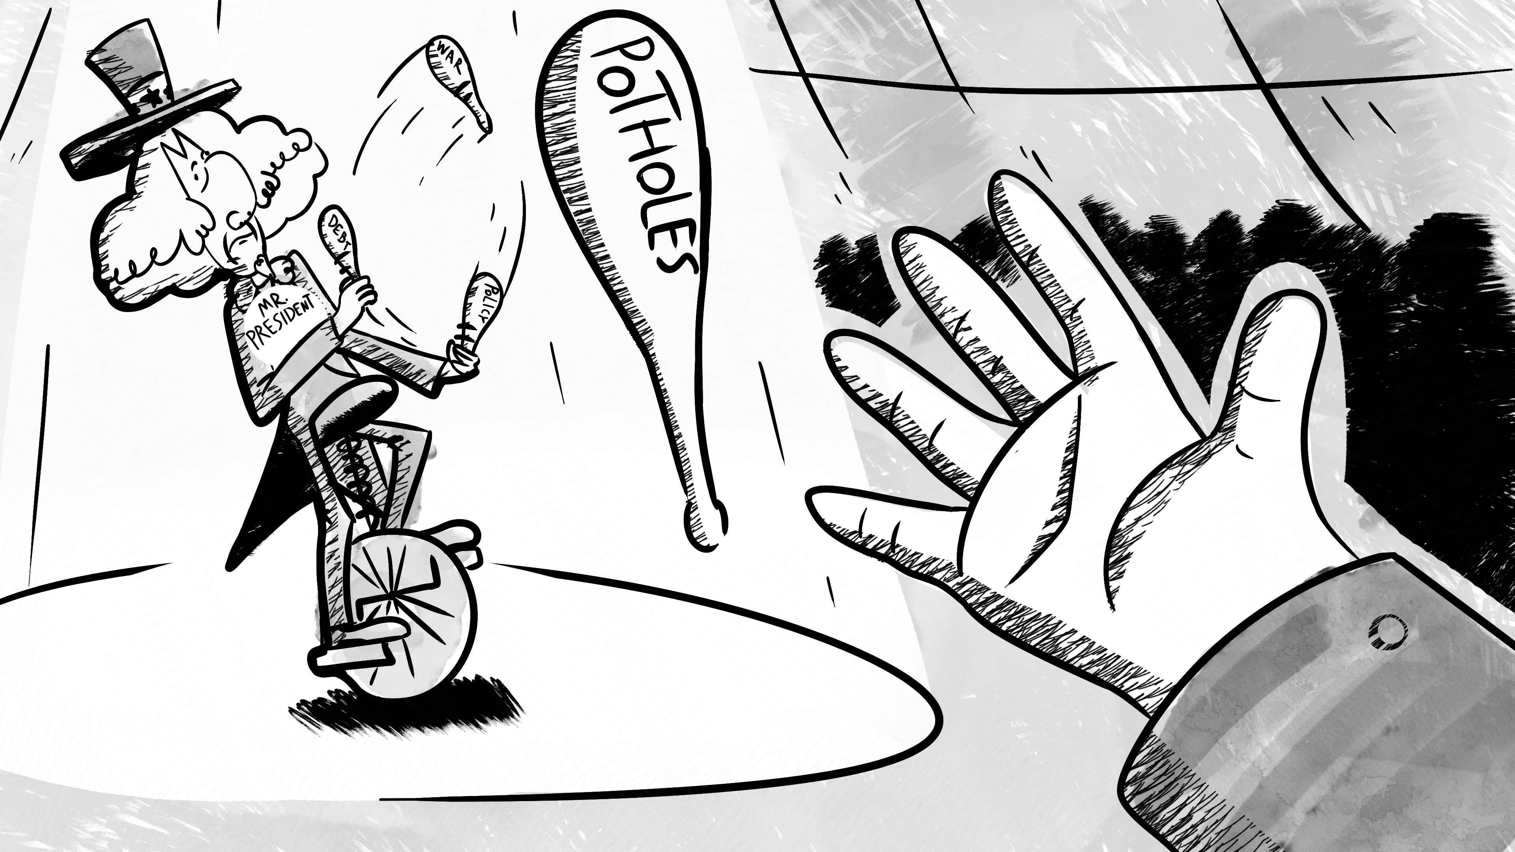

Slide 7
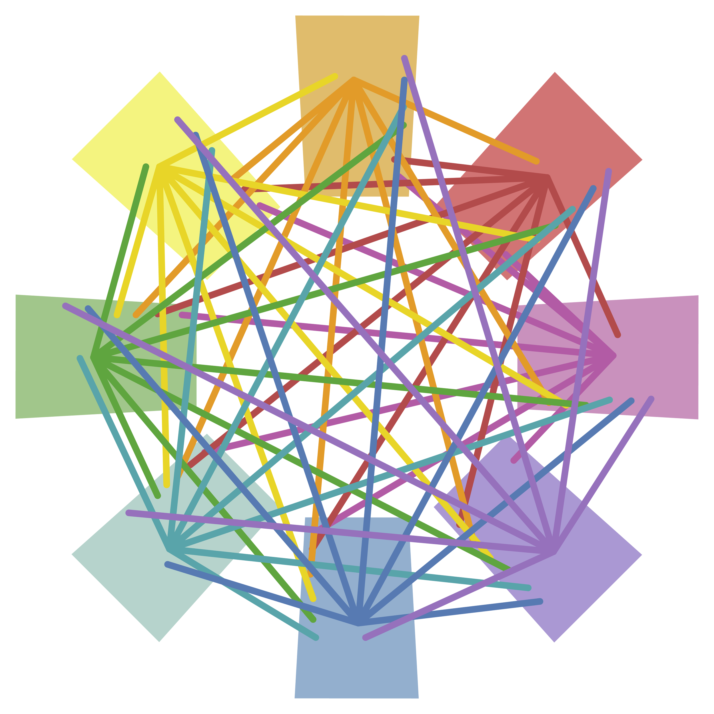
Detective Boards
With your group, read your given scenarios.
Determine which level of government would be responsible for that scenario.
Use the yarn and tape to connect your scenario to the level you think it belongs to.
Notes:
K20 Center. (n.d.). Detective board. Strategies. https://learn.k20center.ou.edu/strategy/3530

Slide 8
Construction crews are working to expand Interstate 35 from four lanes to six lanes in Oklahoma City.

Slide 9
The Oklahoma City Thunder needs downtown streets blocked off for their championship celebration parade.

Slide 10
The location of the border between the United States and Canada is being disputed.

Slide 11
Trash service pickup will run on a different day this week because of a holiday.

Slide 12
Funding for public education will receive a 3% increase over the next ten years.

Slide 13
You need to locate your polling place so that you can vote in the next presidential election.

Slide 14
A diplomat from the United Kingdom is visiting the United States to discuss a free trade agreement.

Slide 15
The street in front of your house has a pothole that you would like fixed.

Slide 16
Your family moved to a new home, and you want to change your forwarding address so that you can still receive mail from your old address.

Slide 17

Inside Out
Read the title of each circle.
With your group, write one example of a scenario that each level of government would be responsible for in each of the corresponding circles.
Notes:
K20 Center. (n.d.) Inside out. Strategies. https://learn.k20center.ou.edu/strategy/93

Slide 18
Federalism
Read the article with a partner.
As you read the article, identify definitions of each level of government.
Add the definitions to your Inside Out handout.
Notes:
K20 Center. (n.d.) Inside out. Strategies. https://learn.k20center.ou.edu/strategy/93

Slide 19
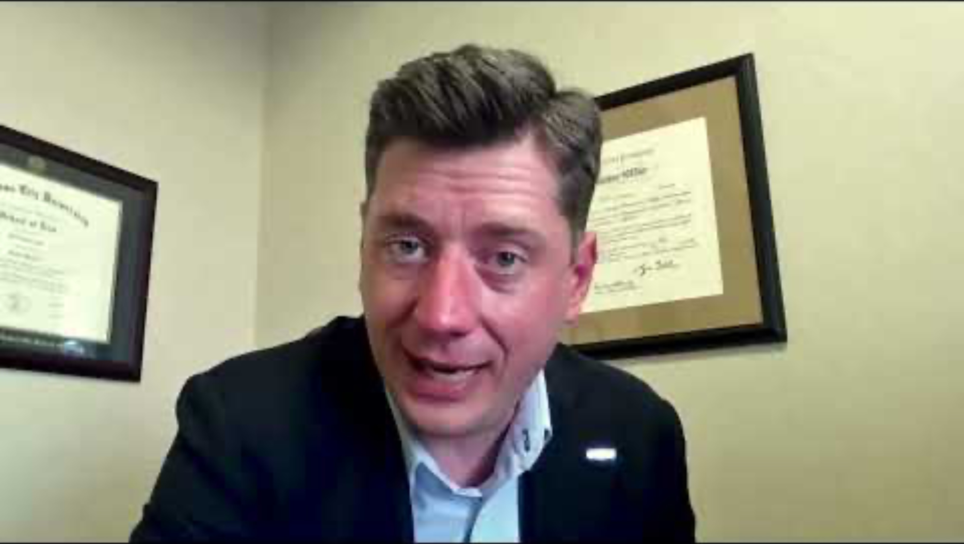
Dear Mr. President—Mayor Holt Interview
Notes:
K20 Center. (2021, June 8). K20 ICAP-Dear Mr. President- Mayor Holt interview [Video]. YouTube. https://www.youtube.com/watch?v=82ZRk_KhHgU&list=PL-aUhEQeaZXLg0yYwLKeUT2Ud1sC0inzo&index=38

Slide 20

Card Sort
With your partner, read the jobs and their corresponding descriptions on the cards.
Sort jobs into the three different levels of government: federal, state, and local.
Prepare to justify your answers.
Notes:
K20 Center. (n.d.). Card sort. Strategies. https://learn.k20center.ou.edu/strategy/147

Slide 21

Gist
On your handout, determine the 5 Ws (who, what, where, when, why) and the H (how) of the lesson.
Write a summary of the lesson using 28 words or fewer.
  Use your Inside Out handout to help you.
Notes:
K20 Center. (n.d.). Gist. Strategies. https://learn.k20center.ou.edu/strategy/3289

