Slide 2

Adapt or Not: How Traits Keep Organisms Alive
From Molecules to Organisms: Structure and Processes

Slide 3
Essential Question
How do specialized characteristics influence the growth and survival of organisms in their environments?

Slide 4
Learning Objectives
Explain how environmental influences affect the growth and reproduction of organisms
Analyze the advantages and disadvantages of specialized characteristics
Communicate how specialized structures enhance reproductive success in plants and animals of particular environments.

Slide 5

Justified True or False
Study the animal and environment on each of the following slides. On your handout:
  Write the name of the animal and type of environment in the blanks.
  Determine if the statement you wrote is true or false.
  Justify your decision using complete sentences.
Notes:
K20 Center. (n.d.). Justified true or false. Strategies. https://learn.k20center.ou.edu/strategy/174

Slide 6
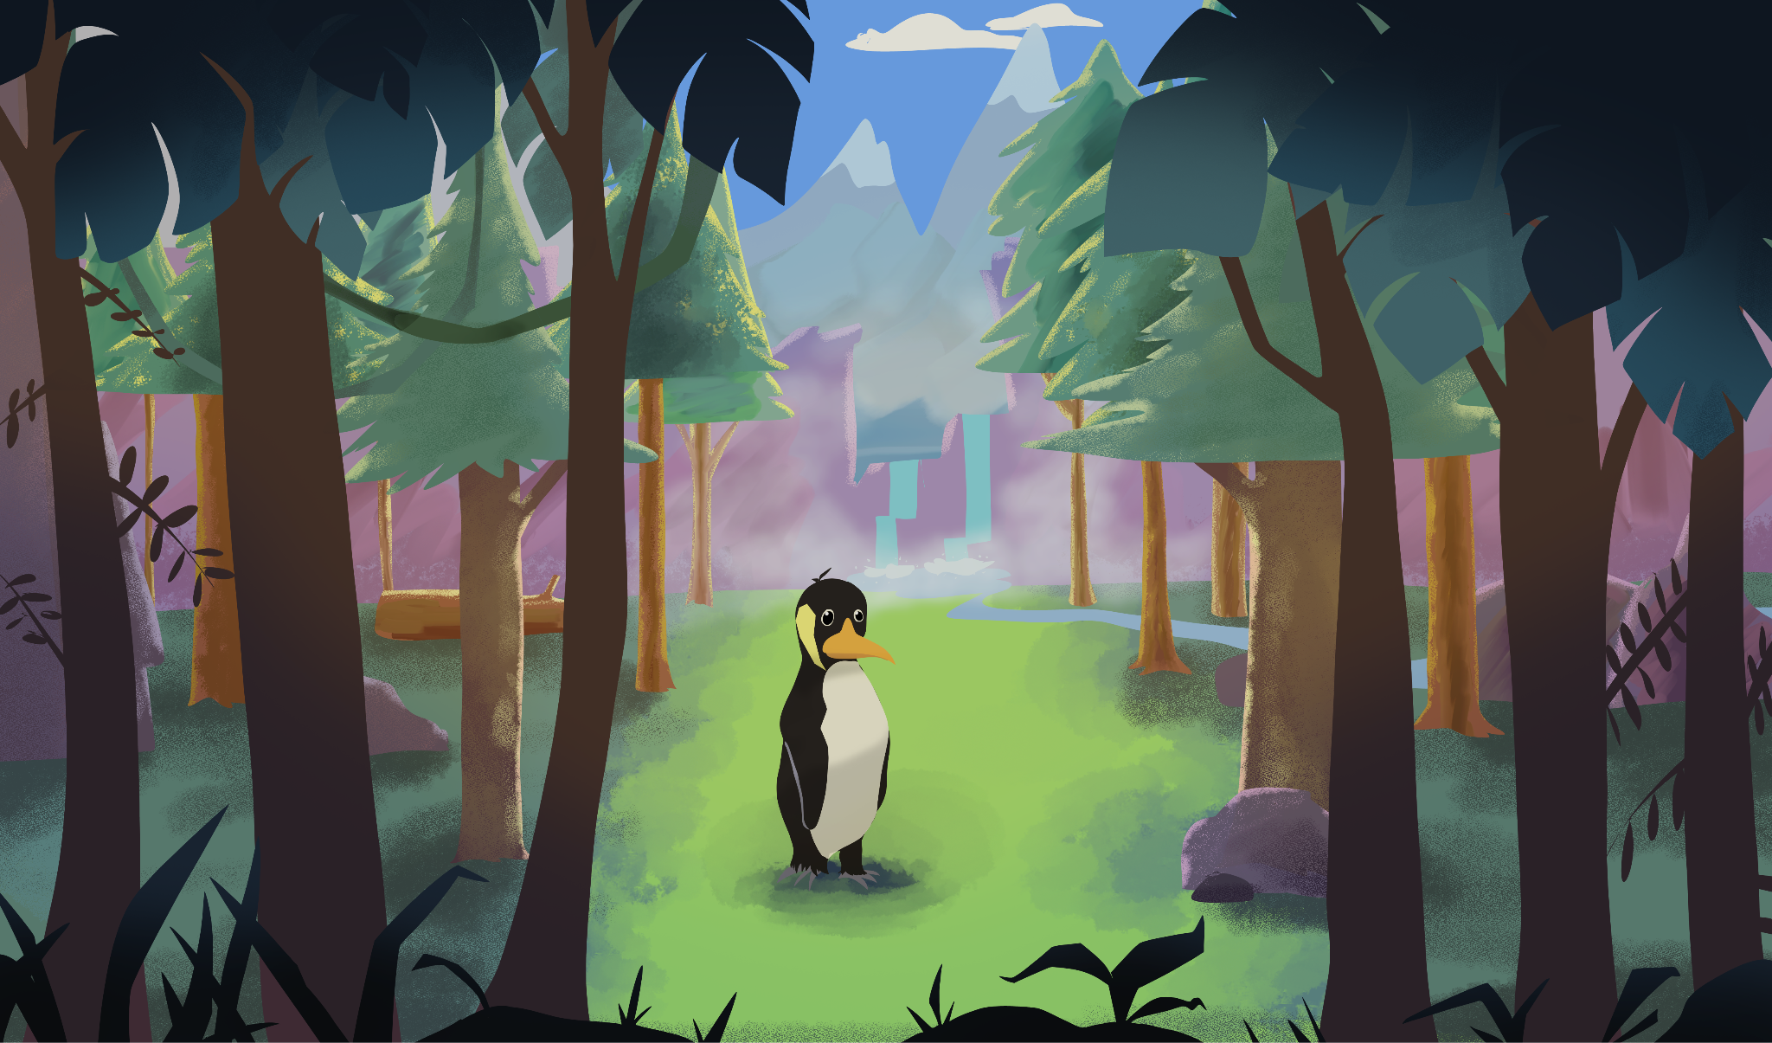
Animal: Penguin
Environment: Rainforest

Slide 7
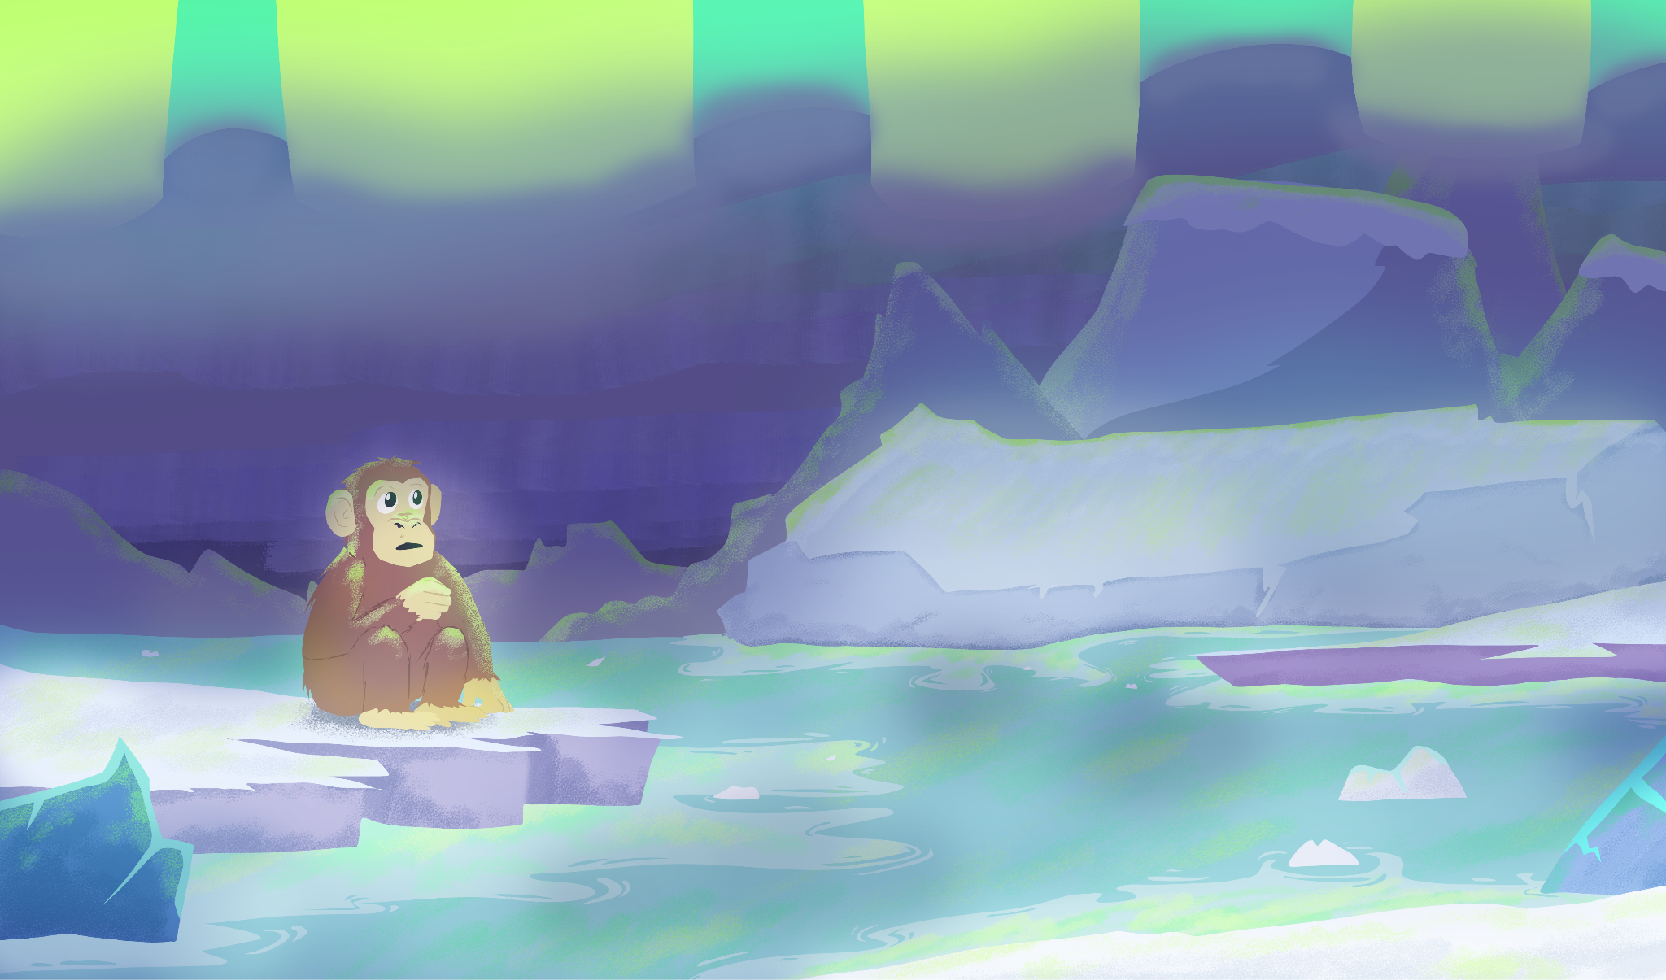
Animal: Chimpanzee
Environment: Artic

Slide 8
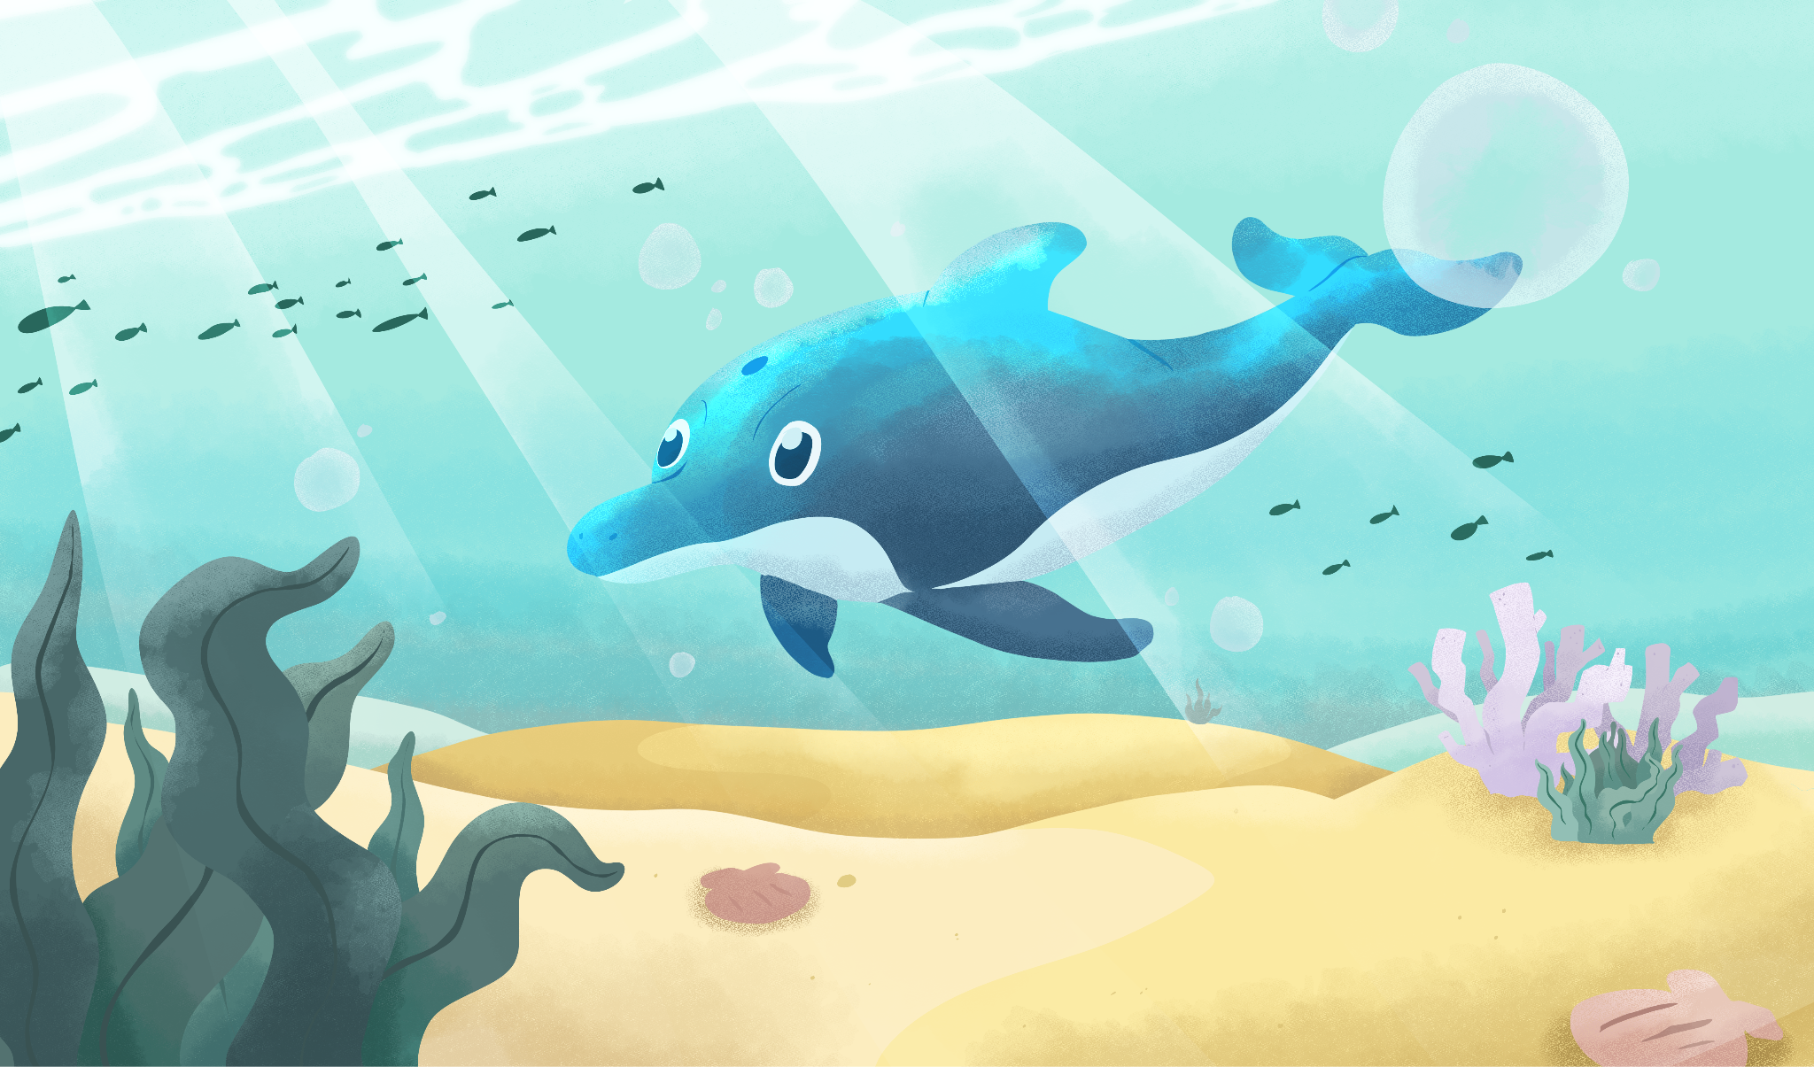
Animal: Dolphin
Environment: Ocean

Slide 9
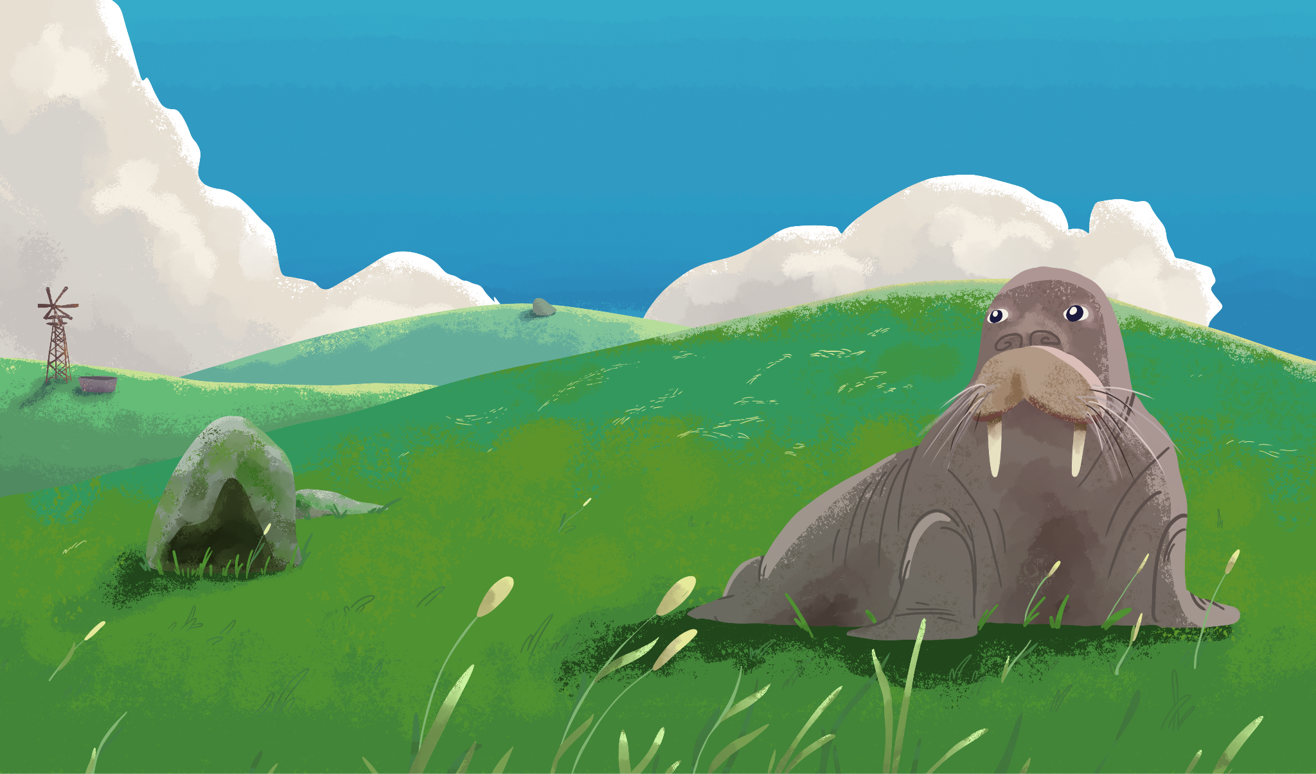
Animal: Walrus
Environment: Grassland

Slide 10
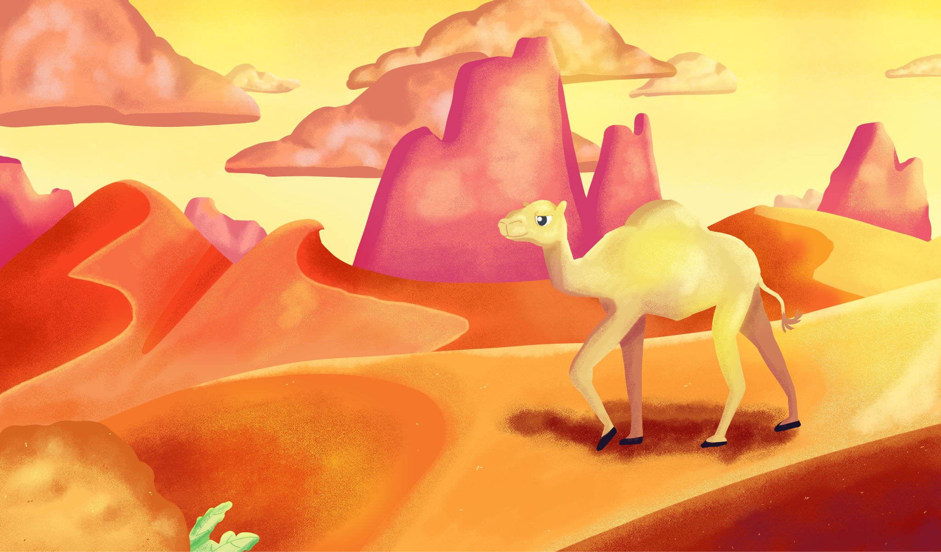
Animal: Camel
Environment: Desert

Slide 11

Animal: Penguin
Environment: Rainforest

Slide 12
Animal: Chimpanzee
Environment: Artic

Slide 13

Animal: Dolphin
Environment: Ocean

Slide 14
Animal: Walrus
Environment: Grassland

Slide 15
Animal: Camel
Environment: Desert

Slide 16
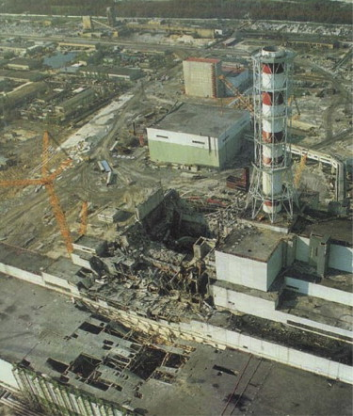
Chernobyl Nuclear Meltdown
In Ukraine on April 26, 1986, a reactor in the Chernobyl Nuclear Power Plant exploded.
The massive explosion and meltdown were caused by a flawed reactor design and unsafe safety test procedures.

Slide 17
Chernobyl Nuclear Meltdown
The meltdown resulted in the release of large amounts of radiation, making Chernobyl one of the worst nuclear disasters in history.
The disaster caused long-term environmental and health impacts to surrounding living organisms.

Slide 18
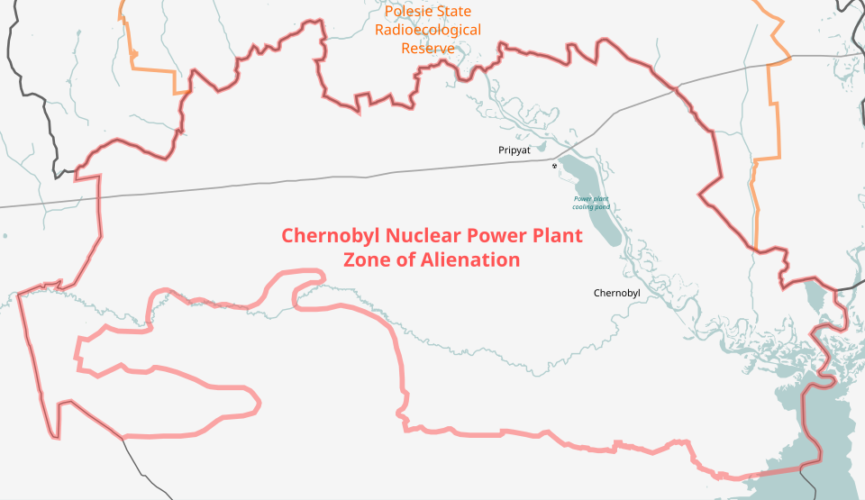
Zone of Alienation

Slide 19

Chernobyl Nuclear Meltdown
Birds were one group of organisms that were severely impacted by the explosion.
Work with your group to organize the cards into two categories:
  Characteristics of bird populations before the Chernobyl meltdown
  Characteristics of bird populations after the Chernobyl meltdown.
Notes:
K20 Center. (n.d.). Card sort. Strategies. https://learn.k20center.ou.edu/strategy/147

Slide 20
Before Chernobyl
Healthy Forest Habitat: Birds lived in thriving forests with plenty of food and nesting sites.
Feather Colors: Bright colors. Many birds displayed strong feather pigmentation due to normal melanin production.
Regular Migration Patterns: Birds followed consistent seasonal migration routes.

Slide 21
Before Chernobyl
4. Populations: Bird species showed typical
population sizes and diversity.
5. DNA (Genetics): Minimal mutations occurred
because radiation levels were low.

Slide 22
After Chernobyl
Low/Unviable Vegetation: Birds lived in areas with highly contaminated, sparsely populated vegetation. Food sources were stunted.
Feather Colors: Loss of pigmentation. Birds showed duller feather colors as melanin production decreased due to radiation stress.
Altered Migration: Some bird populations avoided the exclusion zone or changed their migration timing.

Slide 23
After Chernobyl
4. Populations: Reduced reproduction. Fewer chicks
hatched and survival rates dropped in contaminated
zones.
5. DNA (Genetics): Damaged cells and increased
mutations. Some birds developed deformities, such as
irregular feathers, tumors, or albinism.

Slide 24
Chernobyl Card Sort
How did you decide the placement of the cards?
Because birds migrate, how do you think migrating birds from Chernobyl affected other bird populations?
Can environmental factors impact a population? How do you know?
Notes:
K20 Center. (n.d.). Card sort. Strategies. https://learn.k20center.ou.edu/strategy/147

Slide 25
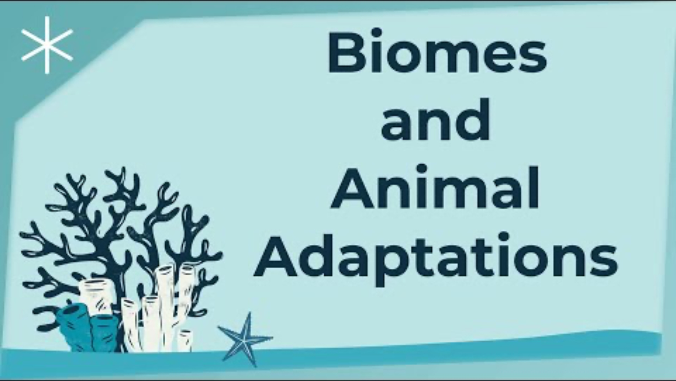
Biomes and Animal Adaptations
Notes:
Natural User Interface Technologies (NUITEQ) Chorus Educational K–12 Content. (2023, April 25). Biomes and animal adaptations [Video]. YouTube. https://www.youtube.com/watch?v=ImQz1dVscR0&t=194s

Slide 26
Reflective Questions
How do environmental factors affect where a species can survive?
What is an example from the video of a specialized characteristic that increases an organism's chance of survival?
Describe an example of a specialized characteristic that was not shown in the video.

Slide 27
The Great Plant Discovery
You and your team of fellow botanists have found a new species of plant. On your poster paper, describe your plant and do the following:
Name the new species
Draw the new species
Determine, label, and describe 5 characteristics of your species.
  e.g., thorns: for protections
Prepare to share.

Slide 28
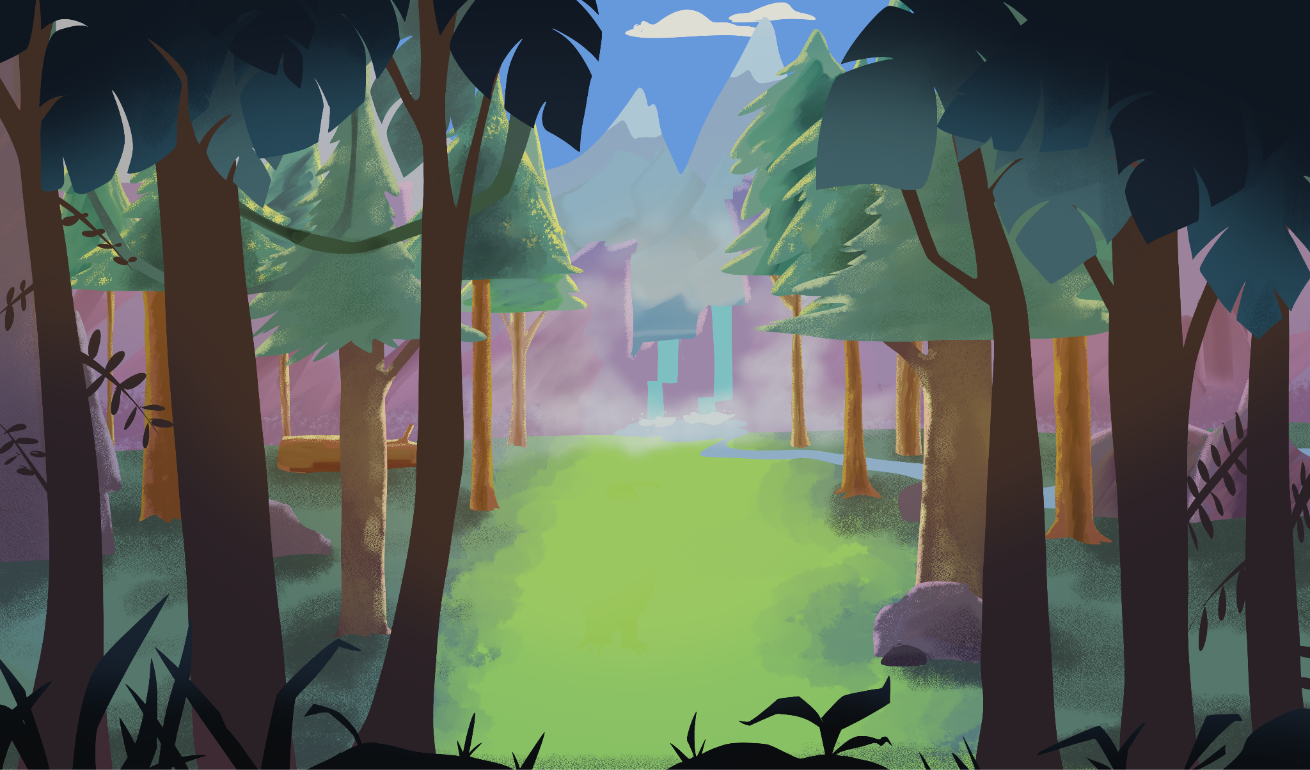
Environment: Rainforest

Slide 29
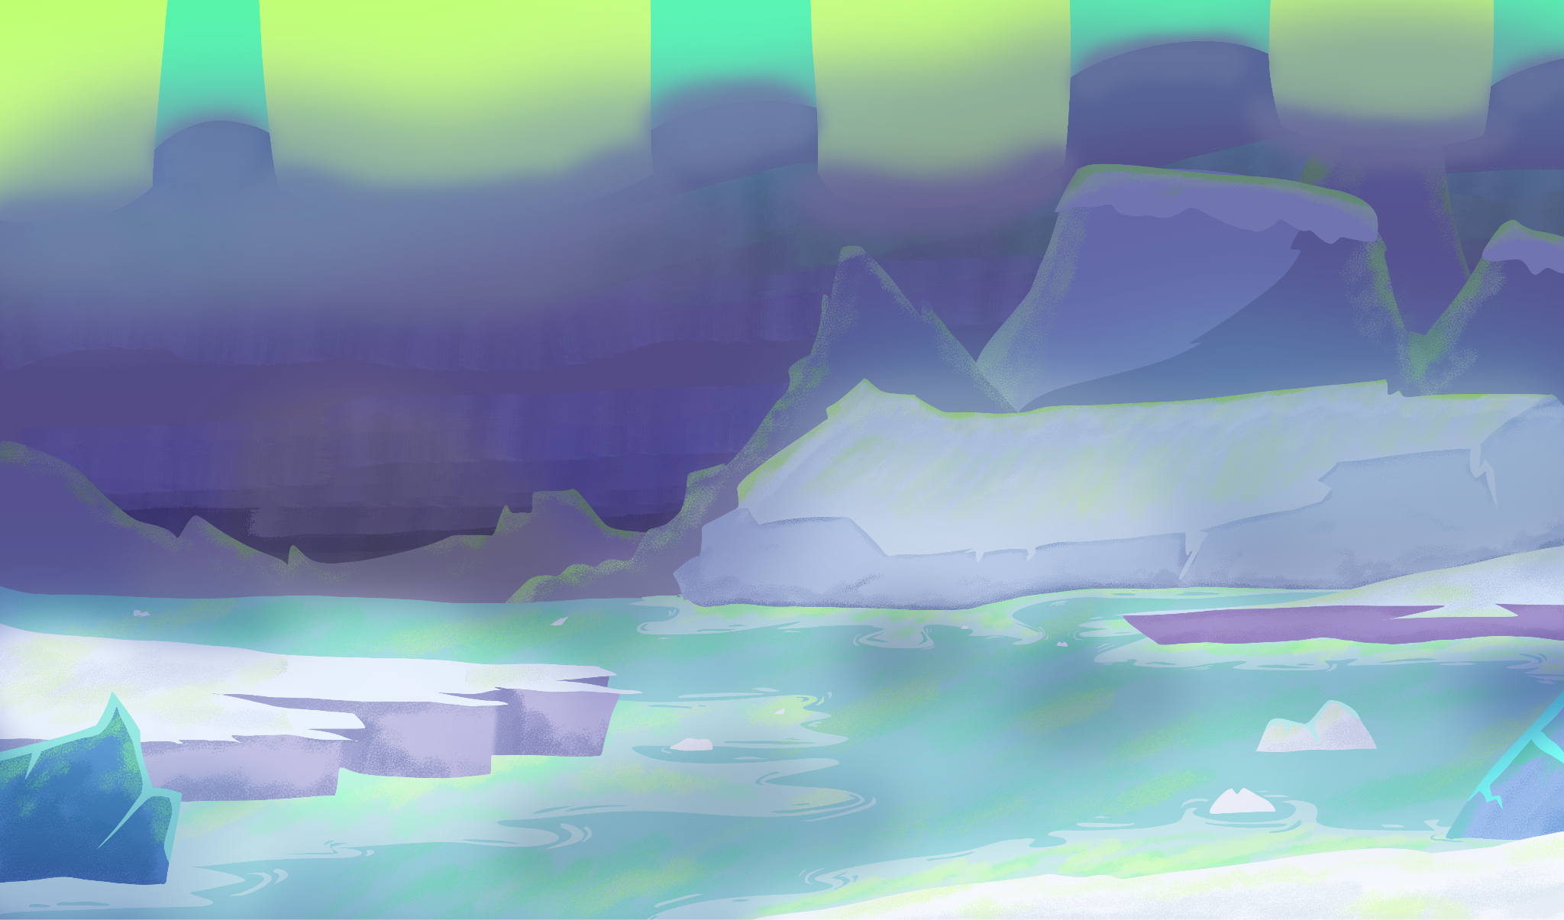
Environment: Artic

Slide 30
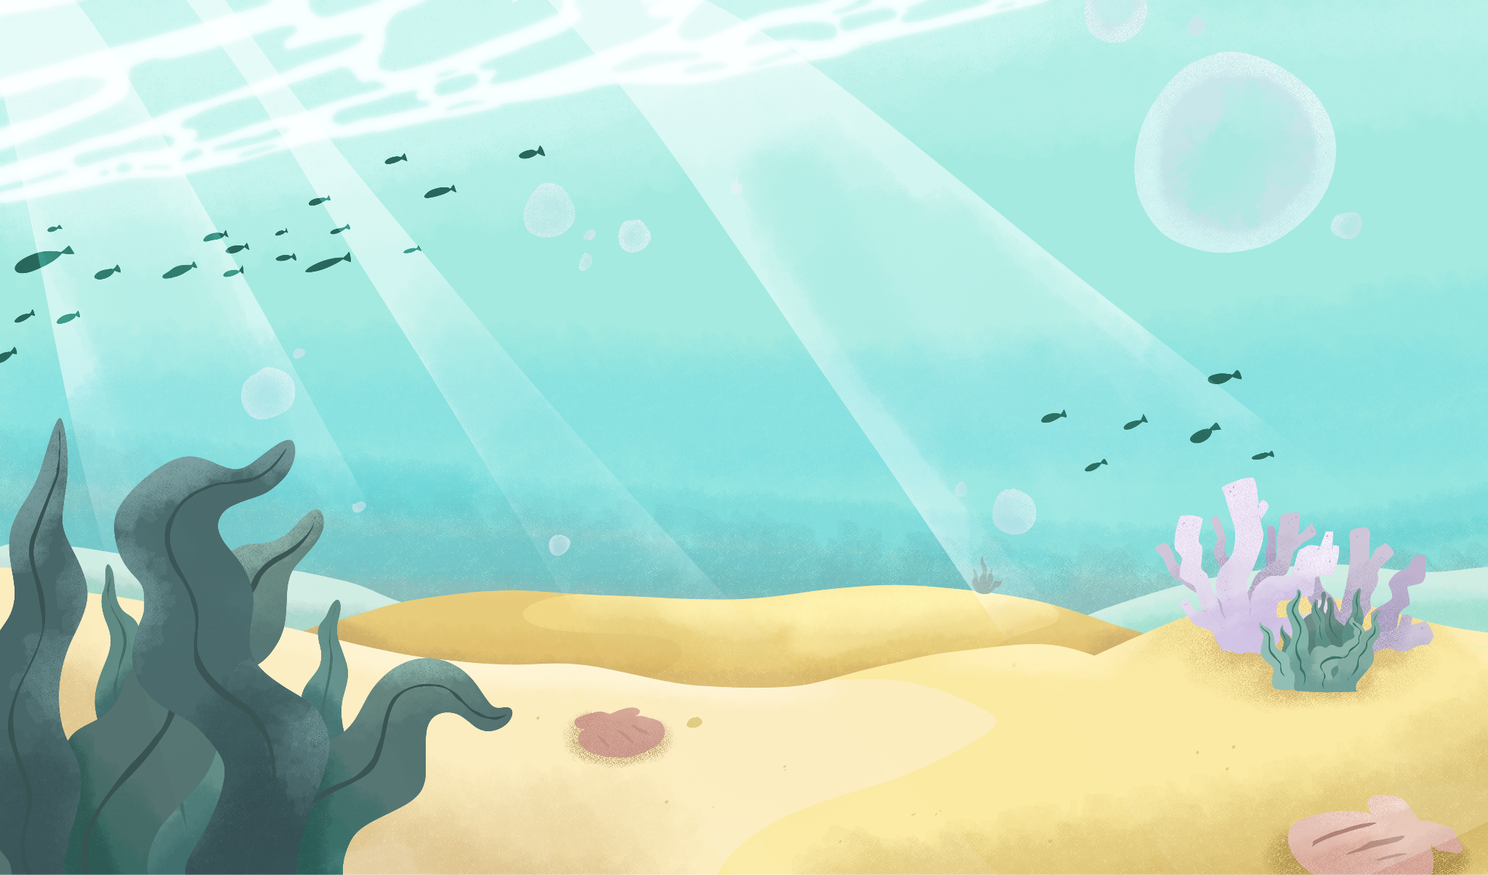
Environment: Ocean

Slide 31
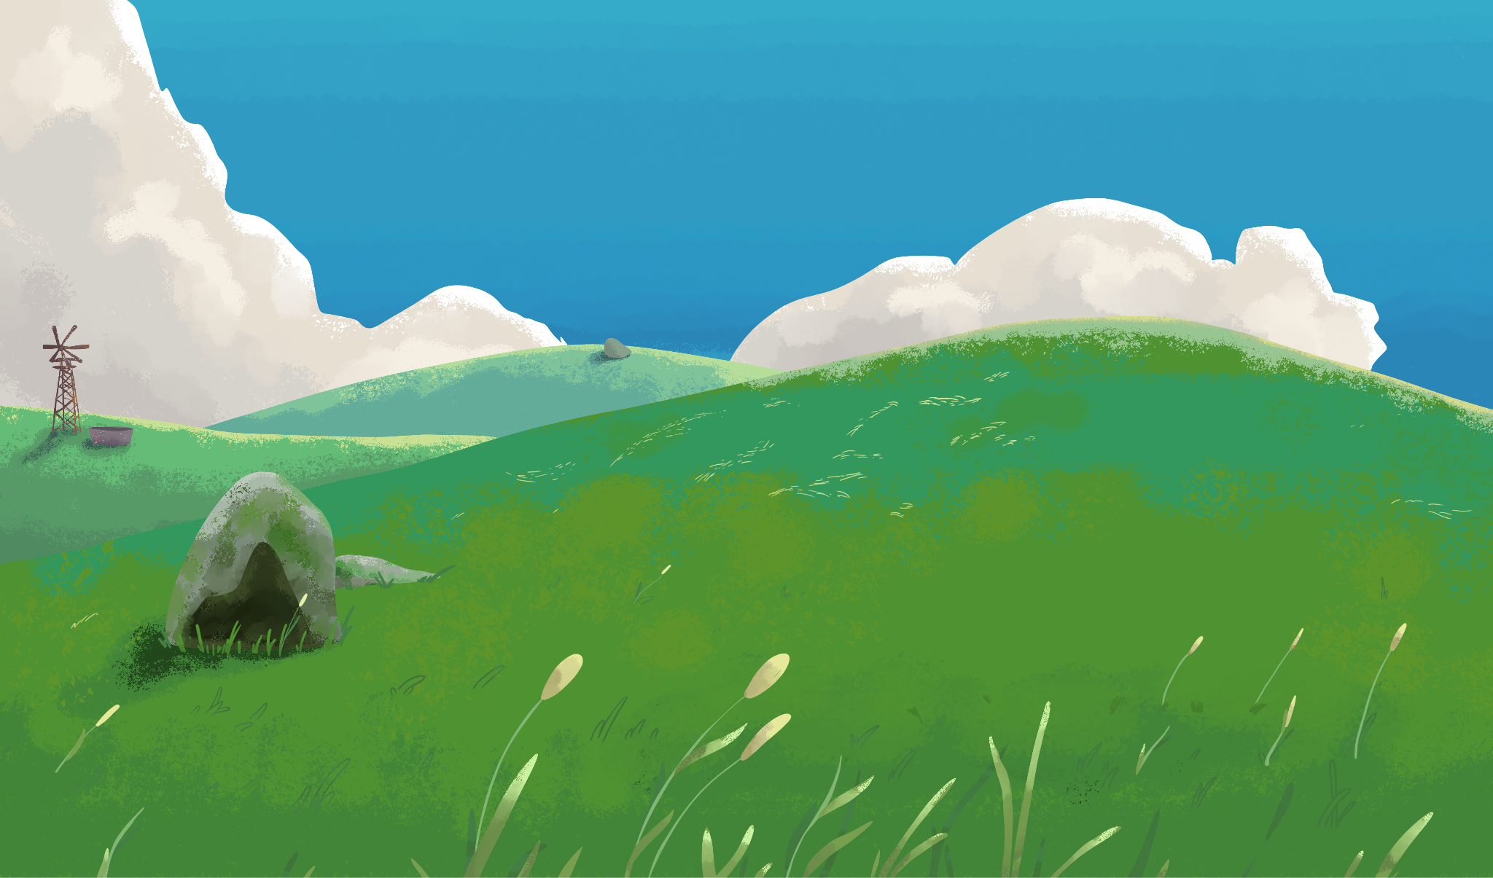
Environment: Grassland

Slide 32
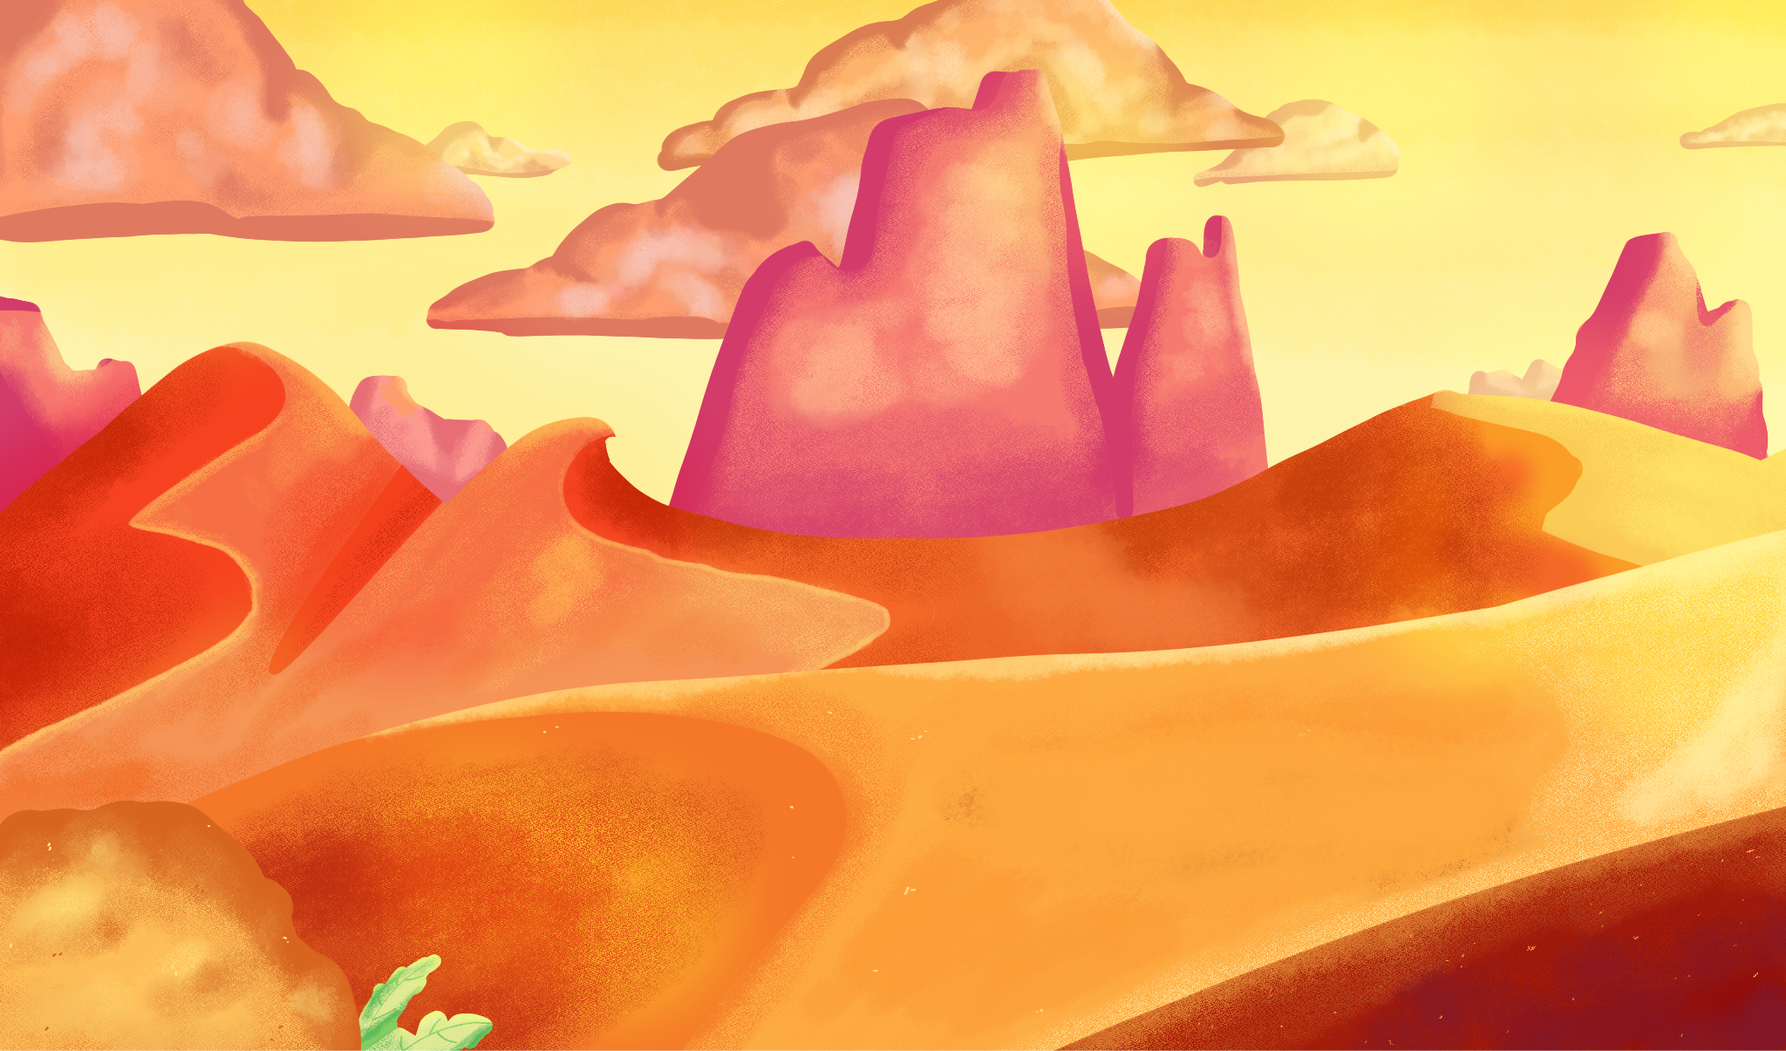
Environment: Desert

Slide 33

I Think
In the left “I Think” column, respond to the following prompts:
How do the specialized characteristics of your organism influence its growth and survival in the shown environments?
What makes an organism successful?
Choose an environment your species wouldn’t normally survive in. What mutation would your organism have to develop for it to survive in that environment?
Notes:
K20 Center. (n.d.). I think / we think. Strategies. https://learn.k20center.ou.edu/strategy/141

Slide 34

We Think
When the timer starts, the first speaker should spend approximately 30 seconds sharing their reflection responses.
The listener will then respond by saying, “What I heard you say was…” and restate what they heard.
Switch roles and repeat the process. The second speaker should share, and the first speaker should summarize what they heard.
Discuss your responses and record a shared response in the right “We Think” column.
Prepare to share out.
Notes:
K20 Center. (n.d.). I think / we think. Strategies. https://learn.k20center.ou.edu/strategy/141
K20 Center. (2021, September 21). K20 Center 3 minute timer [Video]. YouTube. https://www.youtube.com/watch?v=iISP02KPau0

