Slide 2
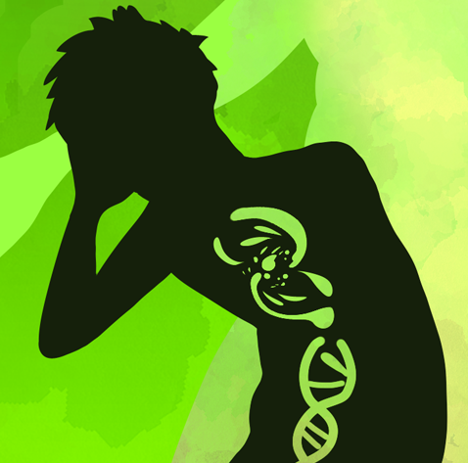
When Mutations Make You Mighty!
DNA Mutations

Slide 3
Essential Question
How do mutations impact your traits?

Slide 4
Learning Objectives
Develop and defend a claim on whether mutations are harmful or helpful using evidence and reasoning.
Construct a DNA model to demonstrate how a mutation can occur within a DNA sequence.
Apply your understanding of the impact of mutations on traits.

Slide 5
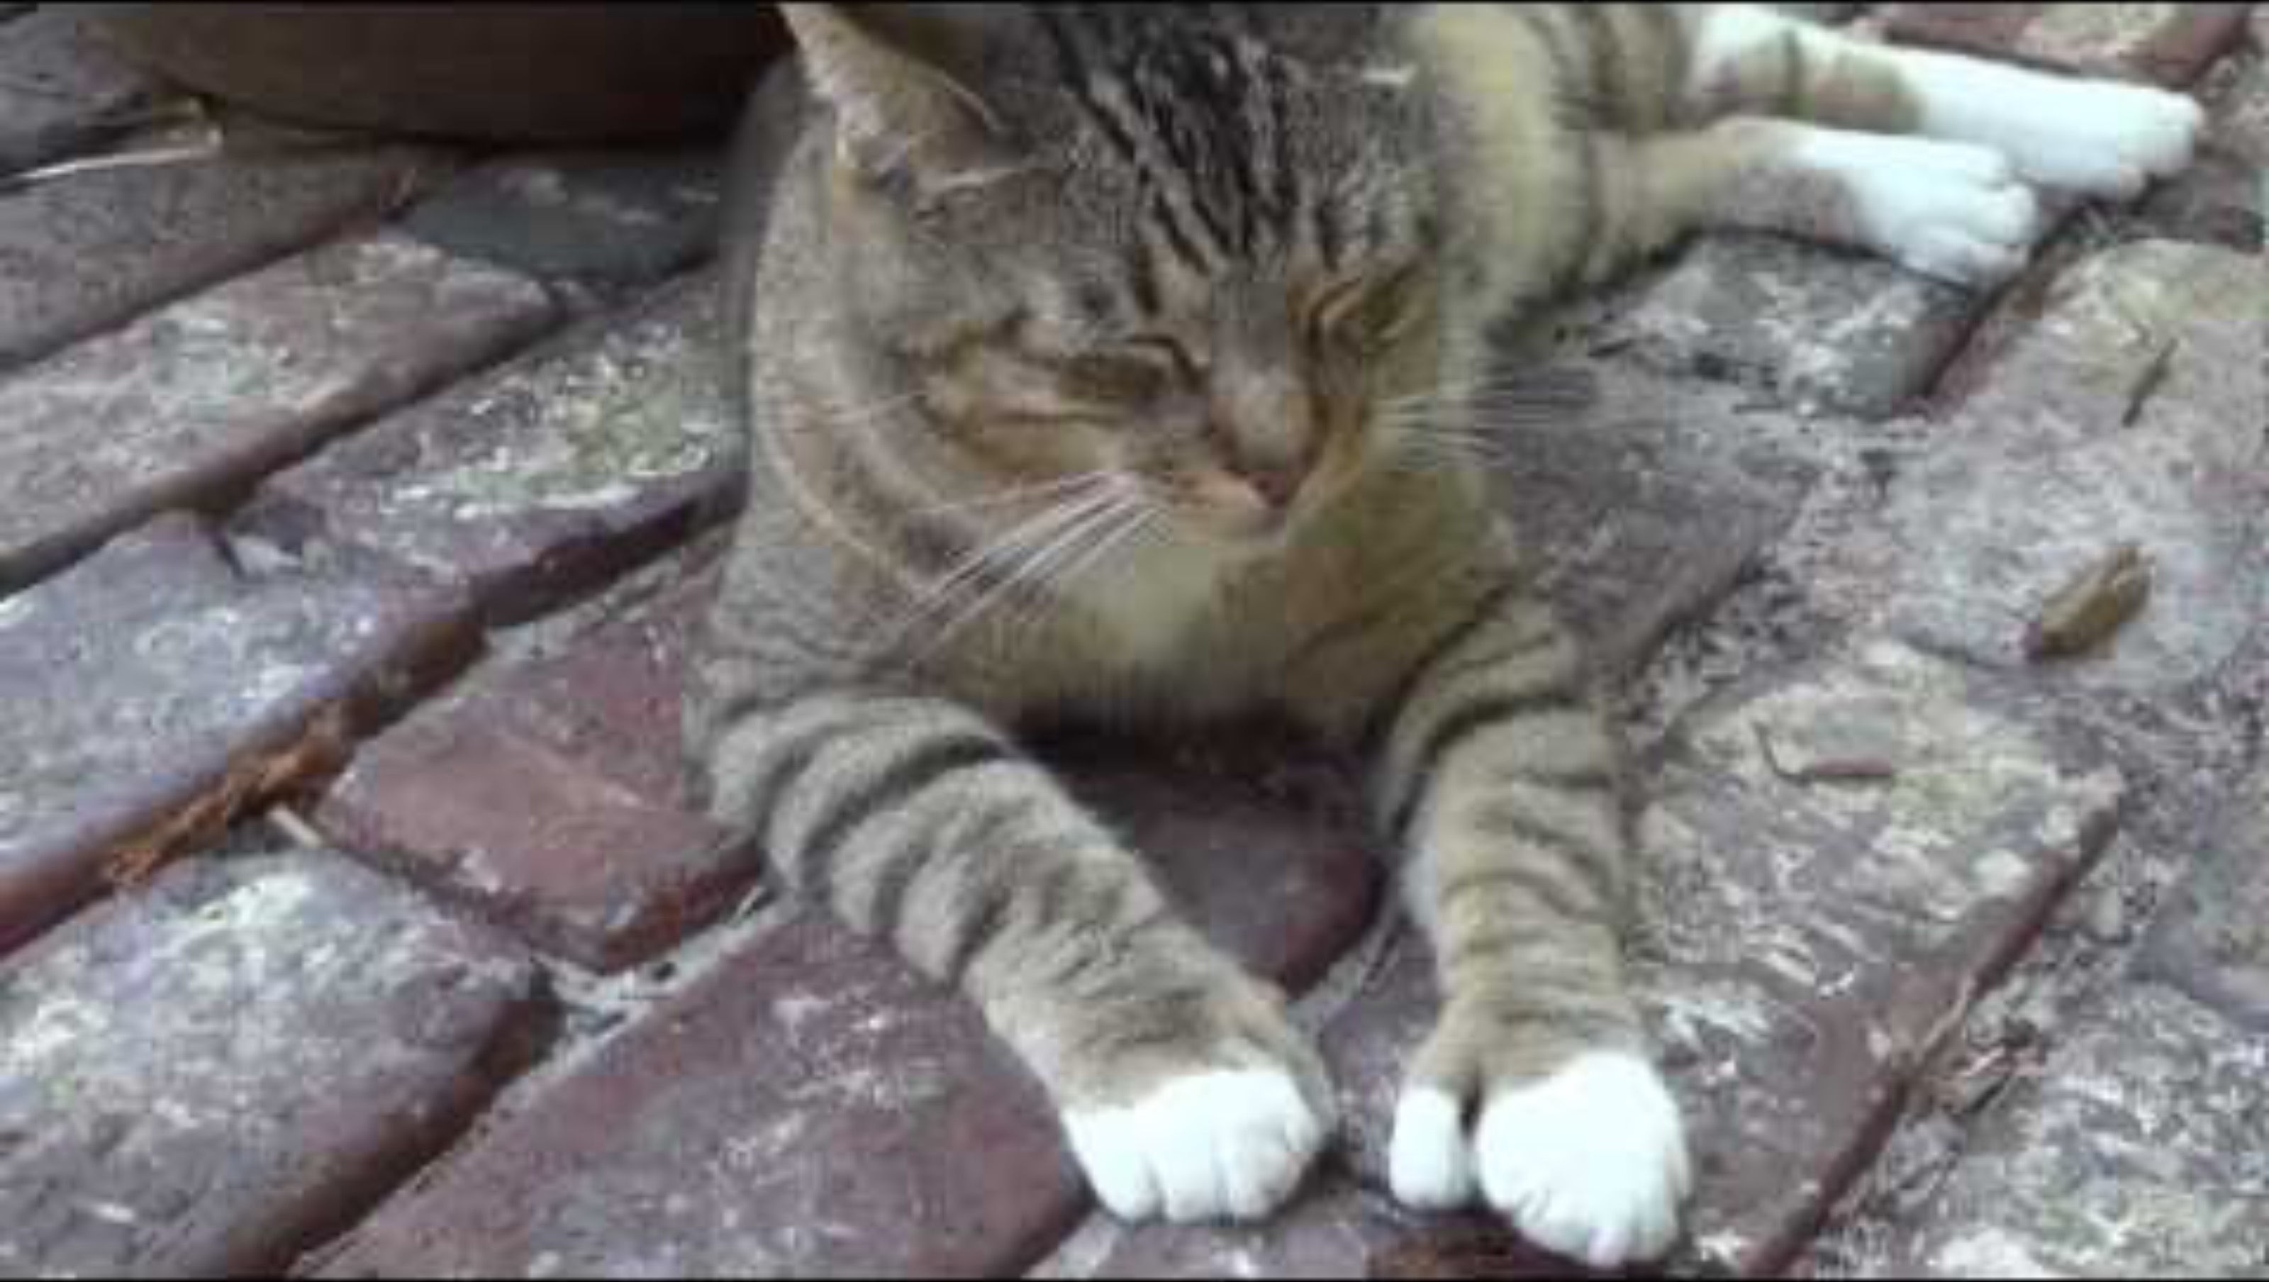
Ernest Hemingway’s Polydactyl Cats

Slide 6
What do you know?
Write down three points about anything you know associated with the following prompt:
What is a mutation?

Slide 7


Chain Notes
Take your paper and pass it clockwise in your group.
With the new paper you receive, choose one of the points presented and add an additional fact, idea, or correction to it through words or a drawing.
Repeat this process until you receive your paper back.
Review your peers’ comments and with your group, create a summary of ideas to share with the class.
Notes:
K20 Center. (n.d.). Chain notes. Strategies. https://learn.k20center.ou.edu/strategy/52

Slide 8


C.E.R.T.I.fy Your Thinking
Use the space provided on your handout to make a claim in response to the following prompt:
  Do you believe that mutations are harmful or beneficial?
Research and identify three points of evidence in support of your claim. Write these down and cite them in the space provided on your handout.
Notes:
K20 Center. (n.d.). Claim, evidence, reasoning, test, improve (C.E.R.T.I.Fy your thinking). Strategies. https://learn.k20center.ou.edu/strategy/827

Slide 9
Debate!
Based on the claim you made, move to the “harmful” side of the “beneficial” side of the room.
Using your claim and evidence, debate the prompt “Do you believe that mutations are harmful or beneficial?”

Slide 10
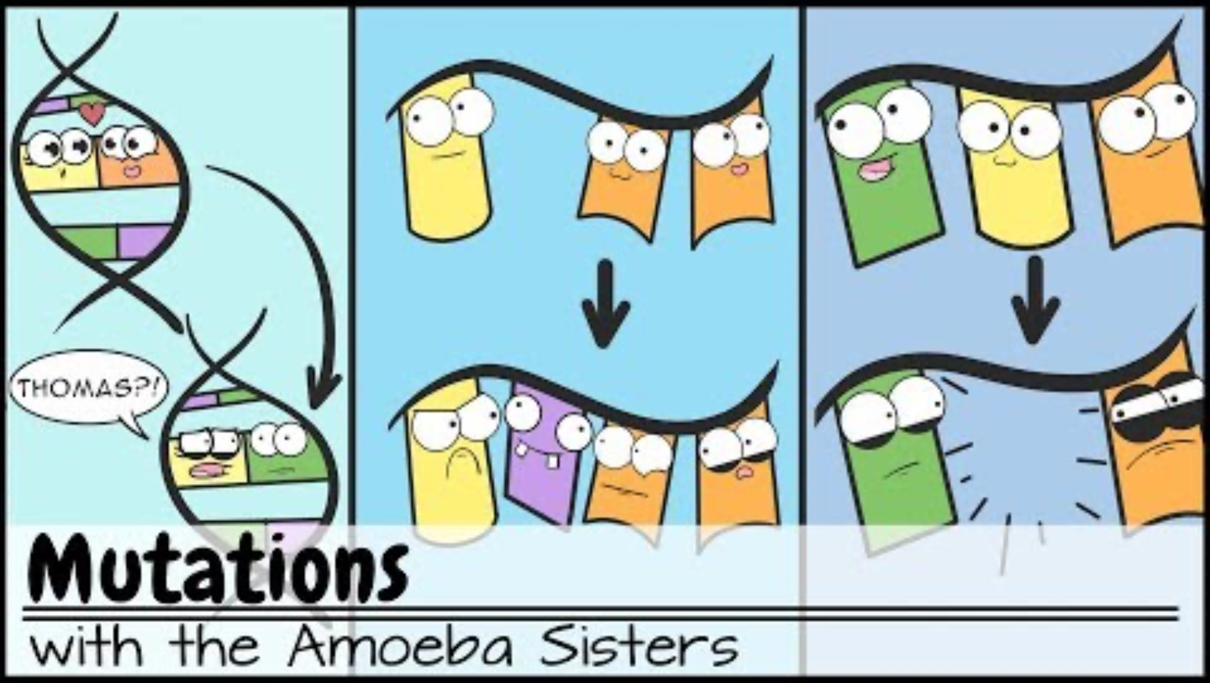
Amoeba Sisters: Mutations
Notes:
Amoeba Sisters. (2019, July 31). Mutations [Video]. YouTube. https://www.youtube.com/watch?v=vl6Vlf2thvI&t=300s

Slide 11
Vocabulary Definitions
Chromosomes: tiny, thread-like structures inside most cells that are made of DNA and contain your genes.
Insertion: a type of mutation where one or more nucleotides are added to DNA.
Deletion: a type of mutation that involves the loss of one or more nucleotides from a segment of DNA.

Slide 12
Vocabulary Definitions
Substitution: a type of mutation where one base pair in the DNA sequence is replaced by another.
Proteins: biomolecules made up of amino acids and found in all living cells that perform bodily functions.
Harmful vs. Beneficial:
  Harmful: causing or having an unfavorable result; negative result.
  Beneficial: producing or promoting a favorable result; advantageous.

Slide 13
Base Pairing
Nitrogen-containing bases: A, G, C, T.
A always pairs with T; G always pairs with C.
What would the complimentary strand be for GACTAAGTA?

Slide 14
Muddiest Point
Review your learning.
Crystal Clear: What do you think is the easiest part to understand about mutations?
Muddiest Point: What do you think is the most confusing part about mutations?
Notes:
https://learn.k20center.ou.edu/strategy/109

Slide 15
DNA Keychains
You will need the following materials needed to create a DNA keychain:
DNA Keychain Instructions handout
Pony beads (48 colors; 16 with 4 different colors, 16 black, and 16 white)
Glitter beads (1 to 4)
Two wires (one of each: 36 gauge and 18 gauge)
Key ring (1)
Sharpie for deletion (1)
Mutation card (1)

Slide 16
Gist
On your handout to write the “gist” about your superhero mutation. Include the following information:
Describe the mutation.
Determine if the mutation can be beneficial or harmful.
Identify the type of mutation at the DNA level.
Describe the impacts of protein and superhero traits.
Draw the non-mutated superhero next to the mutated one in the space provided.
Notes:
https://learn.k20center.ou.edu/strategy/3289

Slide 17
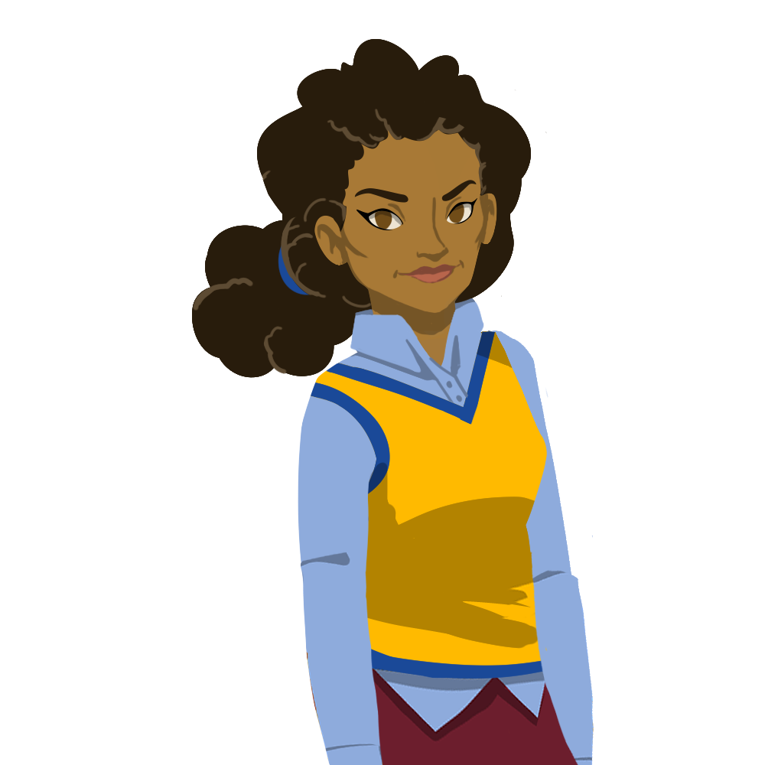
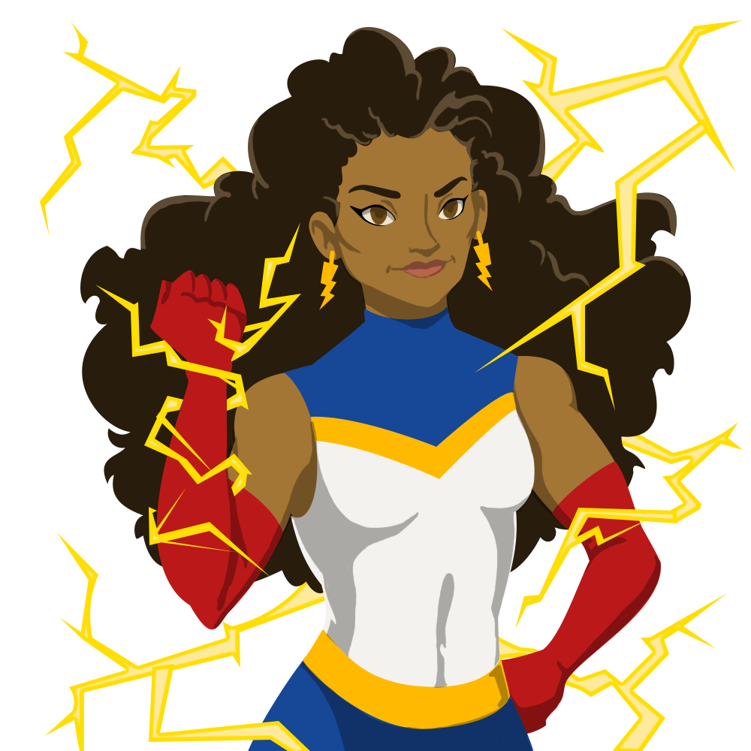
Gist Example

