Slide 2
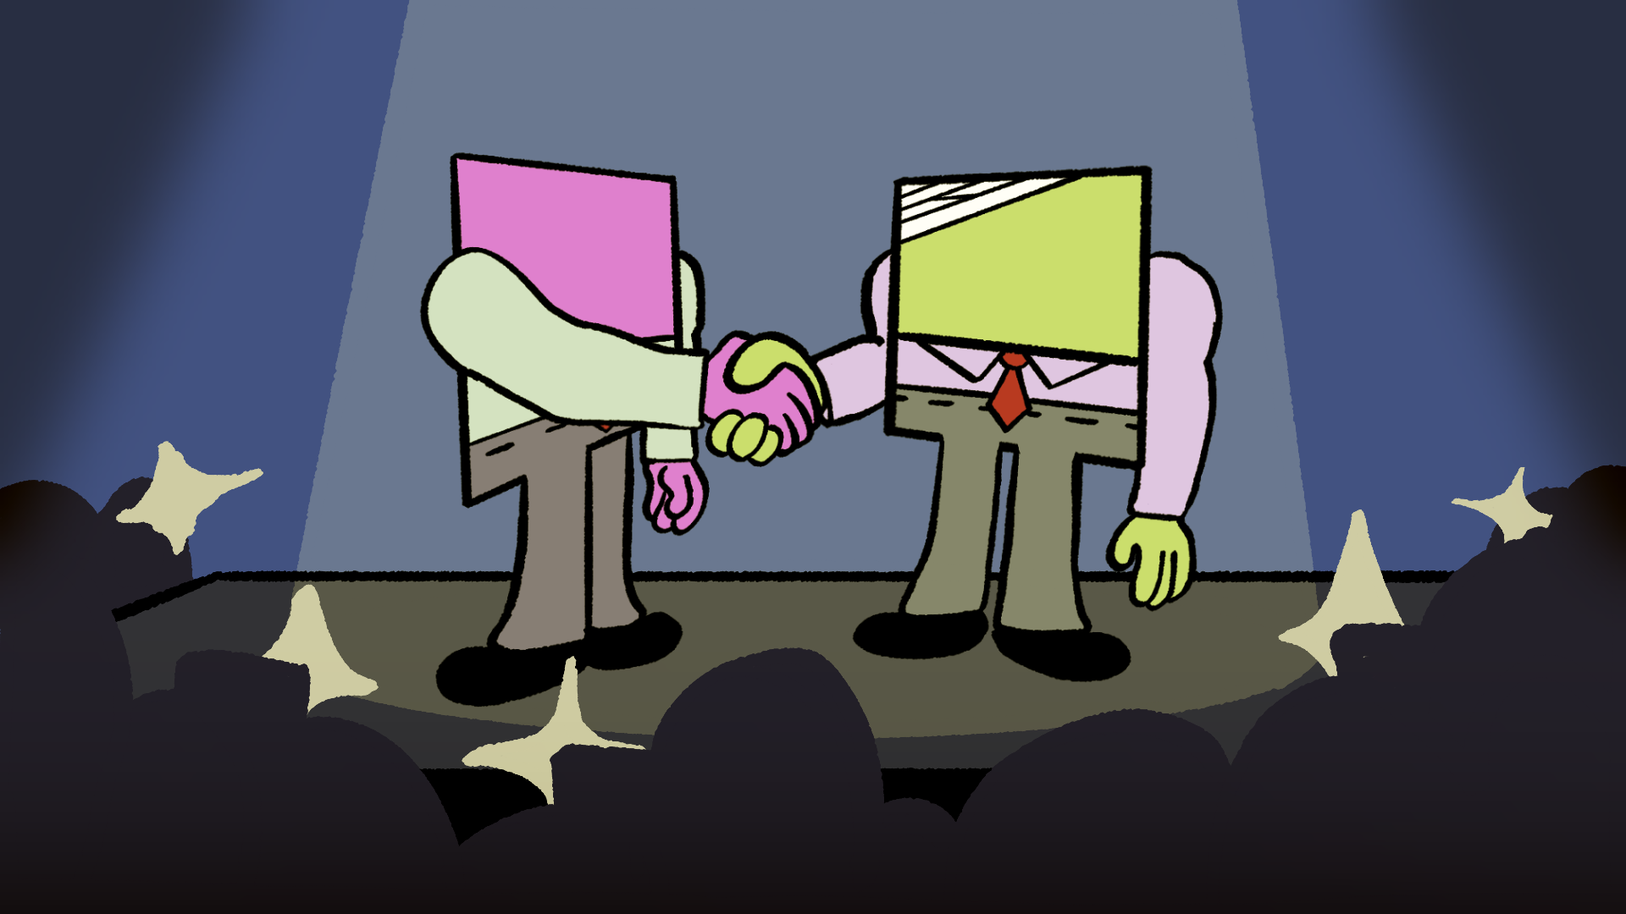
Numbers That Play Fair
Square Numbers and Square Roots

Slide 3
Essential Question
How does the area of a square relate to the length of its side?

Slide 4
Learning Objectives
Identify the relationship between a square’s side length and its area.
Identify the first 20 square numbers and their square roots.
Estimate irrational square roots between perfect squares.

Slide 5
Make a Claim
Make a claim in response to the following prompt:
  Is cereal soup?
Then, provide 1-3 pieces of evidence to support your claim.

Slide 6
Debate
Move to one of the posters in your classroom that represents the claim you made.
Following your teacher’s guidelines and using your groups evidence, debate your claim against the opposing group.

Slide 7
C.E.R.T.I.fy Your Thinking
In the space provided on page 1 of your trifold, write down a claim in response to the following prompt.
  Is a square a rectangle?
Then, provide evidence in the space provided to support your claim.
Move on to write down your reasoning that connects your evidence to your claim.

Slide 8

Create a perfect square
In one minute, create a perfect square using exactly 10 color tiles.

Slide 9
Create a Perfect Square
With your tiles, model the square number 4.
1
1
1
1

Slide 10
Create a Perfect Square
With your tiles, model the square number 9
9

Slide 11
Create a Perfect Square
With your tiles, model the square number 16
16

Slide 12
Recording Perfect Squares
Create and then use your Square Numbers handout to record perfect squares and their side lengths.
Once you have found a pattern, record all of the square numbers from 1-400.

Slide 13
Discussion Questions
How does a square’s area relate to its side length?
What if a perfect square is impossible?

Slide 14
What If a Perfect Square Is Impossible?
Where would the square root of 150 fall on a number line?
Use the classroom number line to determine the answer.

Slide 15

What If a Perfect Square Is Impossible?
Non-perfect square roots are irrational. For an integer that is NOT a perfect square, you can estimate a square root.

Slide 16
What If a Perfect Square Is Impossible?
How to estimate a non-perfect square root:
Find the two perfect square numbers that are directly before and directly after the number. Estimate the square root between these two numbers.

Slide 17

Discuss
How does a square’s area relate to its length?
What if a perfect square is impossible?

Slide 18
Estimating Non-Perfect Square Roots
On page 3 of your trifold, work through exercising reviewing and estimating examples of non-perfect square roots.

Slide 19
Beat the Calculator
When a square root is announced, estimate the square root with your team.
Write the square root on the provided sticky note.
Send one runner to place it in the appropriate spot on the number line.
The designated class calculator will calculate and determine which team has the closest estimation.

